Slide 1


Slide 2
What we will be covering:
Accessing the online reporting system
Overview for creating a reimbursement
Walk-through of reimbursement creation in the online reporting system

Slide 3
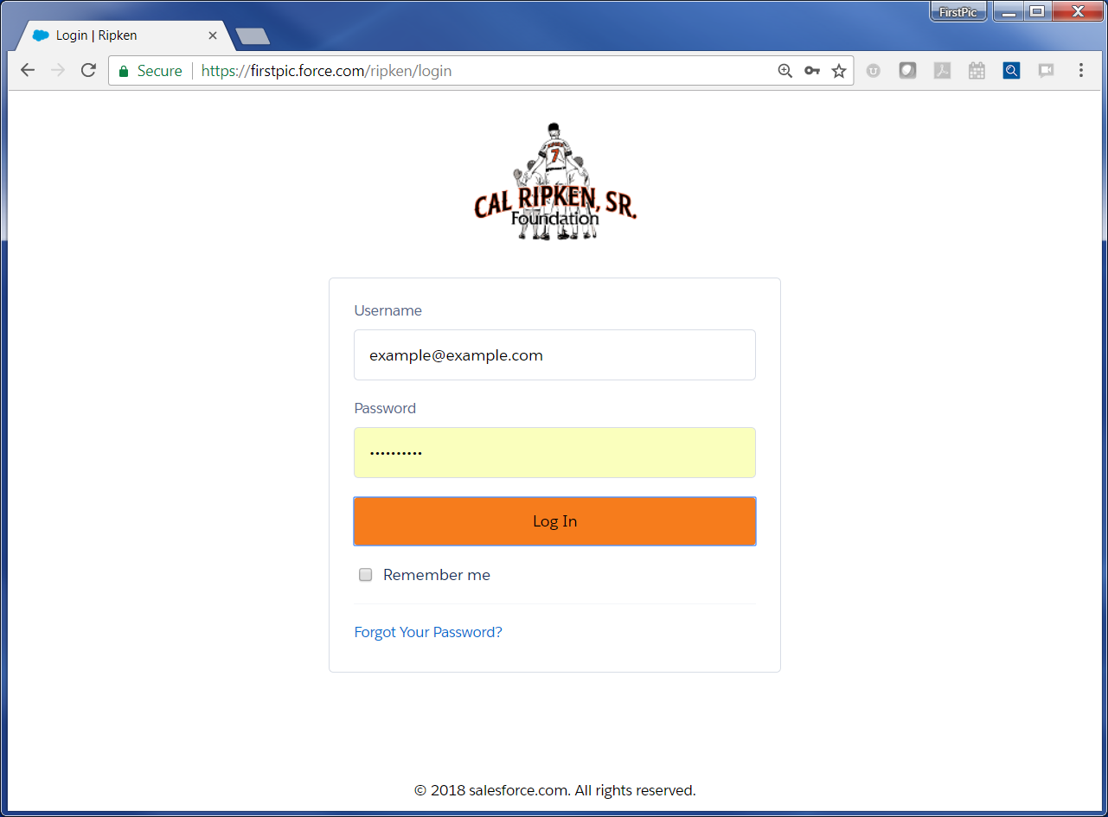
This is the URL. Recommended browser is Google Chrome
Username will be your email address.
Password will be set using the link that was emailed to you.

Slide 4
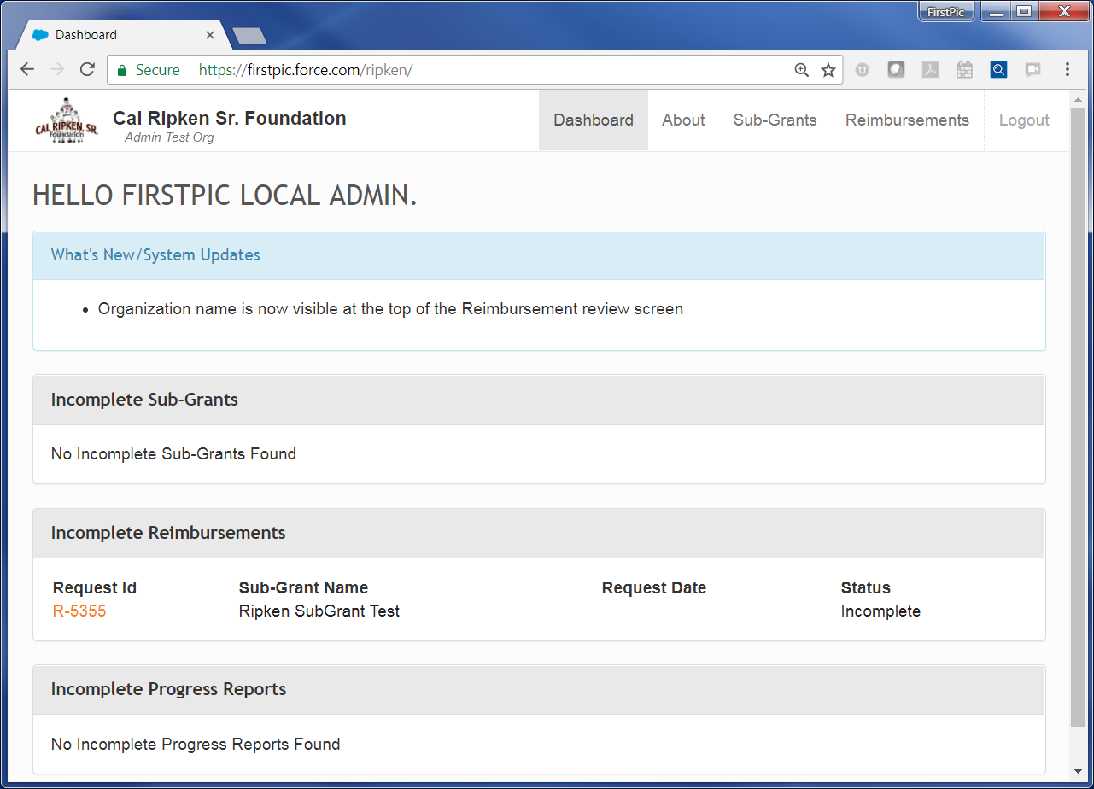
Let’s start them at their dashboard since that will be the first thing they see when they log on.
Please provide information right away that there are two different ways to create a reimbursement request. I would recommend showing them how from the budget first.
The first page you will see when you log in to the site is the Dashboard. There are 2 ways to create a Reimbursement Request. The first method is via the Sub-Grant (Budget Details) page. Click on the Sub-Grants tab to access your Budget.

Slide 5
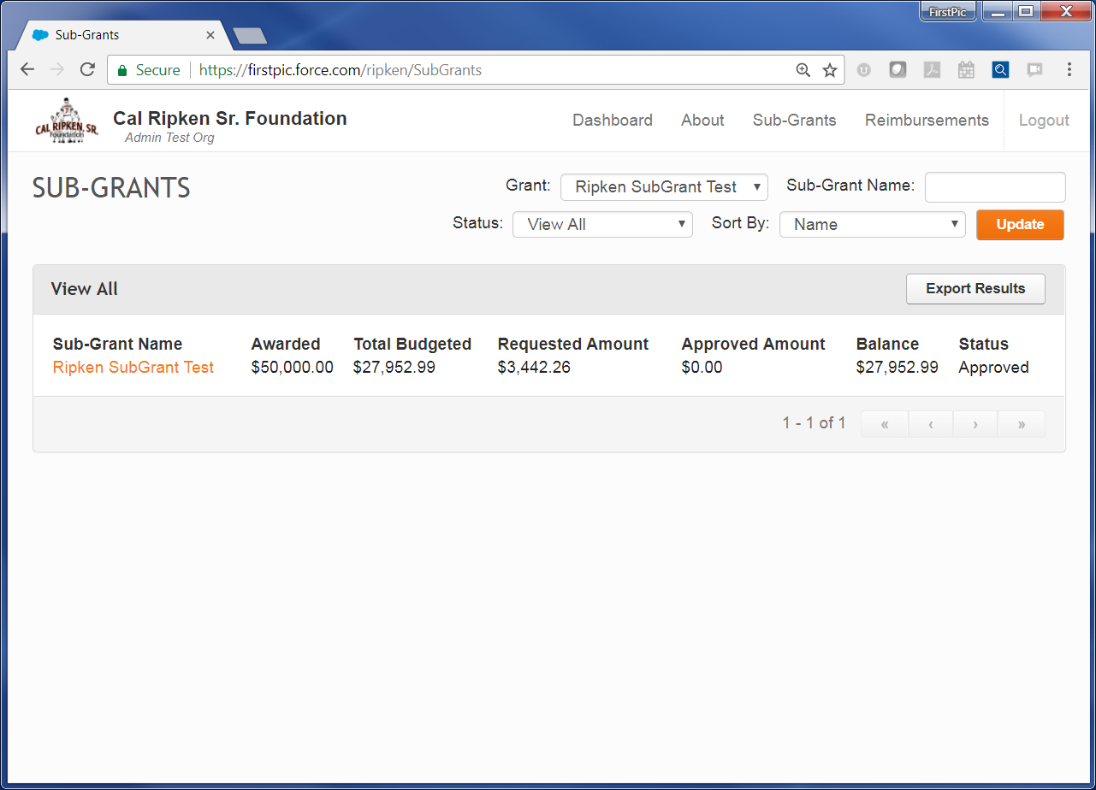
Click on the name of your Sub-Grant to access the Budget Detail screen.
In order to create a reimbursement your budget has to be in “Approved” status.

Slide 6
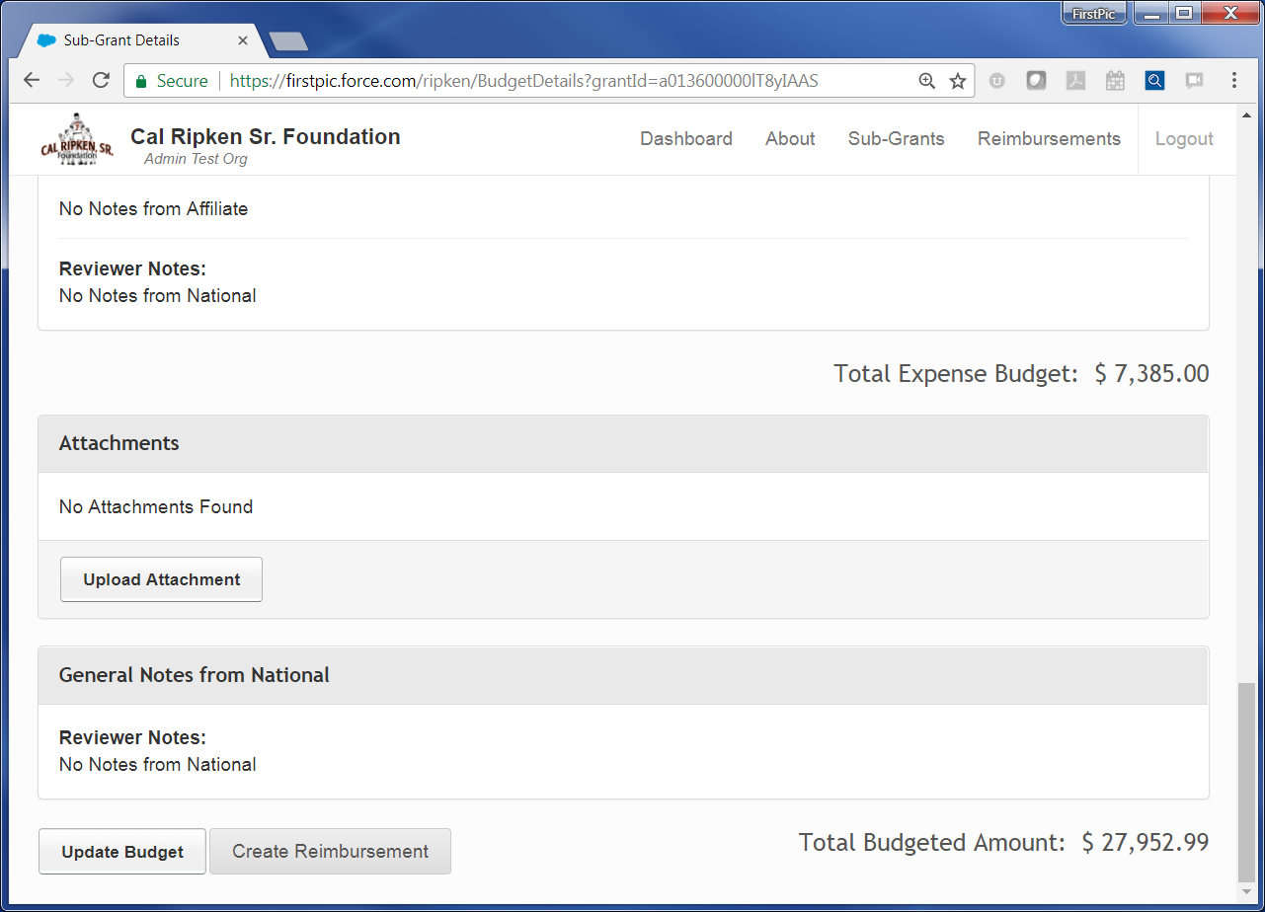
Scroll to the bottom of the Budget Detail screen and click “Create Reimbursement” – The next screen will prompt you to enter the date range and number of pay periods (see slide 9)

Slide 7
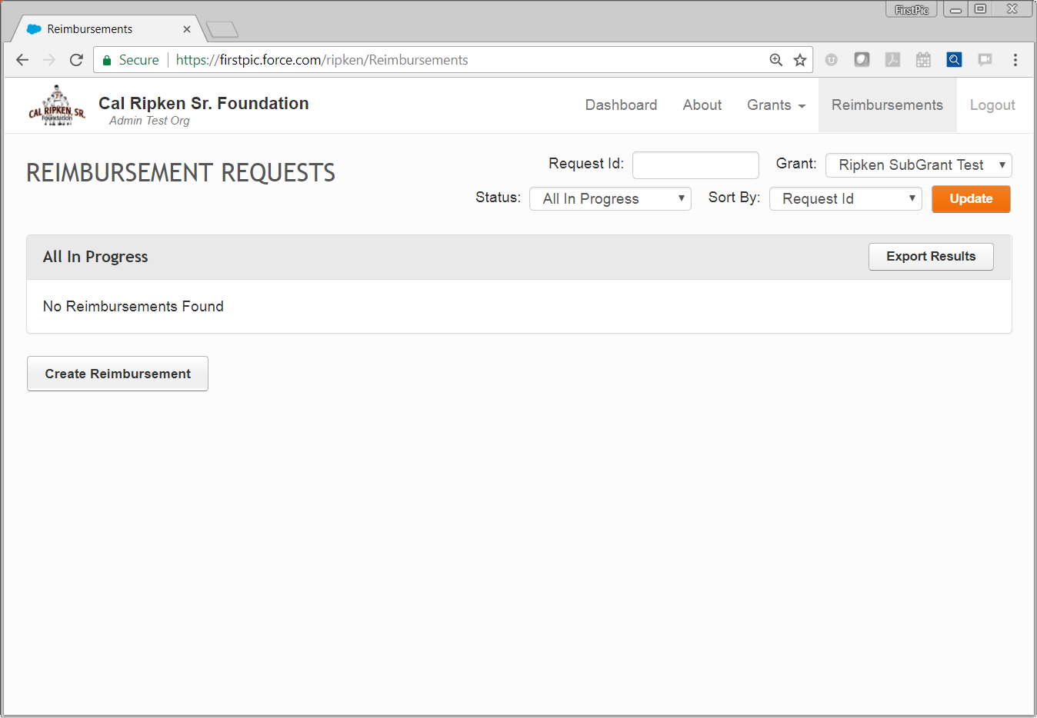
The 2nd method for creating a new reimbursement request is by clicking on the Reimbursements tab, then clicking “Create Reimbursement”.

Slide 8
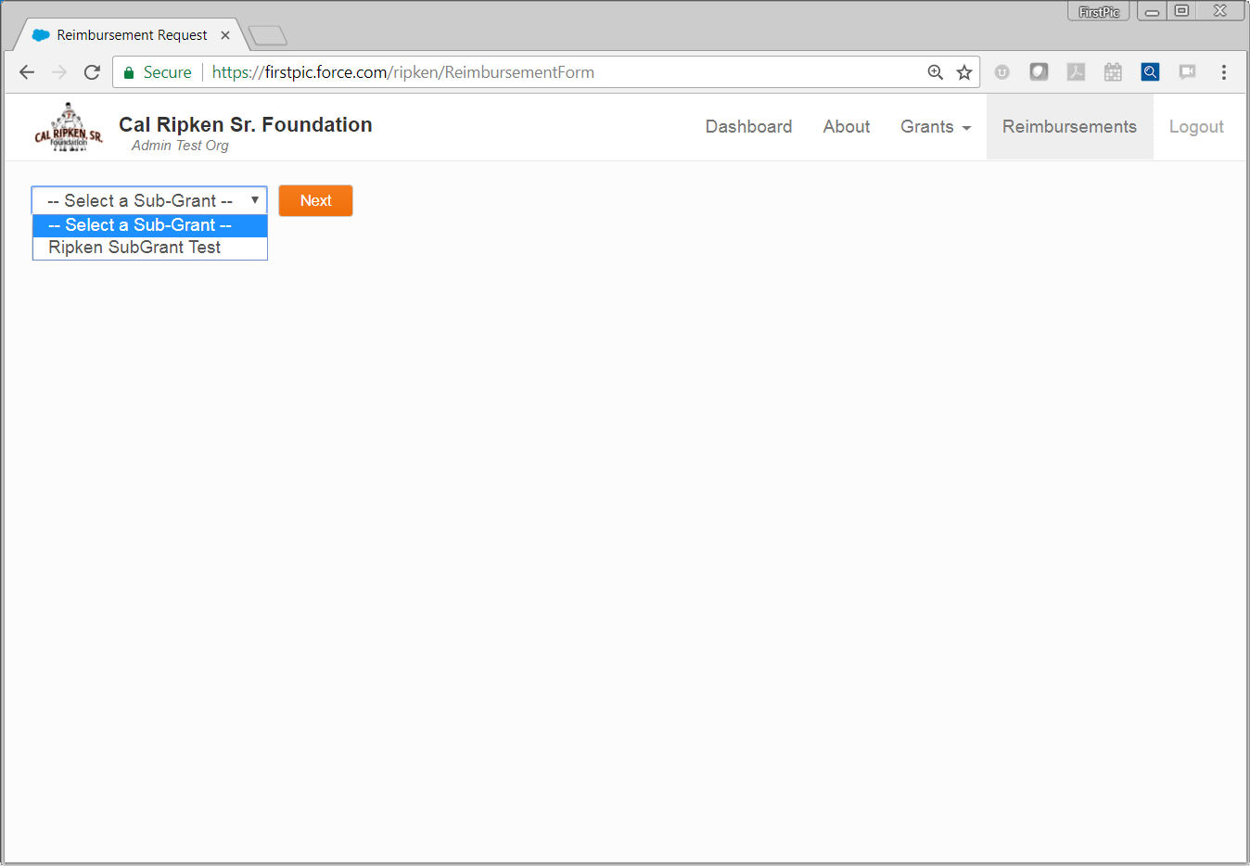
When you create a reimbursement request from the Reimbursement tab, you will need to select the appropriate sub-grant. Note: This will be updated to sub-grant number.

Slide 9
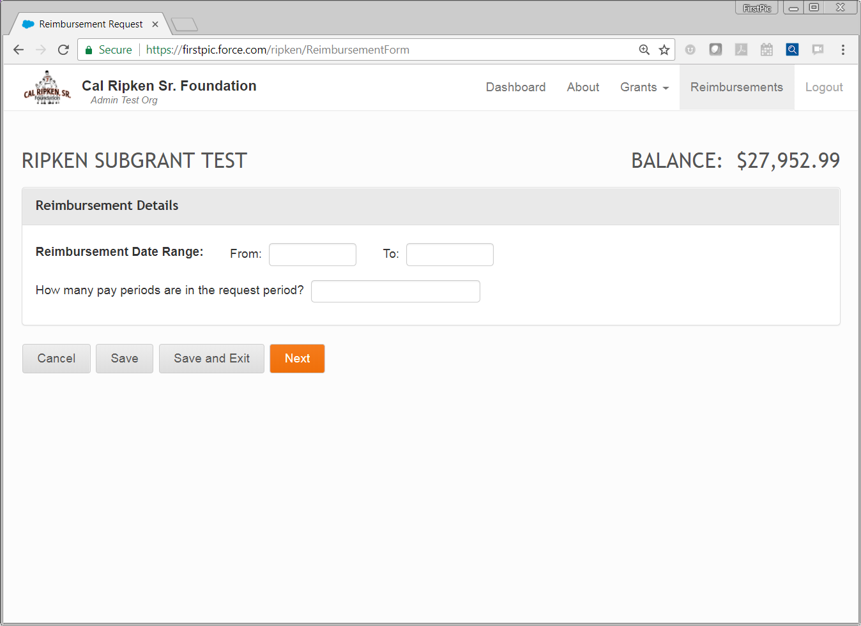
Enter the date range for your request.
These dates are based on the pay periods included in the request.
From: 1st day of 1st pay period To: last day of last pay period
1
Enter the number of pay periods that the request will cover.
2
3
Click Next to Save and move on to the next screen.
Notes:
Next button will also Save information

Slide 10
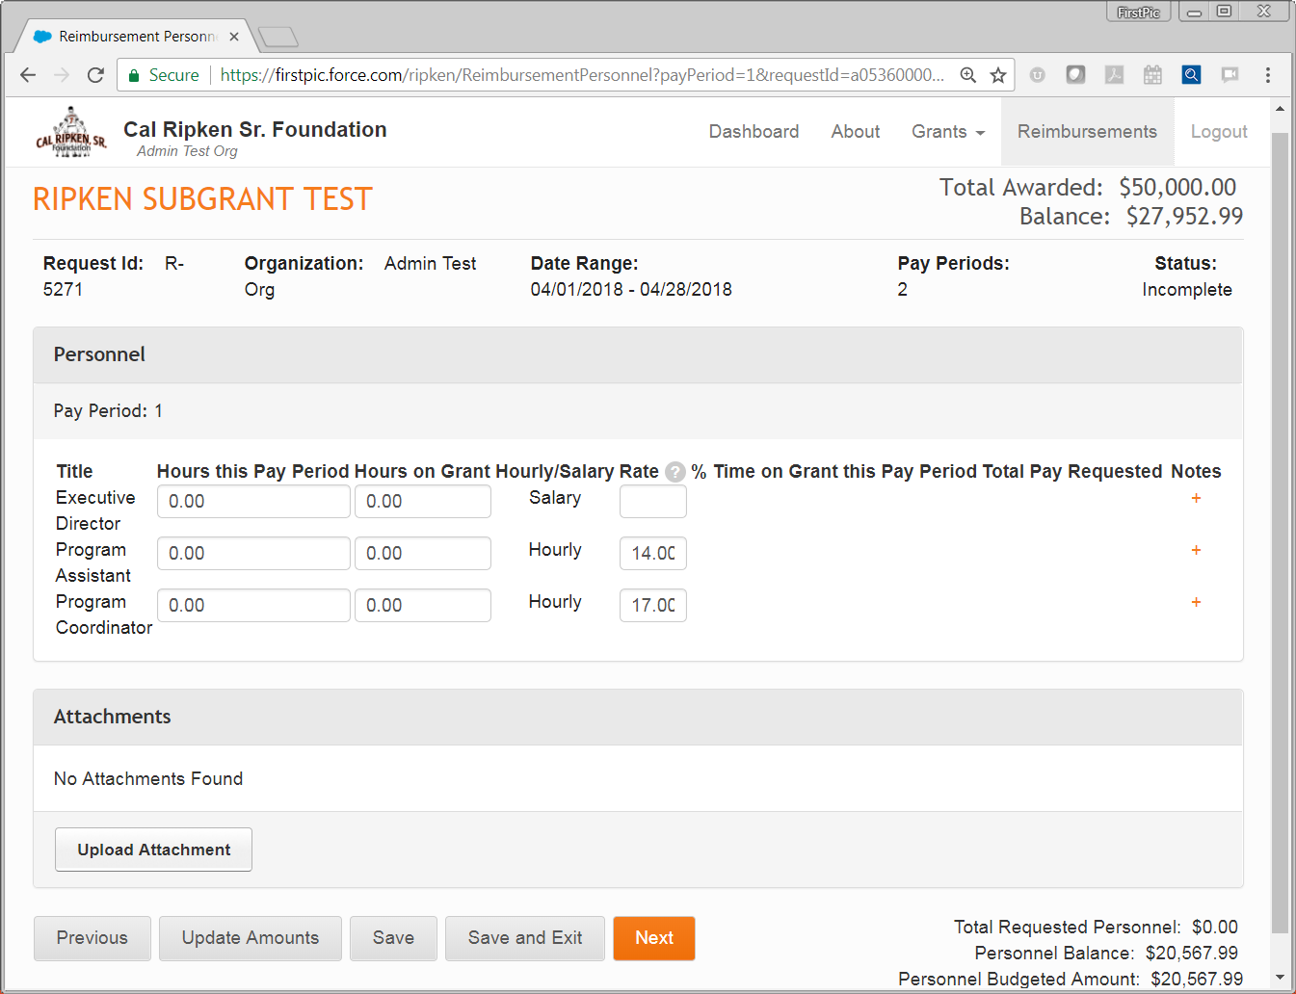
Personnel time for each pay period in the request will be entered separately.
1
3
2
2
Add the Name of each employee in the Notes section
Personnel titles and whether the personnel are hourly or salaried will be pulled from the budget.
Notes:
You will enter personnel hours for each pay period in the request separately.
The system will pull personnel titles and whether they are hourly or salaried from the sub-grant budget.
3. Include the name of each employee in the notes section.

Slide 11
For salaried employees, enter their total regular gross pay for this pay period.
2
For Hourly employees, their hourly rate will populate from the budget, though it can be edited if their actual rate is slightly different.
3
1
Enter the total number of hours the employees worked this pay period and the number of those hours that they worked on the program.

Slide 12
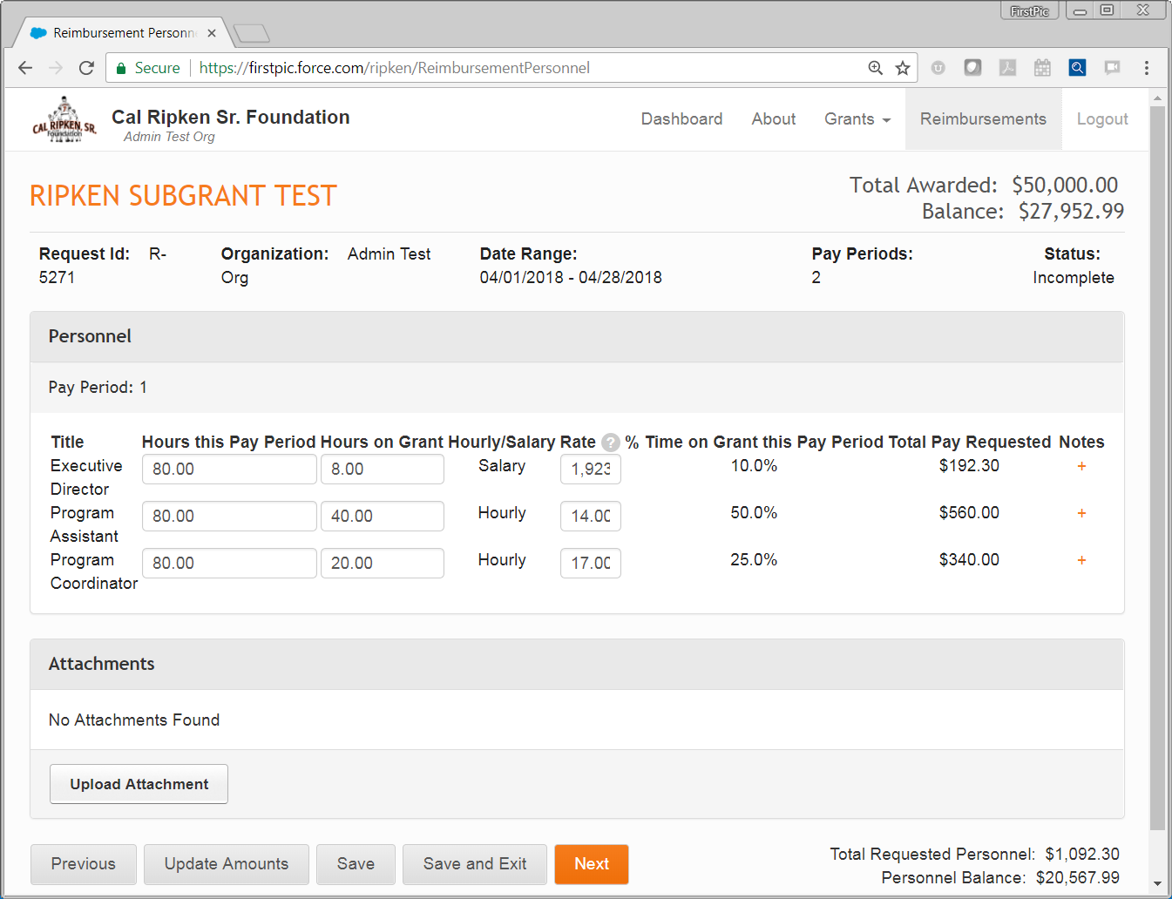
1
Click “Update Amounts” and the system will update the “% Time on Grant this pay period” and the “Total Pay Requested” for each employee.
1

Slide 13
1
To add notes for an employee, click the “+” to the right of their line.
e.g., name of person in this position, staffing change for this position, possible salary pro-rated at the beginning or end of program year, etc.

Slide 14
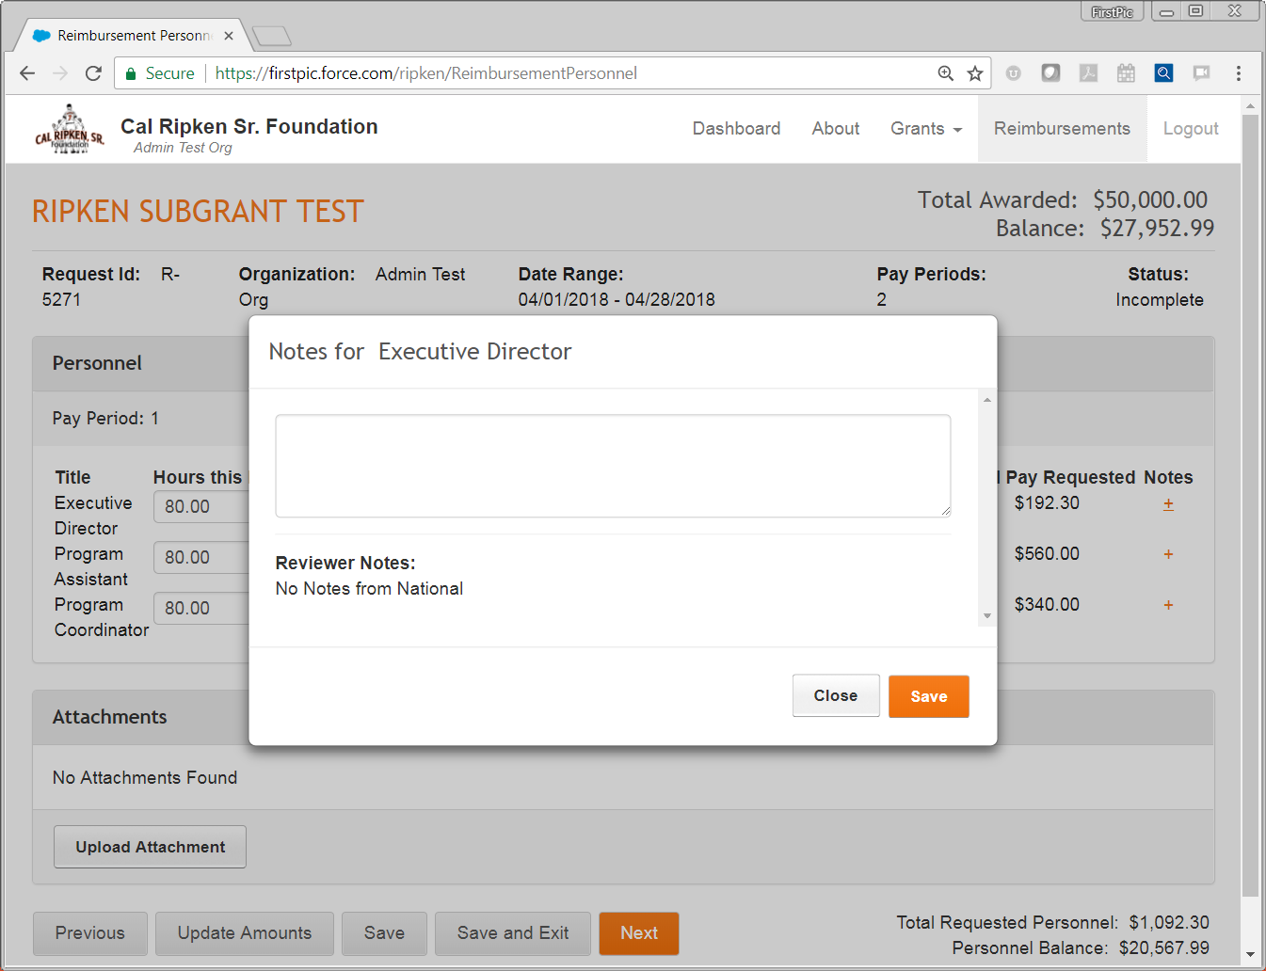
Enter your notes in the box. Click “Save” when done.

Slide 15
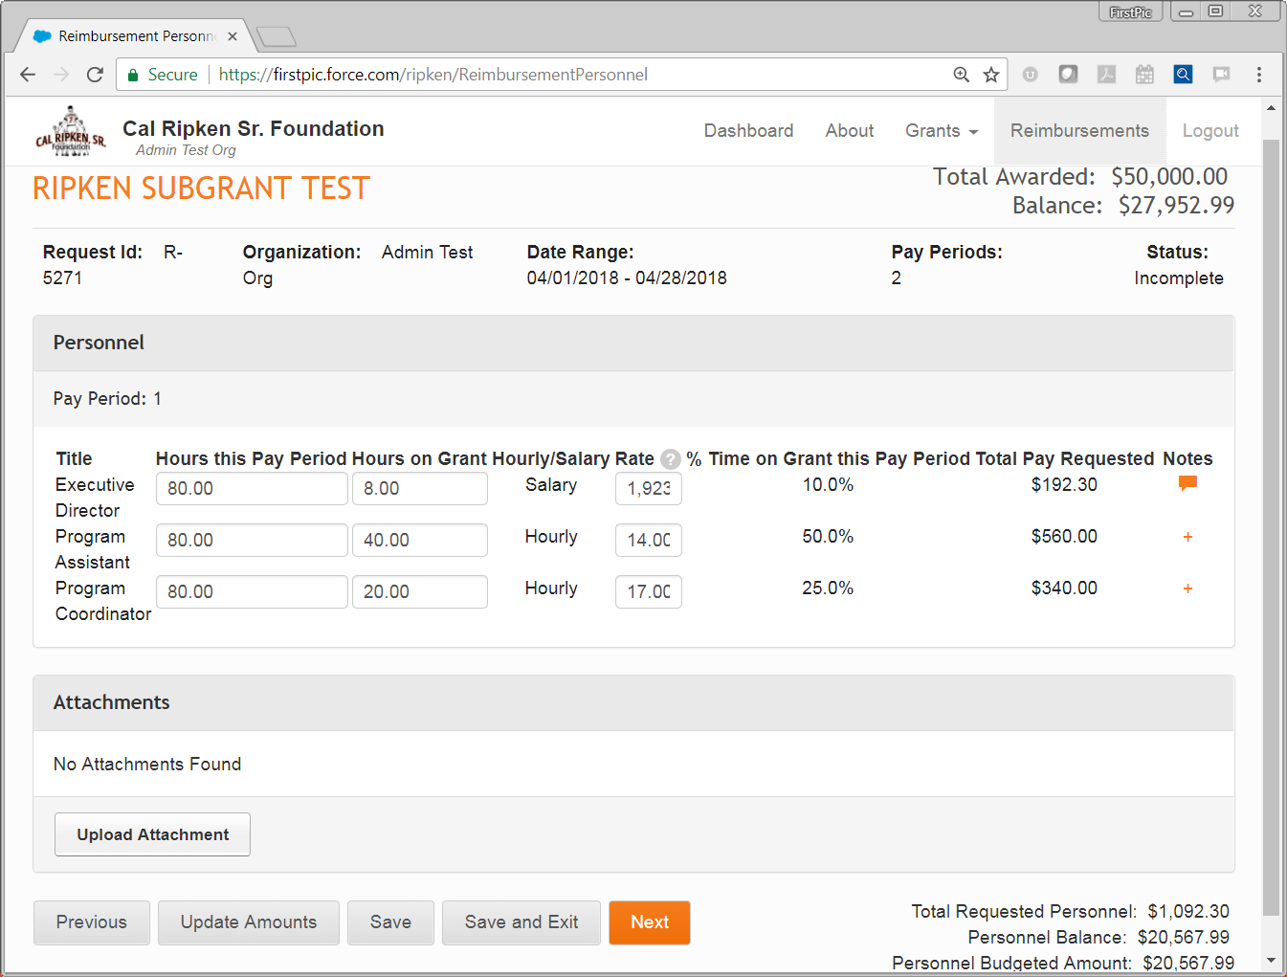
1
To add an attachment, click the “Upload Attachment” button. (Note: Timesheet and Payroll attachments are required at this stage.) All files must be pdf format. Size limit 10 MB
This icon will appear if you have added notes.
2
Notes:
Documentation Requirements:
Salaried (Full Time) Personnel - This represents the percentage of salary corresponding with the percentage of time that an individual spent working on the CRSF program.
Only an individual’s regular salary amount is eligible
- No overtime, no bonuses
- Maximum percentage of time that can be claimed for administrative/executive support is 30%
More than 30% must be approved by your program manager
- FICA is calculated only on the percentage of the payroll expense being reimbursed by CRSF
Must submit:
- Payroll register(s) for each employee listed and for each pay period being reimbursed
- Copies of signed timesheets for each employee listed for each pay period being reimbursed
Part Time Personnel – Only the actual hours spent working on the CRSF program can be reimbursed.
- Holiday, vacation or overtime hours are not reimbursable
- FICA is calculated only on the percentage of the payroll expense being reimbursed by CRSF
Must submit:
- Payroll register(s) for each employee listed and for each pay period being reimbursed
- Copies of signed timesheets for each employee listed for each pay period being reimbursed

Slide 16
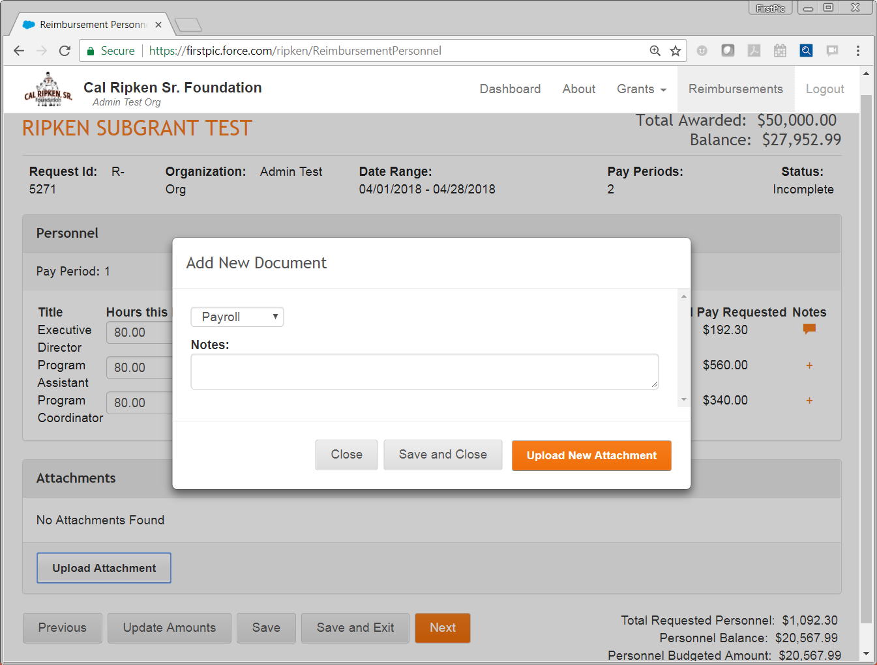
Select the type of document you are uploading: payroll or timesheet
1
2
Click “Upload New Attachment”

Slide 17
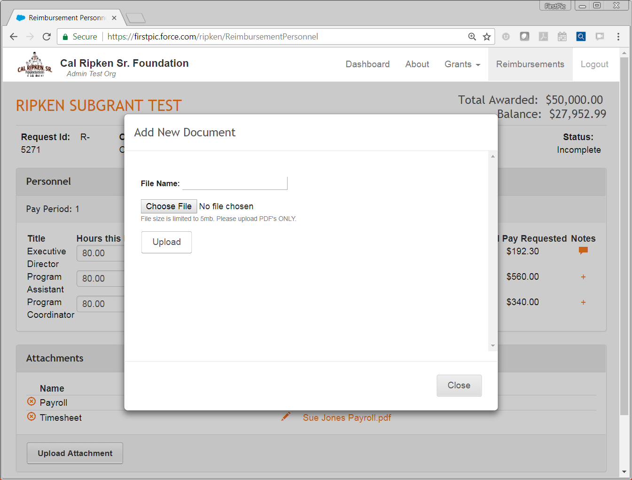
If you would like to rename the file for the upload, type in the new name here.
1
2
Click “Choose File” to select the file to upload.
Reminder: file must be a pdf.
3
Once you have selected the file, make sure you click “Upload.”

Slide 18
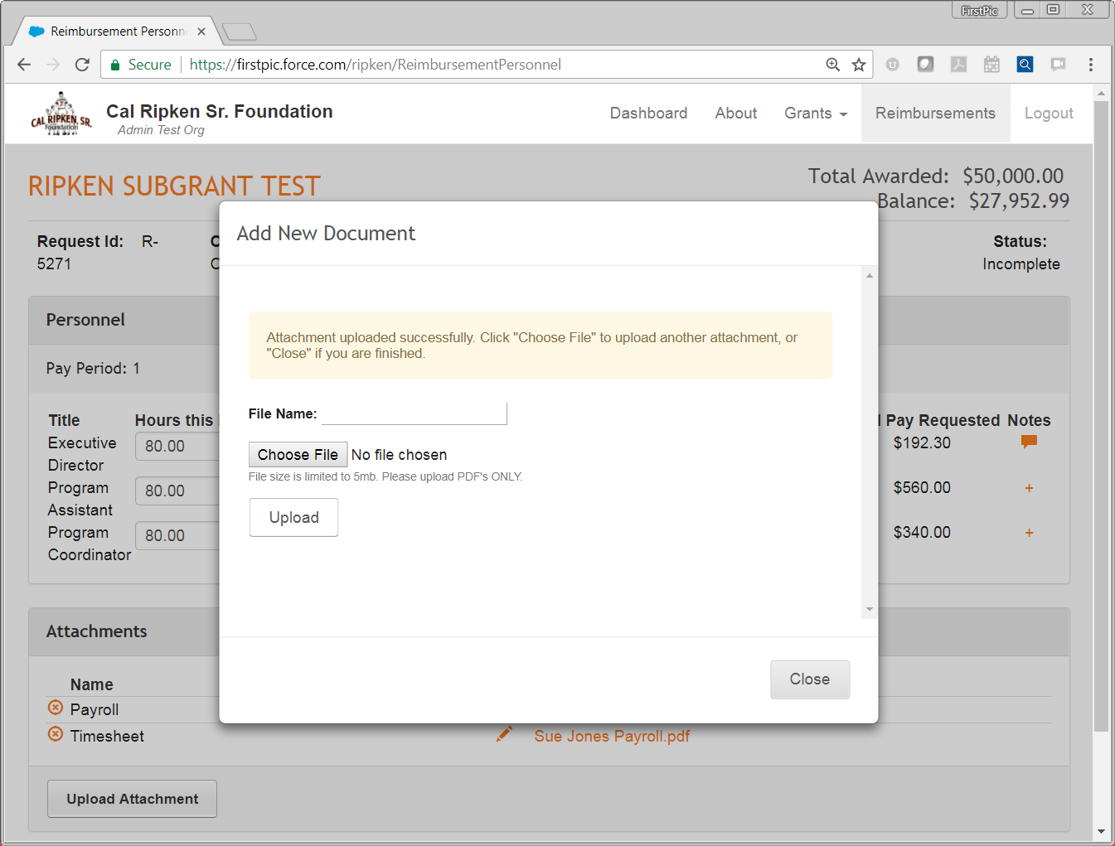
You will receive a confirmation message if your upload was successful.
1
When you are done, click “Close.”
2

Slide 19
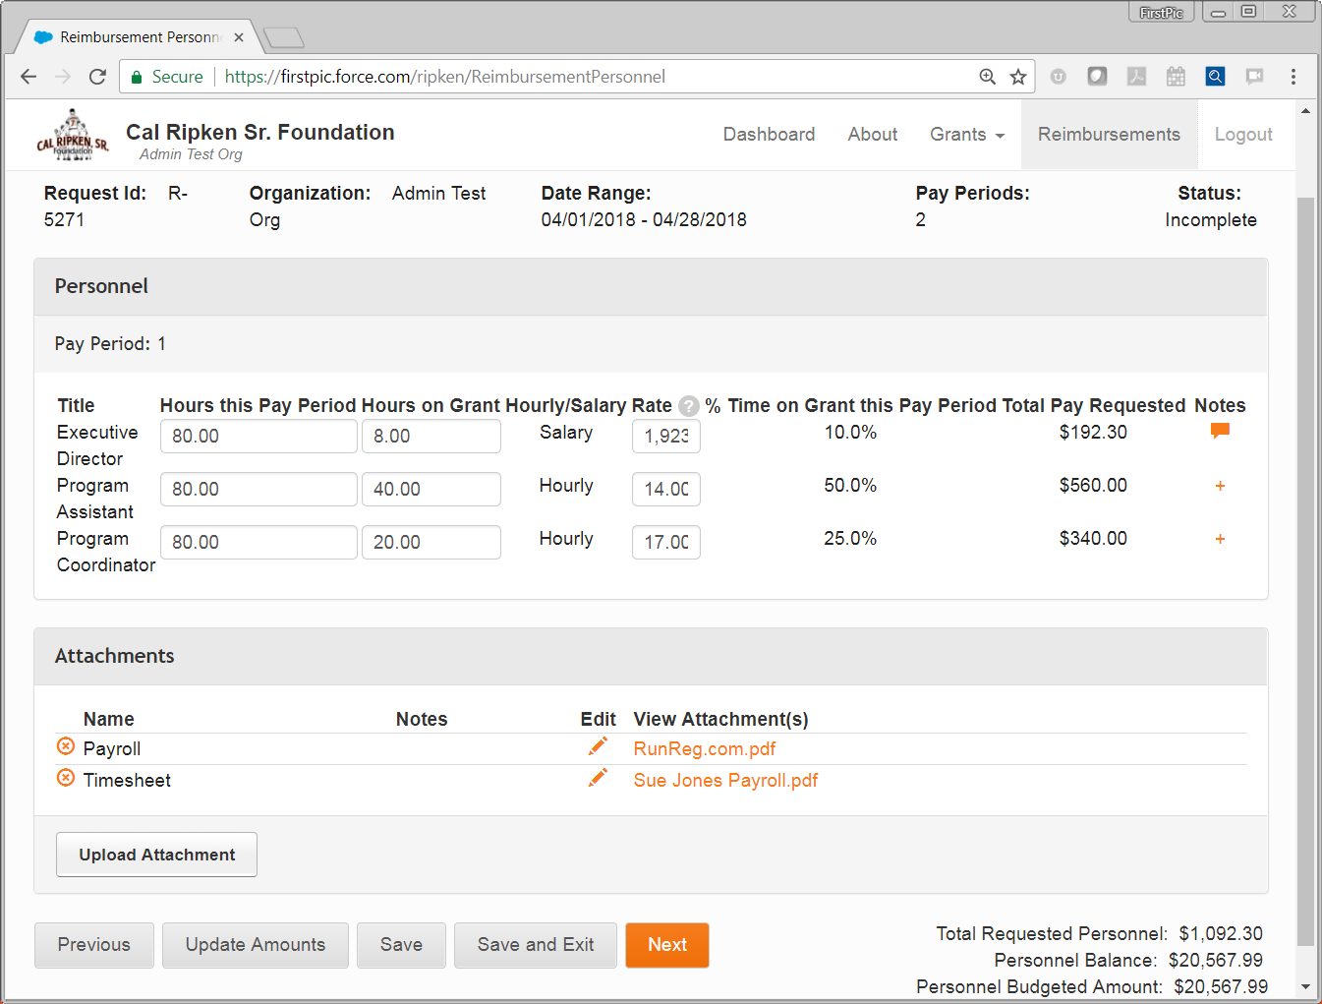
To delete an attachment, click the circled x to the left of the Name. This will delete all attachments in this line.
To edit the attachment notes or name, click the pencil icon in the Edit column. Notes would only be needed if you wanted to distinguish an attachment beyond it’s file name – these are not necessary.
Note: You will NOT be able to move past this page unless you have uploaded a Payroll AND Timesheet document.
2
1
When you have finished the 1st personnel page, click “Next” to go on.
3

Slide 20
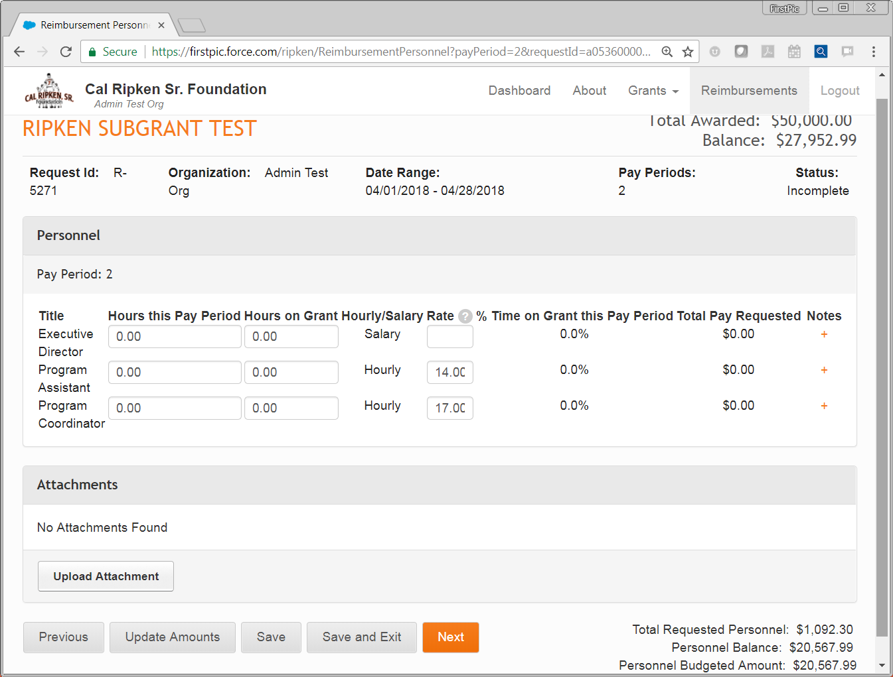
This is the personnel page for the 2nd pay period in this request. It is filled out in the same manner as the previous pay period.
1
Notes:
1. Click Next

Slide 21
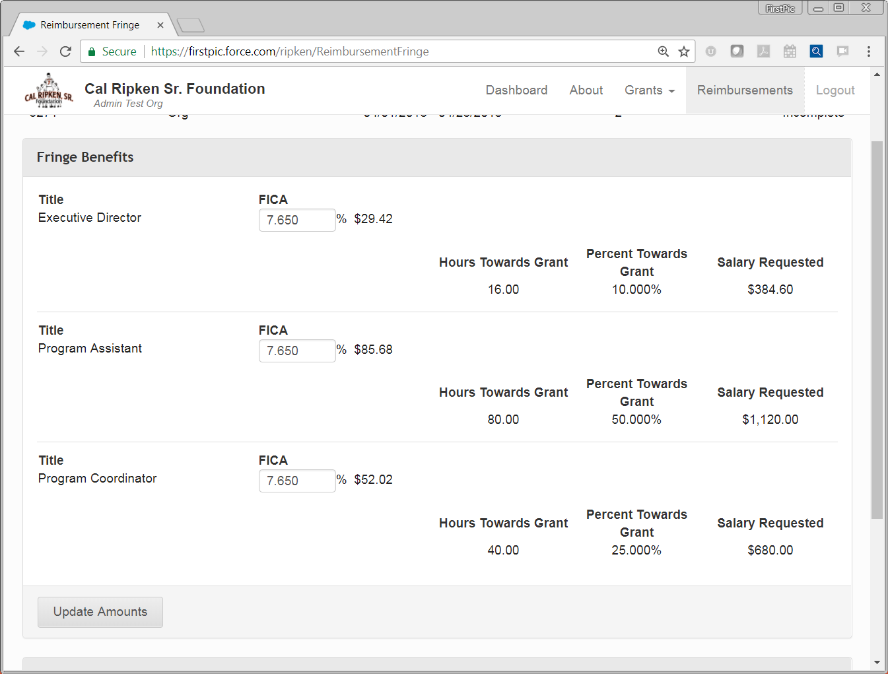
Once you have filled out personnel for all the pay periods in the request, you will come to Fringe Benefits.
1
Enter “7.65” in the FICA box for each eligible employee. (Note: It is NOT required for every employee).
2
Click “Update Amounts” for the system to calculate reimbursable FICA (Salary Requested x 0.0765)
4
3
These amounts will be auto-calculated from the Personnel pages.

Slide 22
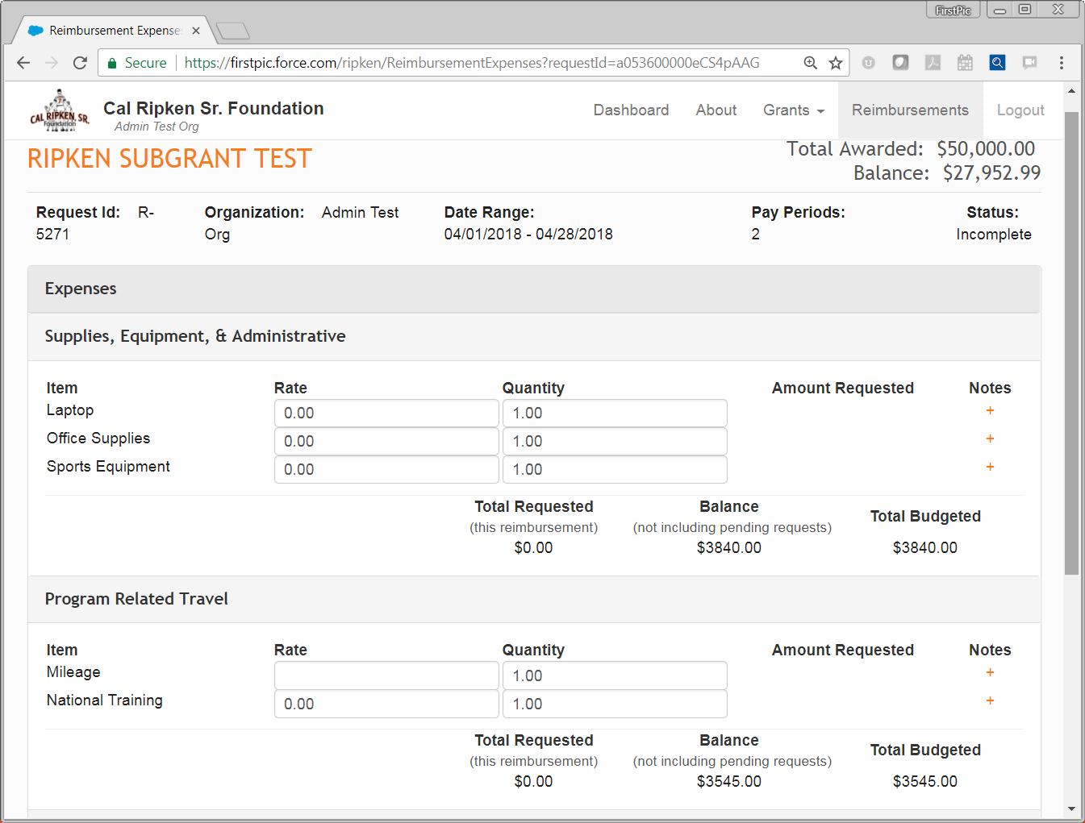
When you are done with Fringe Benefits, you will go on to Expenses.
1
2
Expense Categories and Items will be pulled in from the budget. (Note: If you need to add an item, you will have to submit a budget update).
Notes:
1. To add an item you must submit a budget adjustment

Slide 23
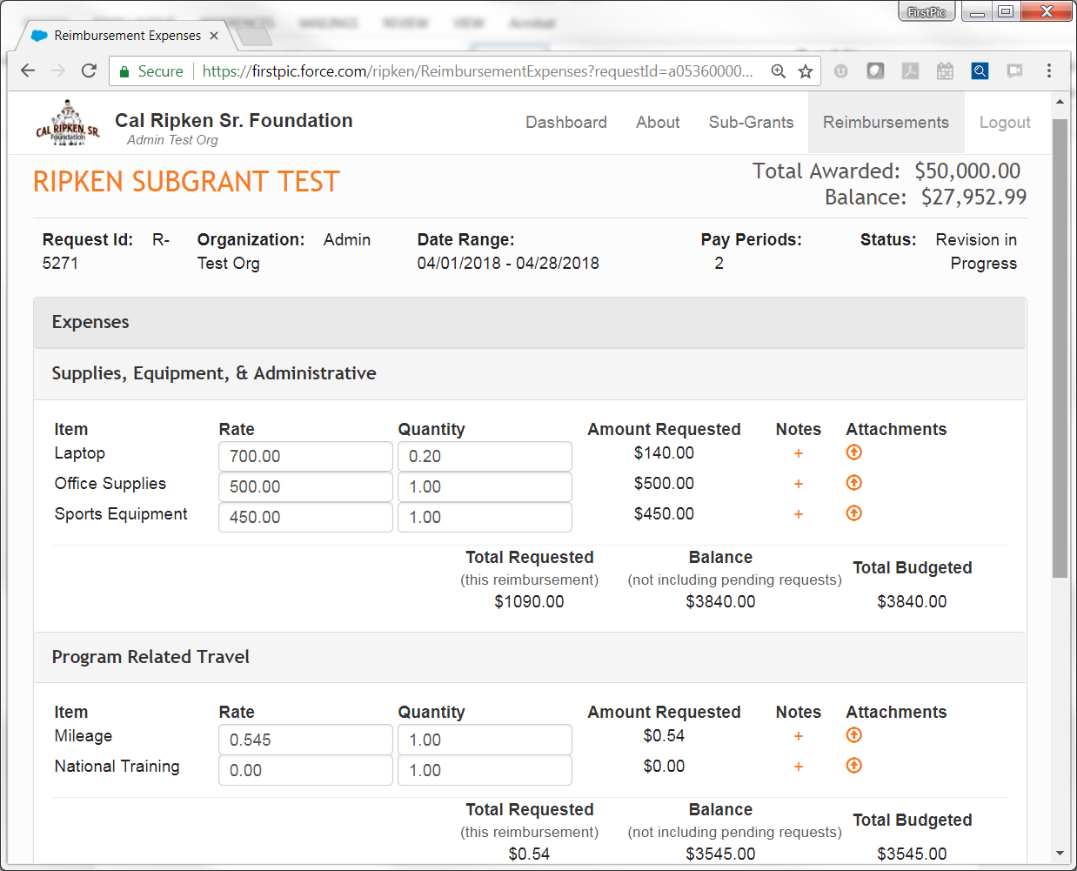
Put in the Rate and Quantity for the items you are requesting.
A quantity of less than one indicates the cost of the item has been pro-rated with only a portion being charged to the program.
1
2
Rate cannot exceed 0.545; Quantity = Miles driven
Add Notes as needed.
Notes are to provide additional information on how the item was used for/related to the program.
3

Slide 24
Upload your receipts and other supporting documentation by clicking on the arrow next to each line item.
Notes:
Supplies, Equipment and Administration – The expenses incurred that were directly related to the running of the CRSF program
FOOD CANNOT BE REIMBURSED
ENTERTAINMENT TICKETS AND ADMISSIONS CANNOT BE REIMBURSED
- This includes but is not limited to movie, athletic events, etc.
Maximum percentage of office supplies and overhead is 20% of the total expenses for the reimbursement
- Submit itemized store receipt OR invoice(s) from vendor displaying expense and date, and payment made
If payment was made by Check – a copy of check or stub is required
If payment was made by Credit Card – a copy of the full CC statement showing the charge AND either subsequent CC statement showing payment made OR copy of check paid to CC is required
Program Related Expenses - Travel expenses related to the running of the CRSF program. This could include travel to practice fields, tournaments, camps, clinics, staff trainings and other CRSF sponsored events. Travel may also include lodging and airfare for over-night trips.
Maximum reimbursement is $0.545/mile for mileage in 2018
Mileage expense for Personal/Employee Owned Vehicle must submit:
- MapQuest/Google maps directions printed with total start to end miles displayed
- Internal expense report AND copy of reimbursement check or payroll register if added to paycheck
Mileage for Organization Vehicle must submit:
- MapQuest/Google maps directions printed with total start to end miles displayed
- Vehicle travel log
All Other Travel Expenses must submit:
- Itemized store receipt OR invoice(s) from vendor displaying expense and date and the payment made
If payment was made by check – a copy of check or stub is required
If payment was made by Credit Card – a copy of the full CC statement showing the charge AND either subsequent statement showing payment made or copy of check paid to CC is required

Slide 25
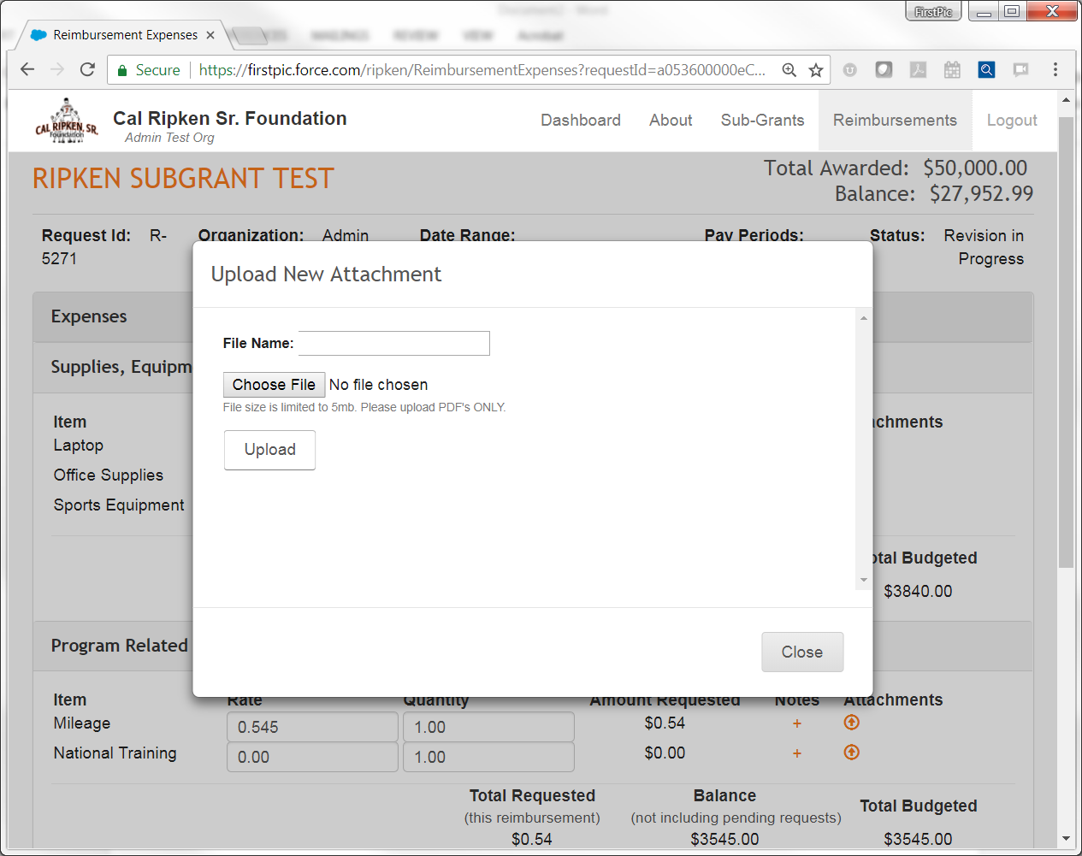
If you would like to rename the file for the upload, type in the new name here.
1
2
Click “Choose File” to select the file to upload. Reminder: file must be a pdf.
3
Once you have selected the file, make sure you click “Upload.”

Slide 26
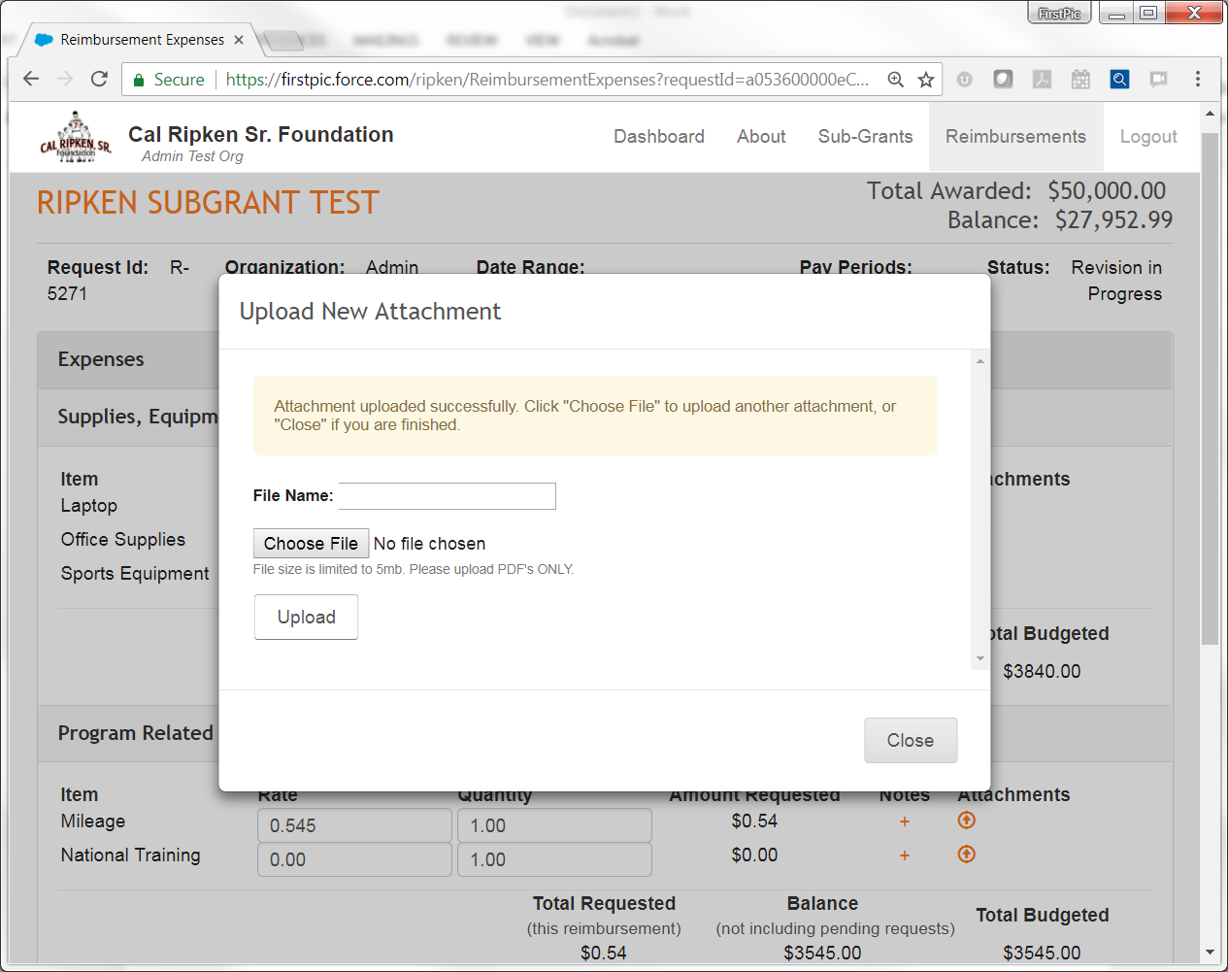
You will receive a confirmation message if your upload was successful.
1
When you are done, click “Close.”
2
Notes:
2. However, it is recommended that you upload each document under it’s own “attachment name” and not upload multiple documents under the same name. If you would need to delete a document, you may not delete just one if multiple documents are uploaded under the same attachment name. All documents attached under that name will be deleted.

Slide 27
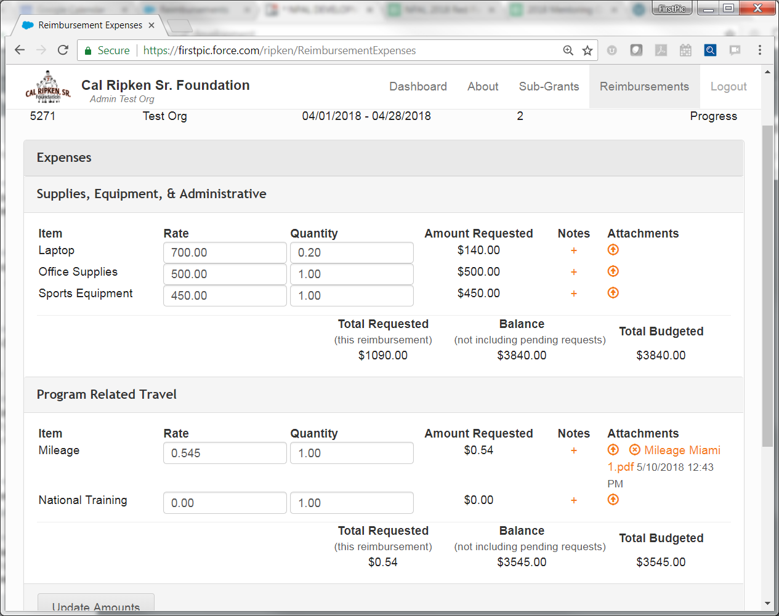
Click on the x to delete an attachment. Click on the file name to view what was uploaded.

Slide 28
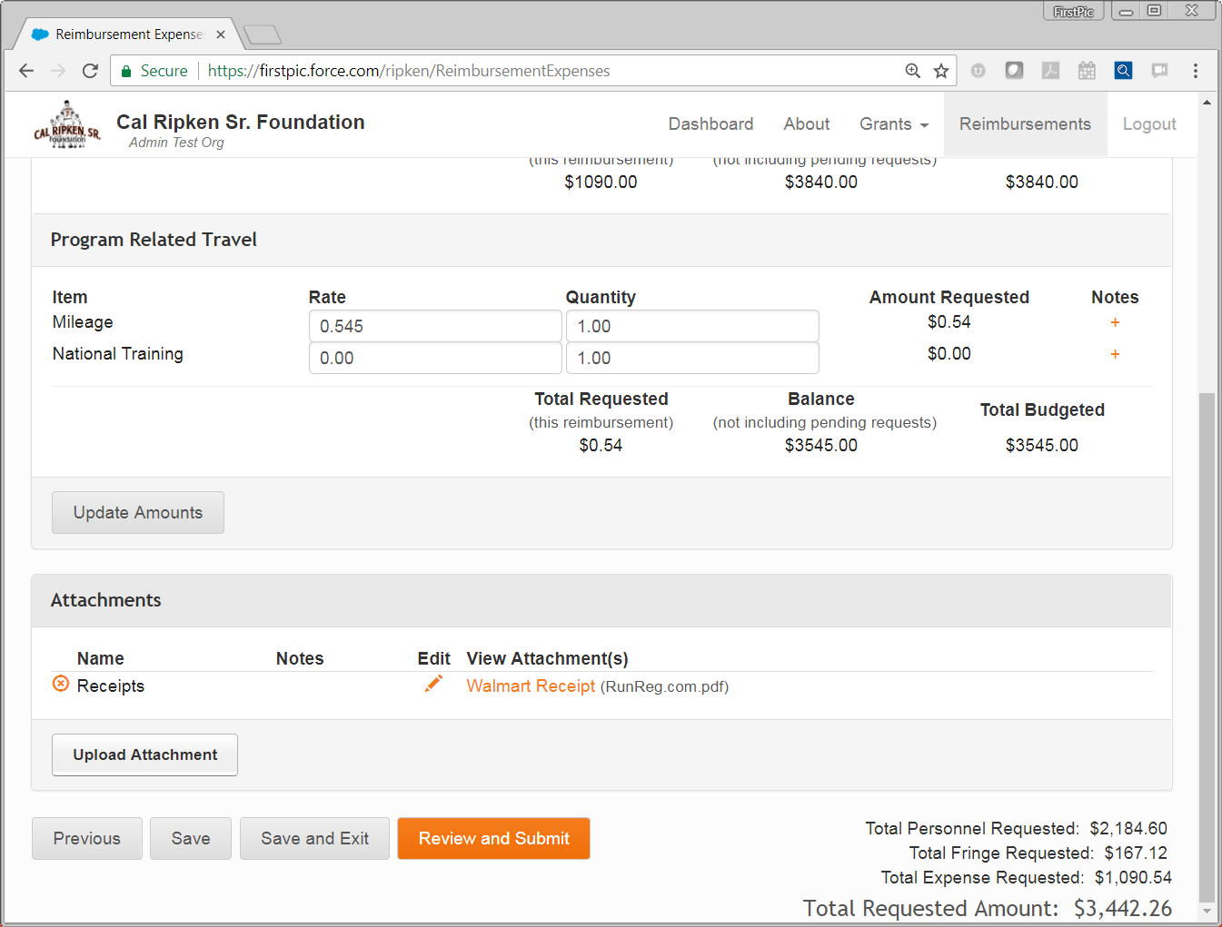
You can check your request totals here.
When you are done, hit “Review and Submit.”
2
1

Slide 29
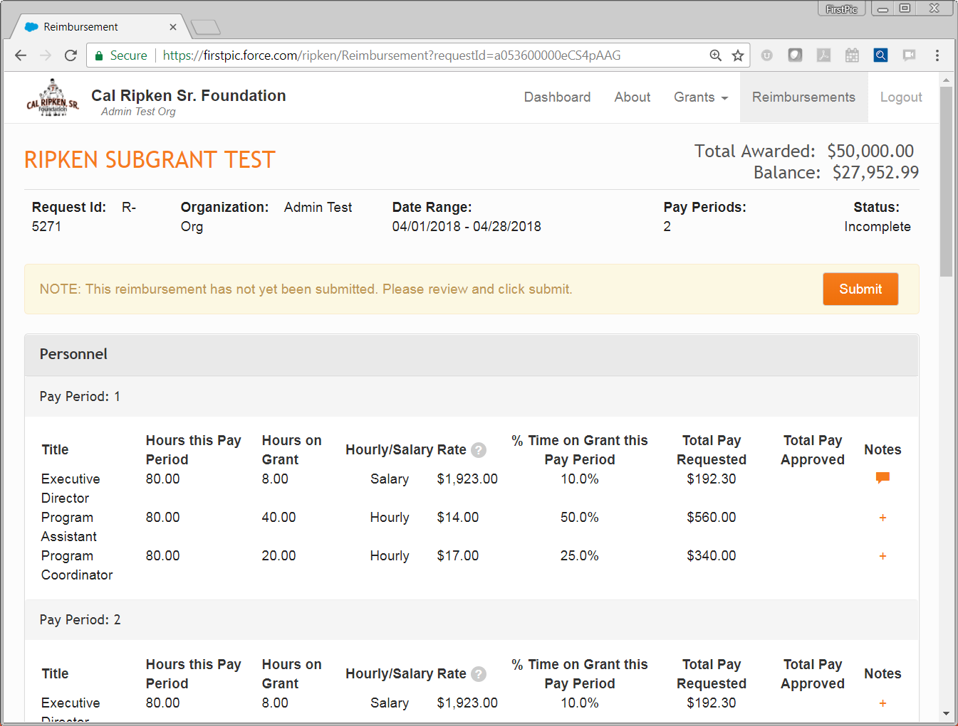
Once you click “Review and Submit,” you will see a review screen for your total request. If everything is correct, hit “Submit.” Otherwise scroll down to the bottom of the page and click “Edit,” and you will return to the start of the request to make any necessary edits.

Slide 30
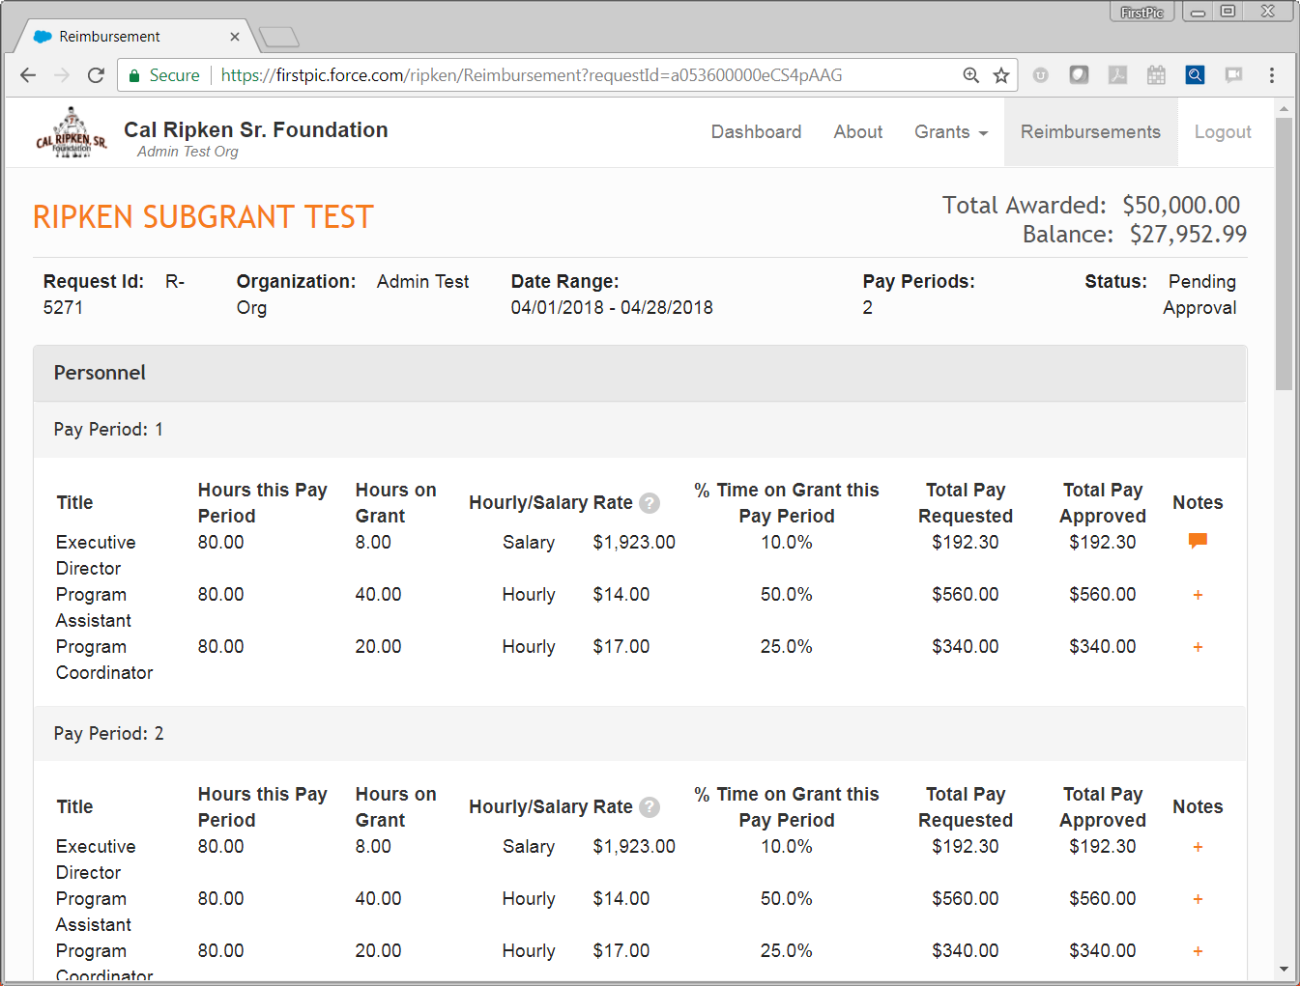
Once you hit submit, the Status will change to “Pending Approval.”

Slide 31
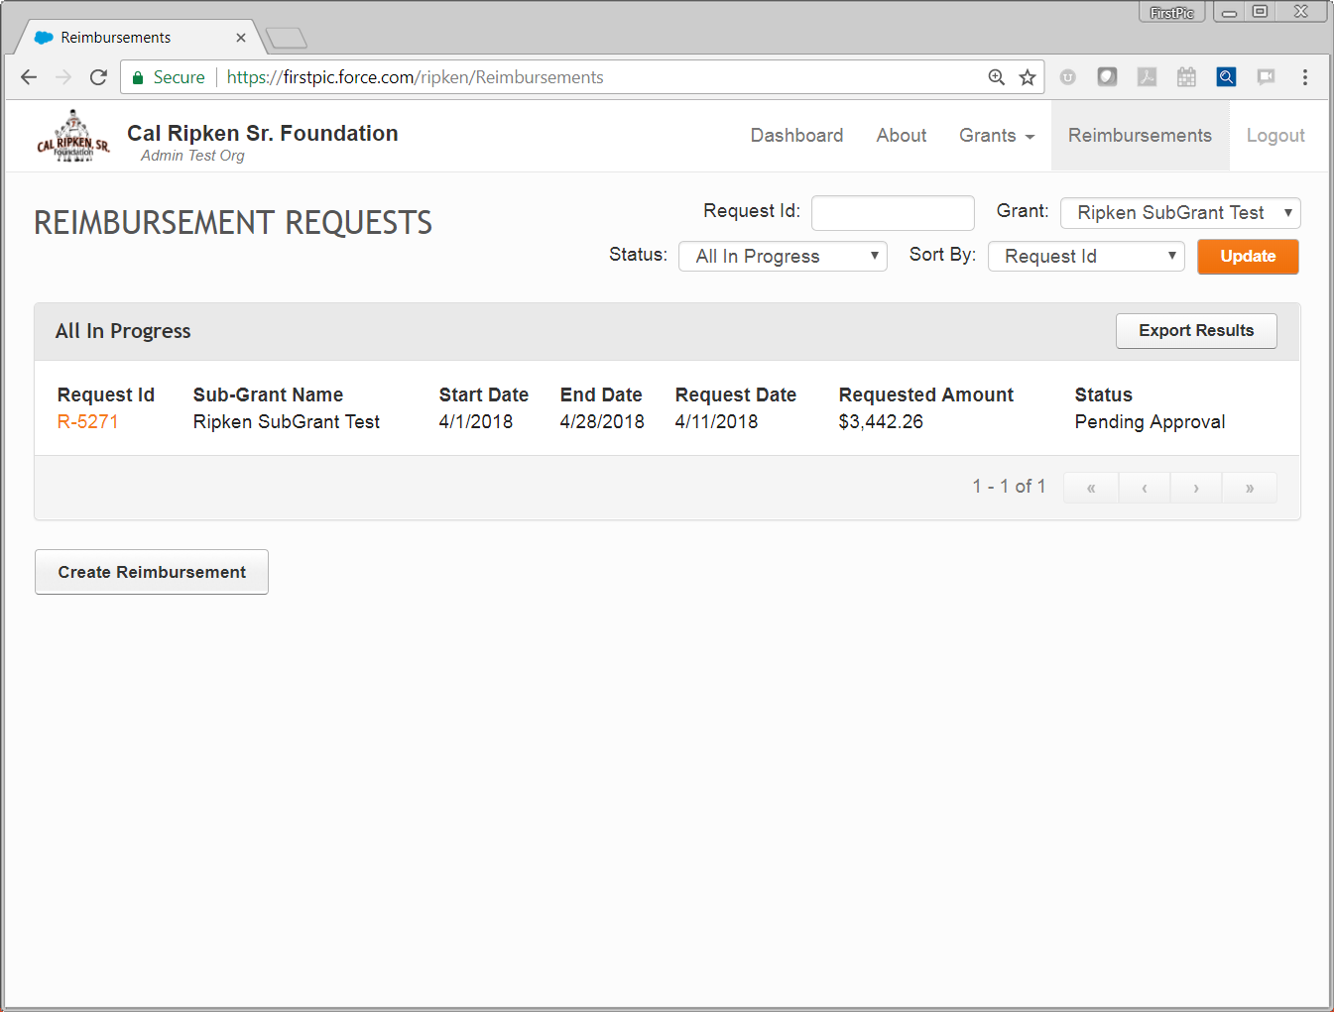
Click “Reimbursements” tab to check status.
1
2
Status:
Pending Approval when first submitted;
Revisions Needed is sent back by reviewer;
Approved if approved by National

Slide 32
Documentation Requirements
Salaried (Full Time) Personnel - This represents the percentage of salary corresponding with the percentage of time that an individual spent working on the CRSF program.
Only an individual’s regular salary amount is eligible
No overtime, no bonuses
Maximum percentage of time that can be claimed for administrative/executive support is 30%
More than 30% must be approved by your program manager
FICA is calculated only on the percentage of the payroll expense being reimbursed by CRSF
Must submit:
Payroll register(s) for each employee listed and for each pay period being reimbursed
Copies of signed timesheets for each employee listed for each pay period being reimbursed

Slide 33
Documentation Requirements
Part Time Personnel – Only the actual hours spent working on the CRSF program can be reimbursed.
Holiday, vacation or overtime hours are not reimbursable
FICA is calculated only on the percentage of the payroll expense being reimbursed by CRSF
Must submit:
Payroll register(s) for each employee listed and for each pay period being reimbursed
Copies of signed timesheets for each employee listed for each pay period being reimbursed

Slide 34
Documentation Requirements
FOOD CANNOT BE REIMBURSED
ENTERTAINMENT TICKETS AND ADMISSIONS CANNOT BE REIMBURSED
- This includes but is not limited to movie, athletic events, etc.
Maximum percentage of office supplies and overhead is 20% of the total expenses for the reimbursement
- Submit itemized store receipt OR invoice(s) from vendor displaying expense and date, and payment made
If payment was made by Check – a copy of check or stub is required
If payment was made by Credit Card – a copy of the full CC statement showing the charge AND either subsequent CC statement showing payment made OR copy of check paid to CC is required

Slide 35
Documentation Requirements
Travel expenses related to the running of the CRSF program. This could include travel to practice fields, tournaments, camps, clinics, staff trainings and other CRSF sponsored events. Travel may also include lodging and airfare for over-night trips.
Maximum reimbursement is $0.545/mile for mileage in 2018
Mileage expense for Personal/Employee Owned Vehicle must submit:
- MapQuest/Google maps directions printed with total start to end miles displayed
- Internal expense report AND copy of reimbursement check or payroll register if added to paycheck
Mileage for Organization Vehicle must submit:
- MapQuest/Google maps directions printed with total start to end miles displayed
- Vehicle travel log

Slide 36
Documentation Requirements
All Other Travel Expenses must submit:
- Itemized store receipt OR invoice(s) from vendor displaying expense and date and the payment made
If payment was made by check – a copy of check or stub is required
If payment was made by Credit Card – a copy of the full CC statement showing the charge AND either subsequent statement showing payment made or copy of check paid to CC is required

