Slide 1


Slide 2
What we will be covering:
Overview for creating a budget
Accessing the online reporting system
Managing users in the online reporting system
Walk-through of budget creation in the online reporting system

Slide 3
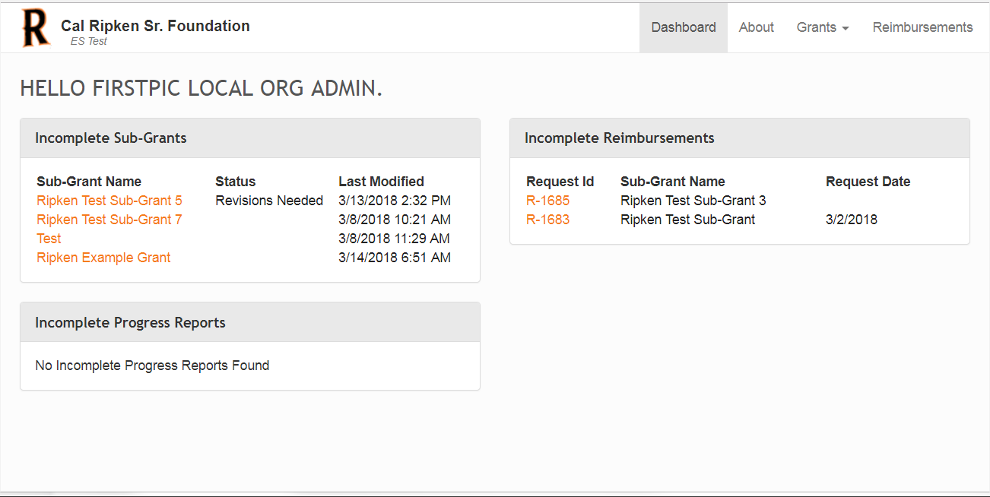

Awarded Sub-Grants that do not have an approved budget will display here. Click on the sub-grant you would like to update.

Slide 4

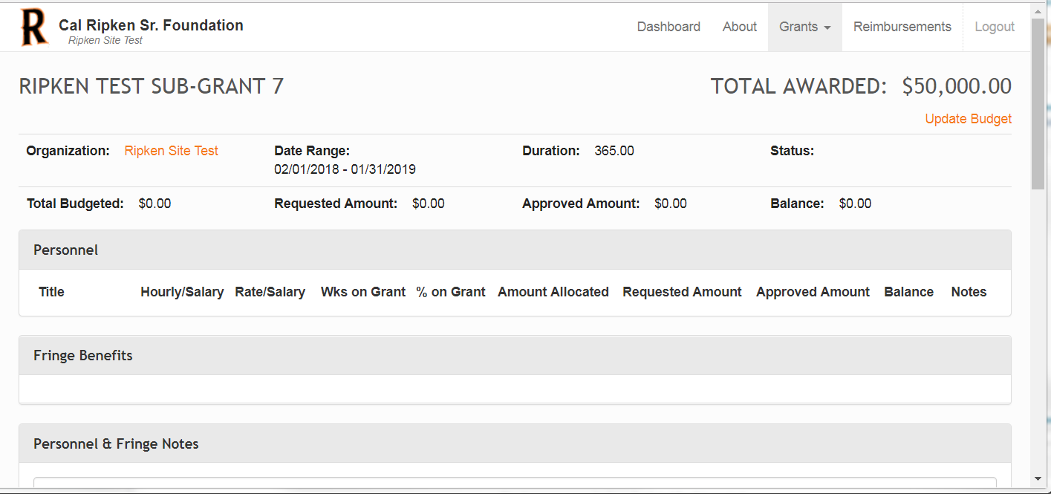
The top of this screen displays general information about the award. Click on “Update Budget” to proceed.

Slide 5
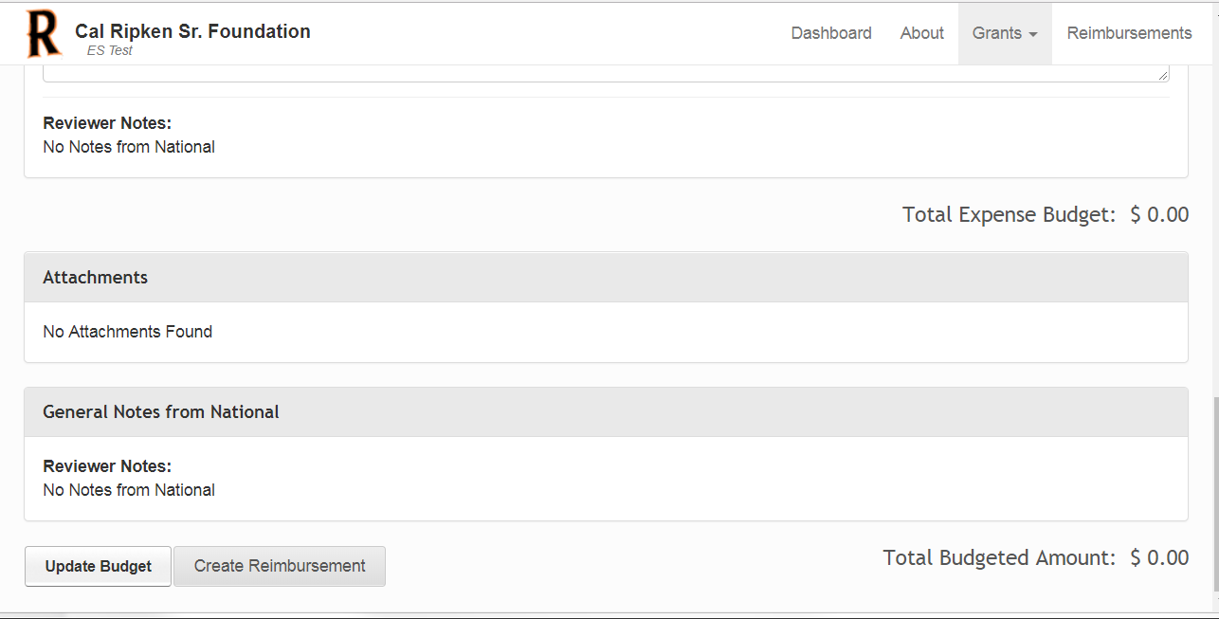
“Update Budget” can also be accessed at the bottom of this screen

Slide 6
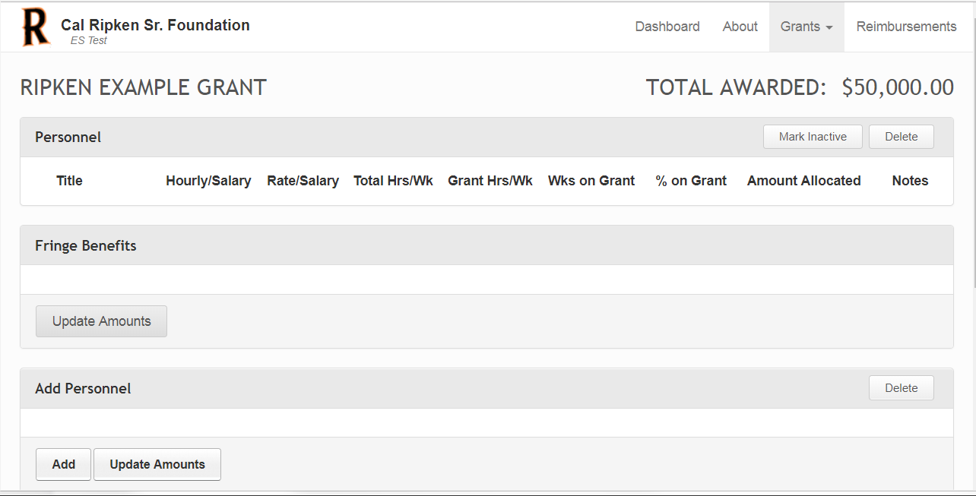
The first screen is where you will add Personnel and Fringe Benefit items. Click “Add” to enter the first item.

Slide 7
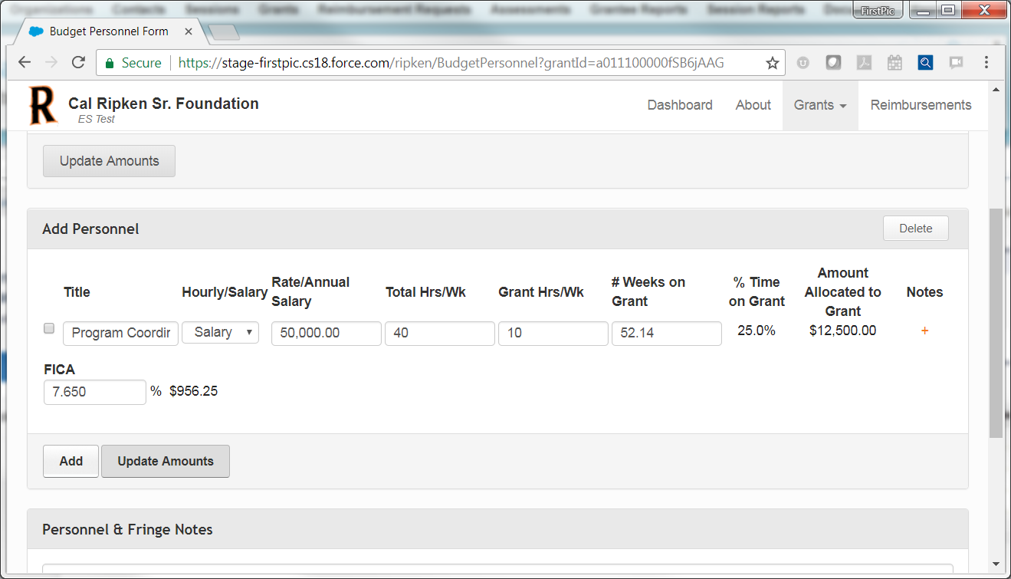
The system calculates these fields when “Update Amounts” is clicked. (Note: Must obtain approval from your program manager if % Time on Grant exceeds 30%.)
Note: 52.14 is the # of weeks in a full calendar year (365/7). This field can be changed to actual number of weeks this person will be working on the program.
Entering a Salaried Employee:
Enter title.
Leave dropdown as “Salary” (default).
Enter Annual Salary.
Enter Total Hrs/Wk (for the staff person).
Enter Grant Hrs/Wk (specific to program).
Enter FICA (7.65) - (Optional Field – Can be left blank)
The system calculates the Amount Allocated to Grant amount as such: Annual Salary ÷ 52.14 * # of Weeks on Grant * % Time on Grant.

Slide 8
If a line item is entered in error, check this box and click “Delete” to delete a personnel item while creating a budget.
Click “Update Amounts” to perform calculations. Click “Add” to add another employee.

Slide 9
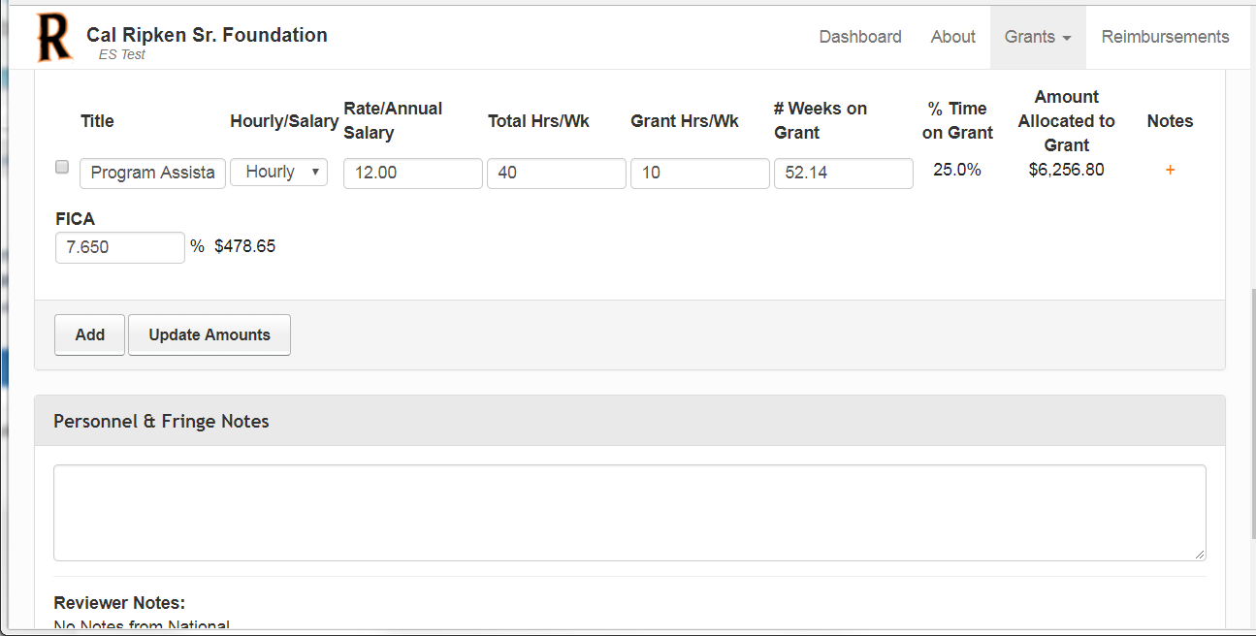

Remember, this field can be changed to actual number of weeks this person will be working on the program.
% Time on Grant = (Grant Hrs/Wk ÷ Total Hrs/Wk) * 100
Entering Hourly Employee:
Enter title.
Change Hourly/Salary dropdown to “Hourly”.
Enter Hourly rate.
Enter Total Hrs/Wk (for the staff person).
Enter Grant Hrs/Wk (specific to program).
Enter FICA (7.65) - (Optional Field – Can be left blank)
Amount Allocated to Grant = Grant Hr/Wk * Rate * # Weeks on Grant

Slide 10
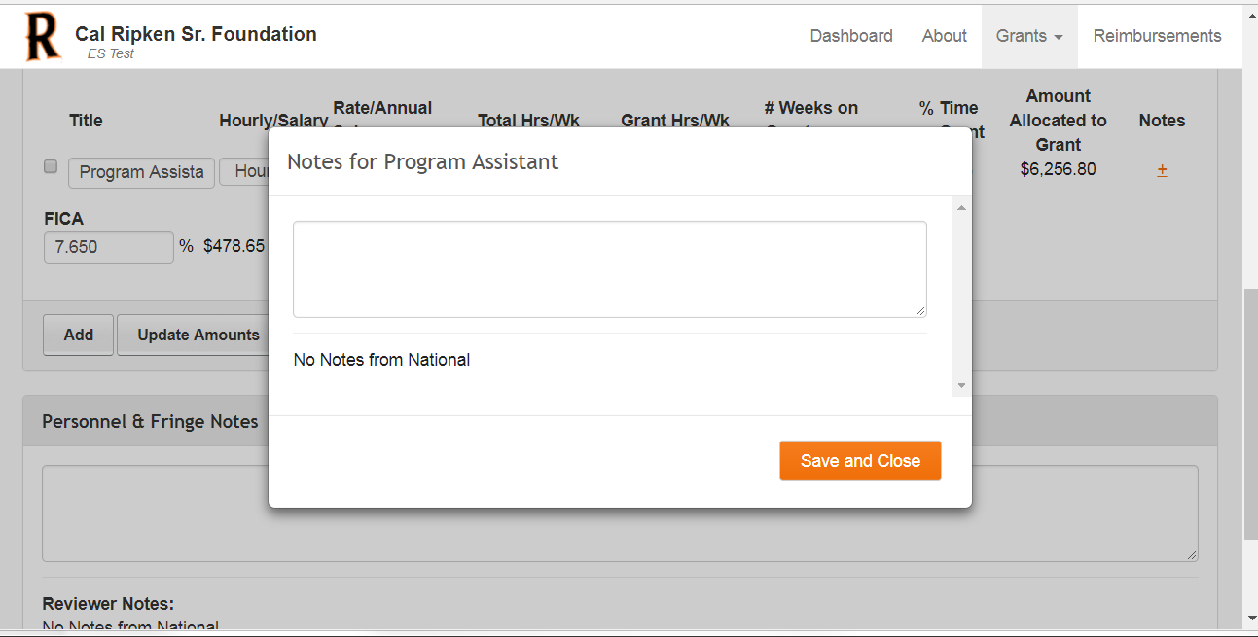

Click on “+” sign to open notes box. Type notes specific to this employee and click “Save and Close”
Enter general Personnel and Fringe notes in this section

Slide 11

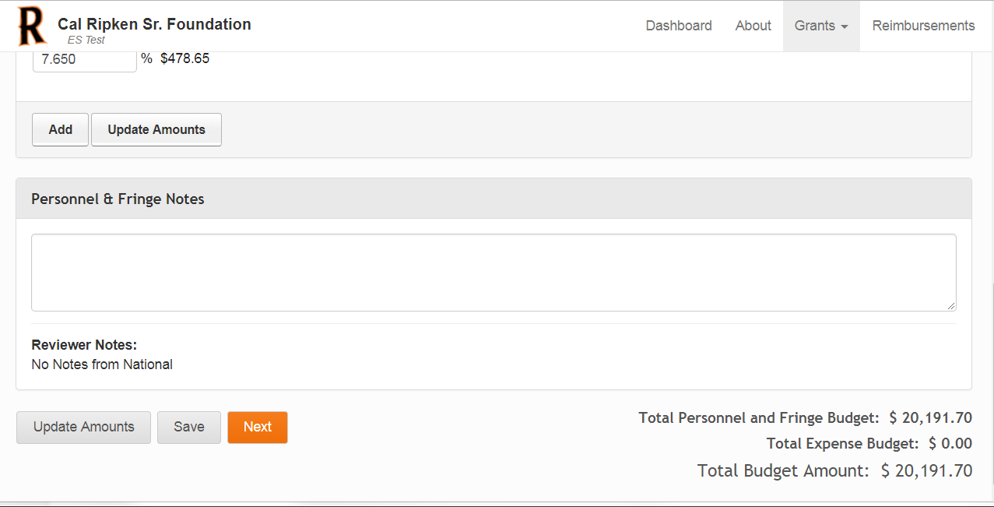
Click “Update Amounts” to update all amounts entered in the Personnel section above.
Amounts budgeted for Personnel and Fringe are displayed here.
Click “Save” to save all data entered on this screen so far.
Click “Next” to move to the next screen. (This will also save all data on the current screen.)

Slide 12
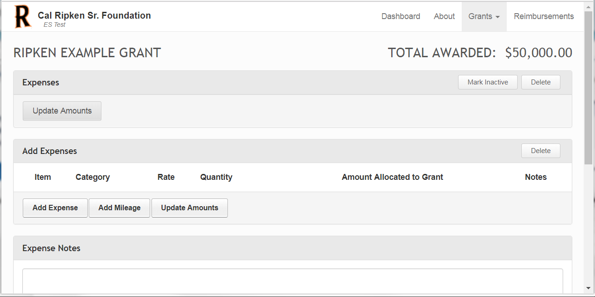
This screen is where additional (non-personnel/fringe) expenses are entered. Click “Add Expense” to enter the first item. Note: Reimbursable items are limited to items that are necessary to implement CRSF programs only. FOOD & DRINK ITEMS ARE NOT REIMBURSABLE. THE COSTS OF ADMISSION OR TICKETS IS ALSO NOT REIMBURSABLE.

Slide 13
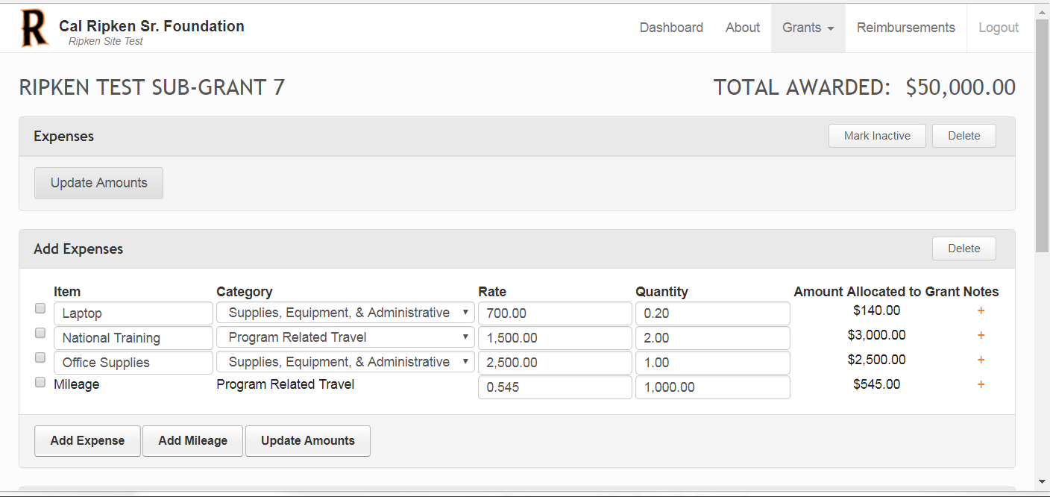
Note: Administrative items and utilities are reimbursable at 20%.” (i.e. Laptop = $700 * 20% = $140)
Enter item names and assign them to categories from the drop down (Options = Supplies, Equipment & Administrative, Program Related Travel, Other Costs). Rate is the dollar amount. Quantity is the number of items (goes to 2 decimal places for pro-rated purchases). Click “Update Amounts” to calculate totals.
Enter additional details about any of the expenses by clicking the “+” sign and typing in the dialogue box
In order to enter a mileage line item, click “Add Mileage”. Rate will default to current GSA rate of 0.545 (but can be overwritten to a lower rate). Quantity = Number of miles. Category defaults to “Program Related Travel”.

Slide 14

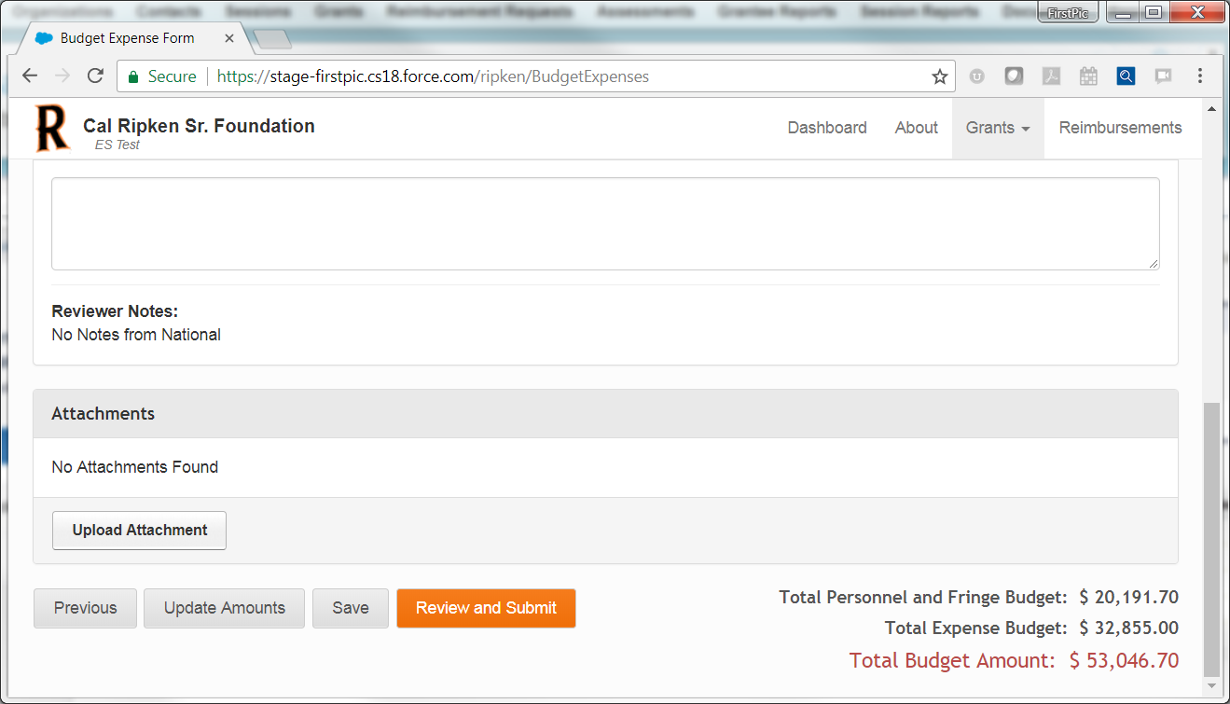
Enter general expense notes here.
Upload supporting documentation, if necessary, as a PDF (limit 10MB).
Click “Update Amounts” (below left) to calculate total amount budgeted (including previous screen).

Slide 15

Click “Previous” to return to Personnel screen (will also save current screen).
Click “Review and Submit” when ready to submit (will also save current screen).

Slide 16

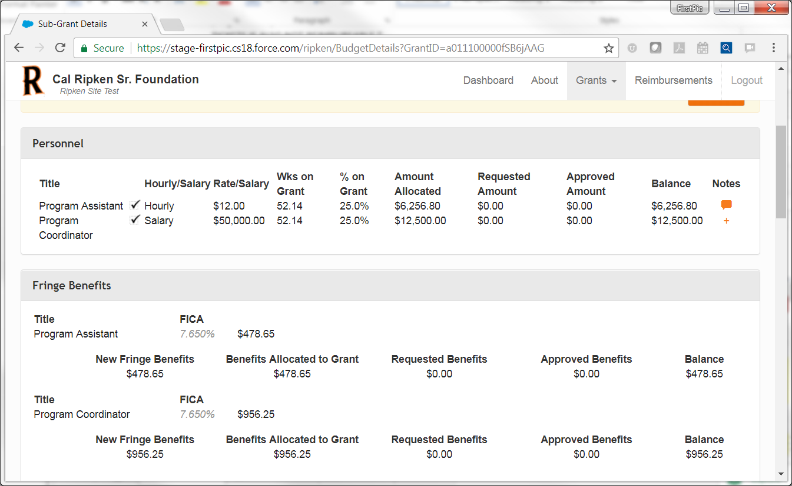
This is a review screen. Budget is not yet submitted. The top of the screen will display amounts entered for personnel and fringe and calculated amounts to be charged to the grant.
This is a review screen. Budget is not yet submitted. The top of the screen will display amounts entered for personnel and fringe and calculated amounts to be charged to the grant.

Slide 17

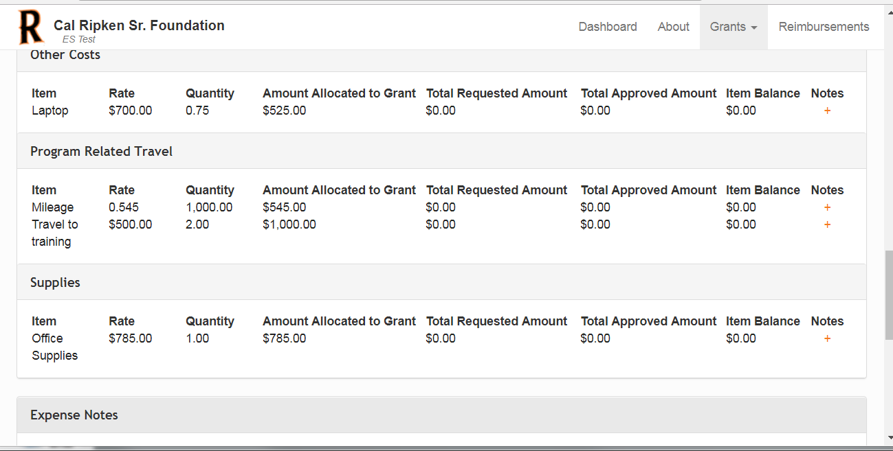
The bottom of the review screen will display other expenses entered and system calculated amounts allocated to the grant. Any notes will also be visible by clicking on speech bubbles to right of expenses.

Slide 18

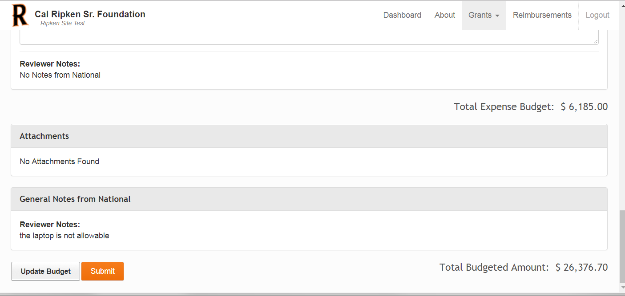
Click “Submit” when ready to submit for approval. Note: It is still possible to update a budget at any time. Hitting “Submit” alerts the National users that the budget is ready to be reviewed.
Total Budgeted Amount: This is the total amount you are requesting for Personnel, Fringe and Other Expenses combined.

Slide 19

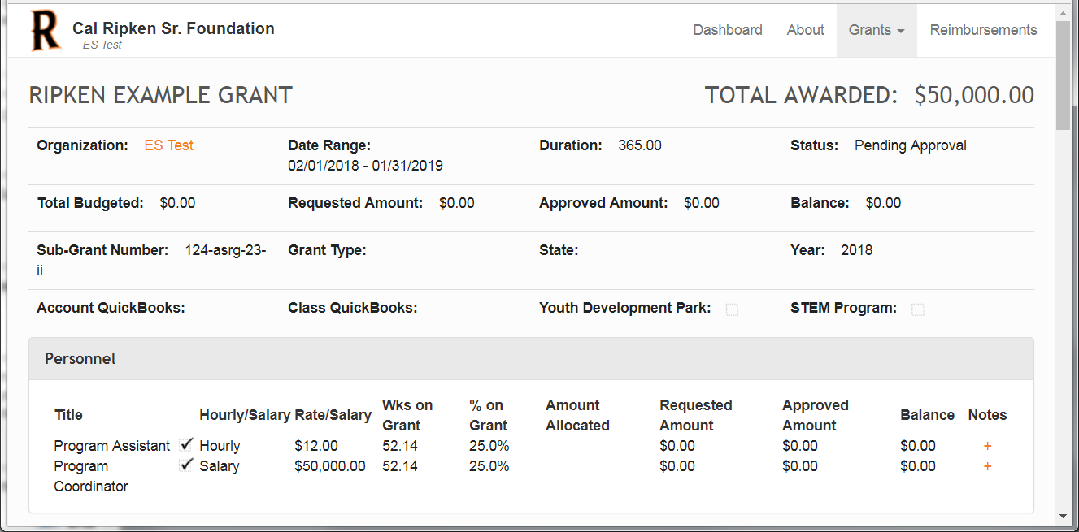
Status updates to “Pending Approval” once budget has been submitted

Slide 20
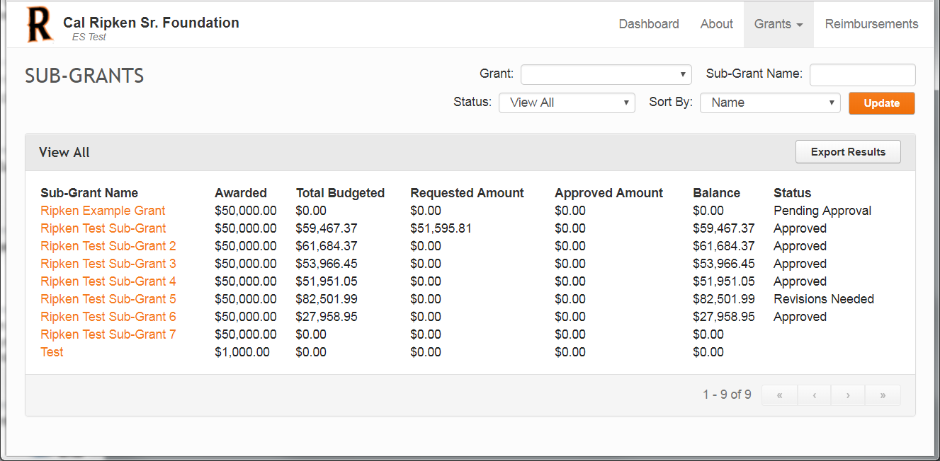

Click on “Grants” tab at any time to verify current status of budget that has been submitted.

