Slide 1

TEAM DETAILS
RAKTSETU
TEAM NAME - Trex
Healthcare · a trust-aware platelet bridge between blood centres, so near-expiry platelets reach patients before they expire, even when stock data is stale.
TEAM LEADER NAME - Siddharth Raj
PROBLEM STATEMENT (DOMAIN) - Open Innovation
Notes:
Team Trex, leader Siddharth Raj. Track: Open Innovation (healthcare). Project: RaktSetu.

Slide 2

PROBLEM STATEMENT & TARGET NEED
WHO IS AFFECTED
Platelets discarded at three Indian hospital blood centres
% of platelet units prepared; share of discards due to expiry in brackets
Patients who need platelets: dengue (2.89 lakh cases in India in 2023), cancer chemotherapy, surgery. When their hospital's centre runs out, families are sent hunting between centres. Pune, Sep 2026: “the shortage of platelets is currently a major concern” (KEM blood bank head).
THE CURRENT GAP
Platelets last only 5 days. In three Indian hospital studies, 8–48% of platelets made were discarded, 96–99% of them to expiry (not everywhere: in Cuttack expiry was the smallest discard cause). Our premise, not yet measured: one centre's surplus could cover another's shortfall. Maharashtra uploaded only 30,000 of 80,000+ units to e-RaktKosh (Sep–Oct 2023).
WHY IT MATTERS NOW
Transfers between licensed centres are allowed (D&C Rule 122P(xiv); NBTC 2015, as reported), yet we found no deployed Indian tool that coordinates them. Maharashtra FDA ordered daily e-RaktKosh stock updates (Aug 2026, as reported). In the US, two-hospital platelet sharing cut outdates by about 20% (Zhang et al. 2023).
Root cause we target: units expire in one centre while another may lack them, and nobody can see reliably who holds what.
Sources: NCVBDC dengue table; Punekar News 8 Sep 2026; Free Press Journal 2 Oct 2023 and 7 Aug 2026 (as reported); IJCMPH 2024 (Thane, 2,588/5,411); AJPCR 2025 (GMC Patiala, 10,995/24,194); Bioinformation 2026 (Goa, 783/9,929); WJPMR 2017 (Cuttack); D&C Rule 122P(xiv), G.S.R. 328(E) 2017; Medical Dialogues 19 Oct 2015 (NBTC); Zhang et al., Oper. Res. 71(5), 2023.
Notes:
All discard numbers are single-centre studies, shown as a range, never as a national rate; Goa (7.9%) is kept deliberately and Cuttack is a counterexample (expiry was its smallest discard cause, 5.2%). The Surat 2015 figure used in v2 was removed: its primary paper could not be opened to confirm 29.0%/95.8%. 'Nearby centres ran short' is now stated as our premise, not a measured fact. NBTC 2015 permission and the Maharashtra FDA daily-update order are cited as reported in news; we did not obtain the official letters.

Slide 3

PROPOSED SOLUTION & INNOVATION
WHAT MAKES IT DIFFERENT
Closest existing solutions vs RaktSetu
Solution | Matches near-expiry units across centres | Handles stale or wrong stock data | Public 'how likely in stock'
e-RaktKosh (India) | Not found | Public pages show 'last updated' only | Raw count
Phone helplines (e.g. Sankalp, Karnataka) | Patient → bank, not bank → bank | Not described | Via helpline
BloodMove (Adelaide, as reported) | Yes | Not described | No
Zhang et al., Oper. Res. 2023 | Yes (2 hospitals) | Not described (abstract) | No
RaktSetu | Yes | Yes: learned trust + confirm | Yes: likelihood band
None of the tools we found describes treating stock listings as possibly stale: they list stock or move near-expiry units. RaktSetu treats every listing as possibly stale: it learns each centre's reliability, confirms before any courier leaves, and shows families a High / Medium / Low likelihood band.
CORE MECHANISM
1 Centres post near-expiry units and shortfalls (form, or message via a mock channel).
2 Trust: Beta(2,1) reliability per centre for listings 0, 1, 2+ days old.
3 Greedy matcher: units expiring ≤2 days, strict ABO/RhD, one-hop rule, ≥12 h margin.
4 Sending centre confirms; medical officer approves; 20–24 °C box recorded.
BUILT FOR ROUND 2
Simulated, strict blood-group matching: a naive matcher that trusts stale listings sent 130–201 wasted courier trips per 150 days and, with poor data, left more patients unserved than no platform (8.1% vs 7.7%). Confirming first (~3.7 calls a day) cut that to 2.6%; adding trust ranking cut failed family visits a further 17–18%.
A working prototype on simulated data: FastAPI backend, browser UI and a message parser with a human check. The trust and matcher code reproduce our simulator's decisions exactly (parity-tested). Mock channel · demo users · not clinically validated.
Sources: e-RaktKosh public pages; Sankalp India Foundation helpline; Nat. Blood Authority (AU) BloodMove case study (as reported; not re-opened); Zhang, Ayer, White, Bodeker & Roback, Oper. Res. 71(5), 2023; Team Trex simulator v3 (realistic / poor stock data, 300 paired runs each). 'Not found' = not found in our search.
Notes:
Round 2 change: the prototype is now built (raktsetu-app). It runs end to end on simulated data: list, match, confirm, approve, dispatch, deliver, plus a public finder and a message parser whose drafts a person checks. The trust and matcher code is ported from the simulator and golden parity tests show it reproduces the simulator's decisions exactly: 2,342 recorded cases and 17 complete 180-day runs, day by day. Input is a mock channel (typed or pasted messages), not WhatsApp; users are demo roles, not real authentication; the matching policy is not clinically validated. The trust estimate is a Beta(2,1) count per centre and listing-age bucket (0, 1, 2+ days); in the prototype it learns from confirmations; there is no decay curve. The matcher is greedy; an exact min-cost-flow matcher changed unserved patients by at most 0.04 percentage points in simulation. The ≥12 h on-arrival margin is our own safety choice, not a regulation.

Slide 4

SYSTEM ARCHITECTURE & TECH STACK
TECH STACK
built for Round 2 · runs locally on simulated data
How a near-expiry platelet unit flows dashed grey = planned
FRONTEND
Blood centres
Near-expiry units + shortfalls by form or message (mock channel)
1 Ingest & parse
Rules or Claude API → draft → human check
Coordinator dashboard
Board, trust bands, explainable matches
Built: React + Vite: board, transfer cards, message inbox, public finder
2 Trust estimate
Beta(2,1) per centre × listing age 0/1/2+ days
BACKEND
e-RaktKosh
Public stock as a prior
Public platelet finder
High / Medium / Low likelihood band
Built: Python FastAPI · trust estimate · greedy matcher · workflow · audit log
3 Matcher (greedy)
Units expiring ≤2 days → requests; strict ABO/RhD, one-hop rule, ≥12 h margin
DATABASE
Outcomes
Confirmations update trust; every step logged
Built: SQLite via SQLAlchemy. Planned: PostgreSQL (same models)
SBTC / FDA report
Wastage avoided, reporting reliability
4 Confirm & approve
Sending centre confirms · only a medical officer approves
AI / APIS
Built: Beta-Bernoulli trust · greedy matcher · parser with human check. Planned: WhatsApp Cloud API
5 Dispatch & audit
20–24 °C box recorded · audit log · transport estimate
HOSTING / DEVOPS
Planned: Docker · India-region cloud · CI. Today: one local process.
Medical officer approves every transfer · no patient data stored · unit IDs not linkable to donors
Rules: D&C Rules 122P(xiv)–(xv) (transfer allowed; recipient may pass units only to a storage centre or patient); platelets 5 days at 20–24 °C (DGHS/NBTC Technical Manual 2023). The ≥12 h margin is our choice. Greedy matcher kept: an exact min-cost-flow matcher changed unserved % by ≤0.04 pp (simulated).
Notes:
Round 2: the stack is built and runs as one local process on simulated data. Deviations from the Round 1 plan, chosen for a 3-day build and a reliable demo: SQLite instead of PostgreSQL (same SQLAlchemy models, a configuration change to switch); a mock message channel instead of the WhatsApp Cloud API (business verification could not be done in time); no Docker, cloud hosting or CI yet; e-RaktKosh and the SBTC/FDA report are planned. The parser uses rules, or the Claude API when a key is set; the LLM only extracts fields and our code resolves dates and raises every check; a person approves each draft. The LLM path has been tested only with a fake client so far. Trust: Beta(2,1) count per centre and listing-age bucket, p = alpha/(alpha+beta), no decay; the prototype learns from confirmations. Matcher: greedy, ported from the simulator and parity-tested.

Slide 5

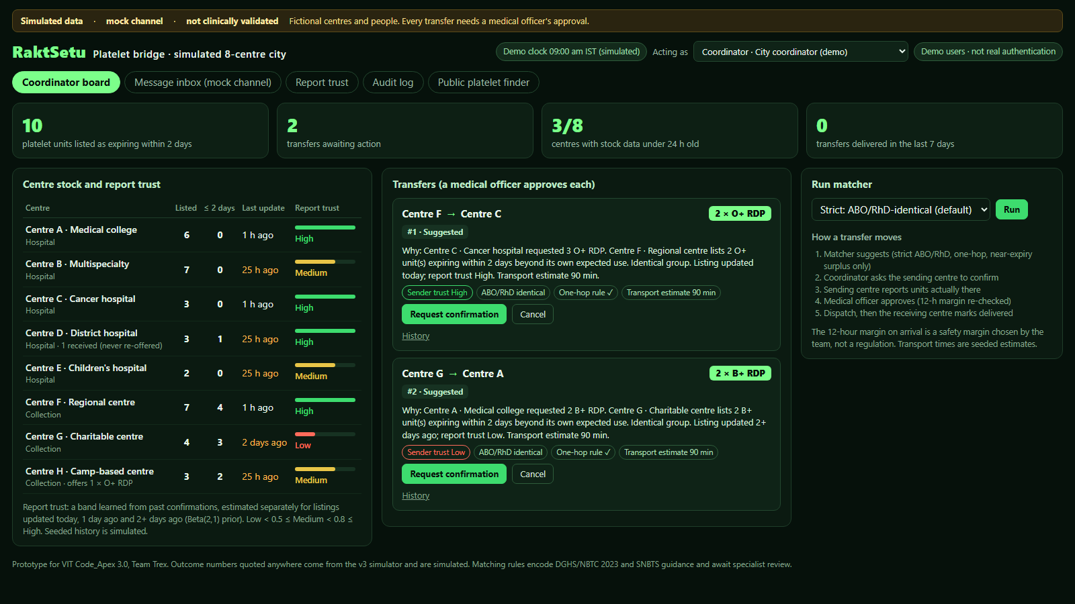
KEY FEATURES & UI/UX
1
Near-expiry board built
every unit expiring within 2 days, city-wide, with listing age
2
Report-trust bands built
learned from confirmations; stale listings stand out
3
Explainable matches built
why this unit; ABO/RhD, one-hop, 12-h checks computed
4
Confirm before dispatch built
staff confirm what is there; only a medical officer can approve
5
Public platelet finder built
bands, not %: raw estimate miscalibrated (ECE 0.03); High/Med/Low in stock 87/71/54% (sim.)
6
Low-effort input built, mock channel
English + Hinglish; a person checks every draft
7
Regulator view planned
wastage avoided and reporting reliability per centre
Working prototype on simulated data · coordinator board after a strict match run · mock channel · not clinically validated
Notes:
Round 2: this is the working app, not a mock-up: a real screenshot of the coordinator board on the seeded, fictional 8-centre city, after the strict matcher suggested two transfers. Every value on it is computed by the backend. We can show it live: confirm, the refused staff approval, medical-officer approval, the trust update after a partial confirmation, the message inbox and the public finder. The finder shows High/Medium/Low bands because the raw reliability estimate is not well calibrated (underconfident below about 0.6); on held-out simulated runs, High-band visits found stock 87% of the time, Medium 71%, Low 54%. Messages come through a mock channel (typed or pasted); Hindi and Marathi parsing and the regulator view are planned.

Slide 6

IMPLEMENTATION ROADMAP & SCOPE
WHAT WE TESTED IN SIMULATION, WHAT WE BUILT FOR ROUND 2, AND WHAT COMES NEXT
ROUND 1: SIMULATION
ROUND 2: BUILT
BEYOND THE HACKATHON
Simulator (strict ABO/RhD): families sent to search
Per day, 8-centre city · realistic vs poor stock-data quality · 300 paired runs
Simulator: 8-centre city, platelets last 5 days, ABO/RhD groups (Mumbai donor mix), 300 paired runs per arm
Pre-registered v3 rules: 2 of 4 passed; G1 and G2 FAILED (chart)
Sensitivity grid, 4 unusual error patterns, calibration check
Working prototype on simulated data: list → match → confirm → approve → dispatch → deliver
Trust + matcher code reproduce the simulator exactly (17 whole runs; 200+ automated tests)
Message parser with human check (mock channel); public finder with bands
Still open: specialist review; parser accuracy test
Transfusion-specialist review of the matching policy
3-month pilot with 5–8 Pune centres via SBTC; measure real outdates and report accuracy
RhD-negative reserve; real WhatsApp channel
e-RaktKosh / ABDM link; red cells and plasma
Target missed: families −37% / −38% vs ≥40% (G1 FAIL); failed visits −66% / −78% vs ≥80% (G2 FAIL). Blood groups keep 55–59% of the single-group effect.
What drives it: coordination plus confirmation alone (~3.7 calls/day): unserved 4.2% → 2.3% (poor data 7.7% → 2.6%). Adding the trust finder gives 2.2% (2.5%) and cuts failed visits per family by 17–18%.
One family per platelet request a hospital cannot fill. Simulated; data-error rates assumed (no published Indian figure). Pre-registration, 95% CIs and all v3 results: sim_v3/RESULTS_v3.md. Prototype test counts: raktsetu-app, 17 Oct 2026.
Notes:
Round 2 column, all built and runnable: the end-to-end workflow on simulated data; the trust and matcher code ported from the simulator, with golden parity tests reproducing 2,342 recorded cases and 17 complete 180-day simulated runs exactly; over 200 automated tests in total (core, parity, API, claims audit). Still open: a transfusion specialist has not yet reviewed the matching policy, and the parser's accuracy test (a frozen synthetic set, partly hand-written) has not been scored. The chart and the red box are unchanged simulator results: G1 (families sent to search cut by at least 40%) and G2 (failed visits cut by at least 80%) FAILED in both scenarios; G3 and G4 PASSED. About half of the gap to the single-group result comes from RhD-negative groups, which the par levels never request (RESULTS_v3.md).

Slide 7

EXPECTED IMPACT & SCALABILITY
WHO BENEFITS, HOW BIG THE OPPORTUNITY IS, AND HOW THIS GROWS BEYOND A DEMO.
−37%
−66%
4.2% → 2.2%
0 by design
families sent to search (13.52 → 8.55 a day); target −40%: FAILED (G1)
failed visits to empty centres (4.89 → 1.68 a day); target −80%: FAILED (G2)
patients left unserved with RaktSetu (poor data: 7.7% → 2.5%)
wasted trips: every transfer is confirmed, at ~3.7 calls a day
All tiles: simulated 8-centre city, strict ABO/RhD matching, realistic stock data, 300 paired runs; error rates assumed. Robustness: with realistic data RaktSetu stays at 2.2–2.5% unserved across 0.5×–5× error rates and 0.5×–1.5× posting rates (25 cells; 2.6% in the 5 poor-data cells). It beats no platform in all 30 cells and under 4 unusual error patterns; 12–17% of calls find less stock than listed.
WHO BENEFITS
HOW BIG
HOW IT GROWS
Patients & families: fewer searches between centres in dengue peaks and for cancer care
Blood centres: fewer near-expiry units lost
Donors: their donation reaches a patient instead of the discard bin
SBTC / FDA: city-wide visibility and a reporting-reliability lens
8–48% of platelets discarded in three Indian hospital studies, mostly to expiry
10,995 platelet units discarded at GMC Patiala in 3 years: about 10 every day
410 blood banks in Maharashtra (as reported, 2026)
~20% fewer platelet outdates from two-hospital sharing (US, Zhang et al. 2023)
City → district → state through SBTC, one MoU template
Later, more products: red cells and plasma use the same engine (shelf life is a parameter)
Plugs into e-RaktKosh / ABDM as a data prior, no duplicate entry
Low cost: open-source stack; messaging and parsing are the main running costs
Sources: Team Trex simulator v3 (sim_v3/RESULTS_v3.md); IJCMPH 2024 (Thane); AJPCR 2025 (GMC Patiala); Bioinformation 2026 (Goa); Free Press Journal 7 Aug 2026; Zhang et al., Oper. Res. 71(5), 2023.
Notes:
All four tiles use one model basis: v3 simulator, strict ABO/RhD matching, realistic stock data (S1), 300 paired runs, seeds 3000–3299. Tiles 1 and 2 missed their pre-registered targets (G1, G2) and are shown as failures. 'Zero wasted trips' is true by design because every transfer is confirmed first; its cost is about 3.7 confirmation calls a day. 10,995 / (3 × 365) ≈ 10 units a day. The v2 tiles and figures (families −66%, failed visits −96%, expiry 37.8% → 21.6%, 4,205 centres, BloodMove −54%) were replaced: the first three came from a model without blood groups and the last two could not be re-verified from a source we could open.

Slide 8

Notes:
Thank you. Team Trex — RaktSetu.

