Slide 1
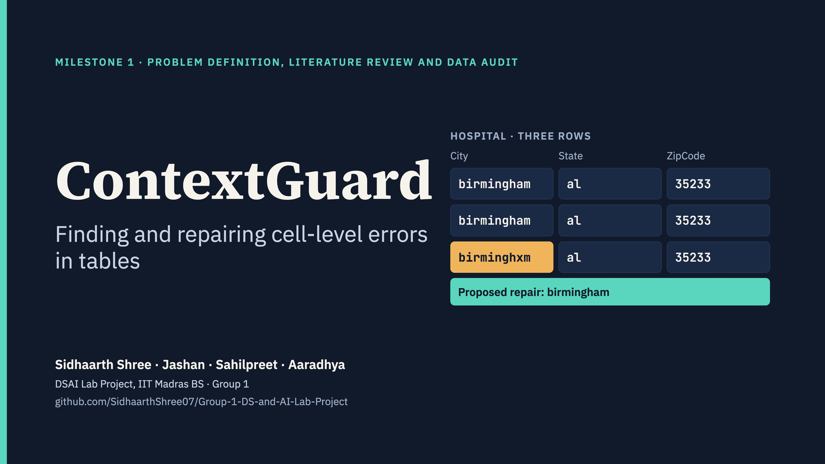
Notes:
Presenter: Sidhaarth. We are building a system that finds cell-level errors in tables, names the error type, proposes a repair and says how confident it is. Today we cover the problem, what exists, the data we will use and how we will measure success.

Slide 2
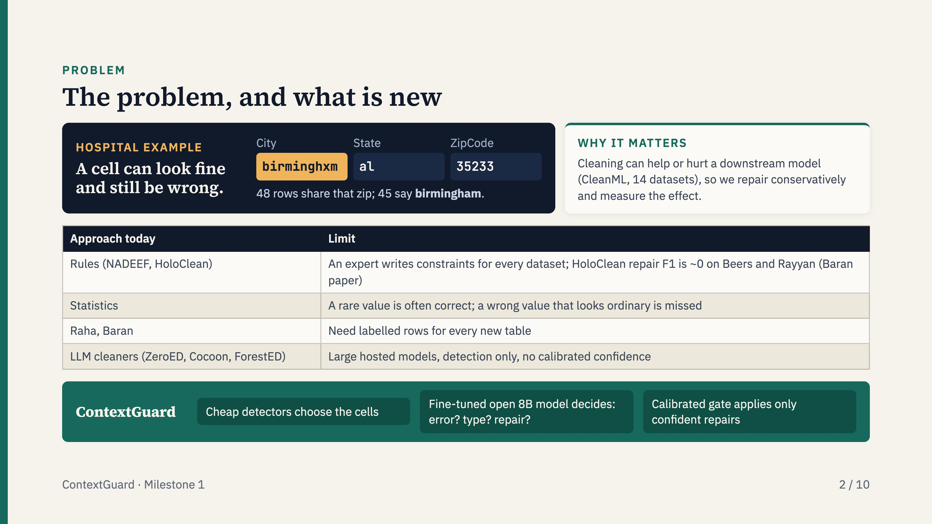
Notes:
Machine-learning models are only as good as their training tables. A cell can look valid and still be wrong given its row, as the Hospital example shows. Rules need an expert per dataset, statistics miss ordinary-looking wrong values, Raha and Baran need labels for every table, and recent LLM cleaners need large hosted models and give no confidence. ContextGuard combines cheap detectors, a fine-tuned open model and a confidence gate, and repairs conservatively because cleaning can hurt a downstream model.

Slide 3
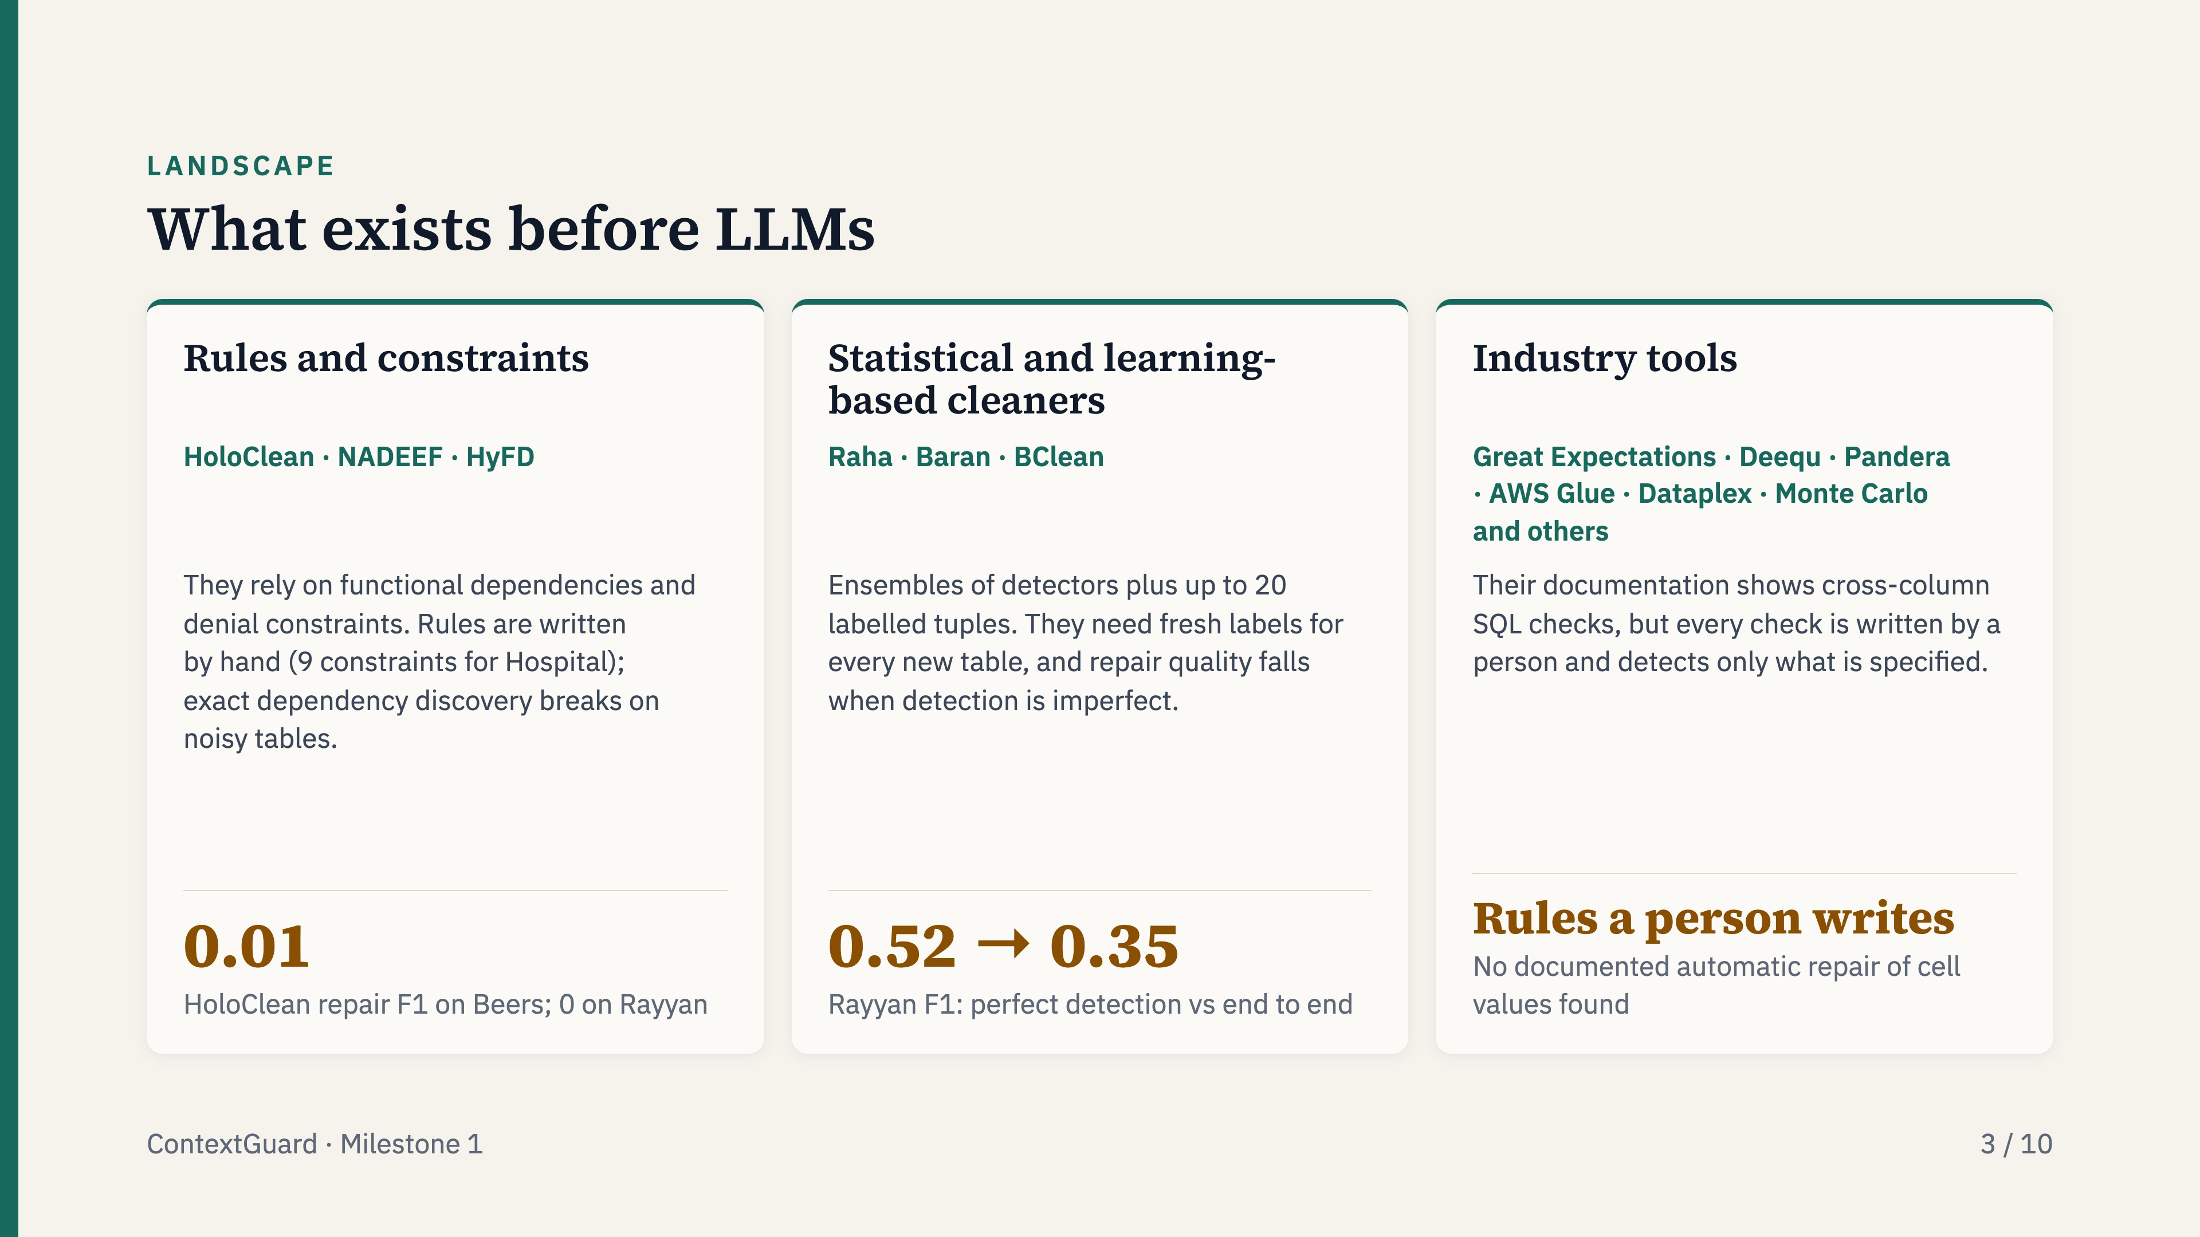
Notes:
Before LLMs there were three families: constraint engines such as HoloClean, statistical and learning-based cleaners such as Raha and Baran, and industry validation tools. The first two need hand-written rules or fresh labels for every table, and repair falls when detection is imperfect. The industry tools check what a person has specified.

Slide 4
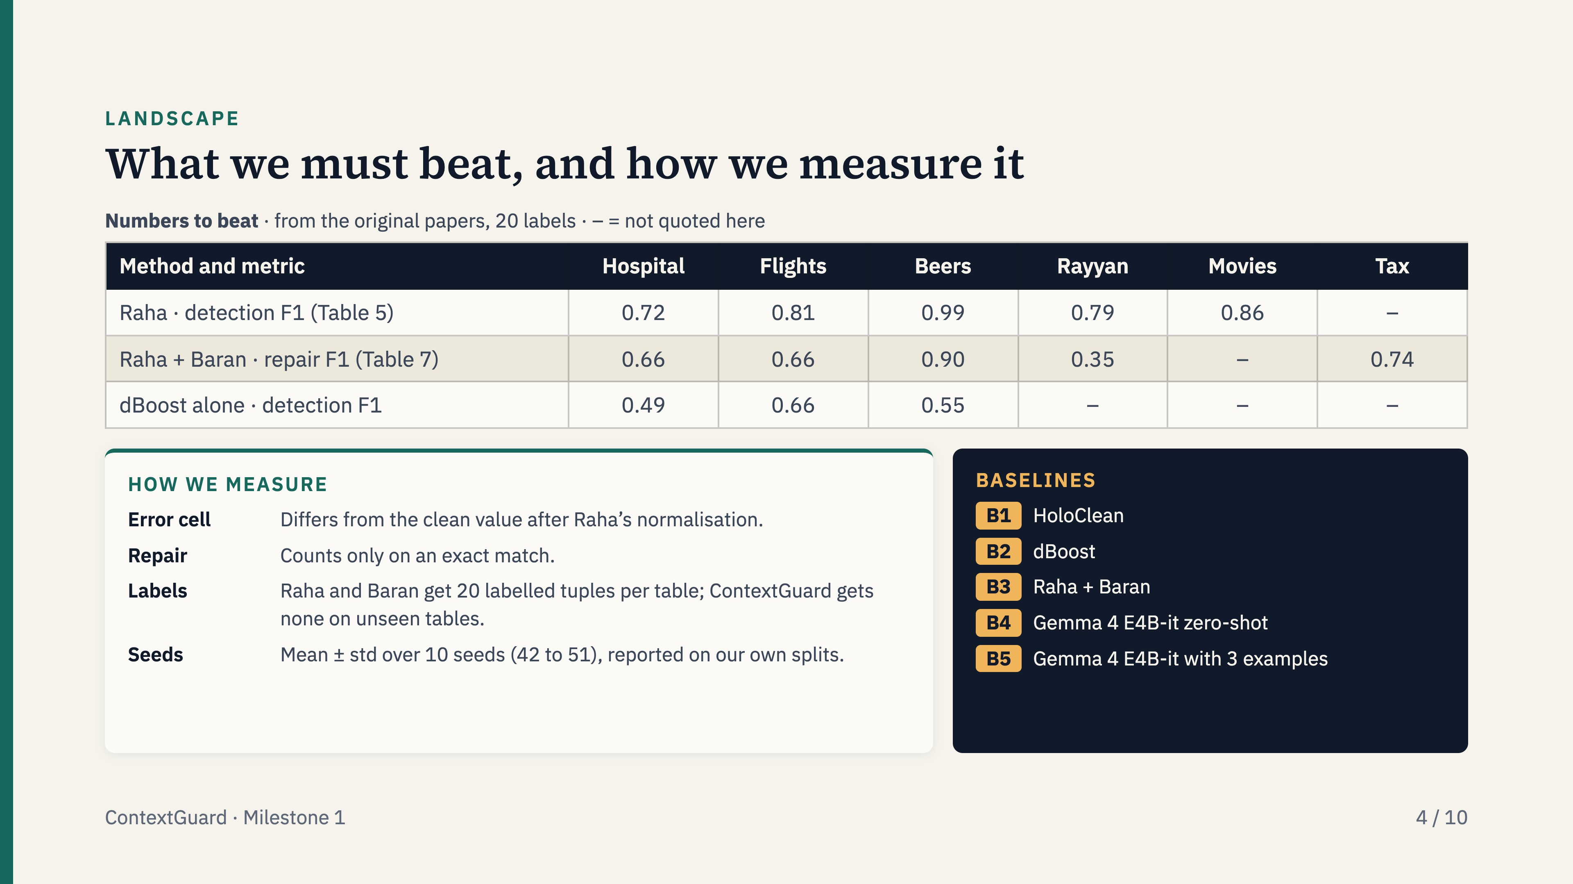
Notes:
These are the numbers we have to beat, taken from the original papers with 20 labels. We never present a paper’s number as our own result: we rerun every baseline on our splits, with Raha’s normalisation, exact-match repair, 20 labels for Raha and Baran on every table and none for ContextGuard on unseen tables, over ten seeds.

Slide 5
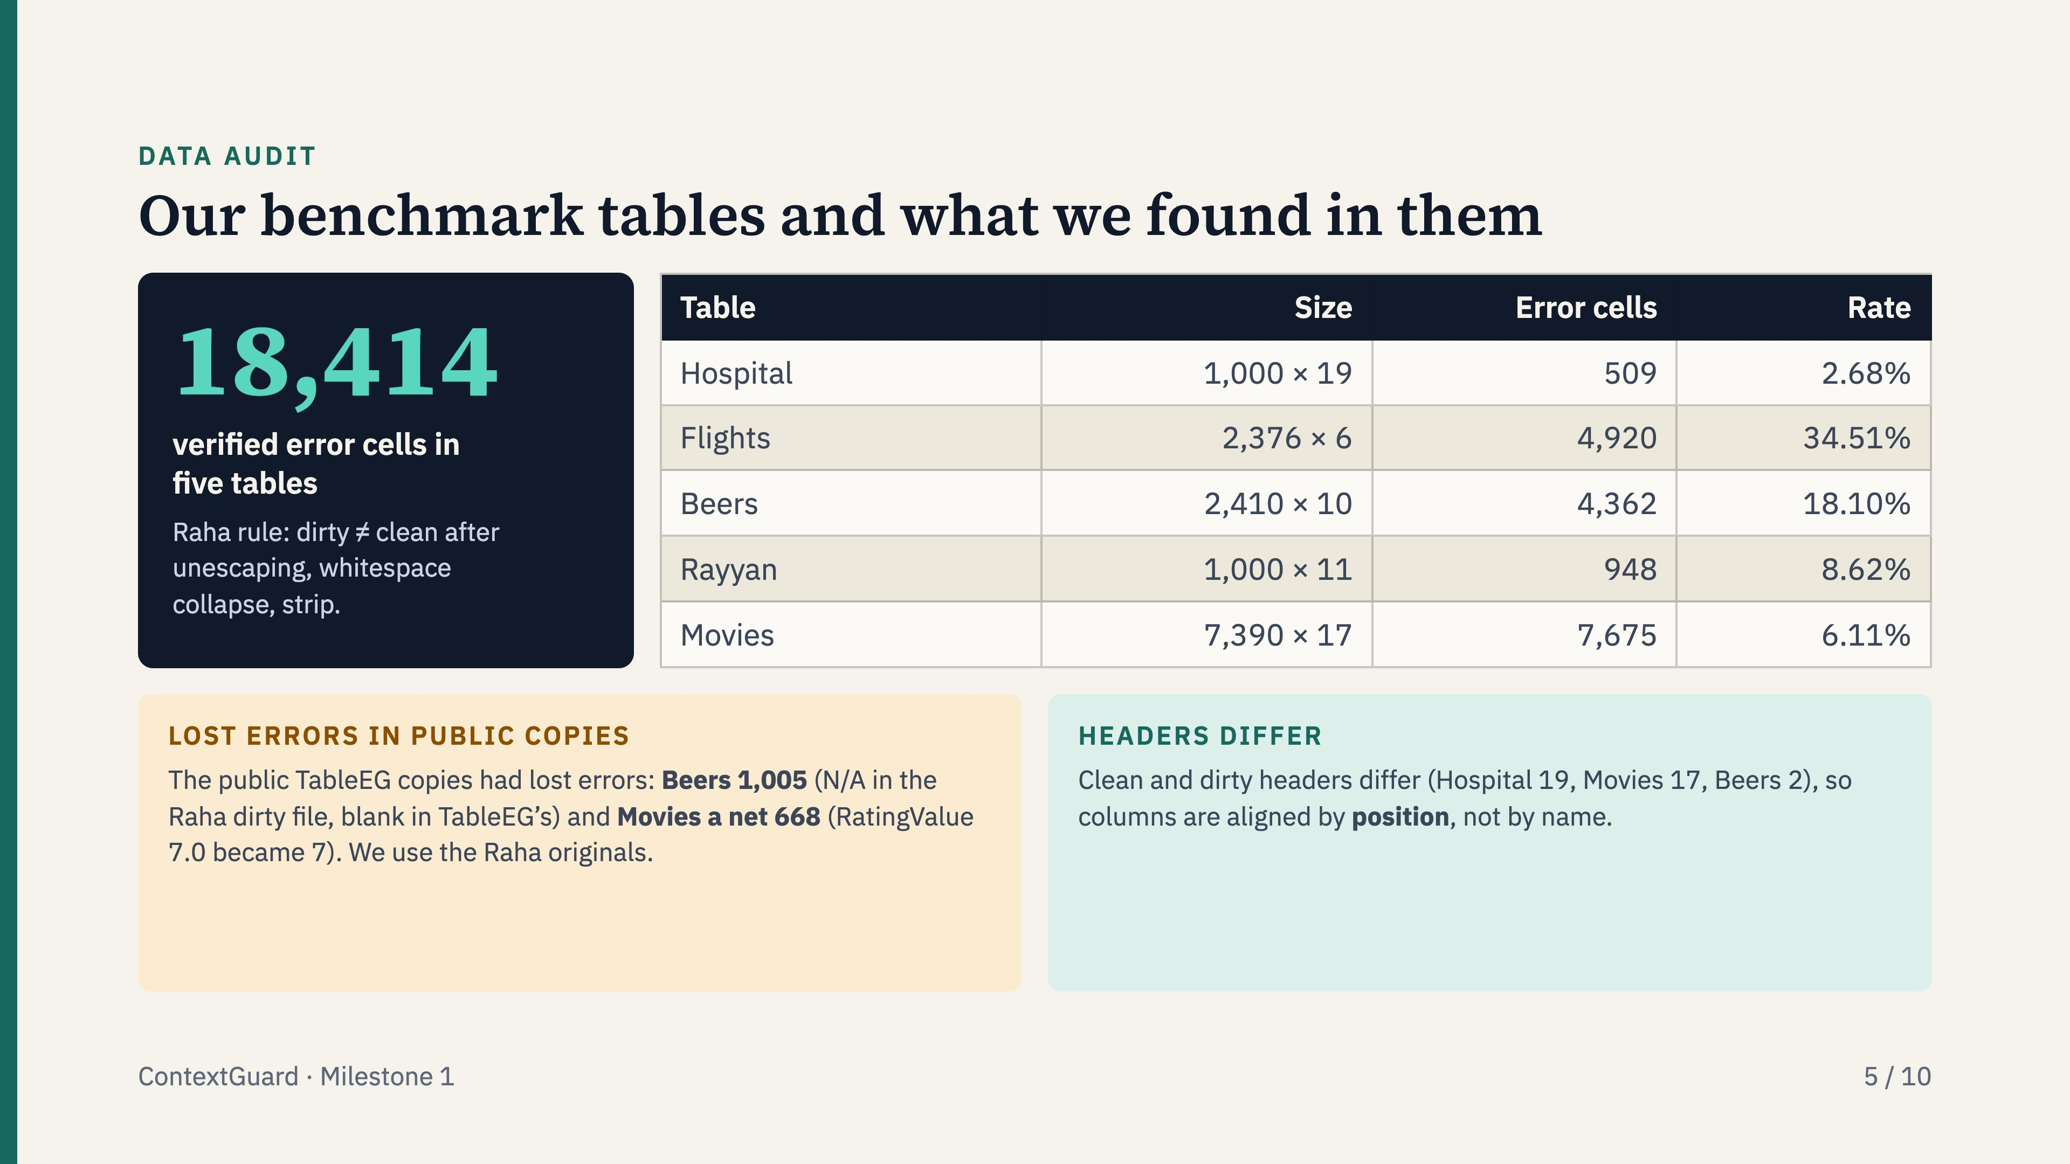
Notes:
I audited the five core benchmark tables with scripts/data_inventory.py, using Raha’s own comparison rule. Two of the TableEG copies had silently lost errors: 1,005 in Beers because N/A was turned into a blank, and a net 668 in Movies because RatingValue 7.0 was saved as 7. We therefore use the Raha originals as ground truth, which also means our baseline numbers can be compared with the published ones. Because headers differ between the clean and dirty files, every loader aligns columns by position.

Slide 6
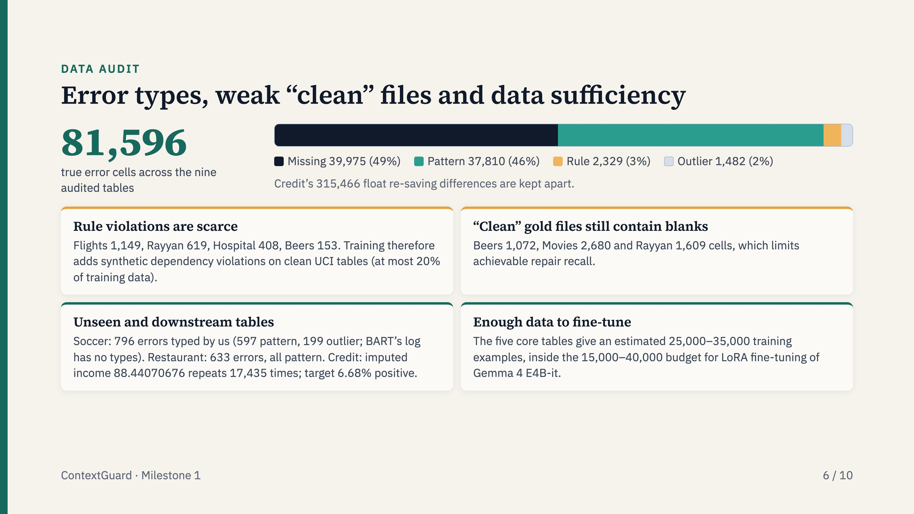
Notes:
Across the audited tables the errors split into about 49% missing values, 46% pattern violations, 3% rule violations and 2% outliers. Rule violations are rare, so we add synthetic ones. The “clean” files are not perfectly clean: Beers has 1,072 blank cells, which caps repair recall. For the unseen tables I typed Soccer’s errors myself, because BART’s log has no types, and computed Restaurant’s 633 errors from the files. The training pool is large enough for fine-tuning.

Slide 7
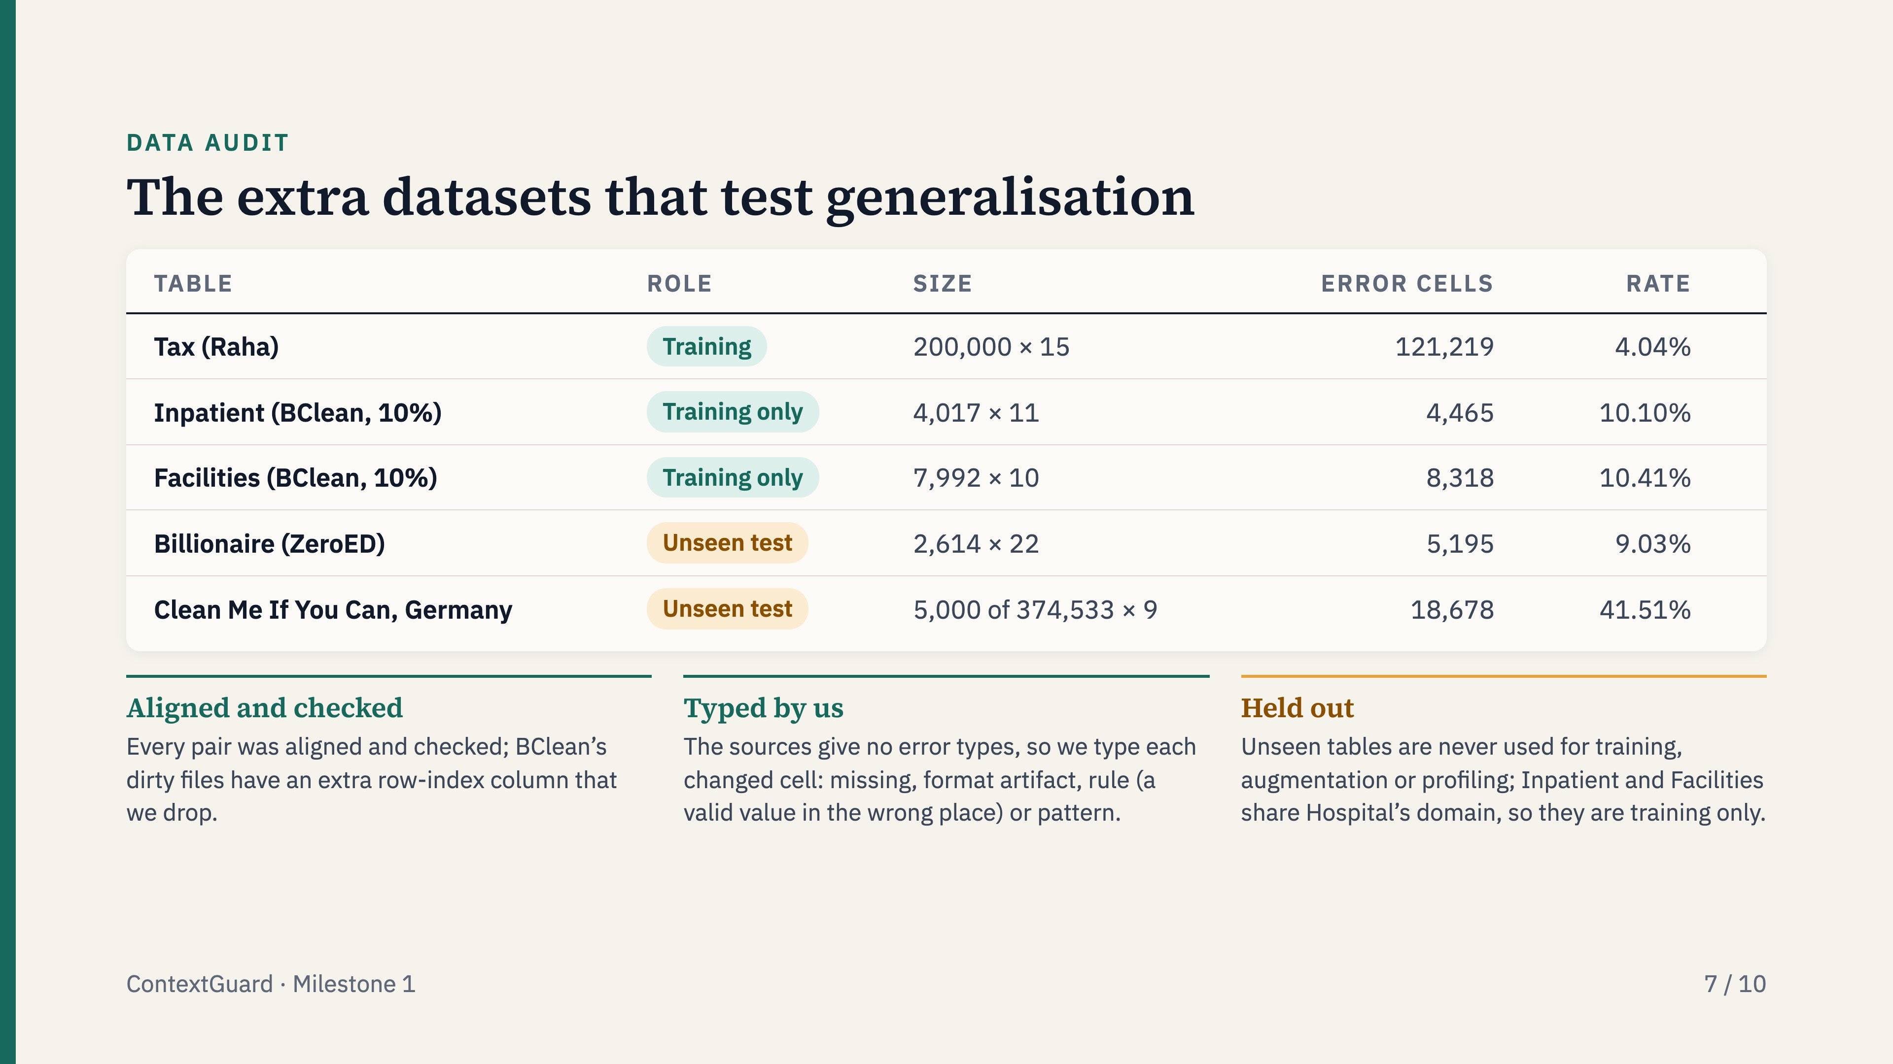
Notes:
These five tables are the extra data beyond the benchmark tables. Tax, Inpatient and Facilities are for training; Billionaire and a German address slice are tests on data the model has never seen. I downloaded each from its source, recorded the commit or Zenodo version and checksums, checked that clean and dirty line up, and counted errors with Raha’s rule. Because these sources have no labels for error types, I typed every changed cell with a simple rule.

Slide 8
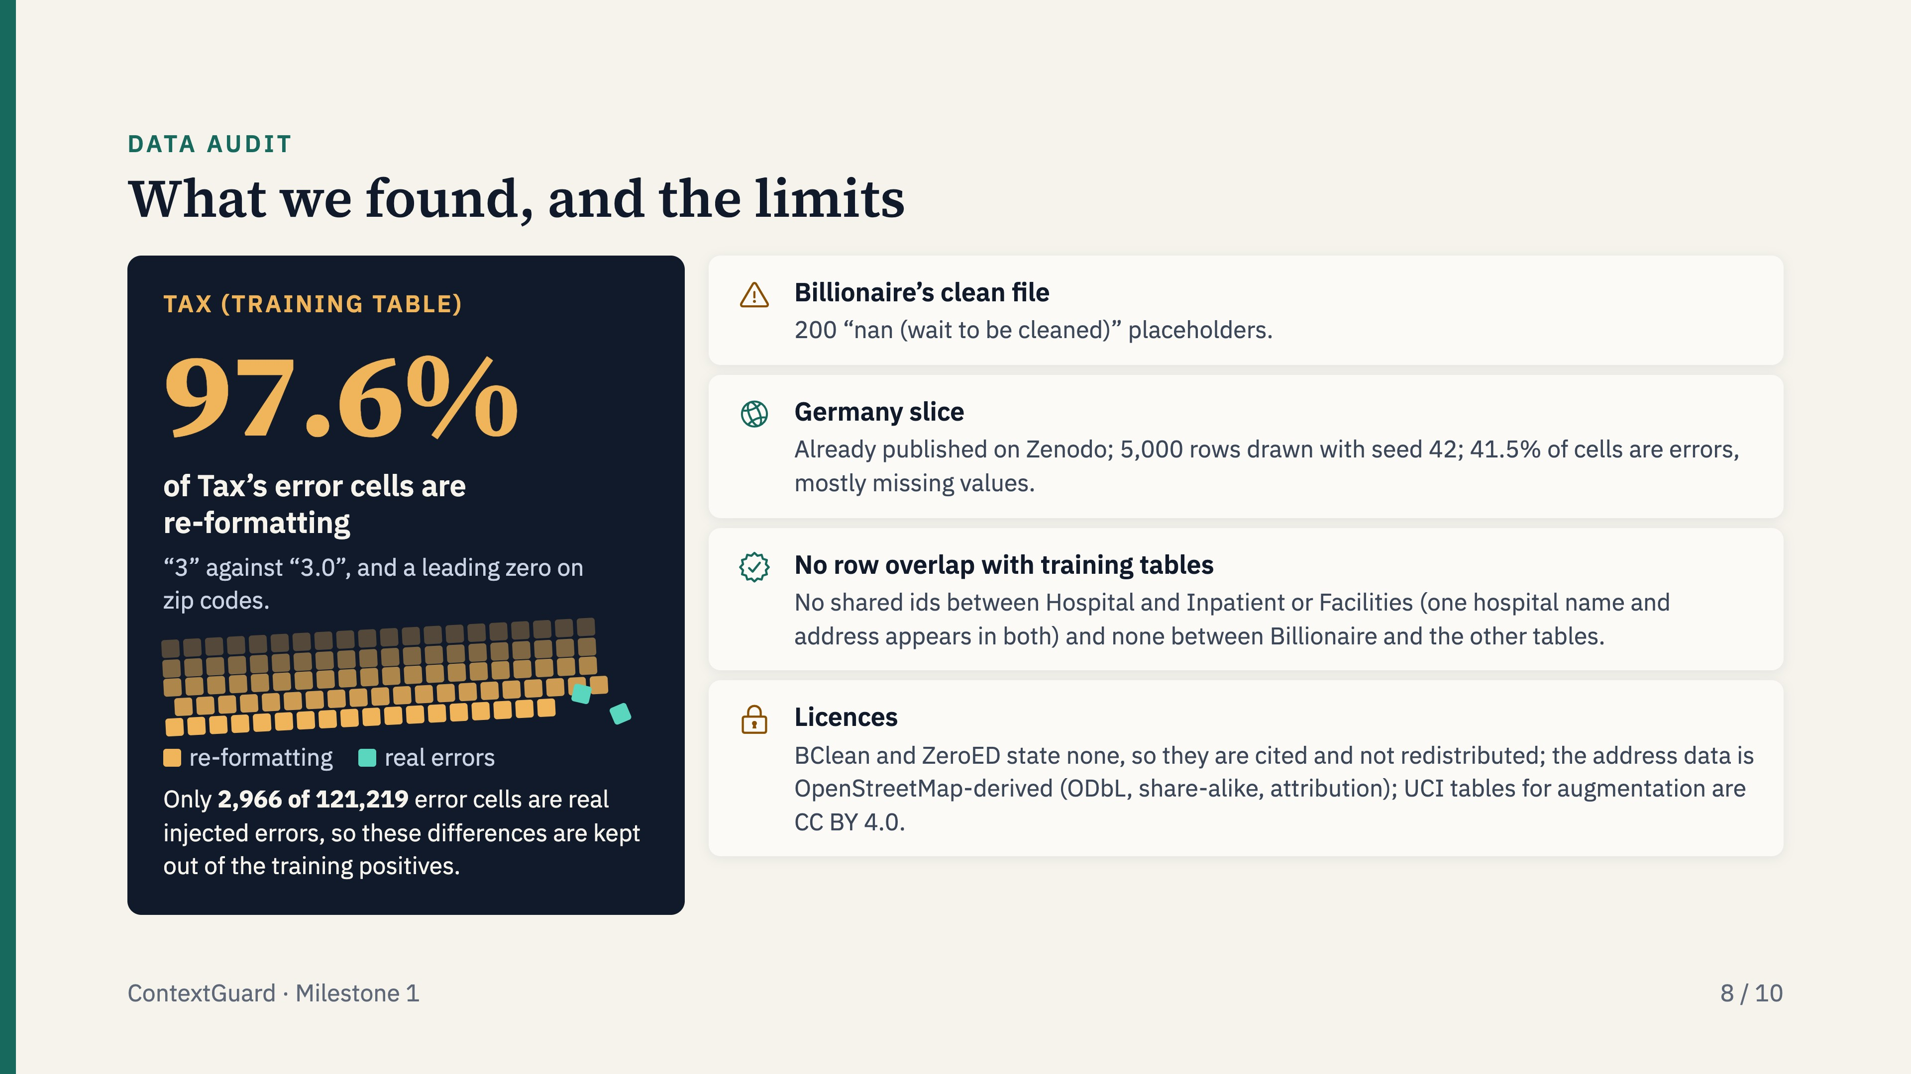
Notes:
The main finding is that almost all of Tax’s errors are number formatting, which would teach the wrong lesson, so we count them separately. The German slice is the hardest test: four in ten cells differ. We found no leakage into the test tables. Two sources have no licence, so we only cite them and keep raw data out of the repository.

Slide 9
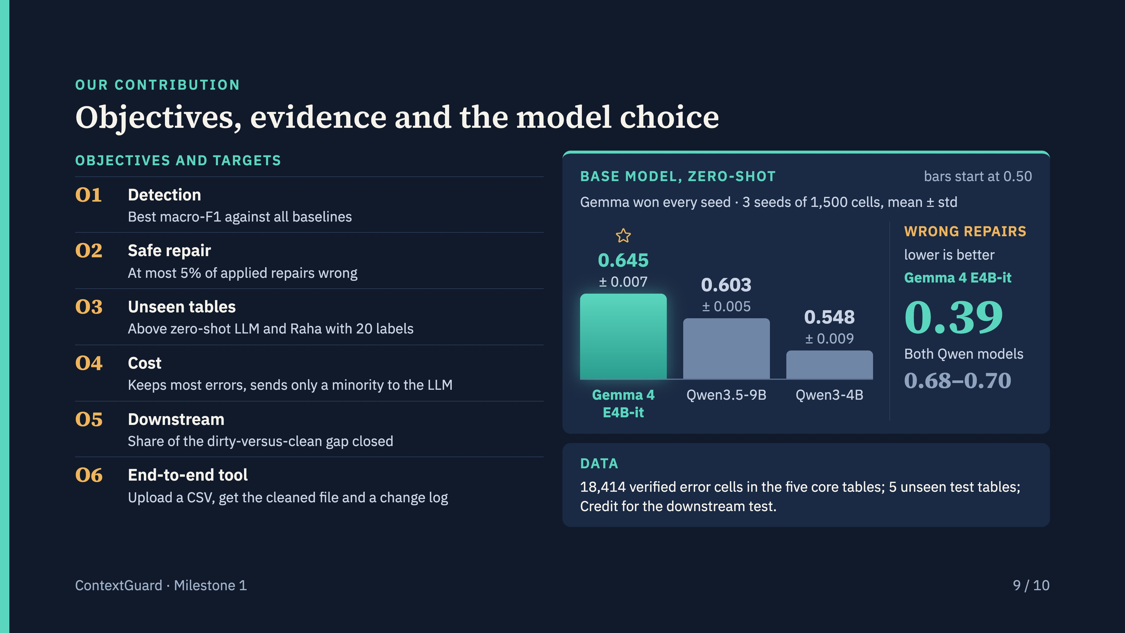
Notes:
These are our six objectives. The first three are about accuracy, safety and unseen tables, and the last is the end-to-end tool: a user uploads a CSV and receives the cleaned data plus a change log. We chose the base model by running three open models zero-shot on the same 1,500-cell samples, with three sampling seeds. Gemma 4 E4B-it won every seed and makes far fewer wrong repairs, so it is the model we fine-tune. This is a zero-shot comparison only; fine-tuning may change the order.

Slide 10
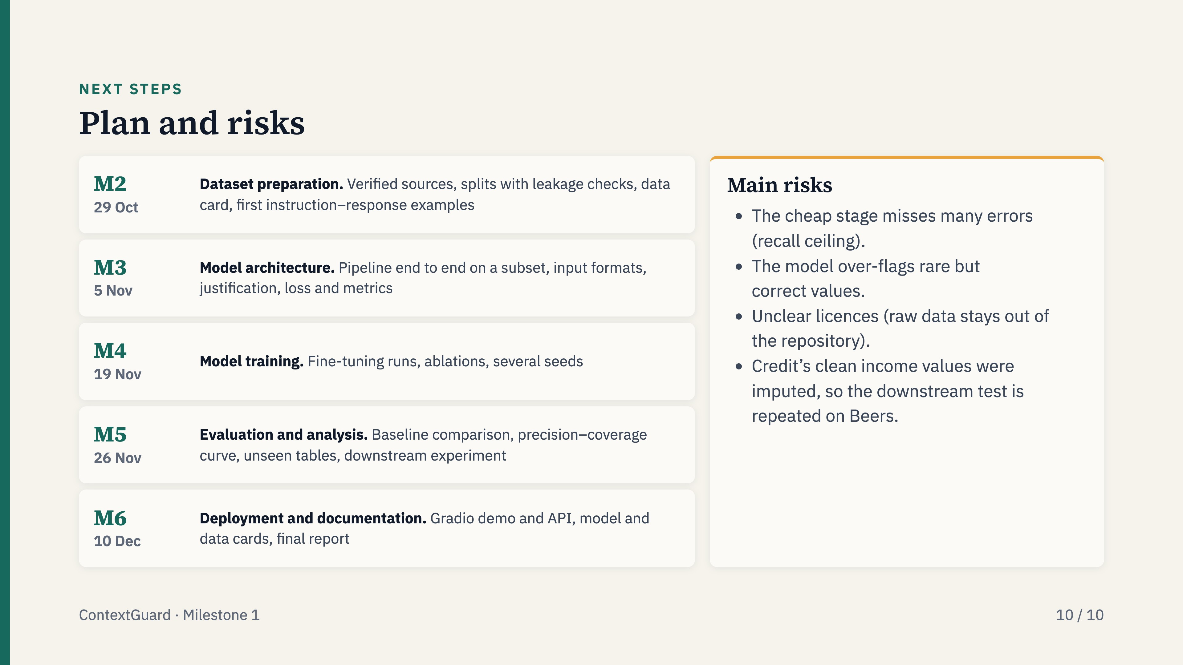
Notes:
The timeline follows the course milestones. The two risks that matter most are recall of the cheap stage, which caps the whole system, and over-flagging, which hurts precision. We address both in training and report the recall ceiling honestly.

