Slide 1

Market Conditions Through the Lens of Zomato
ZOMATO
AUGUST 2026

Slide 2
Table of Contents
Problem statement
KPI
Conclusion
Summary
Recommendation

Slide 3
Business Problem
How do restaurant pricing tiers, service types, and quality benchmarks influence customer ratings and satisfaction, and what key economic thresholds must new market entrants navigate to succeed?

Slide 4
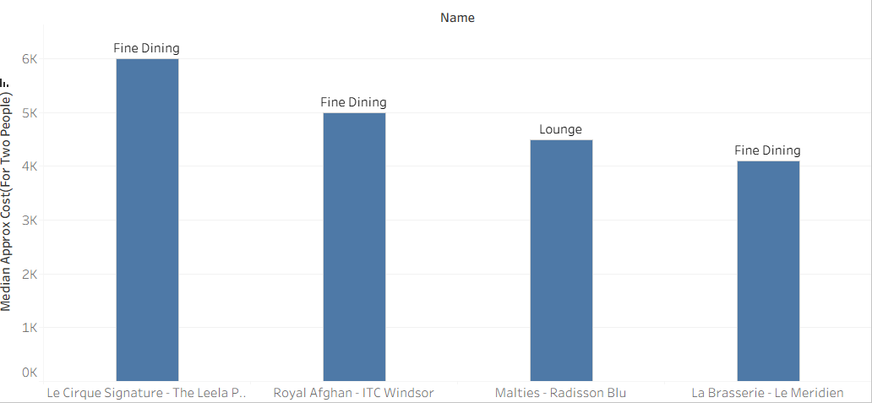
KPI

Slide 5
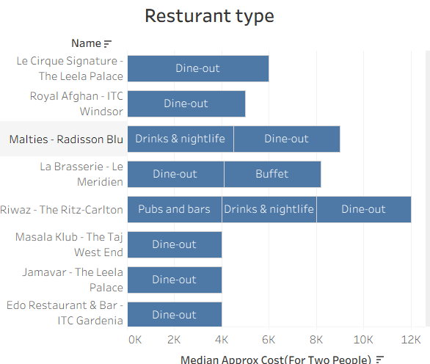
KPI

Slide 6
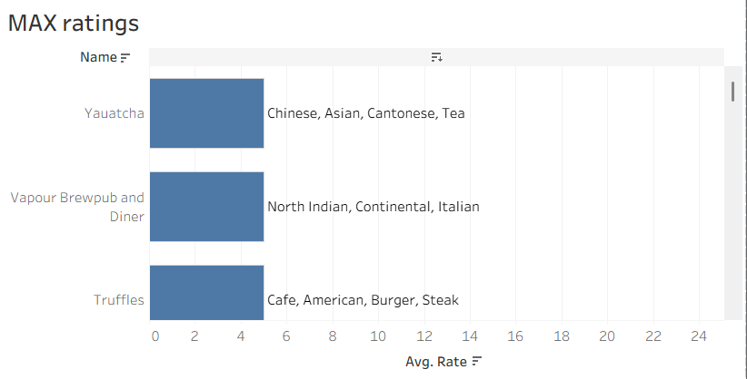
KPI

Slide 7
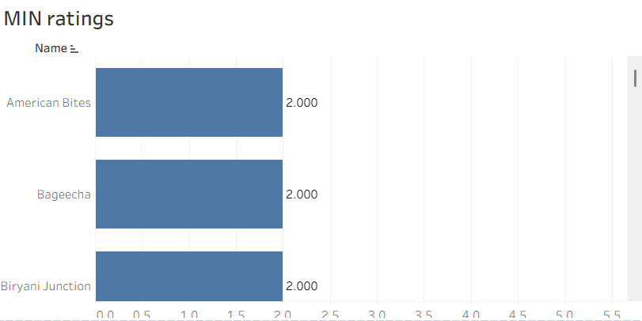
KPI

Slide 8
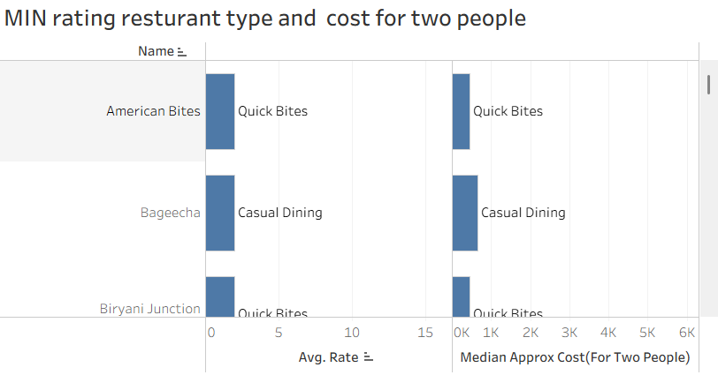
KPI

Slide 9
CONCLUSION
Success in the F&B market depends more on consistent quality and the right service model than on pricing strategy alone.

Slide 10
SUMMARY
Restaurants across every price tier, from budget spots (~₹40 for two) to fine dining (~₹6,000 for two), can achieve high ratings.
Premium pricing and upscale ambiance provide only a marginal advantage; consistent food quality and the right service format (Fine Dining, Quick Bites, Cafe, etc.) are what actually convert customers into satisfied, repeat diners.

Slide 11
RECOMMENDATION
New market entrants and existing restaurants should focus investment on food quality and operational consistency, adopt competitive mid-tier pricing, and align their service format to customer expectations.
Deeper, localized consumer surveys are recommended to further refine pricing and format decisions by region and cuisine.

Slide 12
Thank you

