Slide 1
TEAM 2
TEAM MEMBERS: SIDHANT HANWATE
DEVANSH VERMA
LITHESH REDDY
NISHANT P
SARANYA K N V

Slide 2
Letter of Credit:
Goal: To create a Letter of Credit pdf generation.
Addressing the goals: The Letter of Credit pdf’s template has been created and the user is supposed to fill in the details in the forms given.
Release 1: The UI and the backend connection for pdf generation is completed.
Release 2: Connection and storing of values in database is to be implemented.

Slide 3
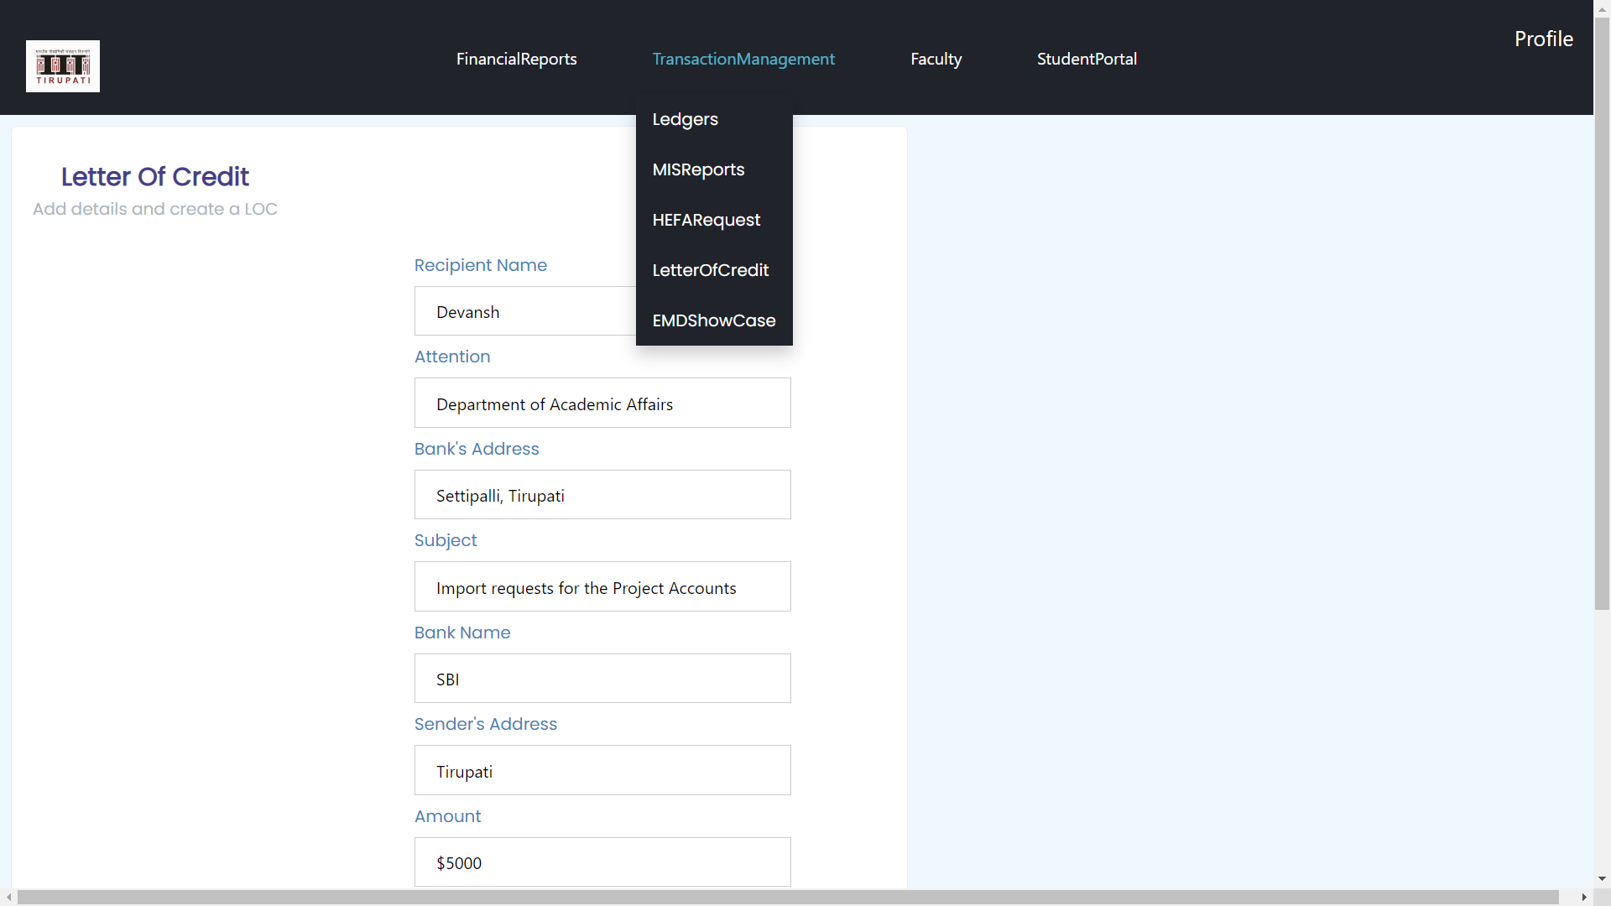
LETTER OF CREDIT:

Slide 4
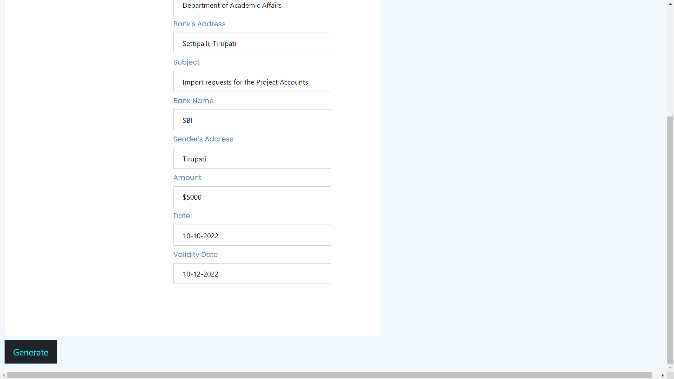

Slide 5
Annual Budget Generation:
Goal: To create annual budget generator.
Addressing the goals: The budget template has been created and the user is supposed to fill in the details in the forms given. The user is given the functionality to download report as a .csv file. The user can also view the report in the form of some graphs.
Release 1: The UI and the backend connection for pdf generation is completed.
Release 2: Connection and storing of values in database is to be implemented.

Slide 6
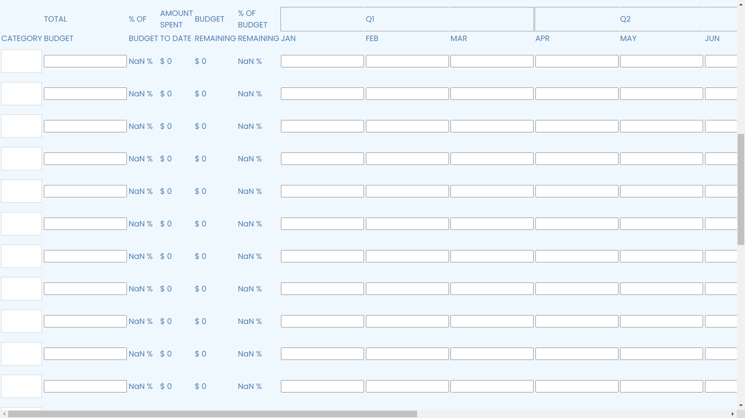

Slide 7
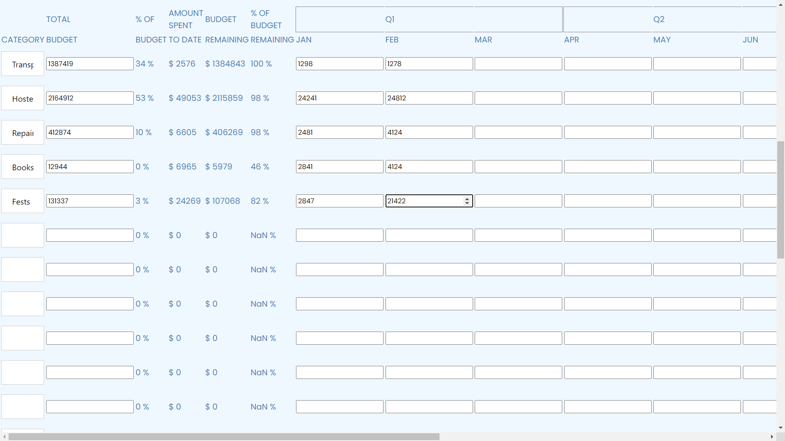

Slide 8
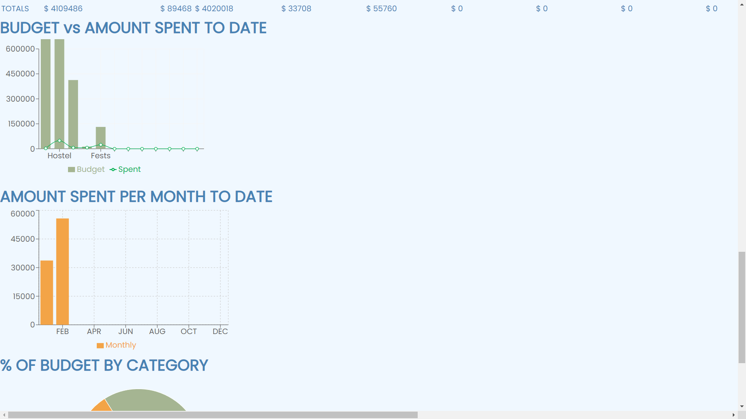

Slide 9
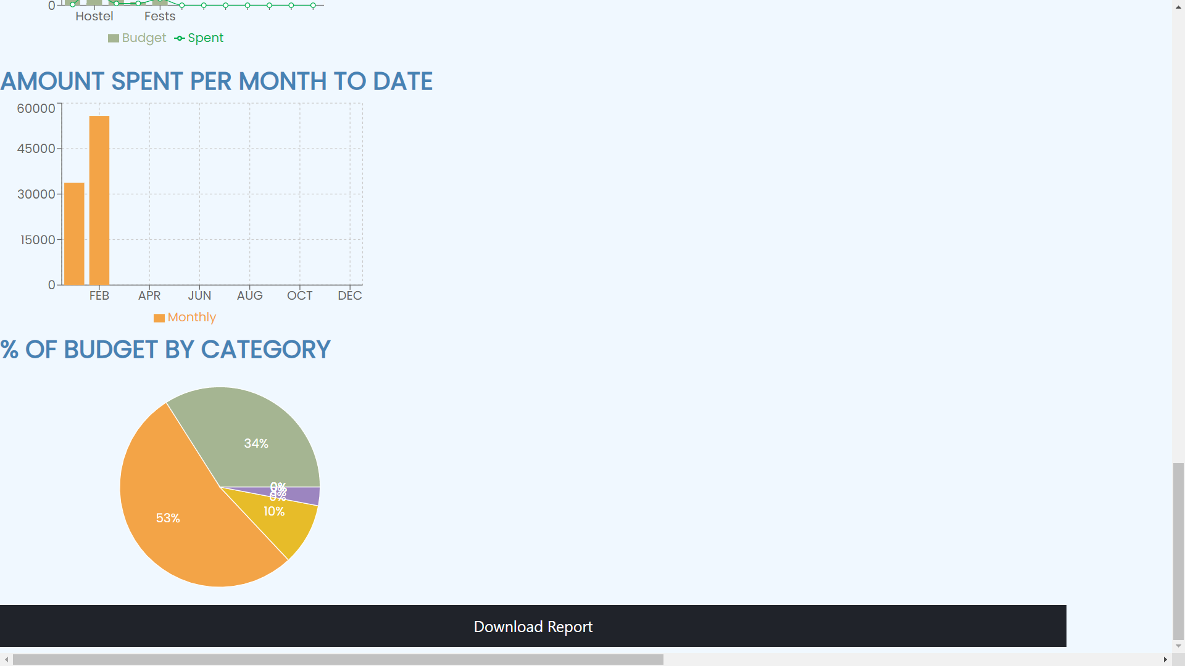

Slide 10
Balance sheet:
Goals: Create and store Balance sheets of the institute.
Addressing the goals: The Balance sheet can be edited and the user can insert values to the respected fields . They can also download the pds of the balance to his local system using the generate button at the bottom.
Release 1: The UI and the backend connection for pdf generation is completed.
Release 2: Connection and storing of values in database is to be implemented.

Slide 11
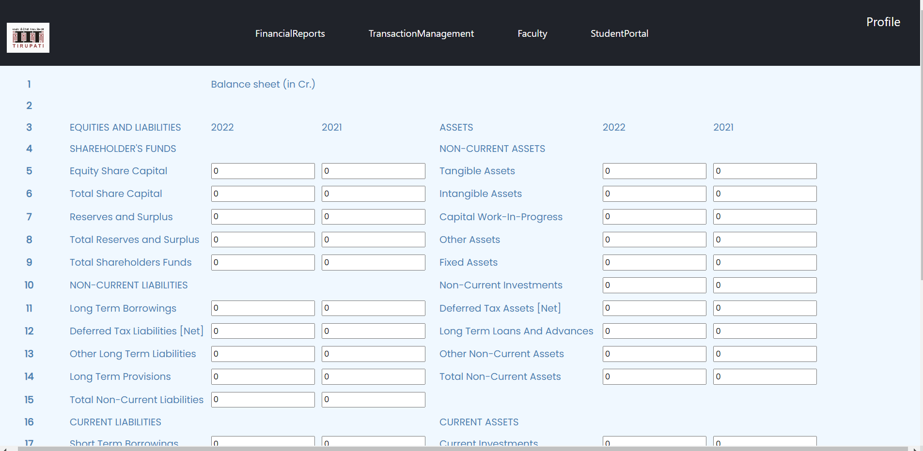
Balance Sheet

Slide 12
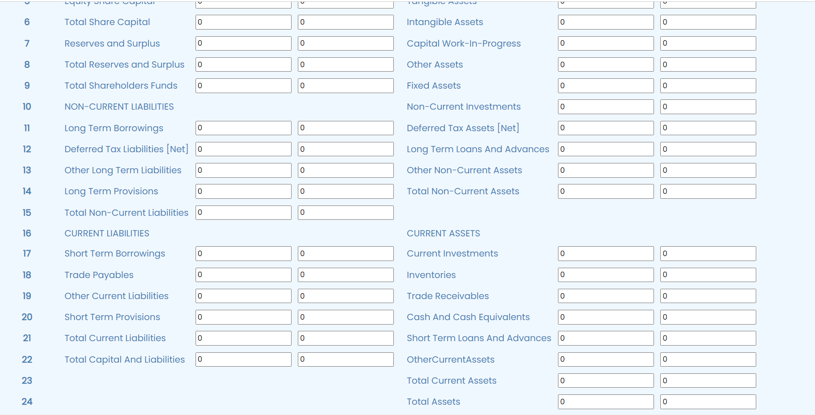

Slide 13
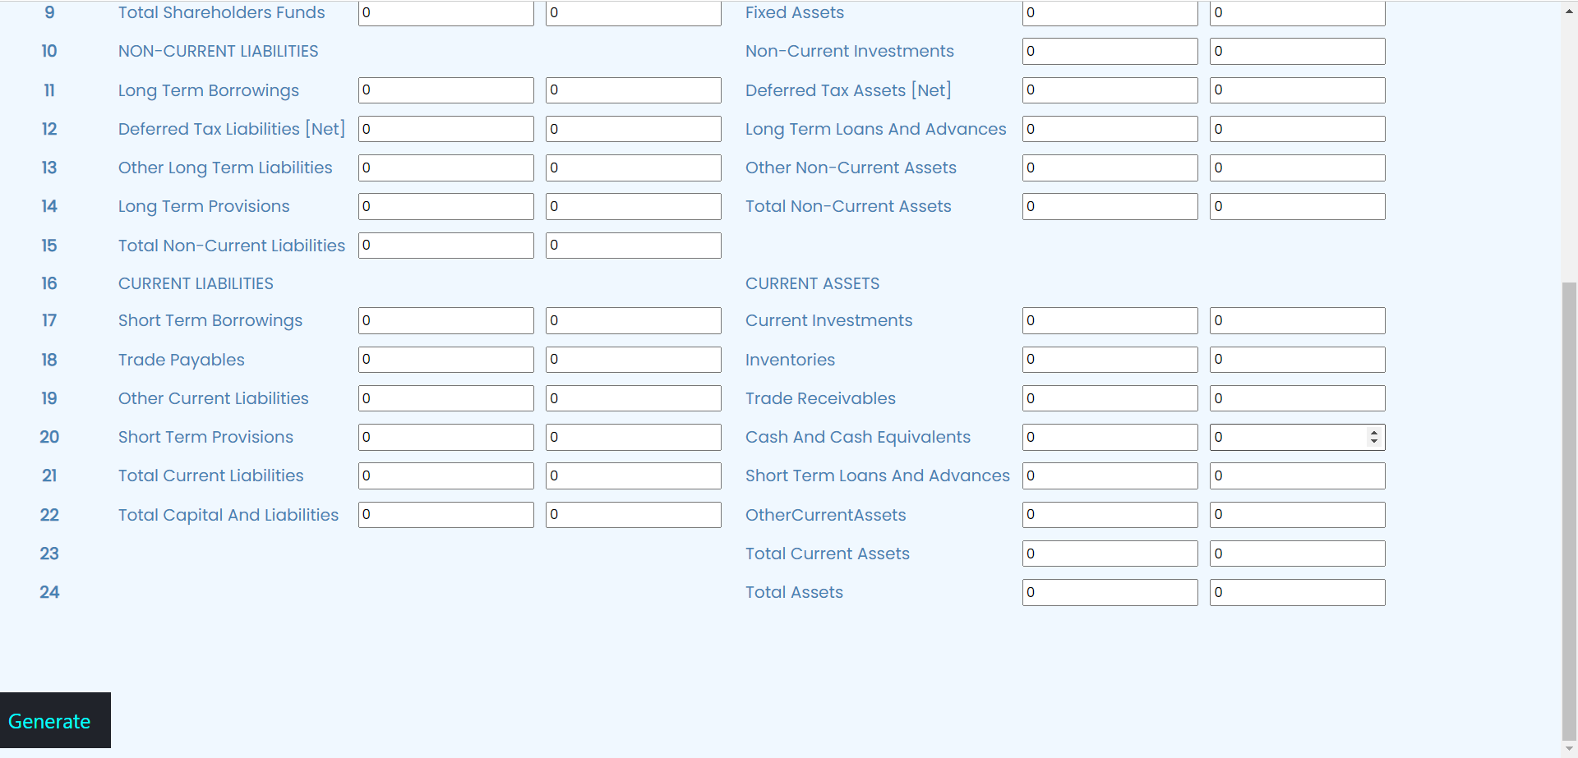

Slide 14
Student Fee Management:
By using Hostel check in and Hostel check out we will store the details of the number of days of stay of the students.Based on that we will calculate the fee.And create the challan for that in following Hostel Fee Challan.
Progress for Release 1:Completed the UI required.
Remained task for Release 2: Connection to database and challan generation.

Slide 15
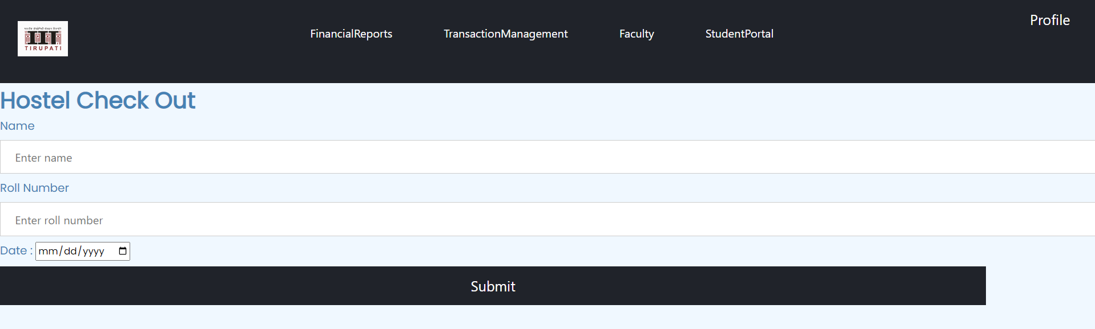

Slide 16
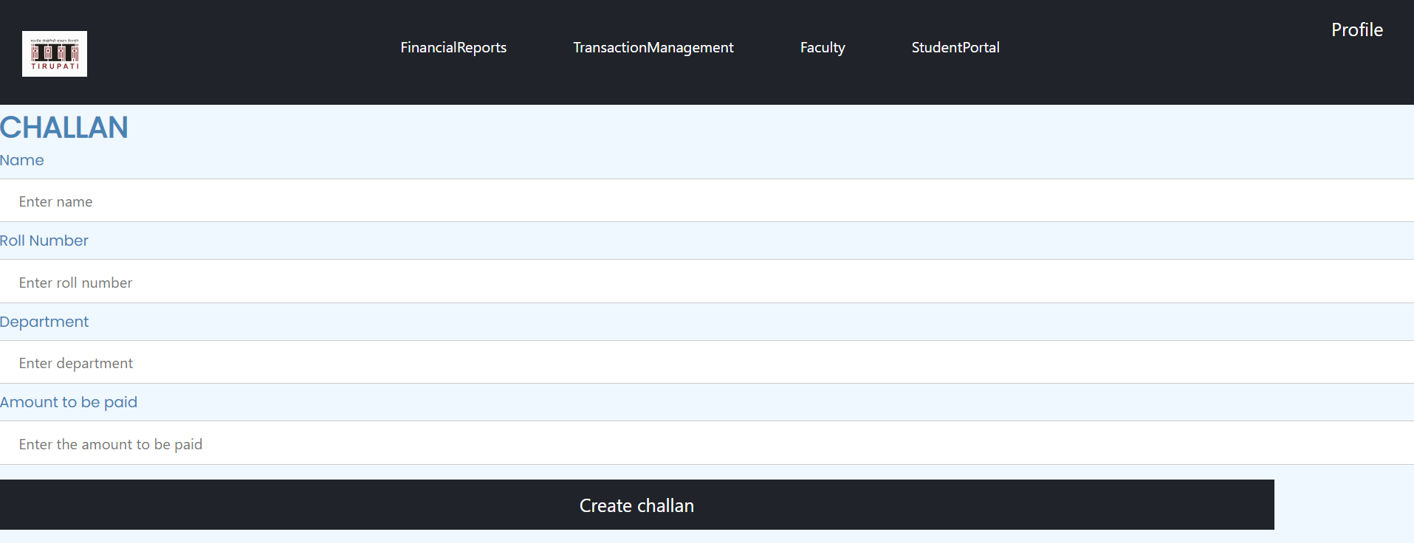

Slide 17
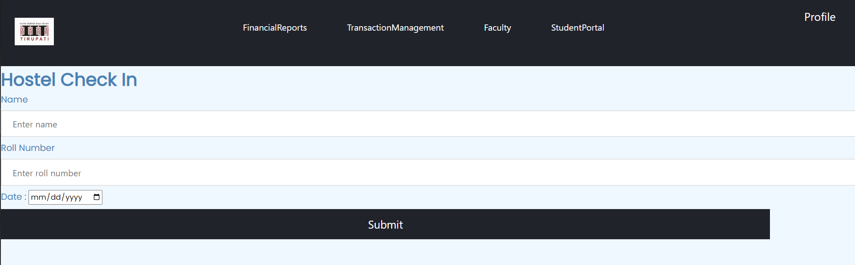

Slide 18
HEFA Request :
Goals : Admin privileged persons can apply for HEFA Request and know the status of loan provided .
Progress in Release 1 :
Complete UI part with validation for user inputs completed.
Need to be in Release 2 :
User data need to be stored with the status of loan. And also notification to user after the expiration time of last given HEFA Request.

Slide 19
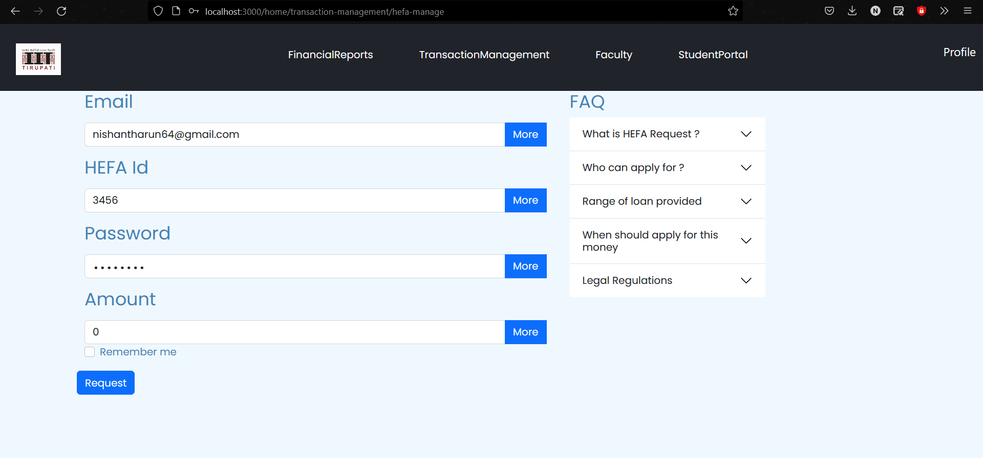

Slide 20
Ledgers :
Goals : To show status of loan amount provided and also to store table that maintain information about the transaction with it.
Progress in Release 1 :
Maximum percentage of UI part (some part’s need to be styled) completed .
Need to be done in Release 2 :
Table data about the transaction and also with the status of loan amount need to be stored.
Some components to be styled.

Slide 21
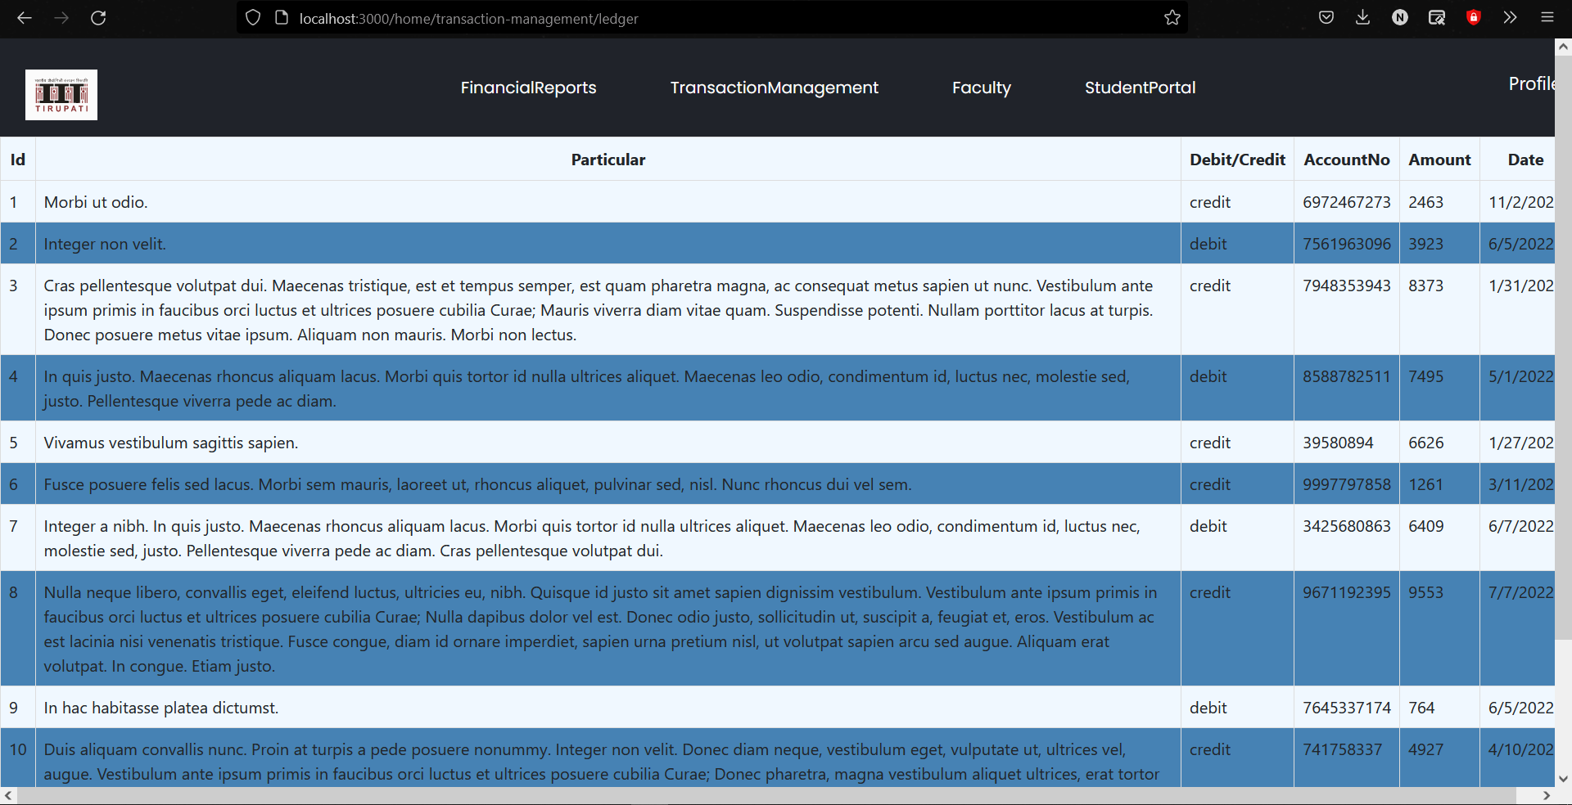

Slide 22
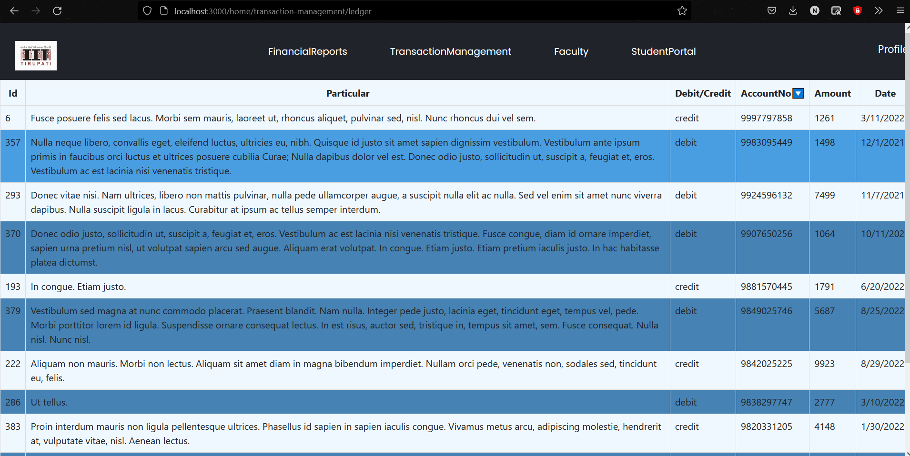

Slide 23
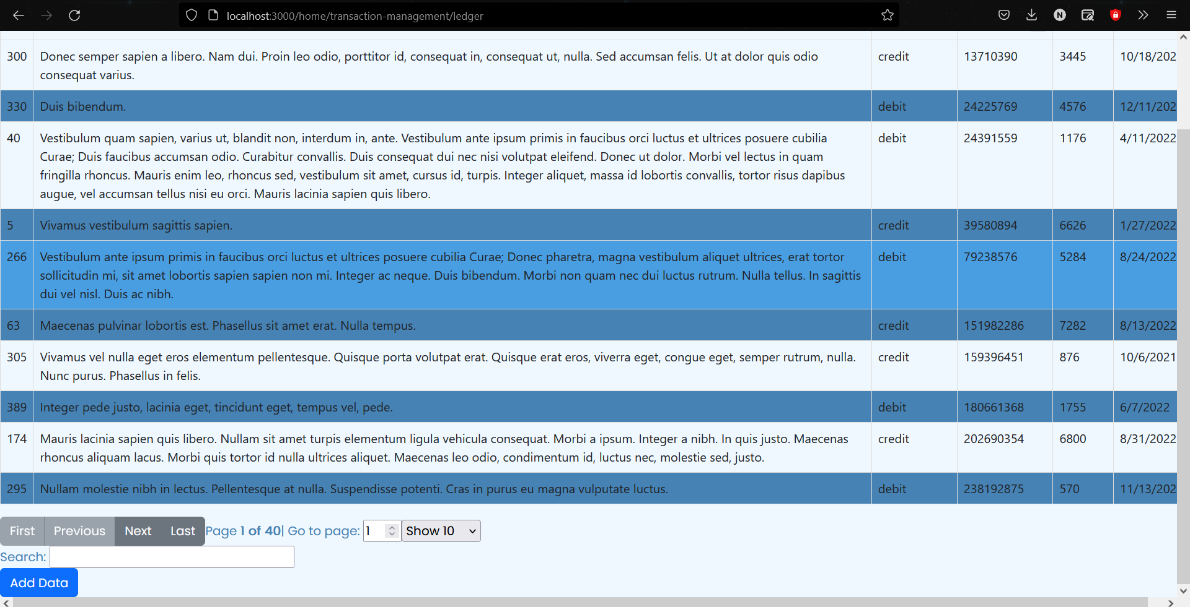

Slide 24
Student Fee Management:
By using Hostel check in and Hostel check out we will store the details of the number of days of stay of the students.Based on that we will calculate the fee.And create the challan for that in following Hostel Fee Challan.
Progress for Release 1:Completed the UI required.
Remained task for Release 2: Connection to database and challan generation.

Slide 25
Payroll Management System
Goals:
Manage payroll system for all members of our institute.
Addressing the goals:
Payment profiles for members can be added, and can be modified/deleted too.
The home page gives basic overview like new members joined, expenditure and other details using info widgets and react-charts. One can also view the user's profile page, salary components, data on leaves etc. by clicking edit.
Release 1: The UI and the basic structure has been created.
Release 2: Some minor bug fixes required. Storing/Retrieving data from database has to be implemented.

Slide 26
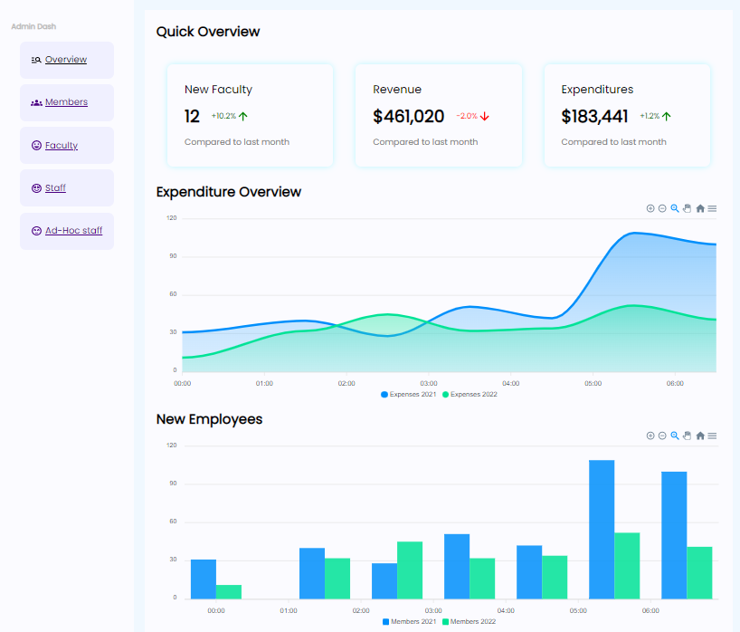
Overview Page

Slide 27
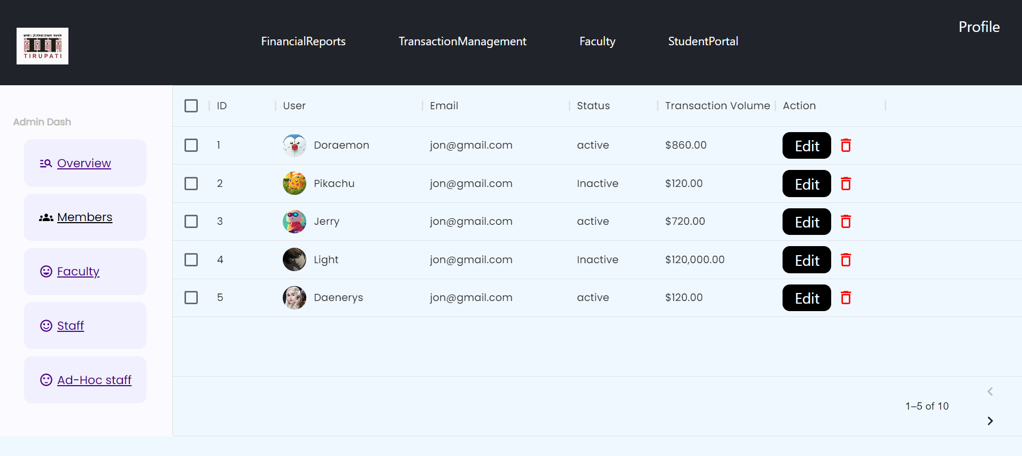
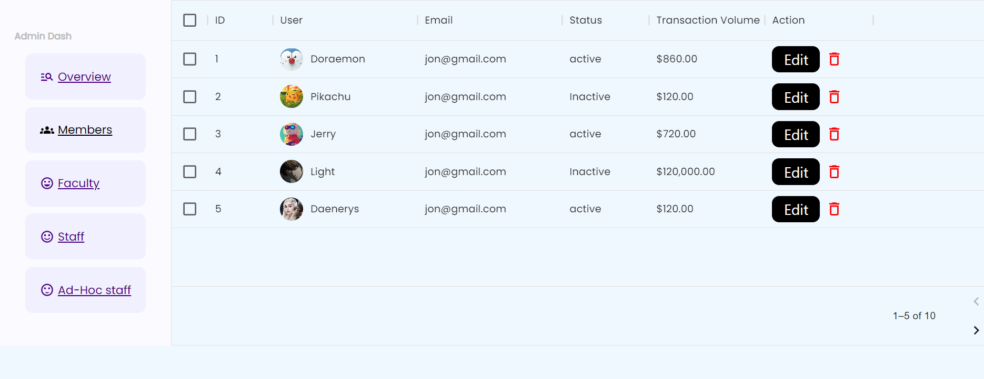
Members List

Slide 28
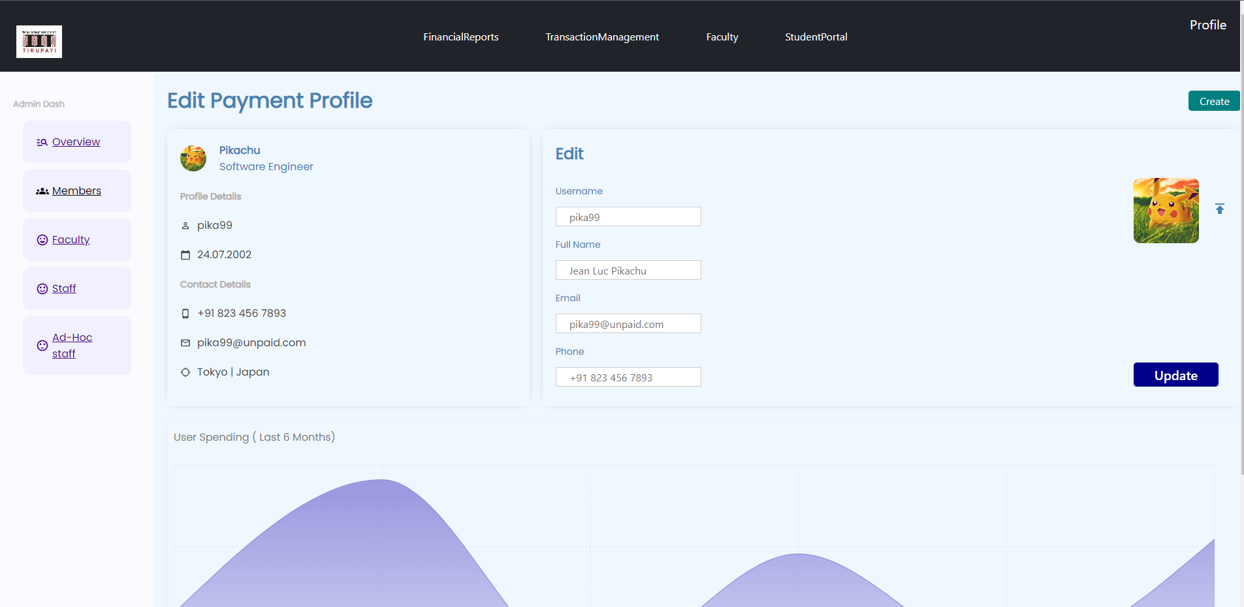
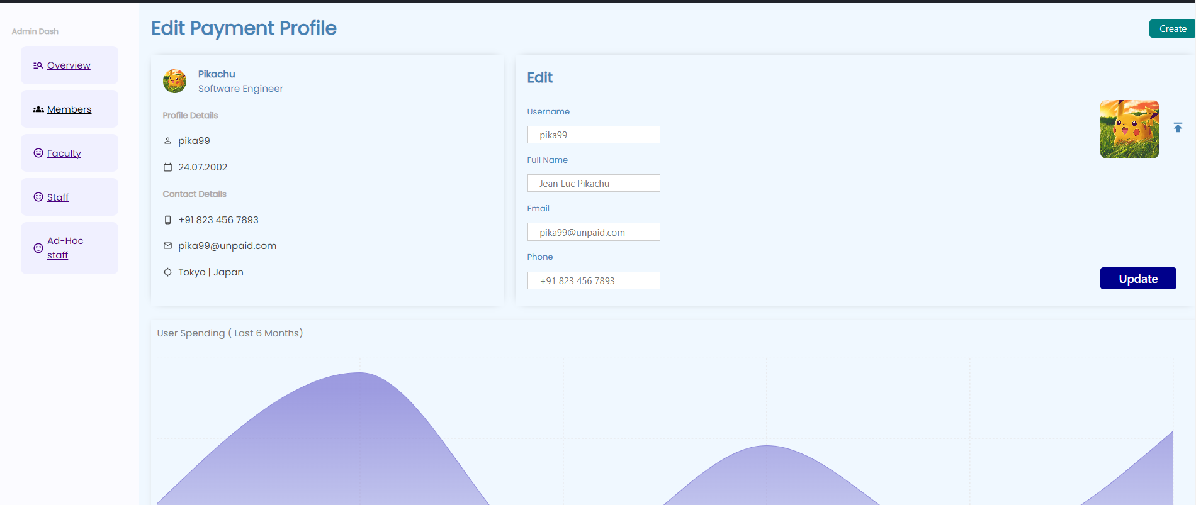
User Payment Profile Page

