Slide 1

Student Management System: Overview
Develop a basic student information database mini-project.
Features include adding, viewing, updating, and deleting records.
Technologies: Python or Java with SQLite or MySQL.
Targeted for small schools and tutoring centers.

Slide 2
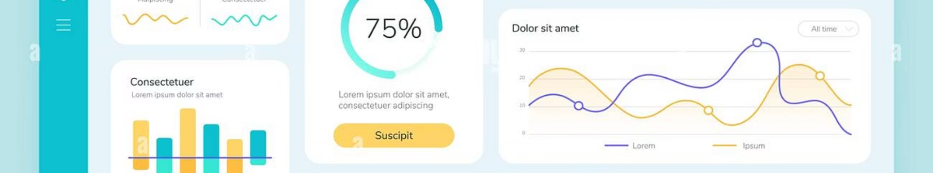
Project Goals & Objectives
CRUD Operations
User Interface
Create, read, update, and delete student data efficiently.
Develop a user-friendly GUI or command-line interface.
Data Storage
Test Coverage
Use relational databases like SQLite or MySQL for saving data.
Ensure 90% testing for reliable core functionality.

Slide 3
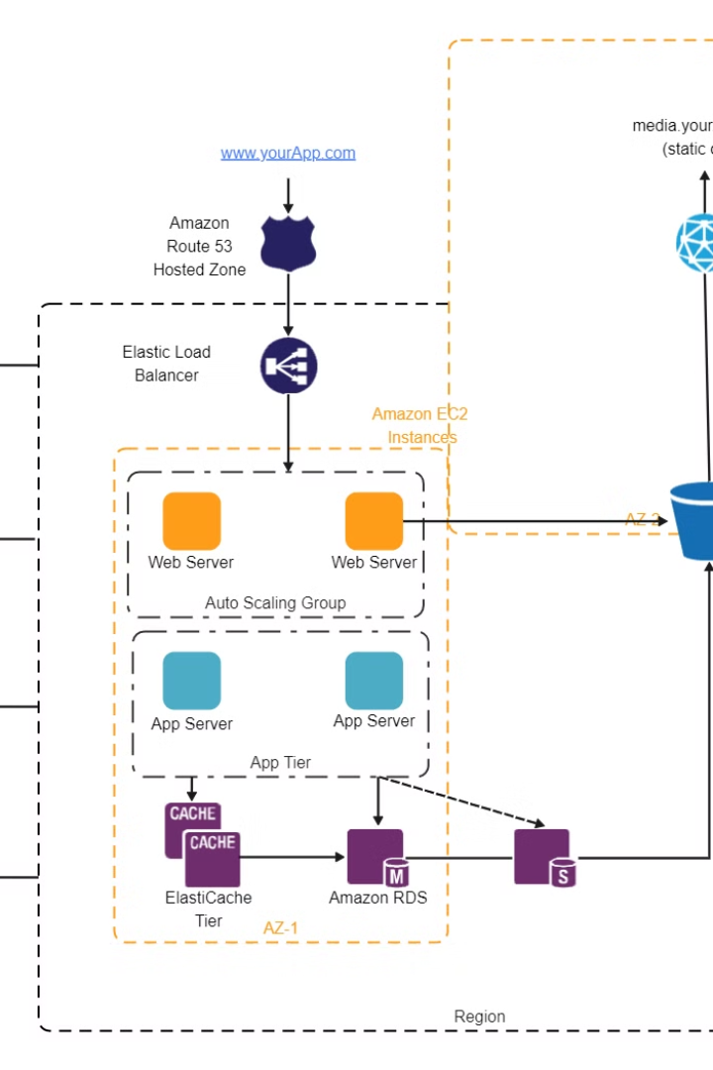
System Architecture
1
Presentation Layer
User interface with Tkinter, Java Swing, or CLI.
2
Application Layer
Business logic implemented in Python or Java.
3
Data Layer
SQLite or MySQL database with optional ORM.
4
Data Flow
Input → Logic → Database → Logic → Output

Slide 4
Core Features
Add Student
View Students
Update Student
Input name, ID, contact info, and courses.
Display student information in tables.
Edit existing student records.
Delete Student
Search Function
Remove student data securely.
Find students by name, ID, or course.

Slide 5
Database Design
Student Table
Course Table
Enrollment Table
student_id (INT, PK)
course_id (INT, PK)
student_id (INT, FK)
name, dob, address
course_name
course_id (INT, FK)
phone, email
credits
enrollment_date
Sample data: 10 students, 5 courses, and enrollments.

Slide 6
User Interface (UI)
Option 1: CLI
Option 2: GUI
Menu-driven text interface for all operations.
Uses Tkinter or Java Swing for buttons and tables.
Consider PyQt for more advanced UI features.

Slide 7

Challenges & Solutions
Data Validation
Error Handling
Security
Prevent SQL injection with parameterized queries.
Validate email and phone formats to avoid errors.
Use try-except blocks to manage exceptions gracefully.
Scalability
Design to support up to 500 student records efficiently.

Slide 8

Conclusion & Future Enhancements
Project Success
Demonstrated core database and UI programming skills.
Future Enhancements
Add user authentication, reporting, and system integration.
Key Takeaways
Structured design and error handling improve user experience.
Next Steps
Deploy application to cloud platforms like Heroku or AWS.

