Slide 1
Deep Learners
Chenglong Wei (z5375926)
Ziyi Ding (z5610550)
Sidhanth Kafley (z5504979)
Yewei Huang (z5459400)
Gorjan Muratov (z5677486)
Sentiment Analysis towards COVID-19 on Twitter

Slide 2
Motivation
News and awareness about COVID-19 spread like the pandemic itself
Negative opinion played an important role in conditioning public
Importance for Individuals
Policymaking
Crisis management
Public health administration.
Presenter: Chenglong Wei (z5375926)

Slide 3
Problem Statement
Tweets are shorts, informal, highly variable context.
Estimating the sentiment of tweets about the COVID-19 pandemic to track people’s opinions on major events surrounding it.
Aims to evaluate statistical, ML, and DL models on Twitter sentiment.
How can Deep Learning be utilised for sentiment analysis of COVID-19 Tweets?
Presenter: Chenglong Wei (z5375926)

Slide 4
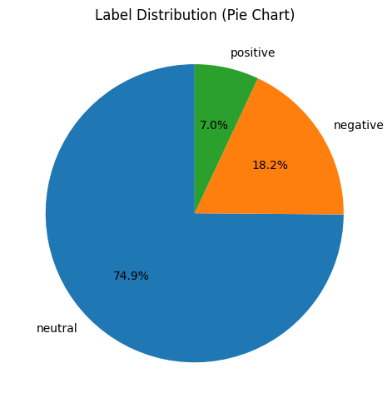
Dataset
Neutral 74.9%
Negative 18.2%
Positive 7%
Slightly Skewed dataset
Presenter: Ziyi Ding (z5610550)

Slide 5
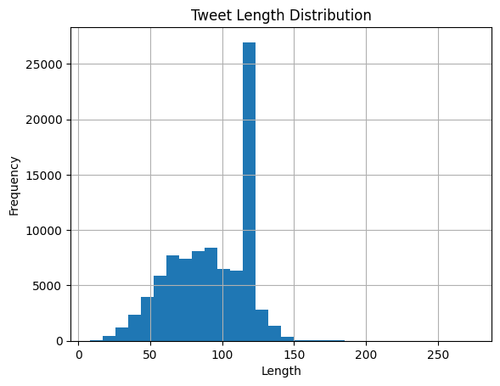
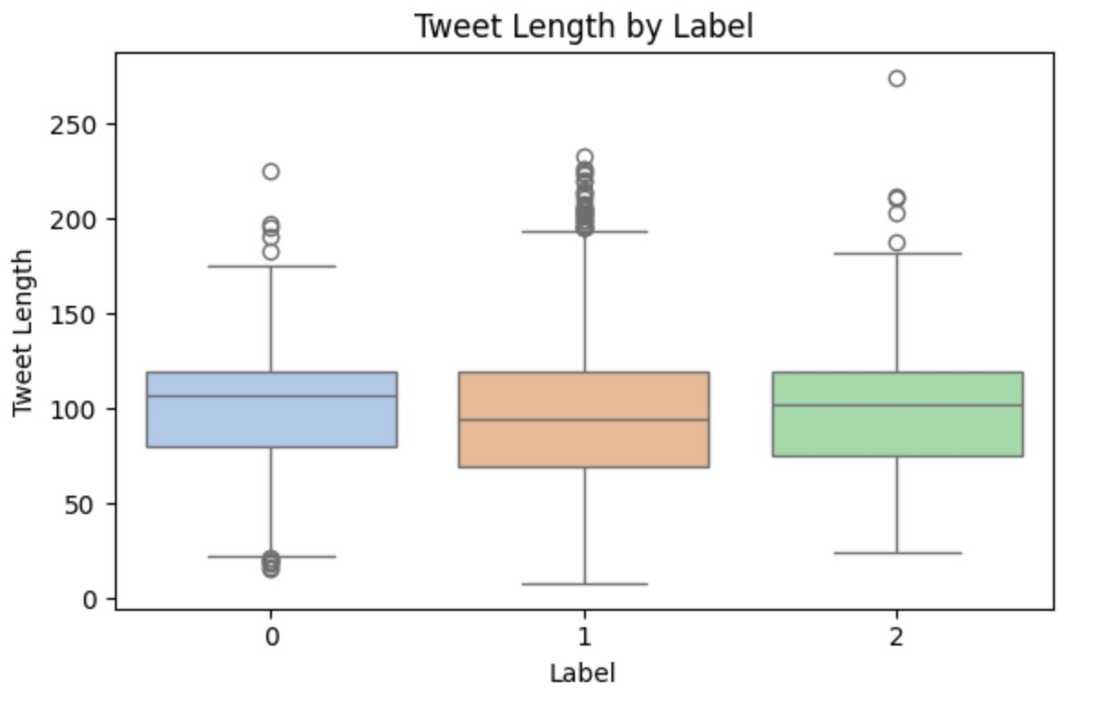
Dataset
0 – Negative
1 – Neutral
2 – Positive
Text Feature Distributions
Presenter: Ziyi Ding (z5610550)

Slide 6
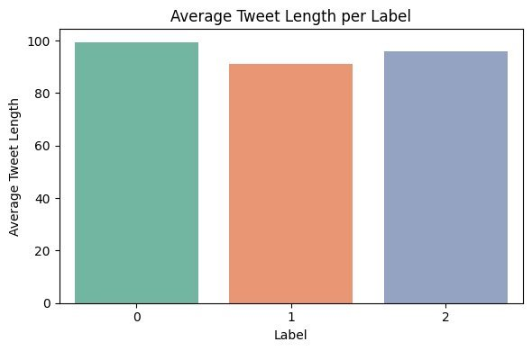
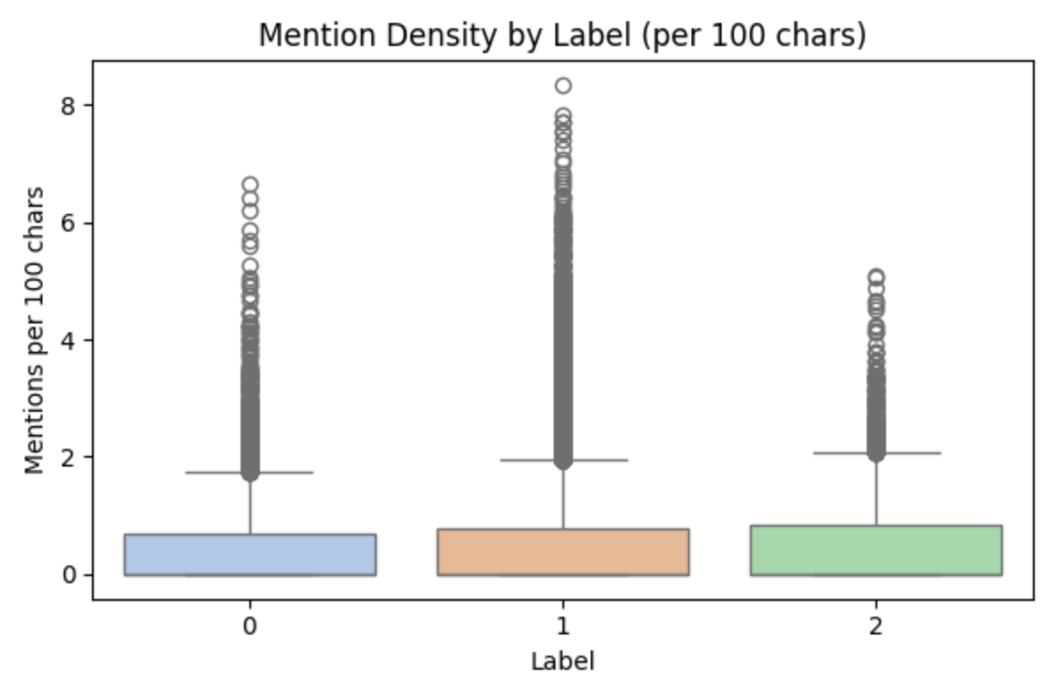
Dataset
0 – Negative
1 – Neutral
2 – Positive
Text Feature Distributions
Presenter: Ziyi Ding (z5610550)

Slide 7
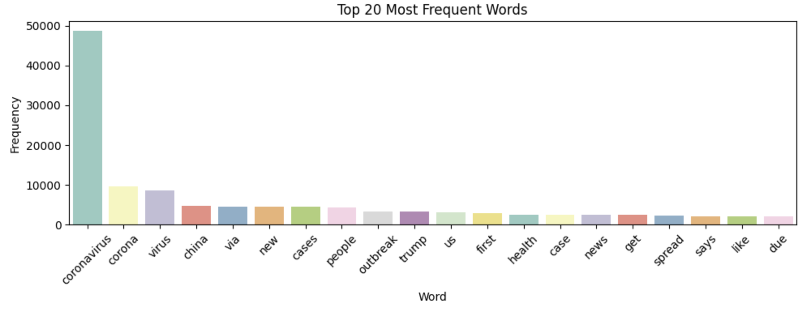
Dataset
Word Frequency Analysis
Presenter: Ziyi Ding (z5610550)

Slide 8
Methods – Approach 1
Standardise pre-processing, evaluation, and data split
Create 2 rule-based models
Create 3 traditional machine learning models (NB, LR)
Create 2 neural network models (LSTM, GRU)
Compare and contrast model effectiveness at sentiment analysis
How do model complexities affect learning?
How do neural networks better learn this task?
Presenter: Sidhanth Kafley (z5504979)

Slide 9
Rules based Model: Text Blob
Assigns sentiment score based on a predefined dictionary
Calculates polarity score based on average word score, range from –1 to +1.
Very basic, simple to implement and performs well for general sentiment analysis.
Presenter: Sidhanth Kafley (z5504979)

Slide 10
Results: Text Blob
 | Precision | Recall | F1 | Accuracy
Negative | 86% | 43% | 58%
Neutral | 31% | 64% | 42%
Positive | 15% | 55% | 24%
Average | 71% | 48% | 52% | 48%
Example:
 | Input | Output
1. | genome sequence of the new coronavirus associated with a pneumonia cluster in wuhan, china: | Neutral
2. | @karidebbink @vineet321 the frieman scary scale makes its debut. wuhan coronavirus scores 3 out of 10 n95 masks. | Negative
Presenter: Sidhanth Kafley (z5504979)

Slide 11
Rule based Model: Vader
Vader uses a lexicon of 7500 words, with each word assigned a valence score (+4 to –4) to reflect sentiment.
Uses heuristic rules like punctuation, capitalization, emojis, etc., to improve sentiment analysis
Easy to use, simple to implement and works well with social media related contents like tweets.
Presenter: Sidhanth Kafley (z5504979)

Slide 12
Results: Vader
 | Precision | Recall | F1 | Accuracy
Negative | 86% | 43% | 58%
Neutral | 31% | 64% | 42%
Positive | 15% | 55% | 24%
Average | 71% | 48% | 52% | 48%
Example:​
 | Input | Output
1. | tldr: not sars, possibly new coronavirus. difficult to confirm because patients identified later in infection when‚ä¶ | Negative
2. | new coronavirus may be cause of outbreak in china from @webmd | Neutral
Presenter: Sidhanth Kafley (z5504979)

Slide 13
Bernoulli Naive Bayes
 | Precision | Recall | F1-score | Accuracy
Negative | 74% | 35% | 47%
Neutral | 80% | 97% | 87%
Positive | 50% | 0% | 1%
Average | 76% | 79% | 74% | 79%
Uses binary features (word presence/absence)
Data imbalance evident in class predictions
Presenter: Yewei Huang (z5459400)
Notes:
Let’s begin with how we prepared our data and evaluated two classic Naive Bayes models.
We used CountVectorizer with binary=True, which means we only care about whether a word is present, not how many times it appears. Importantly, we used the same vectorizer across all models to ensure consistent vocabulary.
Now for the models:
The Bernoulli Naive Bayes model focuses only on word presence. We hypothesized it would work well for sentiment analysis since detecting whether a word like ‘happy’ or ‘sad’ appears might be enough. However, the results showed otherwise. While it performed decently on neutral tweets, it struggled with both positive and negative sentiments — likely due to class imbalance and the overly simplistic binary features.

Slide 14
Multinomial Naive Bayes Performance
 | Precision | Recall | F1-score | Accuracy
Negative | 78% | 46% | 58%
Neutral | 81% | 97% | 88%
Positive | 67% | 4% | 7%
Average | 80% | 81% | 77% | 81%
Uses word frequencies instead of binary features
Slightly better than BNB overall
Still struggles with positive sentiment
Improvement, but still limited by independence assumption
Presenter: Yewei Huang (z5459400)
Notes:
Then, the Multinomial Naive Bayes model uses word frequencies, which should give more information about how strongly a sentiment is expressed. It did slightly better, especially for negative and neutral sentiments. But it still struggled with positive ones, suggesting that frequency alone isn't enough if the model assumes word independence.

Slide 15
Logistic Regression Performance
 | Precision | Recall | F1-score | Accuracy
Negative | 88% | 82% | 85%
Neutral | 93% | 96% | 94%
Positive | 79% | 64% | 71%
Average | 91% | 91% | 91% | 91%
Learns word weights directly to predict sentiment probability
No independence assumption — captures word interactions
Significantly outperforms both BNB and MNB
Handles class imbalance much better
Especially improves performance for positive and negative sentiments
Presenter: Yewei Huang (z5459400)
Notes:
Next, we explored Logistic Regression, a linear model that doesn’t assume features are independent. It learns a weight for each word and predicts probabilities of sentiment classes directly. We increased the maximum number of iterations to 1000 to make sure the model converged properly. As you can see in the table, Logistic Regression outperforms both Naive Bayes models across all classes. It achieved an overall accuracy of 91%, with much better F1 scores for positive and negative classes. This suggests that Logistic Regression is better at handling imbalanced data and can model more complex sentiment patterns.

Slide 16
LSTM Model
Enhanced version of the RNN
Long-term dependencies in sequential data
A memory cell and three gates
Advantages
Remember information over extended periods
Leverages gates to do so
Presenter: Chenglong Wei (z5375926)

Slide 17
LSTM – Structure and Hyperparameters
Model Structure:
Embedding Dimension | Hidden Units | Output
40 | 64 | 3
Hyperparameters:
Optimizer | Batch Size | Learning Rate | Weight Decay | Epochs
Adam | 16 | 0.001 | 0.00005 | 20
Presenter: Chenglong Wei (z5375926)

Slide 18
LSTM – Hyperparameters comparation
How different hyperparameters affect the performance
Batch Size | Weight Decay | Precision | Recall | F1 | Accuracy
64 | 0 | 88% | 88% | 88% | 88%
16 | 0.00005 | 94% | 94% | 94% | 94%
Presenter: Chenglong Wei (z5375926)

Slide 19
LSTM – tokenizer selection
How tokenizer affects the performance
Tokenizer1 - split using white spaces and punctuation
Tokenizer2 - split using white space, including punctuation
Tokenizer | Weight Decay | Embedding Dim | Hidden Units | Precision | Recall | F1 | Accuracy
Tokenizer1 | 0.00005 | 40 | 64 | 56% | 75% | 64% | 75%
Tokenizer1 | 0 | 128 | 128 | 92% | 92% | 92% | 92%
Tokenizer2 | 0.00005 | 40 | 64 | 94% | 94% | 94% | 94%
Presenter: Chenglong Wei (z5375926)

Slide 20
GRU Model
Type of RNN
Similar to LSTM
Utilises gates to learn
Simpler alternative to LSTM
Created to fix vanishing gradient problem
Pros
Efficient training and faster inference
Fewer parameters than LSTM with similar performance
Presenter: Gorjan Muratov (z5677486)

Slide 21
GRU Model Results
 | Precision | Recall | F1 | Accuracy
Negative | 87% | 83% | 85%
Neutral | 94% | 96% | 95%
Positive | 83% | 72% | 77%
Average | 92% | 92% | 92% | 92%
Model has learned sentiment task well
Learned sarcasm, temporal dependencies, and context
Presenter: Gorjan Muratov (z5677486)

Slide 22
GRU Model Hyperparameters
Final Hyperparameters after Gridsearch
Embedding Dimension | Hidden Dimension | Learning Rate | Number of Layers
100 | 128 | 0.001 | 3
Hyperparameters used in Gridsearch
Embedding Dimension | Hidden Dimension | Learning Rate | Number of Layers
50 | 64 | 0.001 | 1
100 | 128 | 0.01 | 2
 |  |  | 3
Presenter: Gorjan Muratov (z5677486)

Slide 23
Final Model Comparison
 | Precision | Recall | F1 | Accuracy
TextBlob | 71% | 48% | 52% | 48%
Vader | 71% | 48% | 52% | 48%
Bernoulli Naïve Bayes | 76% | 79% | 74% | 79%
Multinomial Naïve Bayes | 80% | 81% | 77% | 81%
Logistical Regression | 91% | 91% | 91% | 91%
LSTM | 94% | 94% | 94% | 94%
GRU | 92% | 92% | 92% | 92%
Deep Learning Models perform the best due to their ability to understand text better
Presenter: Gorjan Muratov (z5677486)

Slide 24
Error Analysis
Tweet | Rule-Based Vader | Logistic Regression | LSTM | True Label
when i said i wanted to die,, i didnt mean to die from coronavirus lmao no lawd ive suffered enuf plz | Pos | Neg | Neu | Neu
oh great, two vancouver school are closed because there are kids with presumptive positive cases of coronavirus f me | Pos | Neg | Neu | Neu
even a mild case of covid-19 is extremely serious (might even include pneumonia). the word mild is very misleading. | Neg | Neg | Neu | Neu
LSTM has captured long term context, sarcasm, and connotation
Vader and Logistic Regression to link sequence beginning to end
They focus on local neighbourhood of words
Presenter: Gorjan Muratov (z5677486)

Slide 25
Methods – Approach 2
Standardise pre-processing, evaluation, model, and data split
Experiment with different embedding strategies
Try TF-IDF embedding approach
Try Word2Vec embedding approach
Try GloVe embedding approach
Compare and contrast the different types of embedding approaches
How do more complicated neural network embedding approaches affect the models performance?
Presenter: Gorjan Muratov (z5677486)

Slide 26
Embeddings Approach
TF-IDF: Is a frequency based embedding that measures importance of a word in corpus based on frequency.
Word2Vec: Learns vector representation based on the context of the word in the corpus.
Glove: Learns vector representation based on not only the context but also the cooccurrence of word in the corpus.
Presenter: Sidhanth Kafley (z5504979)

Slide 27
Results and Discussion
Comparison of different embeddings: Logistic Regression
Simple frequency-based embeddings outperform dense word embeddings for our dataset.
Likely due to overfitting or tweets being too short for word embedding models to properly understand the context.
 | Precision | Recall | F1 | Accuracy
Count Vectorizer | 91% | 91% | 91% | 91%
TF-IDF | 87% | 87% | 86% | 87%
Word2Vec | 71% | 75% | 68% | 75%
Glove | 73% | 77% | 72% | 77%
Presenter: Sidhanth Kafley (z5504979)

Slide 28
Conclusion
EDA
Statistic Model: VADER, TextBlob
Traditional Machine Learning Models:
Bernoulli Naive Bayes, Multinomial Naive Bayes, Logistic Regression
Deep Learning Models: LSTM, GRU
Error Analysis
Combining Word Embedding with Traditional Models:
Word2Vec, GloVe, TF-IDF
Presenter: Ziyi Ding(z5610550)

Slide 29

This Photo by Unknown Author is licensed under CC BY-SA

