Slide 1
MLSA- FULL STACK INTERNSHIP
SIDHANT PANDEY
2300290100252
CSE 2ND YEAR , SEC-D

Slide 2
OVERVIEW
Introduction
Projects
Images
Description
Conclusion
Thank You

Slide 3
INTRODUCTION
I am grateful to have the opportunity to do internship in Full stack Development in MLSA program. Moreover with this internship I have gained hands on experience with using HTML,CSS, Javascript and much more about using git and other technologies.

Slide 4
Projects
Project 1- (Easy) A simple TODO List
In this project I made a simple Todo list application for using in day to day life managing tasks on a daily basis , so you wont forget . This application is made using HTML,CSS and Javascript. This project helped me in applying knowledge practically.
Project 2- (Intermediate) A Calculator
This calculator app built using JavaScript provides a simple and user-friendly interface for performing basic mathematical operations. It allows users to add, subtract, multiply, and divide numbers with ease. The app features a clean design and responsive functionality and hence making quick calculations convenient and accessible.

Slide 5

Project 1 Preview

Slide 6
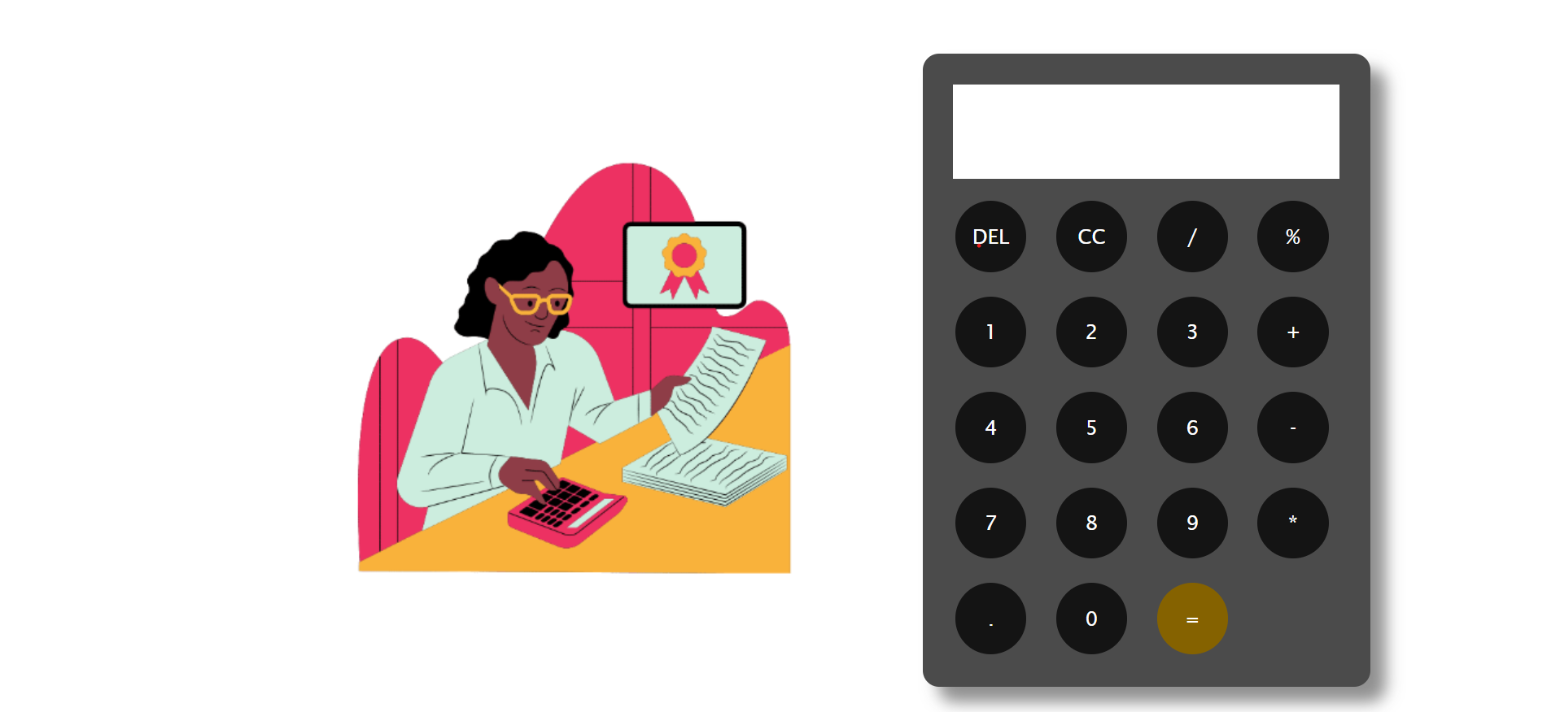
Project-2 Preview

Slide 7
Description
Project 1- To do list
I used HTML,CSS, and Js to make this project , To complete this project I took reference from W3 Schools for CSS and images from google
Project 2- Calculator
This Project uses Javascript to perform evaluation and operations and to display the result in the input field of the web page. Focussing less on the UI and more on the working and functionality. Took reference from MDN docs for Javascript.

Slide 8
Conclusion
My MLSA internship in full-stack development was a great learning experience. I built skills in both front-end and back-end development, learned to solve problems, and worked well. This experience gave me a strong foundation in software development and has prepared me to take on more projects and grow in this field. I gained practical skills learned effective problem-solving strategies, and honed my ability to work collaboratively within a development team.

Slide 9
THANK YOU

