Slide 1


HEART ATTACK PREDICITON💀
Your results are a few heartbeats away
Implementation of website running an ML model capable of heart attack prediction

Slide 2
Heart attacks account for 27.2% deaths around the world
Some estimate that nearly 80% of all heart attacks are silent.

Slide 3

WE HAVE A SOLUTION
With our website we aim at providing a simple yet accurate ML model capable of predicting the chances that an individual might suffer a heart attack
This is done by taking in inputs like age, sex, ECG etc. from the user. The information entered is then ran through an ML Model using Google Collab. The dataset used contains a list of data including details such as age, sex, cp, trestbps etc. The Model uses a total of 8 algorithims and using ROC curves the most accurate one is chosen.

Slide 4

Algorithms Ranking Sample using ROC
0 | Logistic Regression | 85.245902
1 | Naive Bayes | 85.245902
2 | Random Forest | 85.245902
3 | Extreme Gradient Boost | 90.163934
4 | K-Nearest Neighbour | 88.524590
5 | Decision Tree | 81.967213
6 | Support Vector Machine | 88.524590
7 | Gradient Boosting Classifier | 88.524590

Slide 6
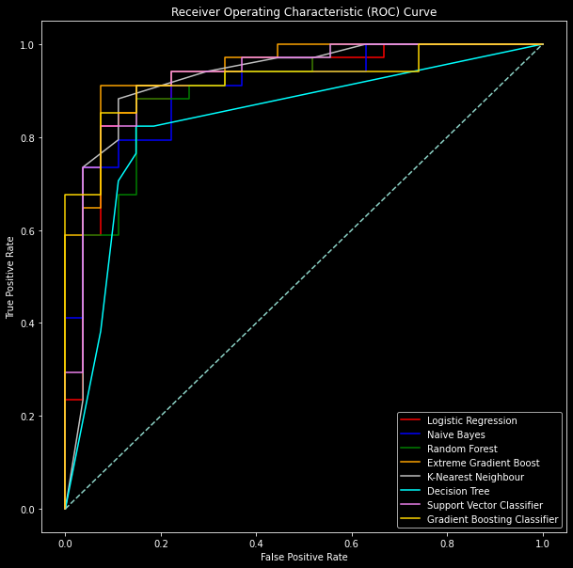

Slide 7

Input Fields Required:
Age
Sex
Chest Pain
BPS
Cholesterol Level
Fasting Blood Sugar Level
Resting ECG
Max Hearbeat
Pain during exercise
Old Peak
Highest Peak
Thalasemia

Slide 8
How the model works:
The information entered is then ran through an ML Model using Google Collab The first three models are used for classification, Whereas the later three are responsible for the decisions made. At last, the Extreme Gradient Boost gives us the best results.

