Slide 1
Credit Approval and Profit generation
Sidharth Suman

Slide 2
Deliverables
Goal is to build a machine learning model that is able to answer which customers are profitable, and decide who to approve.
How business works : - Selected customers are given cards - Customers make transactions depending upon their limits - Company earns commission on each transaction and as interest on leftover amount - If customer defaults, whole amount is lost

Slide 3















Solution Approach
Define Goals
Define a strategy
Exploratory Analysis
Model building and Validation
Getting results
How the solution will be used by business management team.
Figure out whether the customer will default or not.
The profit made by company from each customer.
1st step – Which customer will not default.
2nd step – How much profit will company make from each customer?
Data Cleaning and preprocessing
Remove the garbage records.
Data Imputation:
Handle the missing
values.
Identify interesting
patterns in data
Feature Engineering :: creating new features – breaking down last loan paymeny etc
Machine Learning Models :: Logistic Regression, Random Forest, SVM
Model validation and evaluate model accuracy and precision
Filtering based on attributes
Getting the customers who will not default.
Calculating the profit generated by each customer.

Slide 4
Exploratory Data Analysis
Data Preprocessing
Number of Files: 3
Largely imbalanced dataset,
64592 unique training customer data points.
Removed “channel” column from the dataset.
Removed significant outlier in credit limit with value 613117.
Removed the data points with no value for the target variable.
Also, removed data points with missing credit limit, end_last_loan,ok_since and last_payment.
Encoded the categorical variables
Fetched year and month out of dates data such as end_last_loan and last_payment.

Slide 5
Model for approving the customers
Evaluation metric chosen for this model is precision, as we wish to know which customers were actually defaulters but weren’t identified as such. The number of defaulters is always less than number of non-defaulters, so if are able to identify the defaulters(the customer we do not wish to approve) then we can easily get the right customers. In the models stats below, the precision is the percentage of defaulters which were identified correctly.
Model | Logistic Regressions | SVM | Random Forest | Boosting using C5.0 | Stochastic Gradient Boosting | Bagged Cart
Accuracy | 86.97836 | 87.64282 | 91.62142 | 94.46818 | 91.96212 | 97.10636
Precision | 65.34653 | 69.14062 | 82.48712 | 86.96875 | 82.97248 | 93.23418
Recall | 34.42879 | 36.93271 | 58.47679 | 76.836 | 62.42408 | 88.26615
F-Measure | 45.09737 | 48.14689 | 68.43712 | 81.58898 | 71.24626 | 90.68217
As we see in the results, Bagged Cart has given better results. A point to be noted here is that even though the presence of imbalanced dataset was realized but due to strict deadline, steps are not taken to nullify that effect.

Slide 6
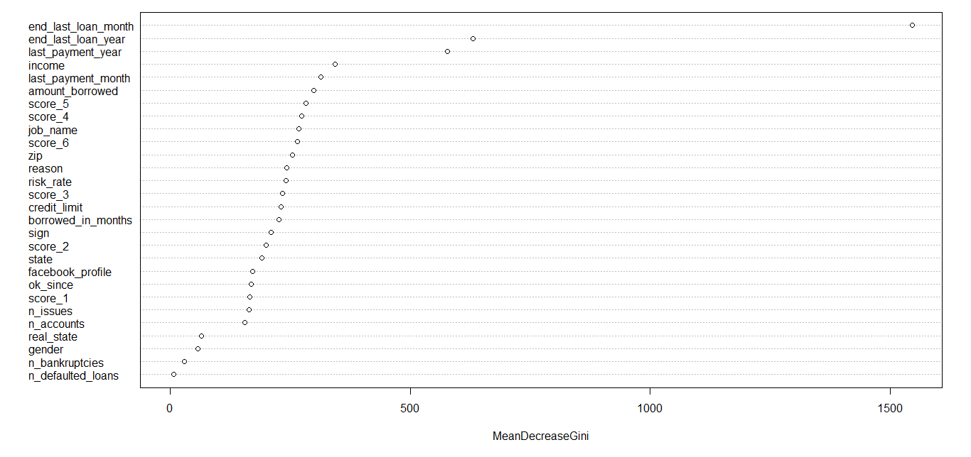
Variable importance
The month and year of end of the last loan of the customer and the last payments made play a crucial role in determining a customer’s acceptance for the card, followed by their income and so on.

Slide 7
Model for predicting the profit generated by each customers
Here, a separate model is made to generate the profit that can be expected from a non-defaulting customer.
Linear regression is chosen as way ahead due to lack of time.
Model | Linear Regression
MSE | 20423131
RMSE | 4519.196
MAPE | 1.46
Rsquared | .0011
MAE | 3411.409

Slide 8
Insights
The customer acquirement team should focus on the end date of last loan of the customer and the date of last payments made along with a customer’s income
The gender of the customer can not be taken as a deciding factor.
Amount already borrowed from the market also plays a crucial role.

Slide 9
Future Scope
The data should have been treated for imbalance.
Some more classification techniques such as ensemble methods should be explored.

