Slide 1

Prediction and Analysis of Comment Volume on Facebook Posts
Sidharth Dinesh

Slide 2
Problem Statement
Social media plays a vital role as an influencing and marketing platform, and the amount of data generated each day is enormous.
Comments have the ability to influence or alter people’s perceptions and shed light on important issues.
Predicting comment volume on Facebook Pages can help businesses optimize their social media strategies and improve engagement with users.

Slide 3
Related work
Using The Same Dataset
Implemented various algorithms and evaluation metrics to determine the best machine learning approach for this use case
Using Other Facebook Data
Proposed a systematic data mining architecture to mine intellectual data from Facebook to predict human behavioural patterns
Using Other Social Networking Platform Data
Predicted comment volume on Instagram posts, Tweets, news articles, etc.
Review Papers
Critiqued existing work, did not implement any novel methods

Slide 4
The Dataset
603,813 samples
UCI Facebook Comment Volume Dataset
54 numeric attributes (14 categorical)
No missing values, some duplicates
Temporal split into training and test data
5 training set variants
10 test sets
Training Set Variant | No. of Instances
Variant 1 | 40,949
Variant 2 | 81,312
Variant 3 | 121,098
Variant 4 | 160,424
Variant 5 | 199,030
Notes:
Find additional images to use for this slide

Slide 5

Data Preprocessing
Feature Scaling: Standardization
Uniqueness in Values: Dropped feature with same values across all samples
Duplicates: Removed duplicate rows
Redundant Features: Removed derived attributes
Source: https://www.flaticon.com/free-icon/data-cleaning_1808958
Notes:
Find additional images to use for this slide

Slide 6
Principal Component Analysis
Dimensionality Reduction
Curse of Dimensionality
Selected the number of principal components by plotting fraction of total variance explained vs. number of components
Processed Data is used for modelling

Slide 7
Implementation
LASSO
Gradient Boosting Regressor
Random Forest
Neural Network (MLP-4)

Slide 8
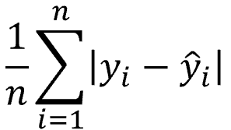
Evaluation Metrics
MARS
The number of posts in top 20 according to number of comments accurately predicted by our model
AUC
Area Under the Curve
(ROC - Receiver Operator Characteristic)
MAE
Mean Absolute Error
Evaluation Time
Time taken by the model to run

Slide 9
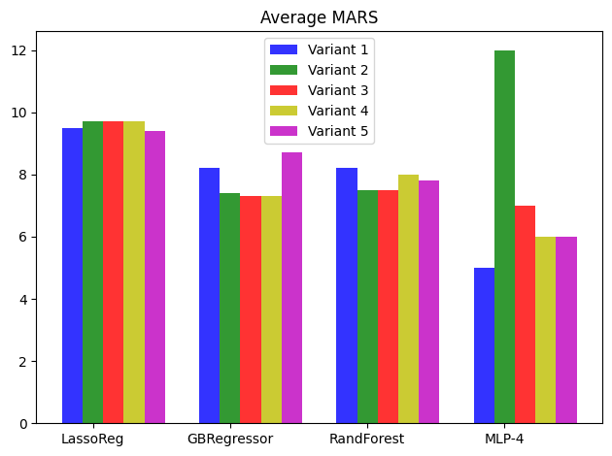
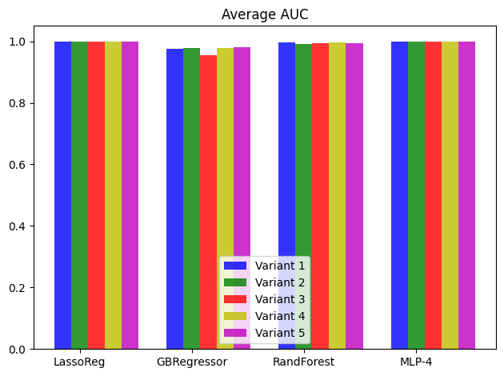
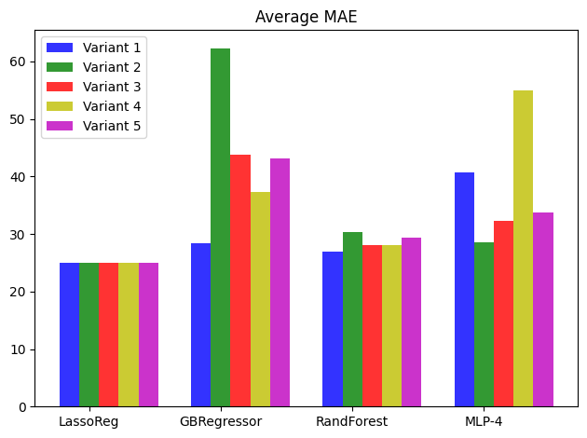
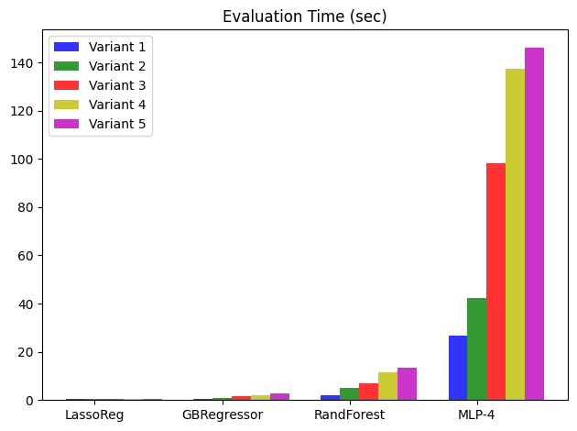
Results
MARS | AUC
MAE | Evaluation Time

Slide 10
Future Works
Scope for Improvement
Analysing applicability to other social media platforms
Performing analysis on latest data
Focus on customized evaluation metrics
Narrow down on other social media engagement factors like likes, shares, or reactions

