Slide 1


Webpack

Slide 2
Agenda
Introduction
Why webpack
Install webpack
Build your code through Webpack
Add Webpack Config
CSS loader & Style loader
Saas loader
Cache busting and HtmlWebpackPlugin
Add prod and dev configs, dev-server
Add html-loader, file-loader, and clean-webpack-plugin
Multiple entry points
Minify JS, CSS, and HTML in production

Slide 3
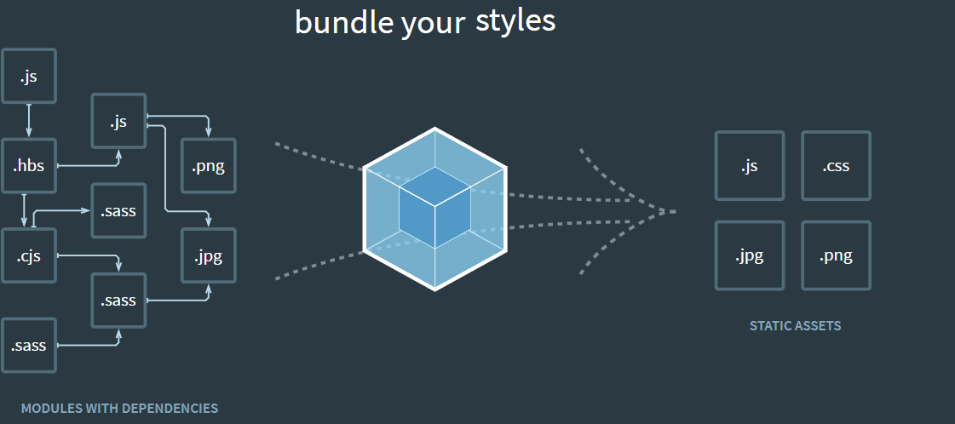
Introduction

Slide 4
Introduction
webpack is a static module bundler for modern JavaScript applications. When webpack processes your application, it internally builds a dependency graph which maps every module your project needs and generates one or more bundles.
Entry
Output
Loaders
Plugins
Mode
Browser Compatibility

Slide 5
Install webpack
Installed webpack and webpack-cli
Added a start script in package.json which calls webpack
Made an index.js file, which is the file webpack looks for by default
Webpack spits out our code in dist/main.js by default
Currently our main app code has nothing to do with webpack, but it will soon

Slide 6
Build your code through Webpack
We use import/export to indicate dependencies
Webpack makes sure everything loads in the correct order
We can remove all our additional script tags in index.html

Slide 7
Add Webpack Config
Created webpack.config.js
Added some basic configuration

Slide 8

CSS loader & Style loader
CSS loader- Turns css into commonjs
Style loader- Inject styles into DOM

Slide 9
Sass loader
Sass loader- Turns sass into css

Slide 10
Cache busting and HtmlWebpackPlugin
Cache Busting
HtmlWebpackPlugin

Slide 11
Add prod and dev configs, dev-server
Broke our webpack.config file into 3 files - webpack.common.js, webpack.dev.js, and webpack.prod.js
Installed webpack-merge to share the common functionality
Updated our package.json to use the new config files
Installed webpack-dev-server and added it to start script in package.json

Slide 12
Add html-loader, file-loader, and clean-webpack-plugin
Added html-loader to automatically require the files we reference in img tags
Added file-loader to handle the svg,png,jpg,gif files from our images
Configured file-loader to add our images to an imgs directory in dist
Also configured it to add a hash to their filenames
Lastly, added clean-webpack-plugin to our production config to clean out the dist directory each time we build

Slide 13
Multiple Entry Points
Why Multiple Entry Points
Configuration

Slide 14
Minify JS, CSS, and HTML in production
Extracted CSS into own file in production
Minified CSS in production
Added TerserJS back in to minify JS in production
Minified HTML in production as well

Slide 15
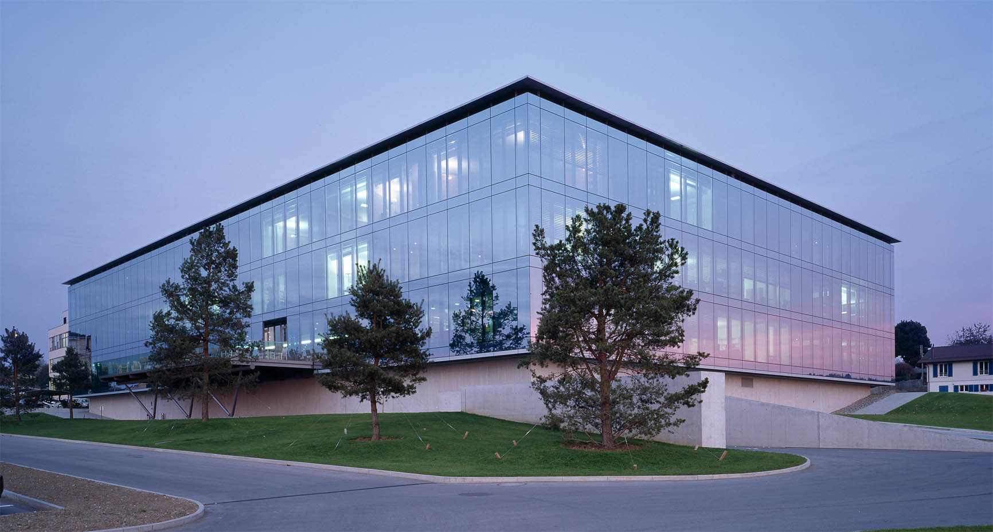
Q&A

