Slide 1
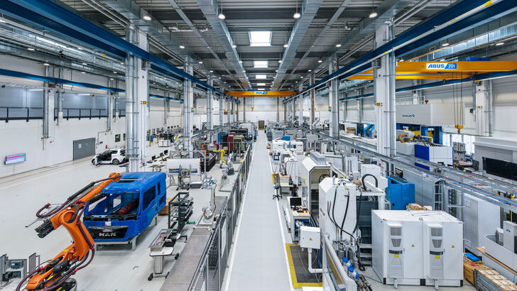

Master Thesis
Figures

Slide 2
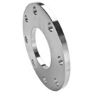
Examples of Fine-blanked parts
Figure 1: Fine-blanked parts

Slide 3
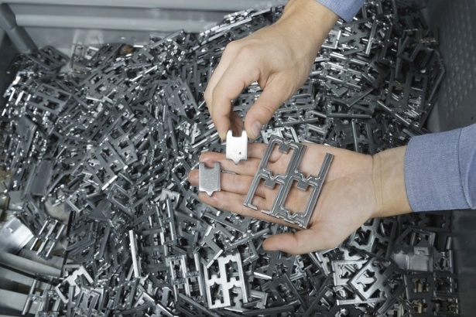
Sample of fine-blanked parts used in this thesis
Figure 2: Fine-blanked parts used for the thesis.

Slide 4
Blanking Process
Figure 3: Simplified blanking process. (a) Steel sheet is fed into position when tool is open. (b) The punch drops. (c) Punch continues to pierce the metal sheet, propagating fracture onto the sheet. (d) Part is blanked as the punch continues to pierce into the strip.

Slide 5
Characteristics of Fine-blanking
Figure 4: Three characteristics of fine blanking.

Slide 6
Normal vs Fine-Blanking
Figure 5 Normal Blanking vs Fine Blanking.

Slide 7
Process of Fine-Blanking (Part A)
Figure 6: Stages of the fine blanking process. (a) Initial position of die. (b) Closure of die. (c) Blanking. (d) Finishing of blanking. 1-Press Plate; 2-Blanking punch; 3-Blanking Die; 4-Ejector; 5-Sheet Metal; 6-Workpiece; 7-Inner form slug; FG- Counter force; FGA- Ejector force; FR- V-ring force; FRA- Stripping force; FS- Blanking force.

Slide 8
Process of Fine-Blanking (Part B)
Figure 6: Stages of the fine blanking process. (e) Opening of die. (f) Stripping. (g) Ejecting. (h) Blowing out part and scrap and feeding. 1-Press Plate; 2-Blanking punch; 3-Blanking Die; 4-Ejector; 5-Sheet Metal; 6-Workpiece; 7-Inner form slug; FG- Counter force; FGA- Ejector force; FR- V-ring force; FRA- Stripping force; FS- Blanking force.

Slide 9
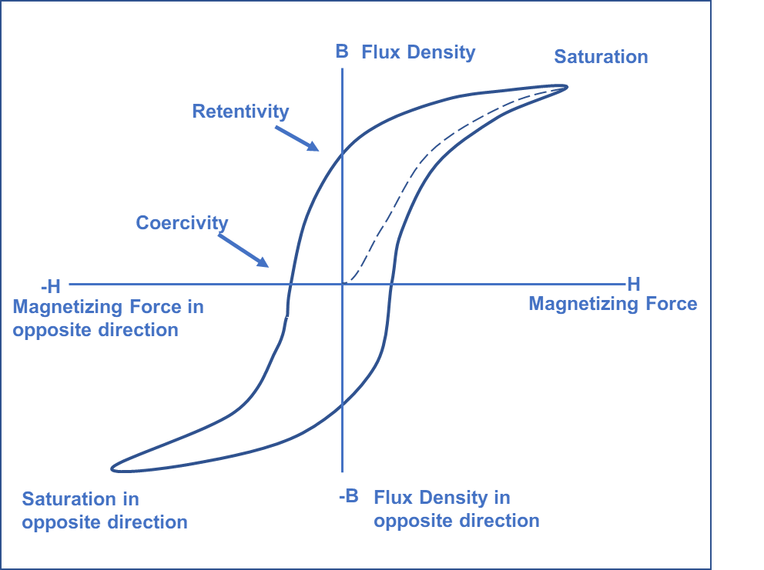
Hysteresis Loop
Figure 7: Hysteresis Loop.

Slide 10
Arrangement
Figure 8: Arrangement for sensing the Barkhausen effect

Slide 11
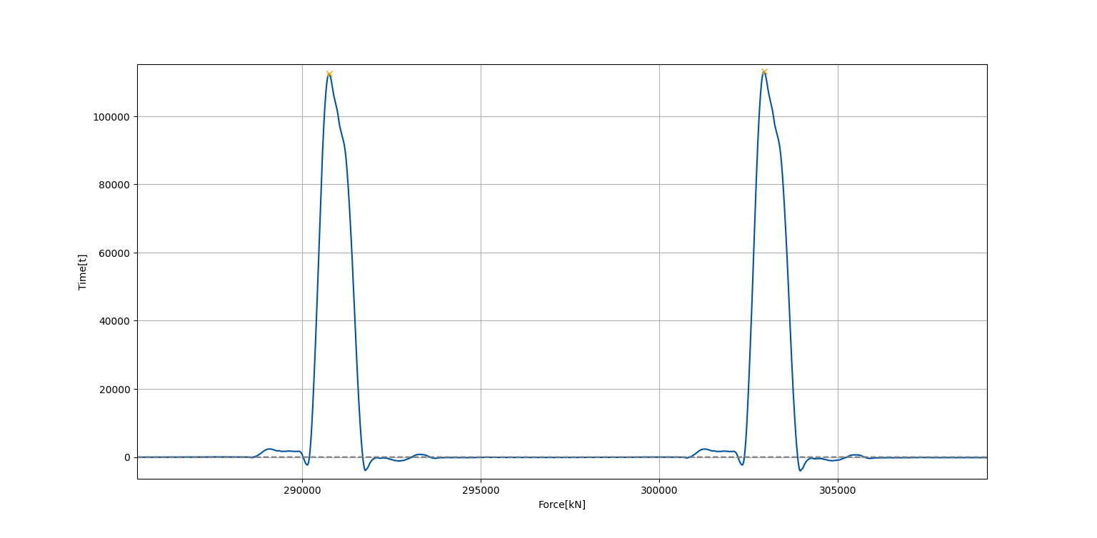
Force Signal Sample
Figure 9: A sample of force signals of the fine-blanking process.

Slide 12
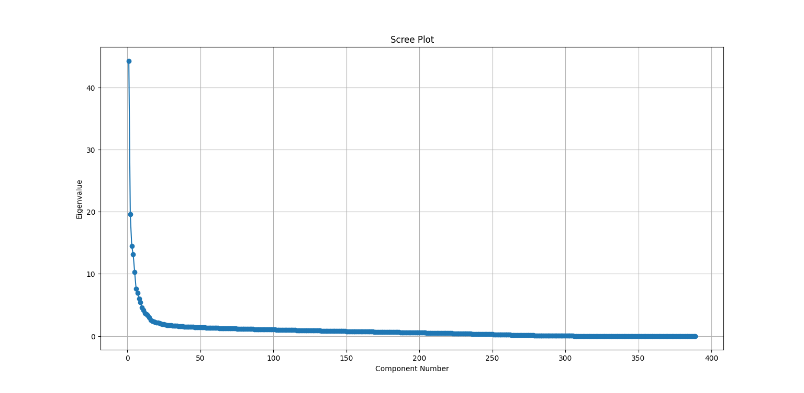
Scree Plot
Figure 10 Scree Plot of force Signals

Slide 13
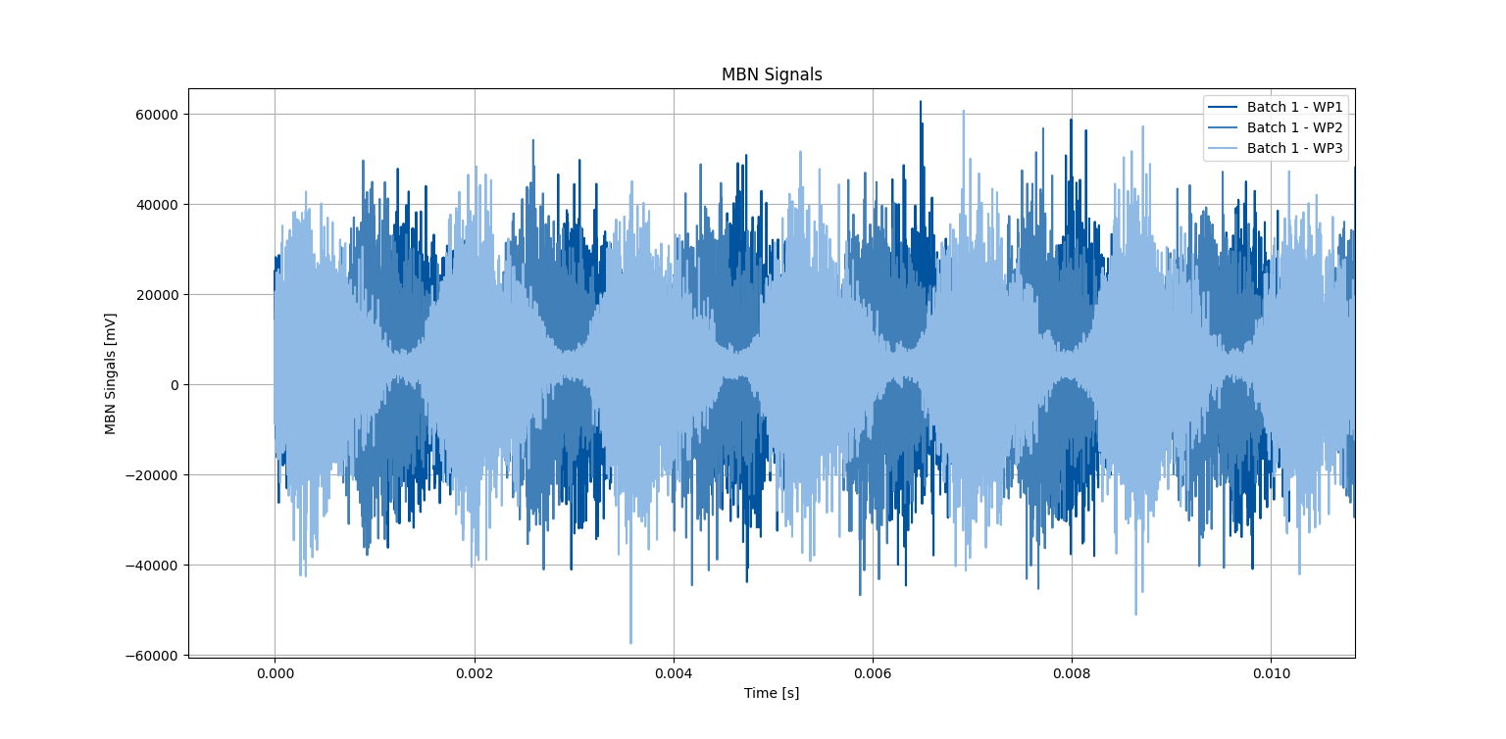
MBN Signal Sample
Figure 11 Raw MBN signals for 3 workpieces.

Slide 14
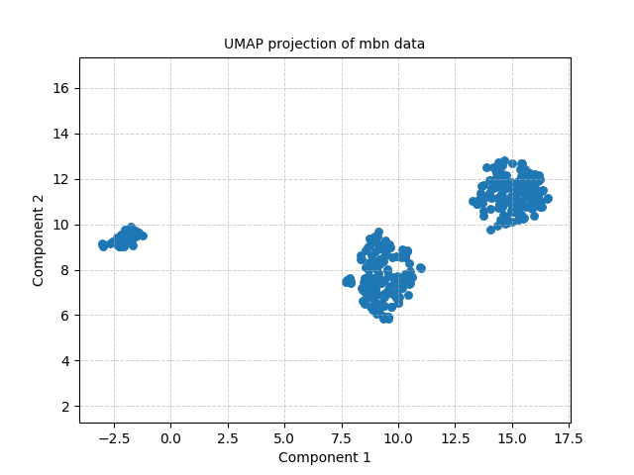
2-Dimensional Projection of MBN data
Figure 12 UMAP Projection of MBN data.

Slide 15
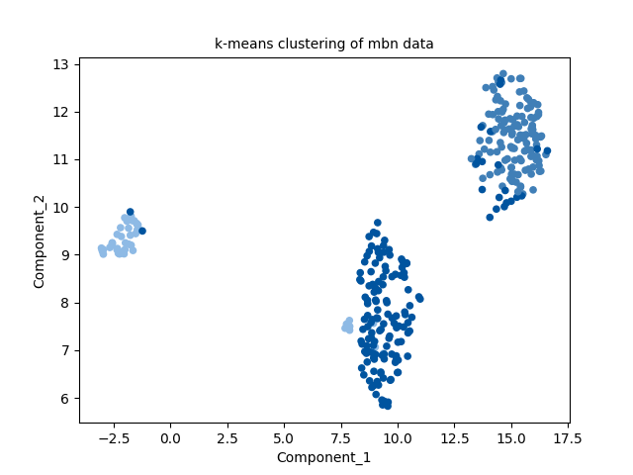
K-means Clustering
Figure 13 k-means clustering of MBN data.

