Slide 1


Slide 2


Distributed Rate Limiter System
Pre-Final Year Project Synopsis
Submitted by
NAME | ROLL NO
Sidharth Krishna S | 2401720003
Ankit Kumar Yadav | 2401720012
Diwakar | 2401720013
Palak Kashyap Devashya Dahiya | 2401840007 2401720001
Faculty Mentor: Dr. Ravinder Beniwal
Notes:
New Courses replaced with New Programmes

Slide 3

Project Overview
The Distributed Rate Limiter System is designed to control and manage API request traffic in high-load applications.
It prevents server overload, misuse, and unfair resource consumption by limiting the number of requests per user or IP.
The system works efficiently in distributed environments, ensuring consistent rate limits across multiple servers.
It uses Redis as a centralized, high-performance store to maintain counters and tokens in real time.
The project supports multiple rate-limiting algorithms such as Token Bucket, Fixed Window, and Sliding Window.
An admin dashboard provides real-time monitoring, analytics, and configuration of rate limits.
Overall, the system improves application stability, security, and performance under heavy traffic conditions.
Notes:
New Courses replaced with New Programmes

Slide 4
To design and implement a distributed rate limiting system capable of handling high-traffic API requests.
To enforce fair usage policies by limiting requests per user, IP address, or API key.
To implement multiple rate-limiting algorithms such as Token Bucket, Fixed Window, and Sliding Window.
To ensure consistent rate limit enforcement across multiple application servers in a distributed environment.
To use Redis for fast, centralized storage of counters and tokens with low latency.
To prevent API abuse and malicious request flooding.
To reduce server crashes and unexpected cloud infrastructure costs.
To provide an admin dashboard for real-time monitoring, logging, and configuration of rate limits.
To make the system scalable, configurable, and easy to integrate with existing backend applications.
Specific Objectives
Notes:
New Courses replaced with New Programmes

Slide 5
Distributed Rate Limiting to ensure consistent request control across multiple servers.
Multiple Rate Limiting Algorithms including Token Bucket, Fixed Window, and Sliding Window.
Redis-Based Centralized Storage for fast, reliable, and atomic request counting.
High Performance & Low Latency suitable for high-traffic and real-time applications.
Fair Usage Enforcement by limiting requests per user, IP address, or API key.
Protection Against Abuse and Attacks such as request flooding and bot traffic.
Real-Time Monitoring Dashboard showing live traffic, violations, and usage patterns.
Configurable Rate Limits for different APIs, users, or environments.
Scalable Architecture that works seamlessly in distributed and cloud-based systems.
Easy Integration with existing backend applications via APIs.
Key Features
Notes:
New Courses replaced with New Programmes

Slide 6
API Traffic Control Limits the number of requests sent to APIs to prevent server overload during high traffic.
Protection Against Abuse Prevents bots, scripts, or malicious users from flooding APIs with excessive requests.
Fair Usage Enforcement Ensures equal resource usage among users, especially in free or limited-access plans.
Login & Authentication Systems Restricts repeated login attempts to prevent brute-force attacks.
E-Commerce Applications Controls request spikes during flash sales or promotional events.
Banking & Financial Systems Protects sensitive APIs from misuse and ensures reliable transaction processing.
Microservices Architecture Maintains consistent rate limits across multiple services and servers.
Project Usecases & Scope
Notes:
New Courses replaced with New Programmes

Slide 7
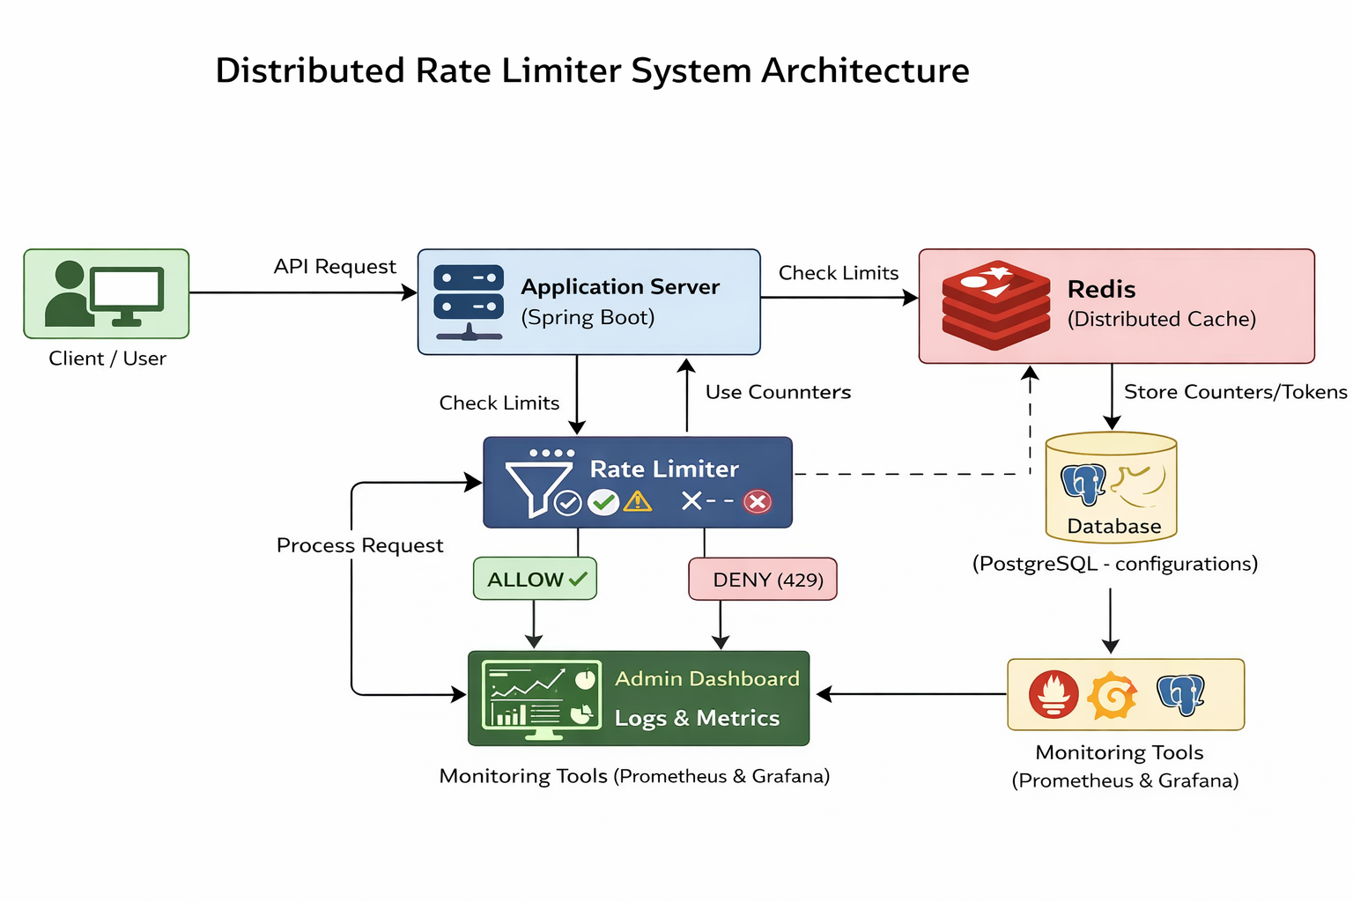
Prototype/Project Flow diagram/Architecture
Notes:
New Courses replaced with New Programmes

Slide 8
Data & Resources
Data Used
API Request Data
User ID / API Key
IP Address
Endpoint Name
Timestamp of request
Rate Limit Configuration Data
Maximum requests allowed
Time window duration
Selected rate limiting algorithm
Log & Analytics Data
Allowed and denied request counts
Rate limit violations
Traffic statistics per API or user
Software Resources
Java 17 – Backend development
Spring Boot – API and service implementation
Redis – Distributed in-memory data store
PostgreSQL – Configuration and metadata storage
HTML, CSS, REACT.js – Admin dashboard
Docker – Containerization and deployment
Prometheus & Grafana – Monitoring and visualization
Git & GitHub – Version control
Notes:
New Courses replaced with New Programmes

Slide 9
Methodology
The system is designed using a distributed client–server architecture to handle high API traffic efficiently and reliably.
Incoming client requests are first received by the Application Server, which forwards request details (user/IP/API key) to a centralized Rate Limiter Service before executing business logic.
The Rate Limiter applies configurable algorithms such as Token Bucket, Fixed Window, and Sliding Window to control request frequency.
Redis is used as a centralized in-memory datastore to store counters and tokens, ensuring atomic operations and consistent rate limiting across multiple servers.
Rate limit rules, thresholds, and algorithm configurations are stored in PostgreSQL, allowing dynamic updates without redeployment.
Based on Redis evaluation, requests are either allowed to proceed or denied with HTTP 429 (Too Many Requests).
All rate-limiting decisions are logged and monitored through an admin dashboard, enabling real-time traffic analysis and system health monitoring.
Notes:
New Courses replaced with New Programmes

Slide 10
Expected Results & Impact
Expected Results
Stable and controlled API traffic even during high-load conditions.
Effective prevention of API abuse, spam requests, and brute-force attempts.
Consistent rate-limit enforcement across all servers in a distributed environment.
Reduced server crashes and improved application response time.
Real-time visibility of API usage, violations, and traffic patterns through the dashboard.
Impact
Improves system reliability, security, and performance.
Ensures fair usage of resources among all users.
Helps organizations reduce infrastructure and cloud costs caused by uncontrolled traffic.
Enhances developer confidence by providing configurable and scalable traffic control.
Demonstrates practical implementation of distributed systems and backend engineering concepts.
Notes:
New Courses replaced with New Programmes

Slide 11
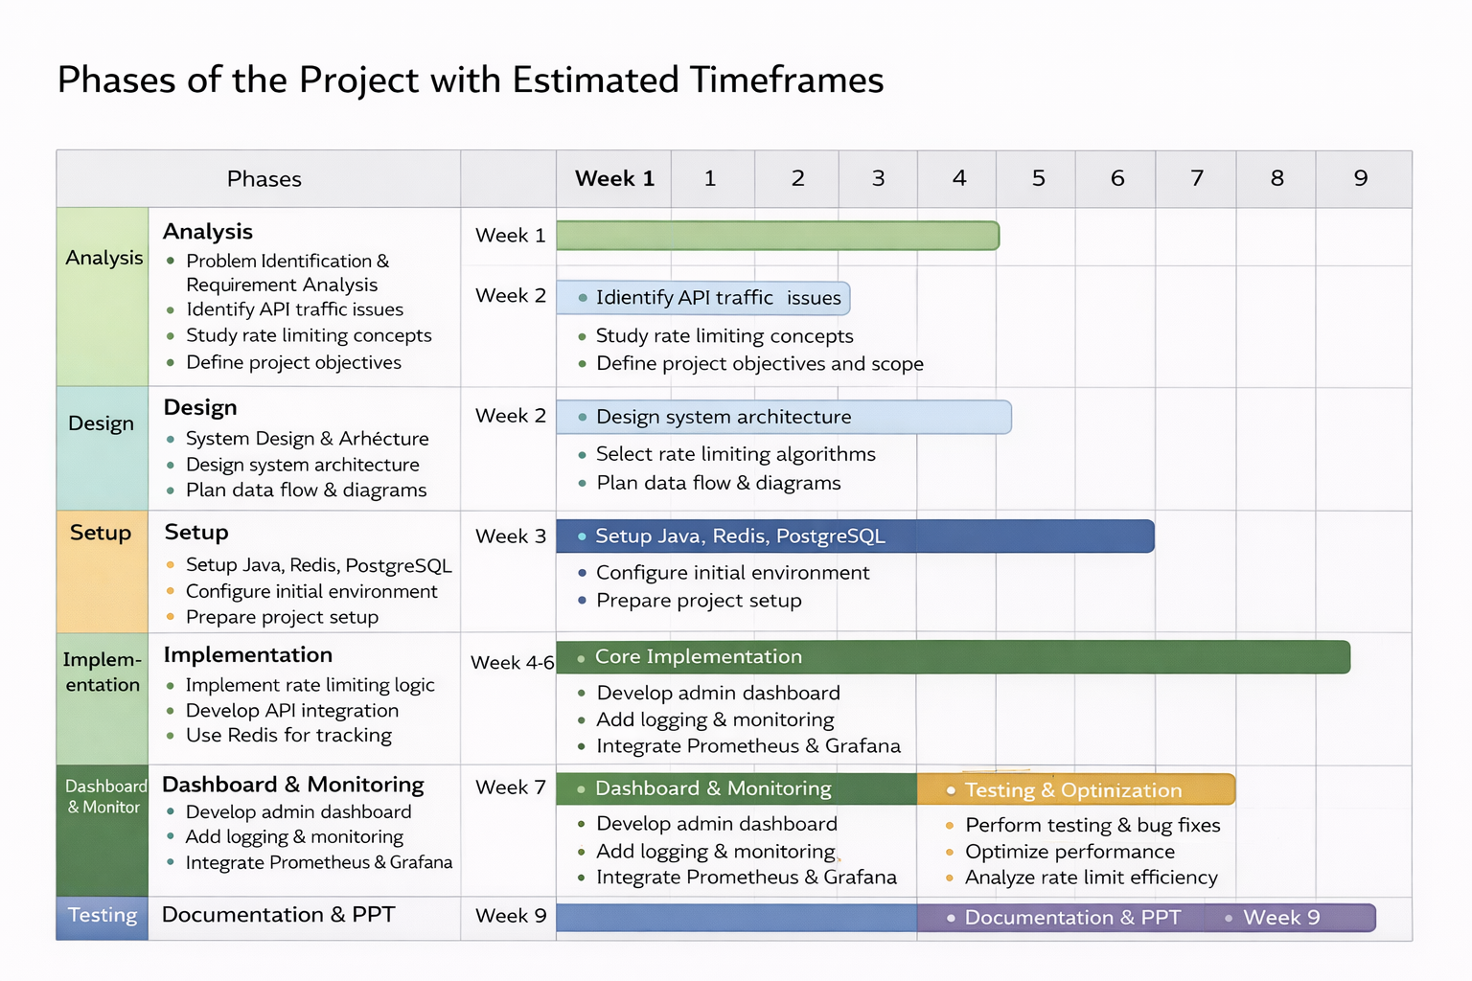
Project Timeline
Notes:
New Courses replaced with New Programmes

Slide 12
THANK YOU

