Slide 1


Slide 2


Distributed API Rate Limiting System
Final Year Project Progress
Submitted by
ROLL | NAME
Sidharth Krishna S | 2401720003
Palak Kashyap | 2401840007
Ankit Kumar Yadav | 2401720012
Diwakar | 2401720013
Devasya Dahiya | 2401720001
Faculty Mentor: Dr Ravinder Beniwal
Notes:
New Courses replaced with New Programmes

Slide 3

Project Overview
The Distributed Rate Limiter System is designed to control API request traffic in high-load environments. It prevents server overload, misuse, and unfair resource consumption. Ensures consistent rate limiting across multiple servers in a distributed system. Uses Redis for fast, centralized request tracking. Supports Sliding Window Algorithm. Provides a real-time monitoring dashboard for analytics and control. Improves system performance, stability, and security.
Notes:
New Courses replaced with New Programmes

Slide 4
Specific Objectives
Design and implement a distributed rate limiting system for high-traffic APIs. Enforce fair usage policies based on user, IP, or API key. Implemented algorithm: Sliding Window. Ensure consistent rate limiting across multiple servers. Use Redis for fast and centralized request tracking. Prevent API abuse, spam, and malicious traffic. Reduce server overload and infrastructure cost. Provide a real-time admin dashboard for monitoring and configuration. Build a scalable and easily integrable system.
Notes:
New Courses replaced with New Programmes

Slide 5
Key Features
Distributed Rate Limiting Ensures consistent request control across multiple servers
Redis-Based Centralized Storage Fast, atomic request counting with low latency
High Performance & Low Latency Designed for real-time, high-traffic systems
Fair Usage Enforcement Limits requests per user, IP, or API key
Protection Against Abuse Prevents bot traffic, spam, and brute-force attacks
Real-Time Monitoring Dashboard Tracks usage, violations, and system performance
Configurable Rate Limits Flexible rules for different APIs and users
Easy Integration Can be plugged into existing backend systems
Notes:
New Courses replaced with New Programmes

Slide 6
Progress Summary
Implemented Spring Boot backend APIs for rate limiting
Developed API key generation and authentication system
Integrated Redis for distributed request tracking and caching
Implemented Sliding Window algorithm for request control
Connected PostgreSQL for storing user data and configurations
Integrated Prometheus & Grafana for monitoring and metrics
Built React.js dashboard for system interaction
Performed API testing using Postman
Achieved stable request handling under controlled traffic
Notes:
New Courses replaced with New Programmes

Slide 7
Detailed Progress – Development Phase
Designed a modular system architecture separating: Authentication, Rate Limiting, Caching (Redis), Monitoring
Developed Spring Boot services for: API handling, Rate limiting logic, API key management
Implemented Sliding Window algorithm for accurate request control
Integrated Redis for: Distributed request counting, Fast in-memory processing
Connected PostgreSQL for: User data, Rate limit configurations
Set up Prometheus & Grafana for: Real-time metrics, Performance monitoring
Notes:
New Courses replaced with New Programmes

Slide 8
Methodology
The system follows a distributed client–server architecture
Client requests are received by the Application Server
Before processing, each request is sent to the Rate Limiter Service
The Rate Limiter applies Sliding Window algorithm
Redis stores request counters and ensures atomic operations
Rate limit rules are stored in PostgreSQL for dynamic configuration
Based on evaluation: Allowed → request processed Denied → HTTP 429 response
All events are logged and visualized via the dashboard
Notes:
New Courses replaced with New Programmes

Slide 9
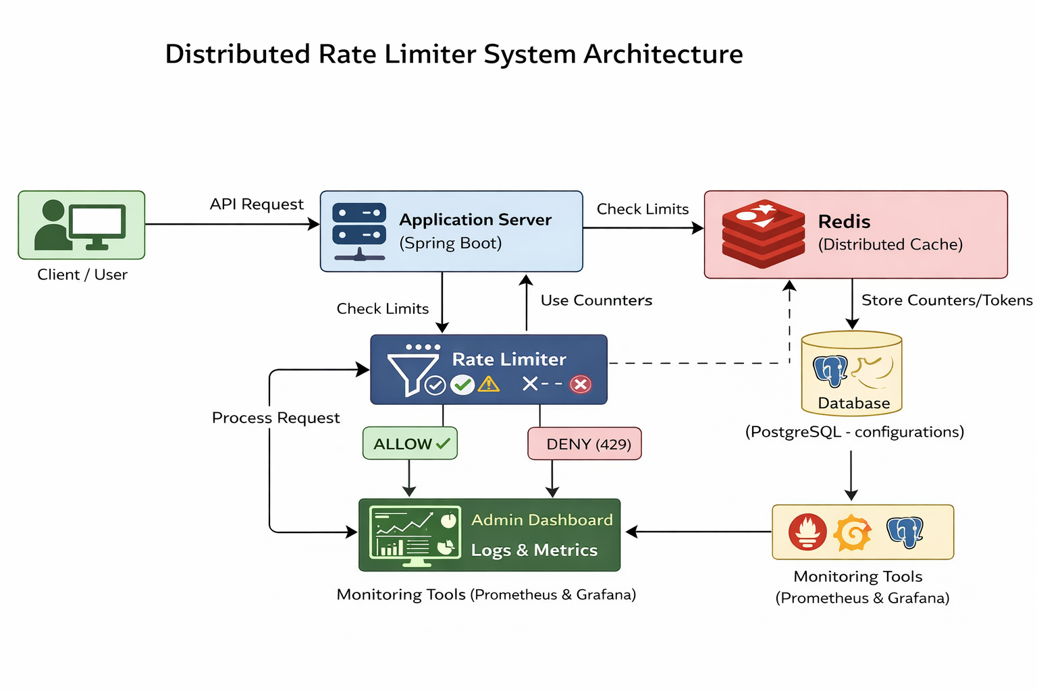
Prototype/Project Flow diagram/Architecture
Notes:
New Courses replaced with New Programmes

Slide 10
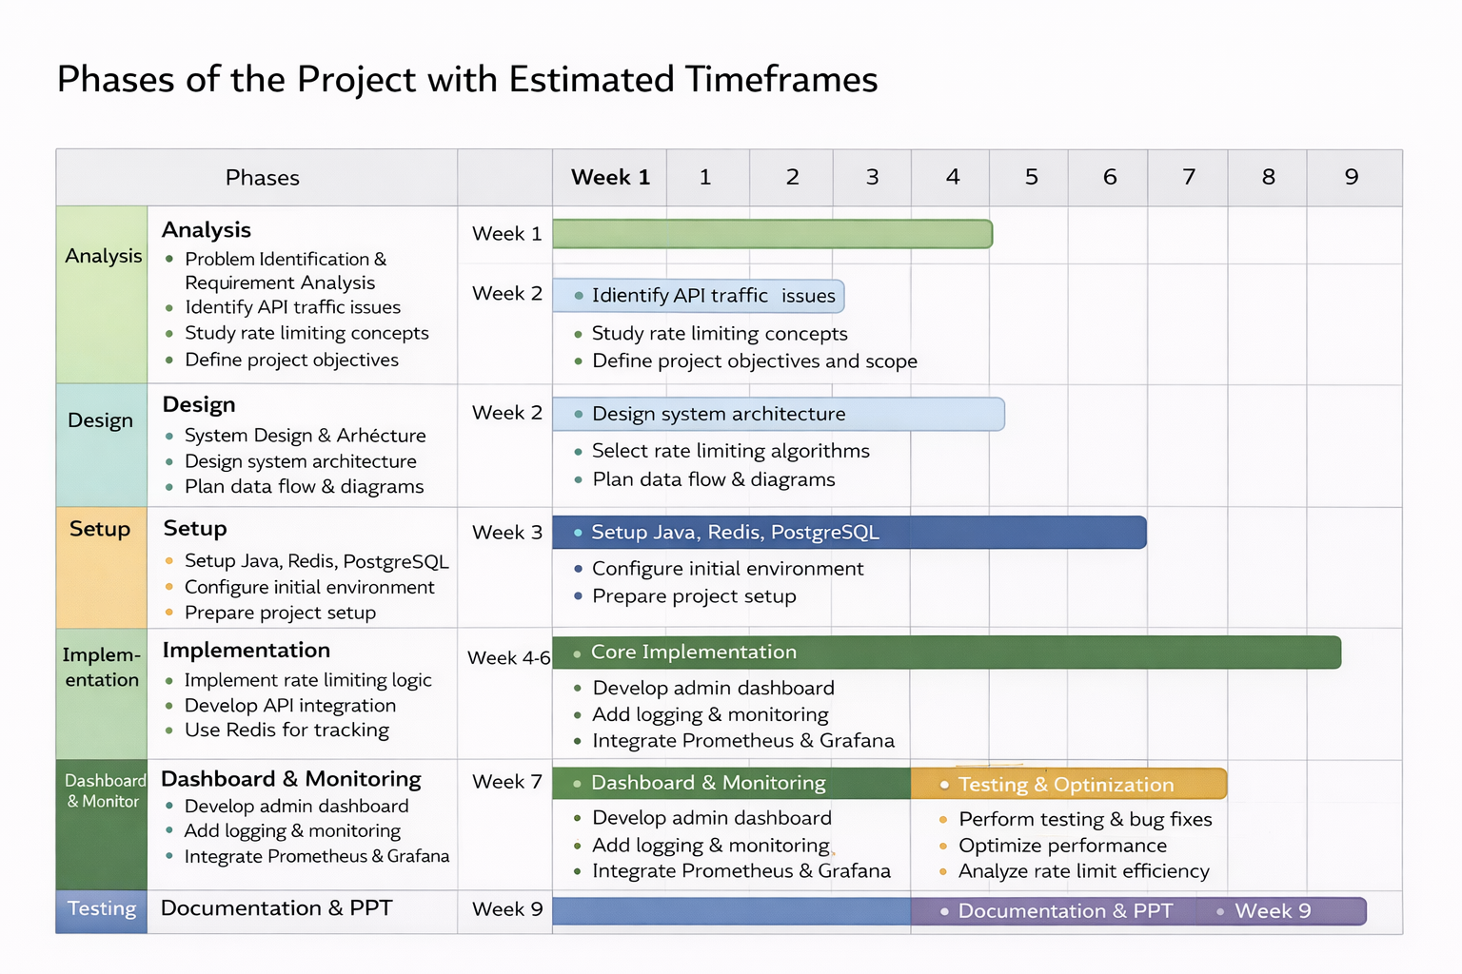
Project Timeline
Notes:
New Courses replaced with New Programmes

Slide 11
Data & Resources
API Request Data User ID / API Key IP Address Endpoint Name Request Timestamp
Rate Limit Configuration Data Max requests allowed Time window duration Selected algorithm
Logs & Analytics Data Allowed / Denied requests Rate limit violations Traffic statistics
Notes:
New Courses replaced with New Programmes

Slide 12
Project Usecases & Scope
Usecases API Traffic Control : Prevents server overload during high traffic Protection Against Abuse: Blocks bots, spam, and malicious requests E-Commerce Platforms: Handles traffic spikes during flash sales Banking & Financial Systems: Secures sensitive APIs and transactions Microservices Architecture: Maintains consistent limits across services Scope of the Project Distributed rate limiting algorithms Centralized configuration using Redis & PostgreSQL Real-time monitoring dashboard API-based integration with backend systems Logging and analytics
Notes:
New Courses replaced with New Programmes

Slide 13
Expected Results & Impact
Expected Results
Stable and controlled API traffic under high load
Effective prevention of API abuse and spam requests
Consistent rate limiting across distributed servers
Reduced server crashes and downtime
Improved response time and system performance
Real-time visibility of API usage and violations
Impact
Improves system reliability and security
Reduces cloud infrastructure costs
Enhances scalability of applications
Provides a production-ready backend solution
Demonstrates strong distributed system design skills
Notes:
New Courses replaced with New Programmes

Slide 14
THANK YOU

