Slide 1


Slide 2


Distributed Rate Limiter System
Pre-Final Year Project Progress
Submitted by
ROLL | NAME
2401720003 | Sidharth Krishna S
2401720012 | Ankit Kumar Yadav
2401840007 | Palak Kashyap
2401720013 | Diwakar
2401720001 | Devasya
Faculty Mentor: Dr. Ravinder Beniwal
Notes:
New Courses replaced with New Programmes

Slide 3

Project Overview
The project focuses on developing a Distributed Rate Limiter System to control and manage API request traffic.
It prevents system overload by limiting requests within a defined time window.
Spring Boot is used for backend API development and rate limiting logic implementation.
Redis enables distributed request tracking and high-performance caching.
Monitoring is implemented using Prometheus and Grafana for real-time system metrics.
A React.js frontend is used for interaction and testing purposes.
Notes:
New Courses replaced with New Programmes

Slide 4
Specific Objectives
Design and implement a distributed rate limiting system to manage high volumes of API requests.
Enforce fair usage policies by limiting requests per user, IP address, or API key.
Implement rate limiting algorithms such as Token Bucket, Fixed Window, and Sliding Window.
Use Redis as a centralized in-memory datastore for fast and efficient request tracking.
Provide real-time monitoring and configuration of rate limits through an admin dashboard.
Notes:
New Courses replaced with New Programmes

Slide 5
Key Features
High-performance request handling designed for low latency in high-traffic systems.
Centralized request tracking using Redis to maintain counters and rate limit data efficiently.
Configurable rate limits that can be customized for different APIs, users, or environments.
Scalable architecture that works smoothly in distributed and cloud-based deployments.
Easy integration with backend services through APIs without major system changes.
Notes:
New Courses replaced with New Programmes

Slide 6
Progress Summary
Implemented user authentication to ensure secure system access.
Developed functionality for API key generation and management.
Integrated PostgreSQL database for storing user and system data.
Configured Prometheus and Grafana for monitoring and performance metrics.
Nearly completed the React.js frontend interface for system interaction and testing.
Notes:
New Courses replaced with New Programmes

Slide 7
Detailed Progress – Development Phase
Designed a modular system architecture separating authentication, rate limiting, caching, and monitoring components.
Developed Spring Boot backend services for authentication and API key management.
Implemented the Sliding Window rate limiting algorithm for controlling API request frequency.
Integrated PostgreSQL database for storing user and API key data.
Implemented Redis caching for distributed request tracking and faster request processing.
Set up Prometheus and Grafana for monitoring system metrics and visualizing performance data.
Performed API testing and validation using Postman to verify system functionality.
Notes:
New Courses replaced with New Programmes

Slide 8
Methodology
The system follows a distributed client–server architecture to efficiently manage high API traffic.
Client requests are first received by the Spring Boot application server, which checks rate limits before processing the request.
The Sliding Window rate limiting algorithm is applied to control the number of requests within a defined time period.
Redis is used as a centralized in-memory datastore to track request counts and ensure fast processing.
Prometheus and Grafana are used to collect and visualize system metrics for monitoring performance and request activity.
Notes:
New Courses replaced with New Programmes

Slide 9
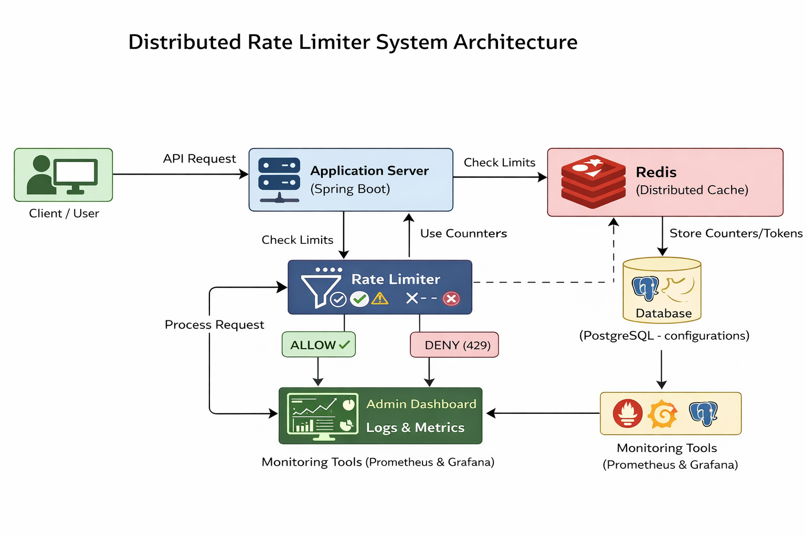
Prototype/Project Flow diagram/Architecture
Notes:
New Courses replaced with New Programmes

Slide 10
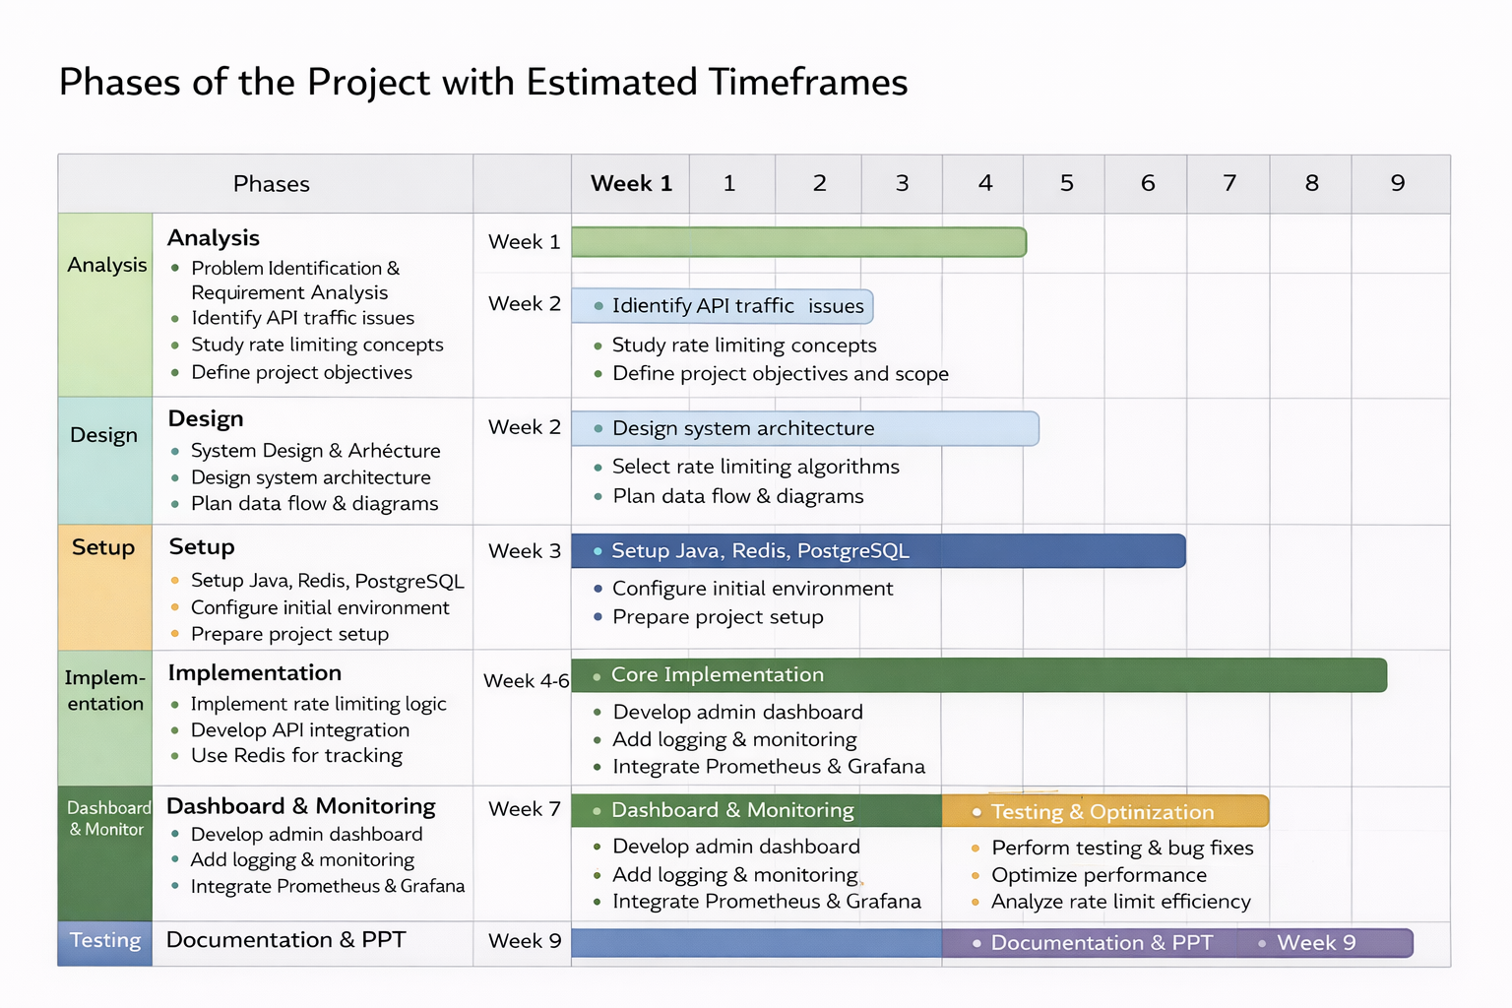
Project Timeline
Notes:
New Courses replaced with New Programmes

Slide 11
Next Steps and Goals
Implement additional rate limiting algorithms such as Token Bucket and Fixed Window.
Enhance the admin dashboard to improve visualization of API usage and system metrics.
Strengthen distributed request handling to ensure system scalability.
Optimize Redis operations and database queries for better performance.
Conduct extensive testing under high traffic conditions to evaluate system reliability.
Finalize documentation and system deployment preparation.
Notes:
New Courses replaced with New Programmes

Slide 12
Data & Resources
API Request Data: User ID or API key, IP address, endpoint name, and request timestamp.
Rate Limit Configuration Data: Maximum allowed requests, time window duration, and selected rate limiting algorithm.
Traffic & Log Data: Allowed requests, denied requests, and rate limit violation statistics.
Backend Technologies: Java and Spring Boot for developing APIs and rate limiting services.
Data Storage Systems: Redis for distributed request tracking and PostgreSQL for configuration storage.
Monitoring & Visualization Tools: Prometheus and Grafana for monitoring system metrics and performance.
Notes:
New Courses replaced with New Programmes

Slide 13
Project Usecases & Scope
API Traffic Control: Limits the number of API requests to prevent server overload during high traffic.
Protection Against Abuse: Prevents bots, spam requests, and malicious traffic from flooding the system
Fair Resource Usage: Ensures equal API access for users by enforcing request limits.
Authentication Systems: Restricts repeated login attempts to reduce brute-force attacks.
High-Traffic Applications: Useful in systems like e-commerce platforms during flash sales or peak usage.
Distributed Systems & Microservices: Maintains consistent rate limits across multiple servers and services.
Notes:
New Courses replaced with New Programmes

Slide 14
Expected Results & Impact
Choosing the Right Algorithm: Fixed Window :Simple but allows burst at boundaries
Sliding Window :More accurate but computationally expensive
Token Bucket :Allows controlled bursts, widely used
Leaky Bucket :Smooth traffic but less flexible
Solution:Why Choose Sliding Window Algorithm: Eliminates Boundary Burst Problem Better Accuracy Improved Fairness Smooth Traffic Control
Notes:
New Courses replaced with New Programmes

Slide 15
THANK YOU

