Slide 1







COMPANY LOGO/NAME
Product
Location
Dashboard
Customer
COGS
Revenue
Profit
Top
Bottom
All
Chart Name Here
Chart Name Here
Chart Name Here

Slide 2
COMPANY LOGO/NAME
Product
Location
Dashboard
Customer
Chart Name Here
COGS
Revenue
Profit
Chart Name Here

Slide 3

COMPANY LOGO/NAME
Product
Location
Dashboard
Customer
Chart Name Here
Chart Name Here
Chart Name Here
Total Customers
Returning Customers
Chart Name Here

Slide 4
COMPANY LOGO/NAME
Product
Location
Dashboard
Customer

Slide 5

Website Analytics

Slide 6
Website Analytics

Slide 7
Website Analytics

Slide 8
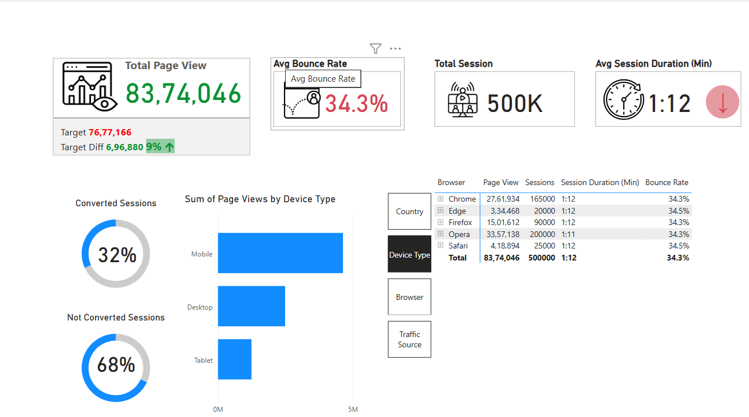

Slide 9
COMPANY LOGO/NAME
Product
Location
Dashboard
Customer
COGS
Revenue
Profit
Top
Bottom
All
Chart Name Here
Chart Name Here
Chart Name Here

Slide 10
COMPANY LOGO/NAME
Product
Location
Dashboard
Customer
Profit
Chart Name Here
COGS
Revenue
Chart Name Here

Slide 11
COMPANY LOGO/NAME
Product
Location
Dashboard
Customer
Chart Name Here
Chart Name Here
Chart Name Here
Total Customers
Returning Customers
Chart Name Here

Slide 12
COMPANY LOGO/NAME
Product
Location
Dashboard
Customer
Chart Name Here
Chart Name Here
Chart Name Here

