Slide 1
British Airways
Task - 2
By Sidharth Thazhathedathu

Slide 2
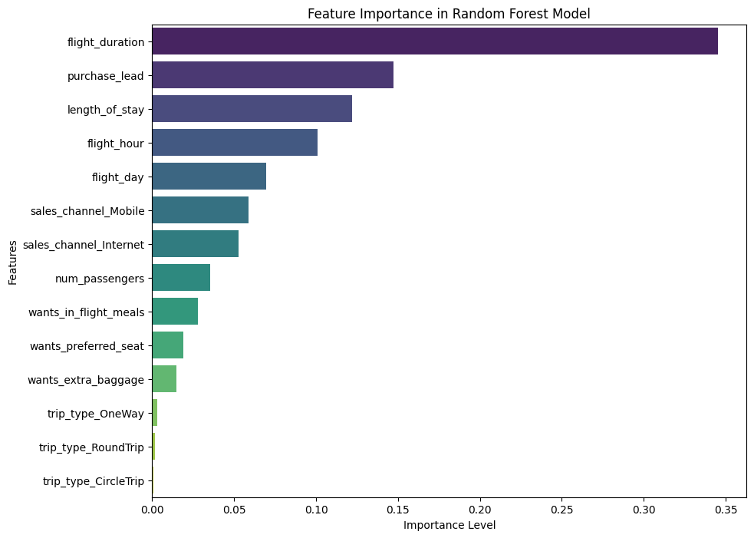
Model Predictions
The model has a memorization score of 0.9015 and generalization score of 0.8203. The precision of ‘people not completing the booking’(0) is0.82. The prediction of ‘people who complete the booking’ are 0.82.
The most import factors that depend on whether a customer books or not are shown in the Feature Importance in Random Forest Model.

Slide 3
Insights
Distribution of Booking : - This indicates that more attention might be needed to understand why so many customers do not complete their bookings, and this imbalance might require handling in your predictive modeling to avoid bias.
Distribution of Sales Channels: If the Internet is the dominant sales channel, this suggests that most customers prefer to book online. The dominance of one channel could influence customer engagement strategies. - If a particular channel has a lower booking completion rate, that channel might need process improvements or more focused marketing efforts.
Booking Completion by Sales Channel : The chart likely reveals whether certain sales channels are more effective in converting bookings to completions. - For example, if bookings made via Travel Agents have higher completion rates than those made via the Internet, it might indicate that personal interaction or additional services offered by agents contribute positively to booking completion.
Distribution of Trip Types : The distribution might show that RoundTrip bookings are the most common, followed by OneWay and CircleTrip. - Understanding the distribution of trip types helps in identifying customer preferences, which can inform tailored marketing strategies.
Booking Completion by Trip Type: This chart could reveal whether certain trip types are more likely to be completed. - For instance, if RoundTrips have a higher completion rate than OneWay trips, it might indicate that customers booking longer or more complex trips are more committed to their plans.

Slide 4
Purchase Lead Time : The distribution likely shows that most bookings are made either well in advance or very close to the travel date. - This insight can inform promotional strategies, such as offering discounts for early bookings or last-minute deals to capture those who book close to the travel date.
Length of Stay Distribution : The chart may show that most trips are of shorter duration, with a few outliers representing very long stays. - This information is valuable for targeting customers with packages or offers that match the most common trip durations
Booking Completion by Flight Day : The graph could reveal trends such as higher booking completions on certain days of the week. - If, for example, bookings for flights departing on weekends have lower completion rates, it could suggest that these are more often tentative or subject to change.
Correlation Heatmap : The heatmap likely highlights strong correlations between specific features, such as between purchase_lead and booking_complete or length_of_stay and flight_duration. - High correlations might suggest that certain features are particularly influential in predicting booking completion, guiding feature selection for modeling.
Pairplot of Selected Features Insight: The pairplot helps in visualizing how features like purchase_lead, length_of_stay, and num_passengers interact with each other and with the target variable. - For example, distinct clusters or trends in the pairplot could indicate that certain combinations of features are predictive of whether a booking will be completed.

Slide 5
Overall Insights
Sales Channels and Completion: The Internet might be the most common sales channel, but it could have lower completion rates compared to others, indicating potential for improvement in this area.
Trip Types: Round Trips are likely the most common, and their higher completion rates suggest more committed customers.
Customer Behavior: Purchase lead time and length of stay distributions suggest typical customer behaviours, such as booking in advance and preferring shorter stays.
Feature Relationships: The correlation heatmap and pairplot provide insights into which features are most important for predicting booking completions, informing the feature engineering and selection process in model building.

Slide 6
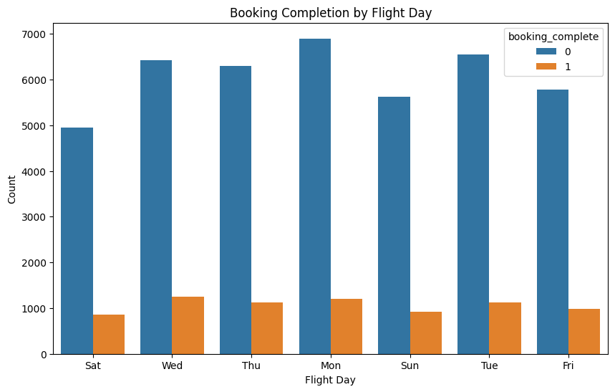
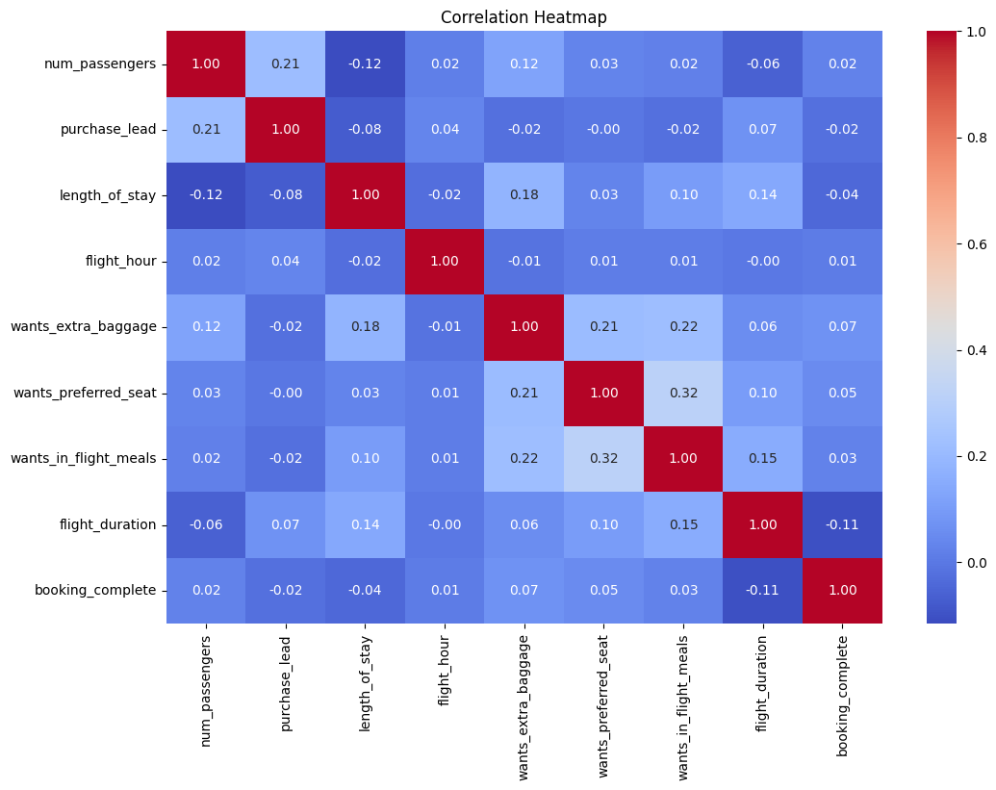
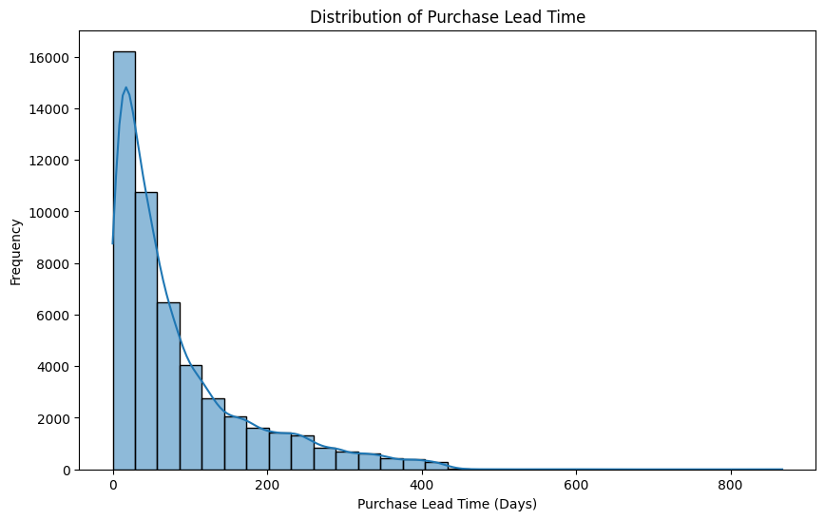

Slide 7
