Slide 1
AUTOMATED ANIMAL IDENTIFICATION AND DETECTION OF SPECIES
Submitted by
SUDHARSAN R (111620104147)
THARUN M (111620104157)
VEEKSHITH E R (111620104169)
Guided by
Ms. M.RAJA SUGUNA

Slide 2
ABSTRACT
Automated animal detection and species recognition have become increasingly important in ecological research, wildlife management and conservation efforts. The use of advanced technologies such as computer vision, machine learning and remote sensing has enabled the development of automated methods for identifying animals in their natural habitat. These methods involve the use of cameras, sensors and other data collection devices to capture images and data, which are then processed using deep learning algorithms to detect and recognize animals and their species.
One of the main challenges in automated animal detection and species recognition is the large variation in the appearance of animals, due to factors such as lighting conditions, weather and background clutter. To address this challenge, researchers have developed deep learning algorithms that can learn to recognize animals and their species based on a large database of labeled images. These algorithms can identify features such as fur patterns, body shape and size which are unique to each species and use them to distinguish between different animals.

Slide 3
INTRODUCTION
Monitoring biodiversity, especially the effects of climate and land-use change on wild populations is a critical challenge for our society. Sensor networks are a promising approach for collecting the temporal data at scales needed to address this challenge, especially visual sensors that record images of animals that move across their field of view. However, processing the large volumes of images that such studies generate to identify the species of animals recorded remains a challenge. At present, all camera-based studies of wildlife use a manual approach where researchers examine each photograph to identify the species in the frame. Computer-assisted species recognition on camera-trap images could make this work flow more efficient, and reduce, if not remove, the amount of manual work involved in the process.

Slide 4
LITERATURE SURVEY
RESEARCH WORKS
Automated detection of wildlife using drones: synthesis, opportunities and constraints.
Author: Evangeline Corcoran, Megan Winsen, Ashlee Sudholz, Grant Hamilton.
ABSTRACT
Accurate detection of individual animals is integral to the management of vulnerable wildlife species, but often difficult and costly to achieve for species that occur over wide or inaccessible areas or engage in cryptic behaviours. There is a growing acceptance of the use of drones (also known as unmanned aerial vehicles, uavs and remotely piloted aircraft systems, RPAS) to detect wildlife, largely because of the capacity for drones to rapidly cover large areas compared to ground survey methods. While drones can aid the capture of large amounts of imagery, detection requires either manual evaluation of the imagery or automated detection using machine learning algorithms.

Slide 5
While manual evaluation of drone-acquired imagery is possible and sometimes necessary, the powerful combination of drones with automated detection of wildlife in this imagery is much faster and, in some cases, more accurate than using human observers. Despite the great potential of this emerging approach, most attention to date has been paid to the development of algorithms, and little is known about the constraints around successful detection.
We reviewed studies that were conducted over the last 5 years in which wildlife species 5 were detected automatically in drone-acquired imagery to understand how technological constraints, environmental conditions and ecological traits of target species impact detection with automated methods.

Slide 6
EXISTING SYSTEM
Camera traps: Camera traps are a commonly used tool for monitoring wildlife populations. They consist of a camera that is triggered by motion or heat and can take photos or videos of passing animals. These cameras can be set up in remote locations and left to capture images over long periods of time. Software can then be used to analyze the images and identify the species present.
Acoustic monitoring: Many animals produce unique vocalizations that can be used for identification. Acoustic monitoring involves placing microphones in a natural environment to record animal sounds. These recordings can then be analyzed using software to identify the species present.

Slide 7
DRAWBACKS
Limited accuracy
Limited scalability
Limited applicability
Data quality issues
Ethical concerns

Slide 8
PROPOSED SYSTEM
In this chapter, we propose a system for automated animal identification and detection of species. The proposed system is based on deep learning techniques and is designed to be accurate, scalable, and easily accessible to non-experts.
DATA COLLECTION AND PREPROCESSING
The first step in the proposed system is to collect data in the form of images or videos of animals in their natural habitat. These data can be collected using various methods, such as camera traps, drones, or satellite imagery.
USER INTERFACE
The interface can allow users to upload images or videos of animals and receive the species identification and individual identification results.

Slide 9
ADVANTAGES
Efficiency: Automatic animal identification and species detection systems use advanced technologies such as machine learning, computer vision, and pattern recognition to analyze and classify animal species.
Accuracy: Automated systems can achieve high levels of accuracy in species identification. They are capable of recognizing subtle differences in physical characteristics, patterns, or behaviors that may be difficult for humans to discern.

Slide 10
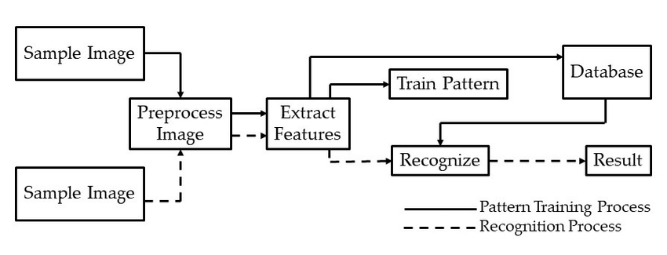
SYSTEM ARCHITECTURE

Slide 11
MODULE
Open CV
numpy

Slide 12
MODULE DESCRIPTION
OpenCV – Open source computer vision library for a wide range of computer vision tasks. OpenCV is a popular open-source library that provides various functions and algorithms for image and video processing, object detection and tracking, feature extraction, camera calibration.
numpy -This imports the NumPy library, which provides support for multi-dimensional arrays and mathematical functions.

Slide 13
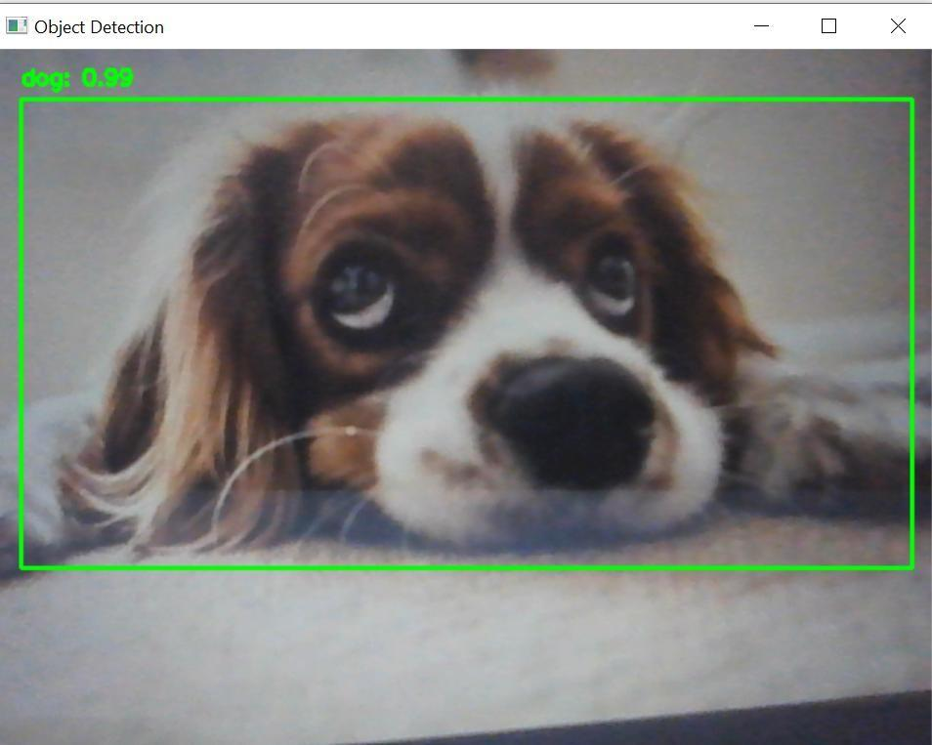
SCREENSHOT

Slide 14
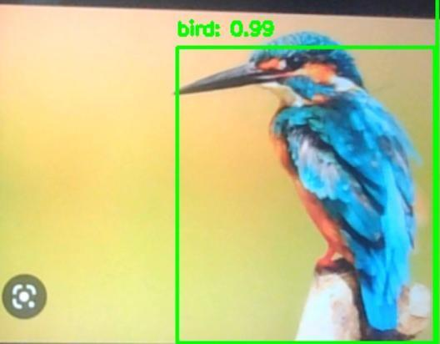
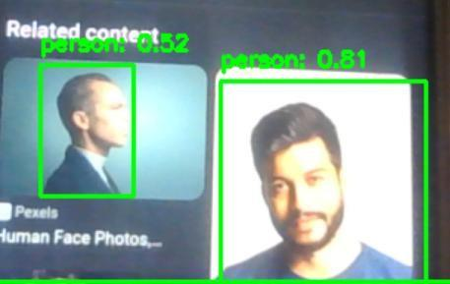

Slide 15
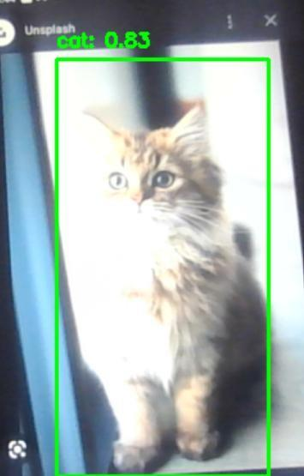

Slide 16
CONCLUSION
This system comes under machine learning which is advanced technique at
present.
YOLO is more suitable for image processing especially in image
classification.
It concludes the experimental result what which is obtained from
developed system is comparatively more accurate than many procedures followed
before.
Image recognition and prediction is a wide concept which is very deep.
Deeplearning concepts can be used in this subject to get efficient results.
Concept like Convolutional neural networks (CNN) can be used, which is effective in obtaining
results for image identification and classification.

Slide 17
FUTURE WORK
In future, the code will be imported into the Arduino board or Raspberry pi and
Will be attached to the live camera which helps to detect the species.

Slide 18
REFERENCE
1. Waziha Kabir, OmairAhmad.M, M.N.S Swamy, “A multi-biometric system
based on feature and score level fusion”, IEEE Transactions on Information and
Forensics and Security, vol.10, no.8, pp.964-971, 2018.
2. Tito Burghardt, Janko Calic, “Real time face detection and tracking of animals”,
IEEE Seminar on Neural Network applications in Electrical Engineering, vol.12,
no.6, pp.1228-1235, 2006

Slide 19


