Slide 1
Modules and Namespacing

Slide 2
Java Script Global’s
JavaScript has implied globals.
  Whenever a name is used,
  Interpreter walks the scope chain backwards
  Looking for a var statement for that name.
  If none is found, that variable is assumed to be global.
  If it’s used in an assignment, the global is created if it doesn’t already exist.
Using or creating global variables in an anonymous closure is easy.
  But it leads to hard-to-manage code
  Not obvious to humans

Slide 3
Global Abatement Pattern
Means reduction or removal of Global Variables
  Need to reduce the Number of global variables
  Need to Avoid Name clashes with local variables.
Done by Namespaces and creating an IIFE
  var app = {};
Create a Namespace by use of a single global variable for the application
  Reducing global footprint to a single name

Slide 4
Global Abatement
var app = {};
  This variable then becomes the container for the application
  Other Variable and applications are associated with this Namespace
Significantly reduces the chance of bad interactions with other applications, widgets, or libraries.
Application becomes easier to read
  app. getPassenger refers to a top-level structure.
Closure for information hiding is also a global abatement technique.

Slide 5
Name Spacing
The most basic approach.
Its Safe and unambiguous
Its verbose renaming the namespace becomes difficult
  var myApp = {}
  myApp.id = 0;
  myApp.next = function() {
  return myApp.id++;
  }
  myApp.reset = function() {
  myApp.id = 0;
  }
  console.log( myApp.next(),myApp.next(),myApp.reset());

Slide 6
Name Spacing
Can also be done by using Object literal Construct
Namespace is referred only once
  switching the name later is a little easier
  var myApp = {
  id: 0,
  next: function() {
  return this.id++;
  },
  reset: function() {
  this.id = 0;
  }
  }
  console.log( myApp.next(), myApp.next(),myApp.reset())

Slide 7
Modules
Can Shield from global scope by a IIFE
  IIFE will return an object representing the module’s public interfaces.
IIFE result is assigned to a namespace variable
  The module’s API in the namespace.
Additionally any variables not included in the return value will remain forever private
  But accessible only to the public functions that reference them.

Slide 8
Module Export
Globals can also be declared
Done by exporting them, using return value.
var MODULE = (function () {
  var my = {},
  privateVariable = 1;
  function privateMethod() {
  // ...
  }
  my.moduleProperty = 1; // public property
  my.moduleMethod = function () { // public method
  // ...
  };
  return my;
  }());

Slide 9
Module Import
  (function(app) {
  app.message2 = function () {
  return "Modules can be Agumented both Loosely and Tightly";
  };
  return app;
  })(myApp);

Slide 10
Augmentation
One limitation of the module pattern is that the entire module must be in one file.
Large Application needs to be splitting among multiple files.
Then its clearer and clean and faster than implied global’s
Can augment modules.
  import the module, then add properties, then export it.
  Anonymous function can be passed global’s as parameters

Slide 11
Loose Augmentation
Initial module creation to be first, and the augmentation to happen second,
  Which may not always be required.
JavaScript application can load scripts asynchronously.
Loose Augmentation
  Allows a flexible multi-part modules that can load themselves in any order
  The import will create the module if it does not already exist.

Slide 12
Loose Augmentation
  var myApp=(function(app) {
  var id = 0;
  app.show = function() {
  return "Use Modules";
  };
  return app;
  })(myApp || {});

Slide 13
Loose Augmentation
  var myApp=(function(app) {
  var id = 0;
  app.next = function() {
  return id++;
  };
  app.reset = function() {
  id = 0;
  return id;
  }
  return app;
  })(myApp || {});

Slide 14
Loose Augmentation
  <!DOCTYPE html>
  <html lang="en">
  <head>
  <!– Changing this Order Will also Work -- >
  <script src="LooseAugmentation.js"></script>
  <script src="BaseModule.js"></script>
  </head>
  <body>
  <script>
  console.log(myApp.show());
  console.log(myApp.next());
  console.log(myApp.next());
  </script>
  </body>
  </html>

Slide 15
Tight Augmentation
Loose augmentation place some limitations on module.
  Anonymous function can be passed global’s as parameters
  override module properties safely.
  Cannot use module properties from other files during initialization but at run-time after initialization
Tight augmentation implies a set loading order, but allows overrides.
Can have overridden Method, but maintain a reference to the original method, if needed.

Slide 16
Tight Augmentation
  var myApp=(function(){
  return{
  id : 0,
  show : function() {
  return "Use Tight Modules";
  },
  display:function(){
  return "Display Function";
  }
  }
  })();

Slide 17
Tight Augmentation
  var myApp=(function(app) {
  app.show = function () {
  return "Its Simple To Use";
  };
  return app;
  })(myApp);

Slide 18
Tight Augmentation
  <!DOCTYPE html>
  <html lang="en">
  <script src="BaseForTight.js"></script>
  <script src="TightAugmentation.js"></script>
  </head>
  <body>
  <script>
  console.log(myApp.show());
  </script>
  </body>
  </html>

Slide 19
JSUNIT

Slide 20
What is an XUnit framework?
A standardized set of language-independent concepts and constructs for writing and running unit tests
  JUnit for Java, CppUnit for C++, PHPUnit for PHP, UTPL/SQL for Oracle SQL
Traditionally open-source
All support certain constructs:
  TestCase and TestSuite are well-defined entities
  The assertion syntax follows rough standards, e.g. assertEquals(comment, expected, actual)
All provide a TestRunner program to run tests

Slide 21
What is unit testing?
Unit
  A Method , a class, a package, or a subsystem.
Can Test :
  an entire object
  part of an object – a method or some interacting methods
  interaction between several objects
Helps discover failures in the logic and improve the quality of their code.
Used to ensure that the code work as expected in case of future changes.

Slide 22
JsUnit: background
The XUnit framework for JavaScript www.jsunit.net
Preserves the standards of a typical XUnit framework
Written in 100% JavaScript
Runs on “most” browser/platform combinations

Slide 23
When to Write Test
During Development
To add new functionality
When adding new features,
During Debugging
While a defect is discovered in code to demonstrates the defect.
write unit tests to thoroughly test a single class
write tests as develop (even before you implement)
write tests for every new piece of functionality
Notes:
Bei Test-getriebener Entwicklung wird - wie der Name schon sagt - die Entwicklung durch automatisierte Tests getrieben, indem neuer Code nur dann geschrieben wird, wenn ein automatisierter Test fehlgeschlagen hat. Die Entwickler müssen Tests schreiben, bevor sie die Implementierung schreiben.

Slide 24
JsUnit: conforming to XUnit
Unit tests in JsUnit are called Test Functions
Test Functions live in an HTML page called a Test Page
A Test Page is any HTML page that has a JavaScript “include” of jsUnitCore.js
jsUnitCore.js provides the assertion functions of JsUnit, e.g. assertEquals(comment, arg1, arg2)
JsUnit supports setUp() and tearDown()
setUp()
  method which runs before every test invocation.
tearDown()
  method which runs after every test method.

Slide 25
Assert Statements
fail(msg)
– triggers a failure named msg
assertTrue(msg, b)
triggers a failure, when condition b is false
assertEquals(msg, v1, v2)
triggers a failure, when v1 == v2 is false
assertEquals(msg, v1, v2, eps)
triggers a failure, if abs(v1 – v2) > eps
assertNull(msg, object)
  triggers a failure, when object is not null
assertNaN()
Checks that a value is NaN (Not a Number)
assertNotNaN()
Checks that a value is not NaN
assertNotUndefined()
Checks that a value is not undefined
assertUndefined()
Checks that a value is undefined<static> void

Slide 26
JSUnit
    var qs={};
  qs.add = function(a, b)
  {
  return (a*b ) +10;
  }
  function testAddWithValidArgs(){
  var actual = qs.add(5,3);
  var expected=115;
  assertEquals("5 Times 3 with 100 equal 115",expected,actual);
  }

Slide 27
Test Page
  <!DOCTYPE html>
  <html lang="en">
  <head>
  <title></title>
  <meta charset="UTF-8">
  <meta name="viewport" content="width=device-width, initial-scale=1">
  <script src="../app/jsUnitCore.js"></script>
  <script src="scripts/QuickStart.js"></script>
  </head>
  <body>
  Using JSUNit Testing
  </body>
  </html>

Slide 28
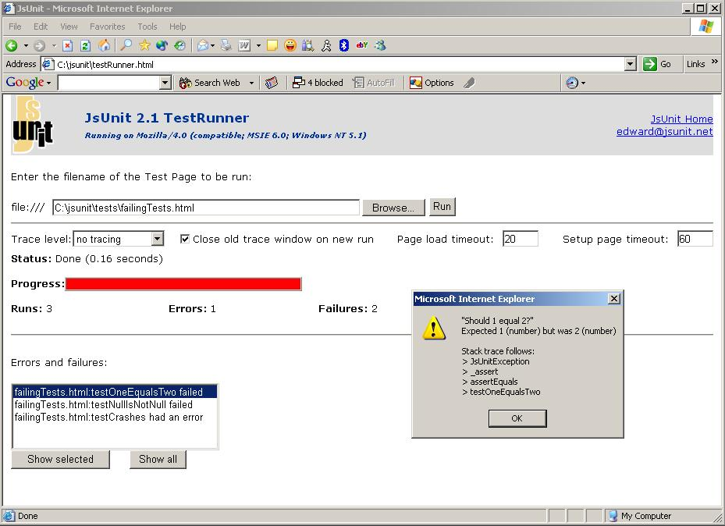
JsUnit: the TestRunner

Slide 29
JsUnit Tracing
Tracing
  view output without using JavaScript “alerts”
  Alternative to a debugger
There are 3 trace functions:
  debug(message) (level 3)
  warn(message) (level 2)
  inform(message) (level 1)
Traces cascade, i.e. trace message at lower levels show up when the level is set higher
  output “traces” to a debugging window

Slide 30
Form Validation
  var loginButton = document.getElementById("loginButton");
  loginButton.addEventListener("click",validate);
  function validate(){
  var usrName= document.usrForm.userName.value;
  var element =document.getElementById("msg");
  if(usrName.length< 6)
  {
  element.innerHTML="Length 6-8 Chars";
  }
  else
  {
  element.innerHTML="Valid Name";
  }
  }

Slide 31
Tests
  function setUp(){
  document.usrForm.userName.value="rames";
  }
  function testValidMessageInitalCondition(){
  actual =document.getElementById("msg").innerHTML;
  assertEquals("",actual);
  }

Slide 32
Tests
  function testValidMessageText(){
  clickLoginButton();
  actual =document.getElementById("msg").innerHTML;
  assertEquals("Length 6-8 Chars",actual);
  }
  function clickLoginButton(){
  validate();
  }
  function tearDown(){
  document.usrForm.userName.value="";
  document.usrForm.passWord.value="";
  }

Slide 33
HTML Page
  <form name="usrForm" action="#">
  <label for="usrName">User Name</label>
  <input type="text" name="userName" id="userName">
  <span id="msg"></span>
  <label for="passWord">Pass Word</label>
  <input type="text" name="passWord" id="passWord">
  <input type="button" value="Login" id="loginButton">
  </form>
  <script src="../app/jsUnitCore.js"></script>
  <script src="scripts/FormHandling.js"></script>
  <script src="scripts/TestingForms.js"></script>

Slide 34
JsUnit
JsUnit is NOT appropriate for submitting forms/other navigation that interacts with a web server:
  It is intended to test purely client-side functionality – it’s a unit testing framework of the in-browser
  Testing “walking through” a web application should be done in HTTPUnit/JWebUnit

