Slide 1
Java Script Design Patterns

Slide 2
Topics
Single Page Application
MVC/MVVM
Definition and Architecture
Sequence flow/Diagram
Advantages and Disadvantages
Anti Patterns

Slide 3
Single Page Application
A Single-Page Application (SPA) is a web application that fits on a single web page
  Page resources are retrieved either at page load or loaded in response to user actions
  The page does not reload at any point
SPA apps can contain multiple fake pages
  Not real pages, but ones that look like a page

Slide 4
Architecture of SPA Apps
SPA Applications have a different architecture than regular JavaScript applications
Commonly SPA apps have:
  A layer of server logic like Web services
    Containing both Database and Business logic
  A client layer, implemented with HTML5 and JavaScript
    Containing communication with the server and UI logic

Slide 5
SPA Applications: Pros and Cons
SPA applications have:
  Better performance
    There is logic on both the server and the client
  Lower bandwidth
    Only JSON/XML data is send over HTTP
    The JSON data is rendered on the client
  Higher code reusability
    The server gives an API, that is fully decoupled with the UI
  A combination of lots of Patterns and Frame Works are required

Slide 6
SPA Applications Architecture
Most SPA applications based solid JavaScript business logic
  They have a server that contains the database and exposes web services
    Web services are kind of requirement for SPA
The JavaScript communicates with the server using HTTP requests and AJAX calls

Slide 7
Architecture and Design
Architecture
  addresses problems of distributed functionality, system partitioning, protocols, scalability, reliability, security
  Comprises of frameworks, tools, programming paradigms, design principles
Design patterns
  Language-independent abstractions
  Created with object oriented mechanisms and described by UML diagrams
  Solve commonly occurring problems in software construction.

Slide 8
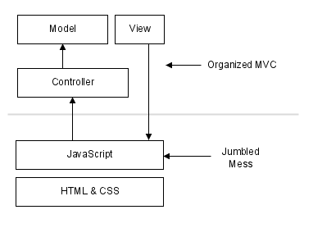
Architecture and Design

Slide 9
MVC
An architectural design pattern
Improved application organization through a separation of concerns.
Has been applied to a diverse range of programming languages
JavaScript a number of frameworks supporting MVC
  Easily add structure to applications without great effort.
  Backbone, Ember.js and AngularJS.

Slide 10
MVC Benefits
Separation of concerns results in simpler modularization
Easier maintenance
  When updates need to be made can be to models and possibly controllers, or to views.
Decoupling models and views enables to write unit tests for business logic
Parallel development can done based size of the application
  One group developers can work on core logic
  While other group can work on the user-interfaces
Client-side MVC frameworks is most appropriate when working with lots of data

Slide 11
MVC
Models
  Isolation of business data
  Data models (JSON or POCO)
Views
  user interfaces
  Contains UI logic (HTML,CSS, UI JS)
Controllers
  Contains business logic
  Handling user-input.
  Fills models with data and passes them to a View
  Plays the role of the middleman

Slide 12
MVC Architecture
Controller
(data communication, View rendering)
Knows of
Knows of
Model
(data from and to the server)
View
(HTML, CSS,
UI JavaScript)
Knows of

Slide 13
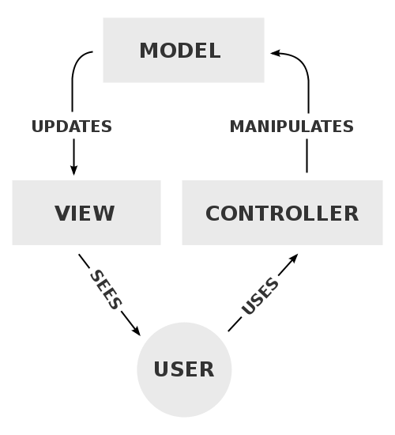
Model-View-Controller
A Controller updates a model, The Model updates the view and the view triggers the Controller.
Model-View communication is done by Observer Pattern

Slide 14
JavaScript Frameworks Implementing MVC
Most of the JavaScript frameworks implement the MVC pattern:
  AngularJS
  Backbone.js
  Ember.js
  Sammy.js
  Google Closure
  Batman.js

Slide 15
Model
Manage the data for an application.
Defines what data the app should contain.
  user account (e.g name, avatar, e-mail)
  music track (e.g title, year, album).
They don’t handle behavior
  Making Ajax Calls , complex Business Logic
They don’t control data rendering
  Models can add some logic to raw Data-total, simple calculation
  Models can validate data being used to define or update existing models
If the state of data changes, then the model will usually notify the view through Controller
  View can then display the change as needed

Slide 16
View
Defines how the Model should be displayed.
Renders in a way suitable for interaction with UI Elements.
Users interact with views to get or set the attribute in models.
They build and maintain a DOM element.
Can also observe a model and is notified when the model changes
  Allows view to update accordingly.
View Could also do Event Handling , that doesn't require any Model Updates
  Eg: - Sorting the Rendered Data

Slide 17
Controllers
Intermediary between models and views
Responsible for updating the model when the user manipulates the view.
The view *could* delegate handling model change events to the controller if the view sees fit
The Controller tells to View to do something with the Model Data.
The Controller knows about both the Model and the View
The Model knows nothing of the View and the Controller

Slide 18
Model
  var model=(function(){
  var app={};
  app.Player=function Player(name,matchesPlayed,ranking) {
  this.name = name;
  this.matchesPlayed = matchesPlayed;
  this.ranking = ranking;
  };
  playerList =[];
  app.add=function(player) {
  playerList.push(player);
  }
  app.get=function(){
  return playerList;
  }
  return app;
  })();

Slide 19
View
  var view =(function(model){
  return {
  handleSaveButton:function(){
  var formEl = document.forms.addPlayerFrm;
  var name =formEl.name.value;
  var matches=formEl.matches.value;
  var rank= formEl.rank.value;
  var player=new model.Player(name,matches,rank);
  cricketCtrl.update(player);
  }
  };
  })(model);

Slide 20
Controller
  var cricketCtrl=(function(model,view){
  return {
  init:function(){
  var saveButton = document.addPlayerFrm.commit;
  saveButton.addEventListener("click", view.handleSaveButton);
  },
  update:function(player){
  model.add(player);
  }
  }
  })(model,view);

Slide 21
HTML Page
  <form action="#" name="addPlayerFrm">
  <input type="text" name="name">
  <input type="text" name="matches">
  <input type="text" name="rank">
  <input type="button" value="Add" name="commit"></input>
  </form>
  <script src="model/Player.js"></script>
  <script src="view/ViewPlayer.js"></script>
  <script src="ctrl/PlayerControl.js"></script>
  <script>
  cricketCtrl.init();
  </script>

Slide 22
MVVM

Slide 23
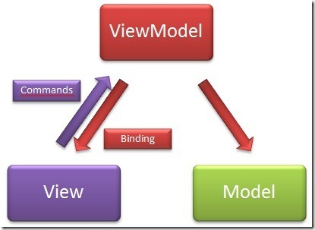
Model-View-ViewModel

Slide 24
Model-View-ViewModel
Model-View-ViewModel has three sub layers:
  Model
    Contains data models (JSON or POCO)
  View
    Contains UI logic (HTML,CSS, UI JS)
  ViewModel
    Model of the View - The View binds to the VM
    Contains business logic
    Keeps models of data, Views get what they need
    Plays the role of the middleman

Slide 25
MVVM Architecture
View
(HTML, CSS,
UI JavaScript)
Binds to
ViewModel
(data communication,
business Logic)
Knows of
Model
(data from and to the server)

Slide 26
MVVM
The View can bind to properties on the ViewModel which in turn expose data contained in Models to the View.
MVVM’s View contains the data-bindings, events and behaviors which requires an understanding of the ViewModel.
Although these behaviors can be mapped to properties, the View is still responsible for handling events from the ViewModel.
View isn’t responsible for handling state - its kept in sync with the ViewModel.

Slide 27
JavaScript Frameworks Implementing MVVM
MVVM was designed mostly for use in WPF/Silverlight, but its usable in JavaScript as well
  Knockout.js
  Knockback.js
  Kendo.UI
  Kendo UI Mobile

Slide 28
View Model
Source Views go to both data and actions.
Views and ViewModels communicate using data-bindings and events.
They expose Model attributes and also access to other methods and features such as validation.
Models and attributes on the ViewModel are synchronized and updated via two-way data-binding.
Triggers (data-triggers) also allow us to further react to changes in the state of our Model attributes.

Slide 29
Anti Patterns
A pattern represents a best practice
  An anti-pattern represents a bad solution to a particular problem
Anti-patterns, allow developers a means to recognize these in advance
  can avoid common mistakes
  Can refactor code to negate them so that the overall quality improves

Slide 30
Anti Patterns
Examples of anti-patterns in JavaScript are the following:
Polluting the global namespace by defining a large number of variables in the global context
Using JavaScript in an inline form as this is inflexible
The use of document.write where native DOM alternatives such as document.createElement are more appropriate.
if it's executed after the page has been loaded it can actually overwrite the page

Slide 31
Extending Object-Anti Pattern
Extending of the base Object's prototype.
This is considered to be very bad practice mainly because it breaks for in loops.
  var obj = {a: "A", b: "B", c: "C", d: "D"};
  for (var key in obj) {
  console.log(key +': '+obj[key]);
  }
  Object.prototype.e = "E";
  for (var key in obj) {
  console.log(key +': '+obj[key]);
  }

