Slide 1

A.I. powered Chess
Dilbagh Singh Sidhu

Slide 2
Chess is not a game. Chess is a well-defined form of computation. You may not be able to work out the answers, but in theory, there must be a solution, a right procedure in any position
- John von Neumann

Slide 3
Basic Structure
A game engine majorly provides below functionalities
Create a search tree with all possible moves.
Evaluate moves hence compare nodes of tree.
Search tree to find best node.
Do above tasks efficiently.

Slide 4
Creating Tree
In this case tree is created by starting from initial state as root node and performing all legal moves one by one on this node to get its child nodes.
Then the above process is repeated recursively for each leaf node.
Above procedure may not be practical as number of nodes in this case may go to the orede of 10^128.
Since computer may not have that tremendous amount of resources we define a max depth.
At any step depth of tree is not allowed to exceed this limit.

Slide 5
Searching Tree
We use minmax algorithm to search the tree for best solution.
Minmax assumes that both the players will choose the best available move.
It tries to choose the move which will best benefit the player at one level and at next level tries to choose move which worst affects the player.

Slide 6
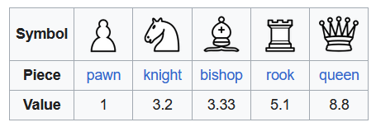
Evaluating the nodes
To evaluate the nodes we use Hans-Berliner system.
Each piece is assigned relative value.
These values of all the pieces present at a particular instance are added to get value of that node.

Slide 7
Improving efficiency
Even after we set a max depth the number of nodes are quiet large in number.
To overcome this we use alpha-beta pruning.
This method cuts the number of nodes that need to be checked by eliminating entire subtrees where optimal solution is likely to be found.
Time complexity in best case is reduced from O(b^d) to O(b^(d/2))

Slide 8
Alpha-Beta pruning
We use two threshold parameters alpha and beta.
Initial value of alpha is –infinity and that of beta is infinity.
Max player updates alpha and min player updates beta.
We only pass alpha and beta to child nodes.
Starting from level above leaf nodes alpha is updated by selecting max of child nodes and beta by selecting min of child nodes.
When alpha>=beta tree is pruned.

Slide 9


