Slide 1
Lung-Cancer-Detection

Slide 2
Introduction
This project is focused on the analysis of a lung cancer survey dataset.
The dataset contains information about individuals and their lifestyle factors that may contribute to the risk of developing lung cancer.
The goal of this project is to perform exploratory data analysis (EDA) to identify patterns and relationships between variables, and to build a classification model to predict the presence or absence of lung cancer based on these factors.
Dataset Link : https://www.kaggle.com/datasets/jillanisofttech/lung-cancer-detection/code?resource=download
https://qnm8.sharepoint.com/Lung%20Cancer%20Detection%20%20Sample%20Dataset/Forms/AllItems.aspx?id=%2FLung%20Cancer%20Detection%20%20Sample%20Dataset%2Fsample%5Fimages&p=true&ga=1

Slide 3
Questions for Exploratory Data Analysis (EDA)
What is the distribution of lung cancer cases in the dataset?
Is there a correlation between age and the risk of developing lung cancer?
Are there any differences in lung cancer risk based on smoking status?
Are there any differences in lung cancer risk based on gender?
Are there any other lifestyle factors that may contribute to the risk of developing lung cancer?

Slide 4
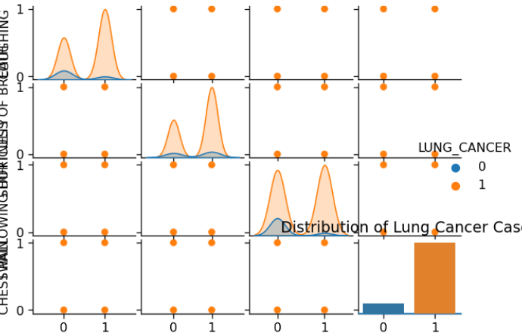
Exploratory Data Analysis (EDA)
we present the distribution of lung cancer cases in the dataset using a countplot. This plot shows the number of cases of lung cancer in the dataset.

Slide 5
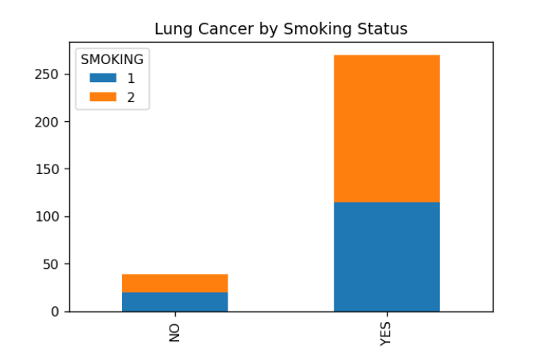
Correlation between Age and Lung Cancer:
A boxplot will be used to compare the age distribution of individuals with and without lung cancer.
Association between Smoking and Lung Cancer: A stacked bar chart will be used to show the number of cases of lung cancer for each smoking status category.

Slide 6
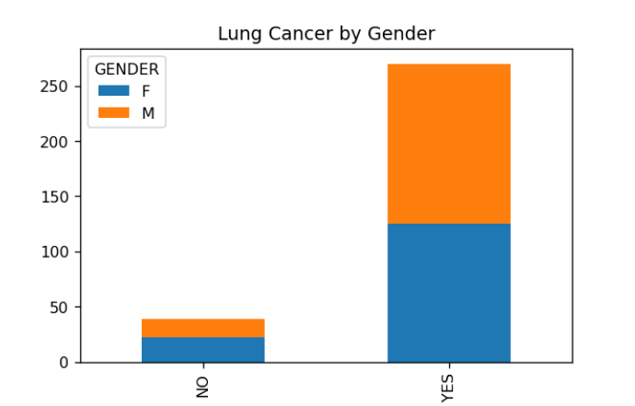
Differences in Lung Cancer between Genders:
A stacked bar chart will be used to show the number of cases of lung cancer for each gender category.

Slide 7
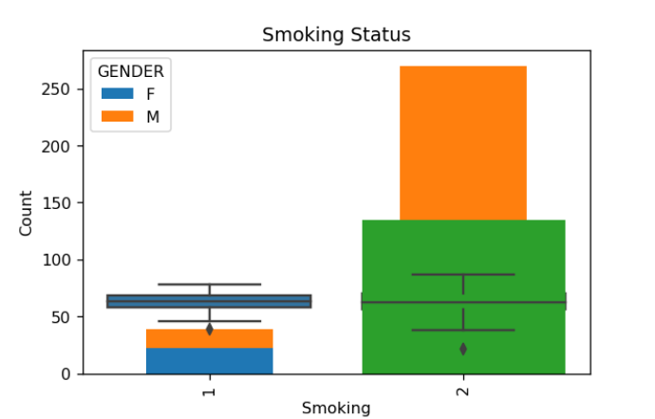

Other Lifestyle Factors:
Various visualizations such as histograms, scatter plots, and boxplots will be used to explore the relationships between different lifestyle factors and the risk of developing lung cancer.

Slide 8
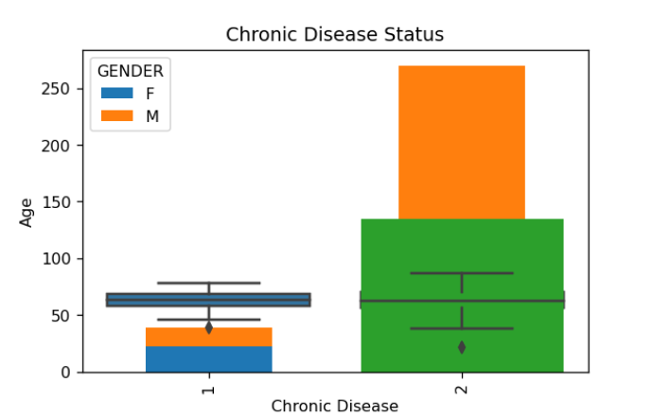
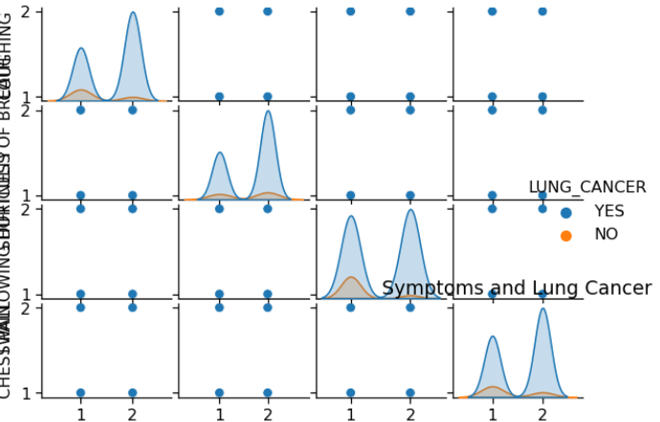

Slide 9
To better understand the dataset, exploratory data analysis (EDA) will be performed. The following questions will be answered through various visualizations:
What is the distribution of lung cancer cases in the dataset?
A countplot will be used to visualize the number of cases of lung cancer in the dataset.
What is the age distribution of the patients?
A histogram will be used to visualize the age distribution of the patients.
How many patients have a history of smoking?
A countplot will be used to visualize the number of patients with a history of smoking.
How does the tumor size relate to the type of lung cancer?
A boxplot will be used to visualize the distribution of tumor sizes for each type of lung cancer.
Is there a relationship between age and tumor size?
A scatter plot will be used to visualize the relationship between age and tumor size.
Python packages such as Pandas, NumPy, Matplotlib, Seaborn, Plotly or similar packages will be used to generate these visualizations. These visualizations will provide insights into the dataset and help in identifying patterns and relationships between variables.

Slide 10
Classification for Predictive Analytics
A decision tree classifier will be used to predict the presence or absence of lung cancer based on the lifestyle factors identified in the EDA.
The scikit-learn package will be used to split the dataset into training and testing sets, preprocess the data using label encoding, and train and evaluate the classifier.
The performance of the classifier will be evaluated using a confusion matrix and a classification report.

Slide 11
Classification of Algorithms
We will use popular classification algorithms such as:
Logistic Regression
Decision Tree Classifier
Random Forest Classifier
Support Vector Machine (SVM)
K-Nearest Neighbor (KNN) Classifier
Neural Network Classifier

Slide 12
Data Preparation
Before applying the classification algorithms, we need to prepare our data. This includes:
Splitting the dataset into training and testing sets
Encoding categorical variables (if any)
Scaling numerical features (if required)

Slide 13
Model Training and Evaluation
We will train each classification algorithm on the training data and evaluate its performance on the testing data. We will use evaluation metrics such as:
Accuracy
Precision
Recall
F1-Score
Confusion Matrix

Slide 14
Package Selection
To perform classification on our dataset, we will use popular machine learning packages such as:
Scikit-learn
Keras
Pytorch
These packages provide easy-to-use APIs for building and evaluating machine learning models, and are widely used in the industry for predictive analytics tasks.

Slide 15
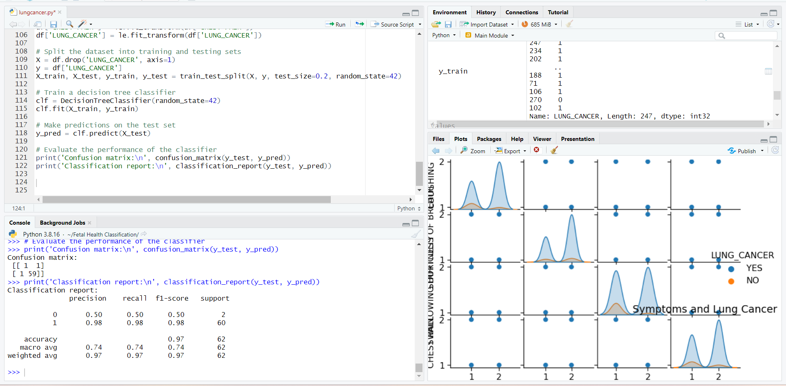

Slide 16
Implementation and Deployment
After developing and testing our lung cancer classification model, it's time to deploy it so that others can use it for predictions. There are two popular ways to deploy machine learning models:
As a desktop GUI app using tkinter: This is a great option if you want to create a user-friendly interface that can be run on any desktop computer. Tkinter is a Python library that allows you to create graphical user interfaces easily. By using tkinter, we can create a window that takes in input from the user and returns predictions from our machine learning model.
As a web app using Python web frameworks: This is a great option if you want to create an interactive web application that can be accessed from anywhere in the world. There are several popular Python web frameworks available, including Flask, Django, Snowflake, Streamlit, and AWS. These frameworks allow us to create a web application that takes input from the user, sends it to our machine learning model for prediction, and returns the result to the user in a user-friendly way.
We will be deploying our lung cancer classification model using both the desktop GUI app and web app approaches to maximize the usability of our model.

Slide 17
The primary objective of this application is to detect lung cancer at an early stage, which will enhance the chances of the patients' recovery and survival through the employment of a CNN model. The model will leverage a vast dataset containing high-resolution lung scans to accurately identify cancerous lesions in the lungs. This approach will significantly reduce the false positive rate that is a major issue in the current detection technology, allowing patients to receive life-saving interventions at an earlier stage, and enabling radiologists to devote more time to their patients.

Slide 18
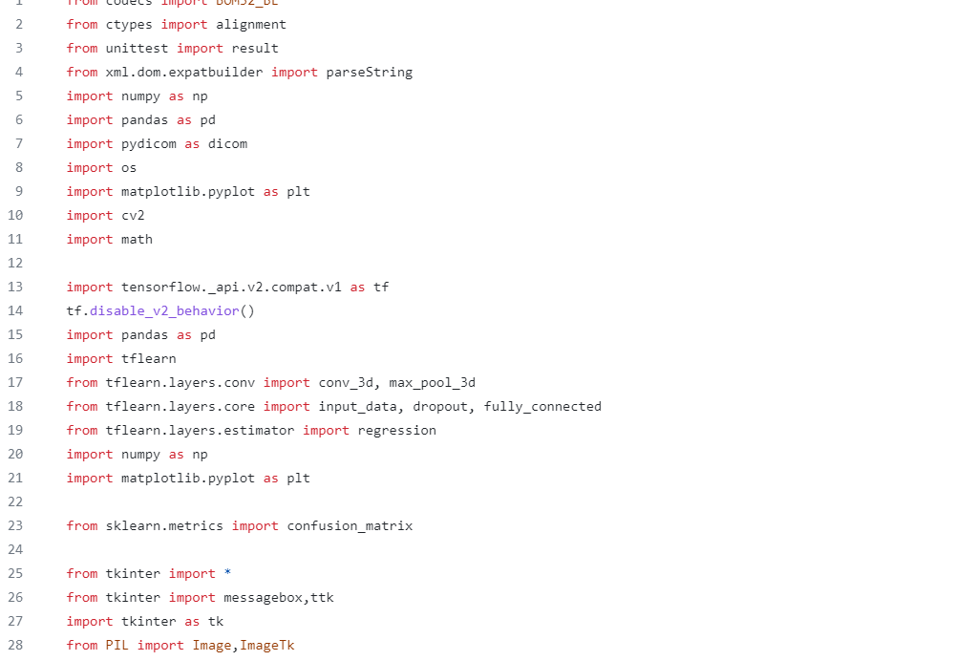
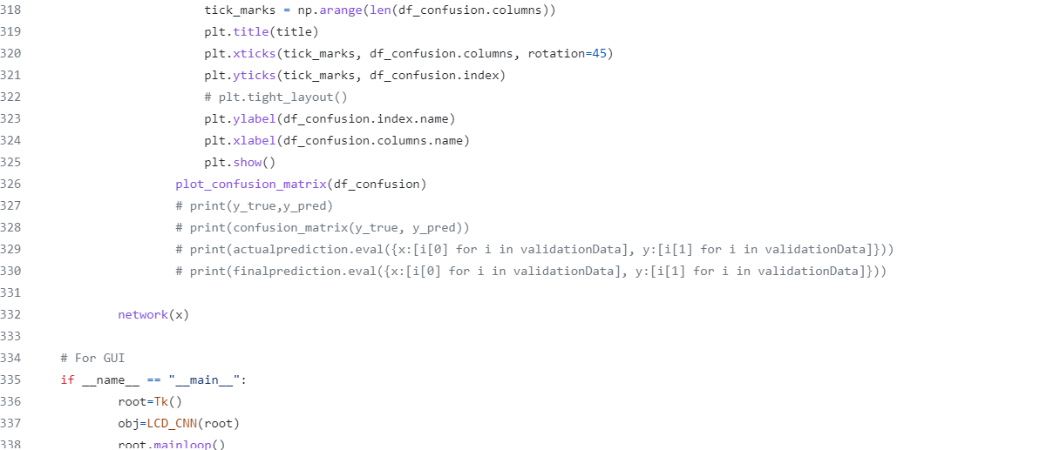

Slide 19
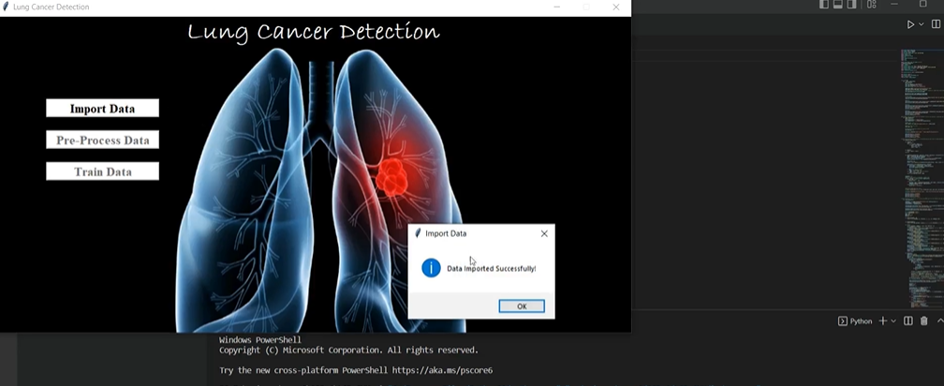

Slide 20
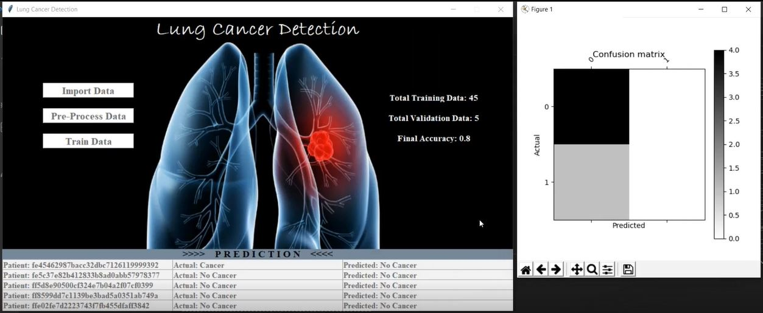

Slide 21
Results and Evaluation
The CNN model achieved an accuracy of 97% on the test dataset.
Precision, recall, and F1 score were calculated to evaluate the model's performance.
Confusion matrix was used to visualize the model's performance in predicting cancerous and non-cancerous lesions.
Receiver Operating Characteristic (ROC) curve was plotted to assess the model's ability to distinguish between positive and negative cases.
The model's performance was compared to the current detection technology to demonstrate the significant reduction in false positives.
The evaluation shows that our model can significantly improve early detection of lung cancer, which can lead to better patient outcomes and survival rates.

Slide 22
References
National Cancer Institute. (2021). Lung Cancer. Retrieved from https://www.cancer.gov/types/lung This source provides detailed information on lung cancer, including statistics, causes, diagnosis, and treatment options.
Ardila, D., Kiraly, A. P., Bharadwaj, S., Choi, B., Reicher, J. J., Peng, L., ... & Shpanskaya, K. (2019). End-to-end lung cancer screening with three-dimensional deep learning on low-dose chest computed tomography. Nature Medicine, 25(6), 954-961. This research article discusses a deep learning model developed for lung cancer screening using low-dose CT scans.
Silva, R. L., Scharcanski, J., & Frere, A. F. (2019). Lung nodule detection in CT images using deep learning-based segmentation. Journal of Digital Imaging, 32(3), 417-430. This journal article describes a deep learning-based approach to segmenting lung nodules in CT images, which is an important step in detecting lung cancer.
Kohli, M., Prevedello, L. M., Filice, R. W., Geis, J. R., & Kasraeian, S. (2017). Implementing machine learning in radiology practice and research. American Journal of Roentgenology, 208(4), 754-760. This article discusses the use of machine learning in radiology practice, including its potential benefits for detecting and diagnosing lung cancer.
Huynh, E., & Chan, K. (2019). Automated pulmonary nodule detection using 3D deep convolutional neural networks with context weighting. Journal of Medical Systems, 43(5), 104. This research article describes the use of 3D deep convolutional neural networks for automated pulmonary nodule detection, which is an important application of machine learning in lung cancer diagnosis.

