Slide 1


Mobile Electronic Training Jacket Naval Undersea Warfare Center
Sponsors: David Silvia, Kevin Genest, Michael Silva
Team: Jacob Strojny, Kevin MacAllister, Tyler MacInnis, Robert Huard
Notes:
Good morning
Today’s presentation is titled the “Mobile Electronic Training Jacket”. The project’s sponsor is NUWC, the naval undersea warfare center. The sponsors from nuwc are David Silvia, Keven Ganest, Micheal Silva. I’d like to introduce the development team, project lead Jacob Strojny, Kevin MacAllister, Tyler MacInnis and, myself, Robert Huard.

Slide 2

Current Electronic Training Jacket
Contains a sailors complete Naval career history
Only available through commercial web browsers
The computer connecting must also be able to read Common Access Cards
Notes:
I’m going to start by explaining “what is an electronic training jacket?”. Its simply an electronic portfolio of a sailors complete naval career history. It encompasses information relative to that sailor. Information such as education, training, awards and advancement status. It can be used to monitor and guide a sailor’s naval career, schedule and plan prerequisites to acquire new credentials, or simply be used to fill out paperwork.
The issue with the current electronic training jacket is its accessibility. To access an electronic training jacket a computer has to be equipped with a CAC card reader, have a commercial browser and an internet connection. Sailors not on a base do not have access to their electronic training jacket.
Knowing the technology existed to give the sailors the capability to access their electronic training jackets, NUWC proposed the idea for a mobile application the sailors could use to access their electronic training jackets from a smartphone or tablet. This brings us to our Mobile Electronic Training Jacket application.

Slide 3
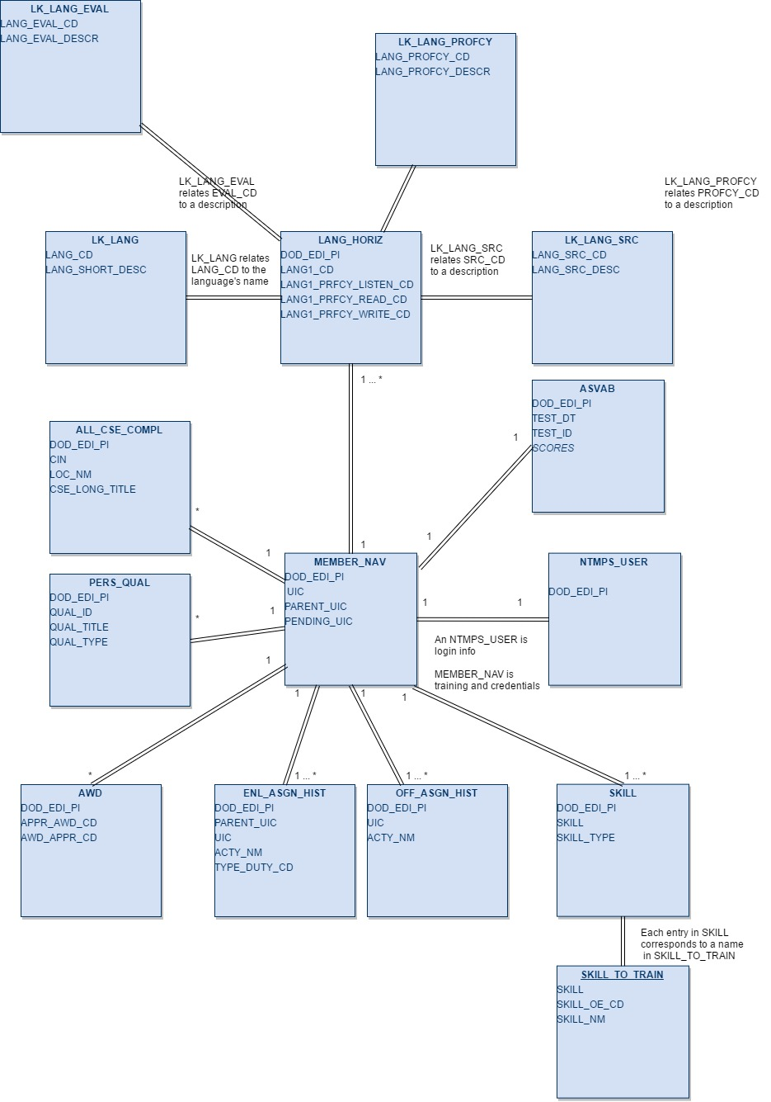
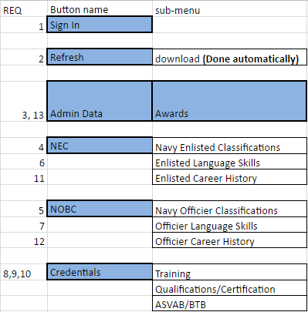

Requirements
App should be easy to use and not look cluttered
Android Based
Able to access SQL database of training information
Notes:
Some of the fundamental requirements for the project were
we knew we needed a fully functioning application that looked good, was easy to navigate through and could display information suitably on a smartphone or tablet screen. In an effort to make the navigation through the application easy we limited the submenu system to 2 level. You’re never more than 2 back clicks away from the home screen.
The application needed to be able to run on an android operating system and be able to connect and read to a SQL database.

Slide 4

Authentication
Use of username/password not allowed, must find another verification method
“Something the user knows and something they have” authentication scheme
IMEI (International Mobile Equipment ID)
WLAN MAC (Unique Phone ID)
Notes:
NUWC wanted a new, easy and unique authentication. They wanted to move away from the traditional username and password authentication. They expressed an interest in using criteria with “something that they know” and “something that they have”.
Deciding what criteria to use for something that they know was easily decided with a user pin.
For something that they had, their smartphone was the obvious choice, considering it’s a mobile application. We came up with two unique identifiers for the smartphones and tablets. An IMEI number and a WLAN number. Since the IMEI number is associated with the sim card and not every device requires a sim card to gain internet access the WLAN number was the more appropriate choice. This is because every individual device has a unique WLAN number assigned to it. Much like the way we have a social security number assigned to us.

Slide 5





Tools & Languages
Tools
Trello
Git, GitHub
Android Studio
Eclipse (For Data Parsing and Server)
Tomcat/Apache
Languages
Java
SQL (SQLite/MySQL)
Notes:
Software tools incorporated into the project:
Trello agile project management and scrum software was used to coordinate, manage and task the entire project.
Git and Github was used as a repository for the android application
Android studio development environment was used to produce the mobile application.
Languages used to code was Java and SQLite.

Slide 6
DEMO
Notes:
Now, to demonstrate the actual mobile application. The demonstration will be run through the android studio’s phone emulator.

Slide 7
Questions and Answers

