Slide 1
Topic 6: Arrays, Pointers and Stack Frames
José Nelson Amaral
University of Alberta

Slide 2
C Sort Using Bubble Sort
temp
7
0
1
2
3
4
5
6
7
C code:
void swap(int v[], int k) { int temp; temp = v[k]; v[k] = v[k+1]; v[k+1] = temp; }
1
3
7
5
9
11
12
15
v
7
5
swap(v, 2)
Assumption:
v ⟷ $a0
k ⟷ $a1
temp ⟷ $t0

Slide 3
C Sort Using Bubble Sort
temp
7
0
1
2
3
4
5
6
7
C code:
void swap(int v[], int k) { int temp; temp = v[k]; v[k] = v[k+1]; v[k+1] = temp; }
1
3
7
5
9
11
12
15
v
7
Address
Value
swap(v, 2)
0x1000104C
0x10001048
0x10001044
Assumption:
v ⟷ $a0
k ⟷ $a1
temp ⟷ $t0
0x10001040
0x1000103C
Processor
0x10001038
$a0
0x1000 1018
0x10001034
0x0000 000F
0x10001030
0x0000 000C
0x1000102C
0x0000 000B
$a1
0x0000 0002
0x10001028
0x0000 0009
0x10001024
0x0000 0005
v[k+1]
0x0000 0007
0x10001020
0x0000 0007
v[k]
0x0000 0005
$t0
0xbbbb bbbb
0x1000101C
0x0000 0007
0x0000 0003
0x10001018
0x0000 0001
$t2
0x10001014
0x0000 0005
0xbbbb bbbb
0x10001010
Section 2.13

Slide 4
C Sort Example
Assumption:
v ⟷ $a0
k ⟷ $a1
temp ⟷ $t0
Intermediate code (2):
temp ← M[v + k*4] tA ← M[v + (k+1)*4]
M[v + k*4] ← tA M[v +(k+1)*4] ← temp
Must separate addess
computation from load
C code:
void swap(int v[], int k) { int temp; temp = v[k]; v[k] = v[k+1]; v[k+1] = temp; }
Intermediate code (2):
temp ← M[v + k*4] tA ← M[v + (k+1)*4]
M[v + k*4] ← tA M[v +(k+1)*4] ← temp
Intermediate code (3):
tB ← v + k*4
temp ← M[tB] tA ← M[v + (k+1)*4]
M[tB] ← tA M[v +(k+1)*4] ← temp
Intermediate code (3):
tB ← v + k*4
temp ← M[tB] tA ← M[v + (k+1)*4]
M[tB] ← tA M[v +(k+1)*4] ← temp
Rewrite as:
v + k*4 + 4 = tB + 4
Intermediate code (1):
temp ← M[v + k*4] M[v + k*4] ← M[v + (k+1)*4] M[v +(k+1)*4] ← temp
Intermediate code (1):
temp ← M[v + k*4] M[v + k*4] ← M[v + (k+1)*4] M[v +(k+1)*4] ← temp
Intermediate code (4):
tB ← v + k*4
temp ← M[tB] tA ← M[tB + 4]
M[tB] ← tA M[tB + 4] ← temp
Intermediate code (4):
tB ← v + k*4
temp ← M[tB] tA ← M[tB + 4]
M[tB] ← tA M[tB + 4] ← temp
multiplication and addition
should be two statements
Can’t load from and store to
memory on a single statement.
Section 2.13

Slide 5
Assumption:
v ⟷ $a0
k ⟷ $a1
temp ⟷ $t0
Intermediate code (5):
tB ← k*4
tB ← v + tB
temp ← M[tB] tA ← M[tB+4]
M[tB] ← tA M[tB+4] ← temp
Intermediate code (5):
tB ← k*4
tB ← v + tB
temp ← M[tB] tA ← M[tB+4]
M[tB] ← tA M[tB+4] ← temp
$a1
$a0
Intermediate code (2):
temp ← M[v + k*4] tA ← M[v + (k+1)*4]
M[v + k*4] ← tA M[v +(k+1)*4] ← temp
C code:
void swap(int v[], int k) { int temp; temp = v[k]; v[k] = v[k+1]; v[k+1] = temp; }
Intermediate code (2):
temp ← M[v + k*4] tA ← M[v + (k+1)*4]
M[v + k*4] ← tA M[v +(k+1)*4] ← temp
Intermediate code (6):
tB ← $a1 << 2
tB ← $a0 + tB
$t0 ← M[tB] tA ← M[tB+4]
M[tB] ← tA M[tB+4] ← $t0
Intermediate code (6):
tB ← $a1 << 2
tB ← $a0 + tB
$t0 ← M[tB] tA ← M[tB+4]
M[tB] ← tA M[tB+4] ← $t0
Intermediate code (3):
tB ← v + k*4
temp ← M[tB] tA ← M[v + (k+1)*4]
M[tB] ← tA M[v +(k+1)*4] ← temp
Intermediate code (3):
tB ← v + k*4
temp ← M[tB] tA ← M[v + (k+1)*4]
M[tB] ← tA M[v +(k+1)*4] ← temp
Intermediate code (1):
temp ← M[v + k*4] M[v + k*4] ← M[v + (k+1)*4] M[v +(k+1)*4] ← temp
Intermediate code (1):
temp ← M[v + k*4] M[v + k*4] ← M[v + (k+1)*4] M[v +(k+1)*4] ← temp
Intermediate code (7):
$t1 ← $a1 << 2
$t1 ← $a0 + $t1
$t0 ← M[$t1] $t2 ← M[$t1+4]
M[$t1] ← $t2 M[$t1+4] ← $t0
Intermediate code (4):
tB ← v + k*4
temp ← M[tB] tA ← M[tB + 4]
M[tB] ← tA M[tB + 4] ← temp
Intermediate code (4):
tB ← v + k*4
temp ← M[tB] tA ← M[tB + 4]
M[tB] ← tA M[tB + 4] ← temp
Section 2.13

Slide 6
The Procedure Swap
Assumption:
v ⟷ $a0
k ⟷ $a1
temp ⟷ $t0
Intermediate code (7):
$t1 ← $a1 << 2
$t1 ← $a0 + $t1
$t0 ← M[$t1] $t2 ← M[$t1+4]
M[$t1] ← t$t2 M[$t1+4] ← $t0
swap: sll $t1, $a1, 2 # $t1 = k * 4
add $t1, $a0, $t1 # $t1 = v+(k*4) =(address of v[k])
lw $t0, 0($t1) # $t0 = v[k]
lw $t2, 4($t1) # $t2 = v[k+1]
sw $t2, 0($t1) # v[k] = $t2 (v[k+1])
sw $t0, 4($t1) # v[k+1] = $t0
jr $ra # return to calling routine
1
2
3
C code:
void swap(int v[], int k) { int temp; temp = v[k]; v[k] = v[k+1]; v[k+1] = temp; }
Section 2.13

Slide 7
The Sort Procedure in C
Non-leaf (calls swap)
C code:
void sort (int v[], int n)
{
int i, j;
for (i = 0; i < n; i += 1) {
for (j = i – 1; j >= 0 && v[j] > v[j + 1]; j -= 1) {
swap(v,j);
}
}
}
Assumption:
v ⟷ $a0
n ⟷ $a1
i ⟷ $s0
j ⟷ $s1
Section 2.13

Slide 8
for loop template
Initialization
C code:
…
for (i = 0; i < n; i += 1) {
/* loop body */
}
/* Block After the loop */
Test
Loop Body
Increment
Block after
the loop
Section 2.13

Slide 9
The Sort Procedure in C
Assumption:
v ⟷ $a0
n ⟷ $a1
i ⟷ $s0
j ⟷ $s1
C code:
void sort (int v[], int n)
{
int i, j;
for (i = 0; i < n; i += 1) {
for (j = i – 1; j >= 0 && v[j] > v[j + 1]; j -= 1) {
swap(v,j);
}
}
}
Intermediate code (2):
sort:
i ← 0;
for1tst:
if (i >= n) goto exit1;
j ← i-1;
for2tst:
if (j < 0) goto exit2;
if (v[j+1] >= v[j]) goto exit2;
swap(v,j);
j ← j -1;
goto for2tst;
exit2:
i ← i+1;
goto for1tst;
exit1:
Intermediate code (1):
sort:
i ← 0;
for1tst:
if (i >= n) goto exit1;
for (j = i – 1; j >= 0 && v[j] > v[j + 1]; j -= 1) {
swap(v,j);
}
i ← i+1;
goto for1tst;
exit1:
Section 2.13

Slide 10
Assumption:
v ⟷ $a0
n ⟷ $a1
i ⟷ $s0
j ⟷ $s1
Intermediate code (4):
sort:
i ← 0;
for1tst:
if (i >= n) goto exit1;
j ← i-1;
for2tst:
if (j < 0) goto exit2;
tC ← v + 4*j
tA ← M[tC];
tB ← M[tC+4];
if (tB >= tA) goto exit2;
swap(v,j);
j ← j -1;
goto for2tst;
exit2:
i ← i+1;
goto for1tst;
exit1:
Intermediate code (3):
sort:
i ← 0;
for1tst:
if (i >= n) goto exit1;
j ← i-1;
for2tst:
if (j < 0) goto exit2;
tA ← v[j];
tB ← v[j+1];
if (tB >= tA) goto exit2;
swap(v,j);
j ← j -1;
goto for2tst;
exit2:
i ← i+1;
goto for1tst;
exit1:
Intermediate code (3):
sort:
i ← 0;
for1tst:
if (i >= n) goto exit1;
j ← i-1;
for2tst:
if (j < 0) goto exit2;
tA ← v[j];
tB ← v[j+1];
if (tB >= tA) goto exit2;
swap(v,j);
j ← j -1;
goto for2tst;
exit2:
i ← i+1;
goto for1tst;
exit1:
Intermediate code (2):
sort:
i ← 0;
for1tst:
if (i >= n) goto exit1;
j ← i-1;
for2tst:
if (j < 0) goto exit2;
if (v[j+1] >= v[j]) goto exit2;
swap(v,j);
j ← j -1;
goto for2tst;
exit2:
i ← i+1;
goto for1tst;
exit1:
Section 2.13

Slide 11
Assumption:
v ⟷ $a0
n ⟷ $a1
i ⟷ $s0
j ⟷ $s1
Must put v in a register
that swap cannot change.
Intermediate code (6):
sort:
sA ← $a0;
sB ← $a1;
i ← 0;
for1tst:
if (i >= sB) goto exit1;
j ← i-1;
for2tst:
if (j < 0) goto exit2;
tD ← 4*j;
tC ← sA + tD;
tA ← M[tC];
tB ← M[tC+4];
if (tB >= tA) goto exit2;
$a0 ← sA;
$a1 ← j;
swap($a0,$a1);
j ← j -1;
goto for2tst;
exit2:
i ← i+1;
goto for1tst;
exit1:
And also n.
Intermediate code (5):
sort:
i ← 0;
for1tst:
if (i >= n) goto exit1;
j ← i-1;
for2tst:
if (j < 0) goto exit2;
tD ← 4*j;
tC ← v + tD;
tA ← M[tC];
tB ← M[tC+4];
if (tB >= tA) goto exit2;
swap(v,j);
j ← j -1;
goto for2tst;
exit2:
i ← i+1;
goto for1tst;
exit1:
Intermediate code (5):
sort:
i ← 0;
for1tst:
if (i >= n) goto exit1;
j ← i-1;
for2tst:
if (j < 0) goto exit2;
tD ← 4*j;
tC ← v + tD;
tA ← M[tC];
tB ← M[tC+4];
if (tB >= tA) goto exit2;
swap(v,j);
j ← j -1;
goto for2tst;
exit2:
i ← i+1;
goto for1tst;
exit1:
Intermediate code (4):
sort:
i ← 0;
for1tst:
if (i >= n) goto exit1;
j ← i-1;
for2tst:
if (j < 0) goto exit2;
tC ← v + 4*j;
tA ← M[tC];
tB ← M[tC+4];
if (tB >= tA) goto exit2;
swap(v,j);
j ← j -1;
goto for2tst;
exit2:
i ← i+1;
goto for1tst;
exit1:
Section 2.13

Slide 12
Assumption:
v ⟷ $a0
n ⟷ $a1
i ⟷ $s0
j ⟷ $s1
Intermediate code (6):
sort:
sA ← $a0;
sB ← $a1;
i ← 0;
for1tst:
if (i >= sB) goto exit1;
j ← i-1;
for2tst:
if (j < 0) goto exit2;
tD ← 4*j;
tC ← sA + tD;
tA ← M[tC];
tB ← M[tC+4];
if (tB >= tA) goto exit2;
$a0 ← sA;
$a1 ← j;
swap($a0,$a1);
j ← j -1;
goto for2tst;
exit2:
i ← i+1;
goto for1tst;
exit1:
Intermediate code (7):
sort:
sA ← $a0;
sB ← $a1;
$s0 ← 0;
for1tst:
if ($s0 >= sB) goto exit1;
j ← $s0-1;
for2tst:
if (j < 0) goto exit2;
tD ← 4 * j;
tC ← sA + tD;
tA ← M[tC];
tB ← M[tC+4];
if (tB >= tA) goto exit2;
$a0 ← sA;
$a1 ← j;
swap($a0,$a1);
j ← j -1;
goto for2tst;
exit2:
$s0 ← $s0 + 1;
goto for1tst;
exit1:
Intermediate code (7):
sort:
sA ← $a0;
sB ← $a1;
$s0 ← 0;
for1tst:
if ($s0 >= sB) goto exit1;
j ← $s0-1;
for2tst:
if (j < 0) goto exit2;
tD ← 4 * j;
tC ← sA + tD;
tA ← M[tC];
tB ← M[tC+4];
if (tB >= tA) goto exit2;
$a0 ← sA;
$a1 ← j;
swap($a0,$a1);
j ← j -1;
goto for2tst;
exit2:
$s0 ← $s0 + 1;
goto for1tst;
exit1:
Intermediate code (8):
sort:
sA ← $a0;
sB ← $a1;
$s0 ← 0;
for1tst:
if ($s0 >= sB) goto exit1;
$s1 ← $s0-1;
for2tst:
if ($s1 < 0) goto exit2;
tD ← 4 * $s1;
tC ← sA + tD;
tA ← M[tC];
tB ← M[tC+4];
if (tB >= tA) goto exit2;
$a0 ← sA;
$a1 ← $s1;
swap($a0,$a1);
$s1 ← $s1 -1;
goto for2tst;
exit2:
$s0 ← $s0 + 1;
goto for1tst;
exit1:

Slide 13
Intermediate code (8):
sort:
sA ← $a0;
sB ← $a1;
$s0 ← 0;
for1tst:
if ($s0 >= sB) goto exit1;
$s1 ← $s0 - 1;
for2tst:
if ($s1 < 0) goto exit2;
tD ← 4 * $s1;
tC ← sA + tD;
tA ← M[tC];
tB ← M[tC + 4];
if (tB >= tA) goto exit2;
$a0 ← sA;
$a1 ← $s1;
swap($a0,$a1);
$s1 ← $s1 -1;
goto for2tst;
exit2:
$s0 ← $s0 + 1;
goto for1tst;
exit1:
Intermediate code (9):
sort:
sA ← $a0;
sB ← $a1;
$s0 ← 0;
for1tst:
if ($s0 >= sB) goto exit1;
$s1 ← $s0 - 1;
for2tst:
if ($s1 < 0) goto exit2;
$t1 ← 4 * $s1;
$t2 ← sA + $t1;
$t3 ← M[$t2];
$t4 ← M[$t2 + 4];
if ($t4 >= $t3) goto exit2;
$a0 ← sA;
$a1 ← $s1;
swap($a0,$a1);
$s1 ← $s1 -1;
goto for2tst;
exit2:
$s0 ← $s0 + 1;
goto for1tst;
exit1:
Intermediate code (9):
sort:
sA ← $a0;
sB ← $a1;
$s0 ← 0;
for1tst:
if ($s0 >= sB) goto exit1;
$s1 ← $s0 - 1;
for2tst:
if ($s1 < 0) goto exit2;
$t1 ← 4 * $s1;
$t2 ← sA + $t1;
$t3 ← M[$t2];
$t4 ← M[$t2 + 4];
if ($t4 >= $t3) goto exit2;
$a0 ← sA;
$a1 ← $s1;
swap($a0,$a1);
$s1 ← $s1 -1;
goto for2tst;
exit2:
$s0 ← $s0 + 1;
goto for1tst;
exit1:
Intermediate code (10):
sort:
$s2 ← $a0;
$s3 ← $a1;
$s0 ← 0;
for1tst:
if ($s0 >= $s3) goto exit1;
$s1 ← $s0 - 1;
for2tst:
if ($s1 < 0) goto exit2;
$t1 ← 4 * $s1;
$t2 ← $s2 + $t1;
$t3 ← M[$t2];
$t4 ← M[$t2 + 4];
if ($t4 >= $t3) goto exit2;
$a0 ← $s2;
$a1 ← $s1;
swap($a0,$a1);
$s1 ← $s1 -1;
goto for2tst;
exit2:
$s0 ← $s0 + 1;
goto for1tst;
exit1:

Slide 14
Intermediate code (10):
sort:
$s2 ← $a0;
$s3 ← $a1;
$s0 ← 0;
for1tst:
if ($s0 >= $s3) goto exit1;
$s1 ← $s0 - 1;
for2tst:
if ($s1 < 0) goto exit2;
$t1 ← 4 * $s1;
$t2 ← $s2 + $t1;
$t3 ← M[$t2];
$t4 ← M[$t2 + 4];
if ($t4 >= $t3) goto exit2;
$a0 ← $s2;
$a1 ← $s1;
swap($a0,$a1);
$s1 ← $s1 -1;
goto for2tst;
exit2:
$s0 ← $s0 + 1;
goto for1tst;
exit1:

Slide 15
Assembly Code:
sort:
move $s2, $a0 # $s2 ← $a0; $s2 ← v
move $s3, $a1 # $s3 ← $a1; $s3 ← n
move $s0, $0 # $s0 ← 0; i ← 0
for1tst:
bge $s0, $s3, exit1 # if ($s0 >= $s3) goto exit1; if i >= n goto exit1
addi $s1, $s0, -1 # $s1 ← $s0 - 1; j ← i - 1
for2tst:
blt $s1, $0, exit2 # if ($s1 < 0) goto exit2; if j<0 goto exit2
sll $t1, $s1, 2 # $t1 ← 4 * $s1; $t1 ← 4*j
add $t2, $s2, $t1 # $t2 ← $s2 + $t1; $t2 ← v + 4*j
lw $t3, 0($t2) # $t3 ← M[$t2]; $t3 ← v[j]
lw $t4, 4($t2) # $t4 ← M[$t2 + 4]; $t4 ← v[j+1]
bge $t4, $t3, exit2 # if ($t4 >= $t3) goto exit2; if v[j+1] >= v[j] goto exit2
move $a0, $s2 # $a0 ← $s2; 1st param. of swap ← v
move $a1, $s1 # $a1 ← $s1; 2nd param. Of swap ← j
jal swap # swap($a0,$a1); swap(v,j)
addi $s1, $s1, -1 # $s1 ← $s1 -1; j ← j-1
j for2tst # goto for2tst; goto for2tst
exit2:
addi $s0, $s0, 1 # $s0 ← $s0 + 1; i ← i+1
j for1tst # goto for1tst; goto for1tst
exit1:
Move params
Outer loop
Inner loop
Pass params & call
Inner loop
Outer loop

Slide 16
Assembly Code:
sort:
move $s2, $a0 # $s2 ← $a0; $s2 ← v
move $s3, $a1 # $s3 ← $a1; $s3 ← n
move $s0, $0 # $s0 ← 0; i ← 0
for1tst:
bge $s0, $s3, exit1 # if ($s0 >= $s3) goto exit1; if i >= n goto exit1
addi $s1, $s0, -1 # $s1 ← $s0 - 1; j ← i - 1
for2tst:
blt $s1, $0, exit2 # if ($s1 < 0) goto exit2; if j<0 goto exit2
sll $t1, $s1, 2 # $t1 ← 4 * $s1; $t1 ← 4*j
add $t2, $s2, $t1 # $t2 ← $s2 + $t1; $t2 ← v + 4*j
lw $t3, 0($t2) # $t3 ← M[$t2]; $t3 ← v[j]
lw $t4, 4($t2) # $t4 ← M[$t2 + 4]; $t4 ← v[j+1]
bge $t4, $t3, exit2 # if ($t4 >= $t3) goto exit2; if v[j+1] >= v[j] goto exit2
move $a0, $s2 # $a0 ← $s2; 1st param. of swap ← v
move $a1, $s1 # $a1 ← $s1; 2nd param. Of swap ← j
jal swap # swap($a0,$a1); swap(v,j)
addi $s1, $s1, -1 # $s1 ← $s1 -1; j ← j-1
j for2tst # goto for2tst; goto for2tst
exit2:
addi $s0, $s0, 1 # $s0 ← $s0 + 1; i ← i+1
j for1tst # goto for1tst; goto for1tst
exit1:
Move params
Outer loop
Inner loop
Pass params & call
Inner loop
Outer loop

Slide 17
The Full Procedure
Assumption: v ← $a0
n ← $a1
i ← $s0
j ← $s1
sort: addi $sp,$sp, –20 # make room on stack for 5 registers
sw $ra, 16($sp) # save $ra on stack
sw $s3,12($sp) # save $s3 on stack
sw $s2, 8($sp) # save $s2 on stack
sw $s1, 4($sp) # save $s1 on stack
sw $s0, 0($sp) # save $s0 on stack
… # procedure body
…
exit1: lw $s0, 0($sp) # restore $s0 from stack
lw $s1, 4($sp) # restore $s1 from stack
lw $s2, 8($sp) # restore $s2 from stack
lw $s3,12($sp) # restore $s3 from stack
lw $ra,16($sp) # restore $ra from stack
addi $sp,$sp, 20 # restore stack pointer
jr $ra # return to calling routine
Section 2.13

Slide 18
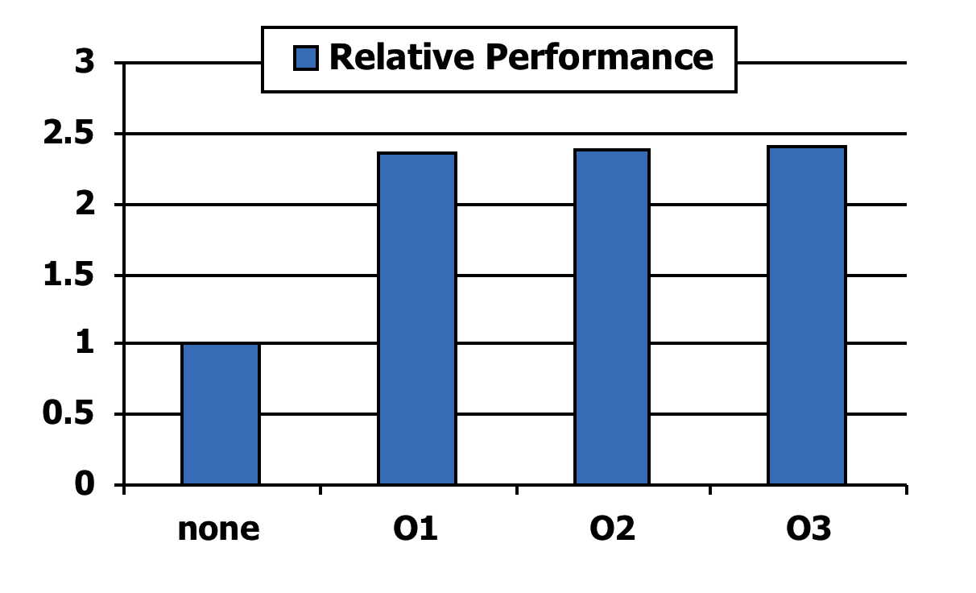
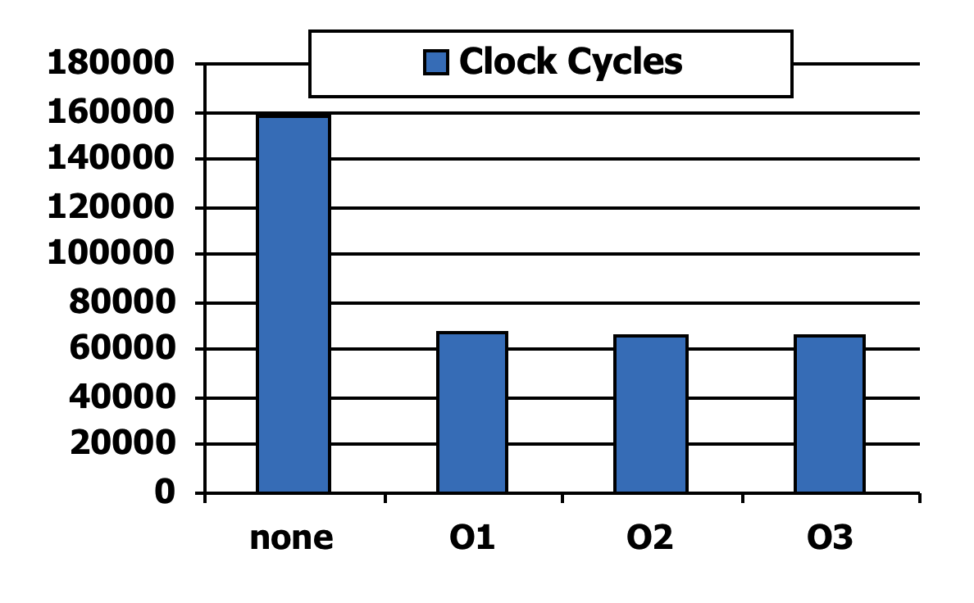
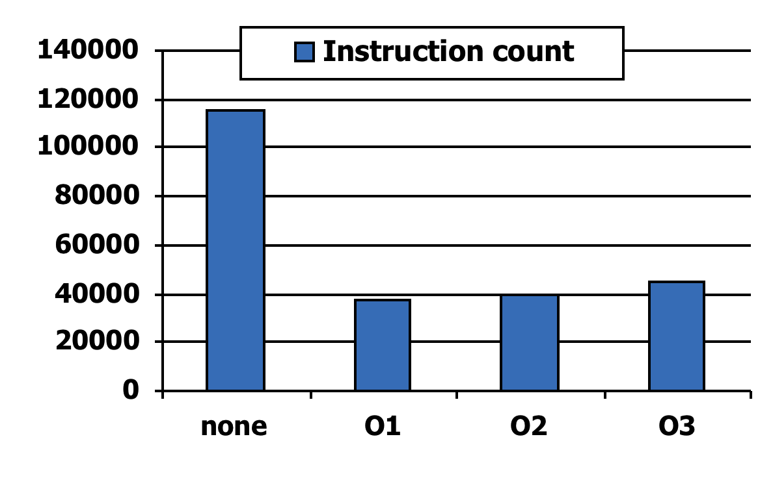
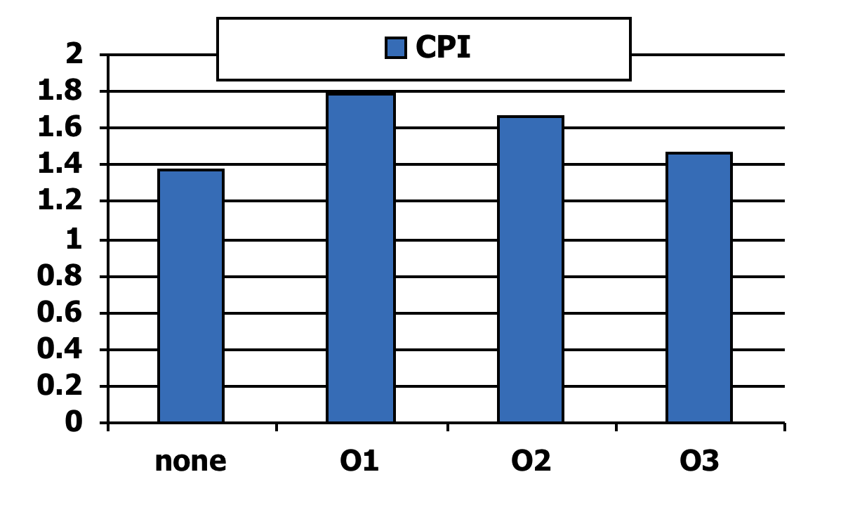
Effect of Compiler Optimization
Compiled with gcc for Pentium 4 under Linux
See section 2.15 in CD for compiler optimizations.

Slide 19
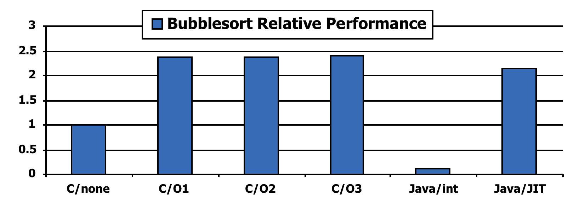
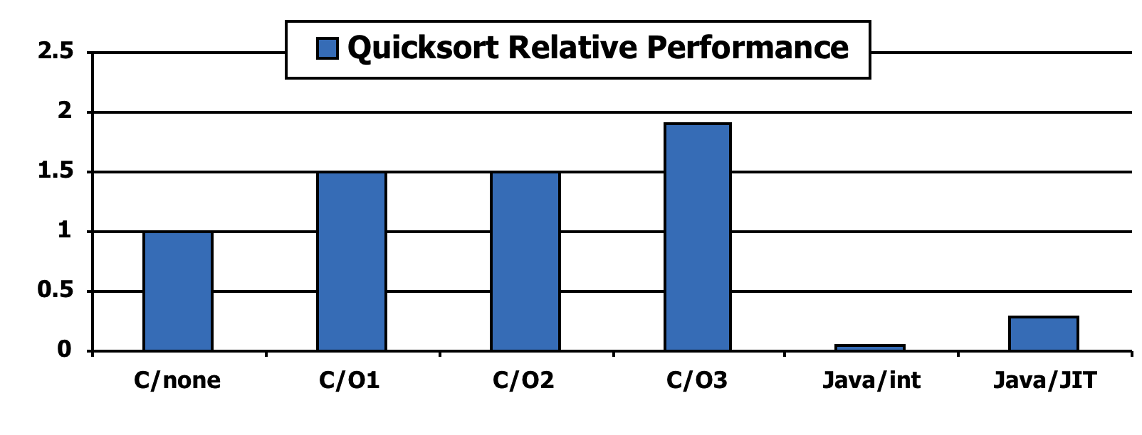
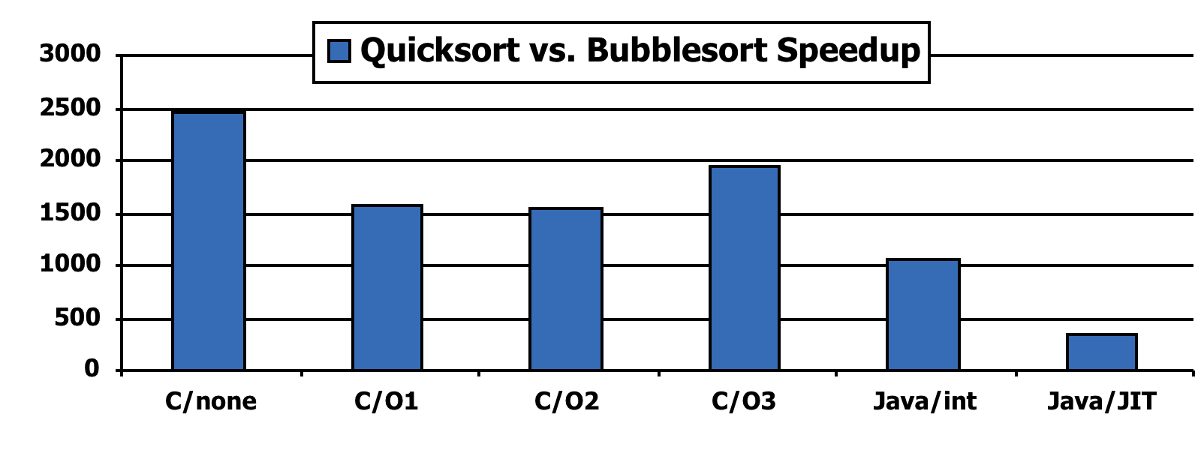
Effect of Language and Algorithm

Slide 20
Lessons Learnt
Instruction count and CPI are not good performance indicators in isolation
Compiler optimizations are sensitive to the algorithm
Java/JIT compiled code is significantly faster than JVM interpreted
Comparable to optimized C in some cases
Nothing can fix a dumb algorithm!

Slide 21
Arrays vs. Pointers
Array indexing:
Pointer indexing:
clear1(int array[], int size) { int i; for (i = 0; i < size; i += 1) array[i] = 0; } | clear2(int *array, int size) { int *p; for (p = &array[0]; p < &array[size]; p = p + 1) *p = 0; }
move $t0,$zero # i = 0 loop1: sll $t1,$t0,2 # $t1 = i * 4 add $t2,$a0,$t1 # $t2 = # &array[i] sw $zero, 0($t2) # array[i] = 0 addi $t0,$t0,1 # i = i + 1 slt $t3,$t0,$a1 # $t3 = # (i < size) bne $t3,$zero,loop1 # if (…) # goto loop1 | move $t0,$a0 # p = & array[0] sll $t1,$a1,2 # $t1 = size * 4 add $t2,$a0,$t1 # $t2 = # &array[size] loop2: sw $zero,0($t0) # Memory[p] = 0 addi $t0,$t0,4 # p = p + 4 slt $t3,$t0,$t2 # $t3 = #(p<&array[size]) bne $t3,$zero,loop2 # if (…) # goto loop2
for(…){
$t2 ← array+4×i
M[$t2] ← $zero
i = i+1
}
pointer ← v
for(…){
reg ← M[pointer]
pointer = pointer+1
}
$t0 ← array
$t2 ← &array[size]
for(…){
M[$t0] ← $zero
$t0 = $t0+4
}
$a0
array
$a0
array
$t0
i
Section 2.14
$t0
p

Slide 22
Arrays vs. Pointers
Array indexing involves
Multiplying index by element size
Adding to array base address
Pointers correspond directly to memory addresses
Can avoid indexing complexity
§2.14 Arrays versus Pointers
Section 2.14

Slide 23
Example: Clearing an Array
clear1(int array[], int size) { int i; for (i = 0; i < size; i += 1) array[i] = 0; } | clear2(int *array, int size) { int *p; for (p = &array[0]; p < &array[size]; p = p + 1) *p = 0; }
move $t0,$zero # i = 0 loop1: sll $t1,$t0,2 # $t1 = i * 4 add $t2,$a0,$t1 # $t2 = # &array[i] sw $zero, 0($t2) # array[i] = 0 addi $t0,$t0,1 # i = i + 1 slt $t3,$t0,$a1 # $t3 = # (i < size) bne $t3,$zero,loop1 # if (…) # goto loop1 | move $t0,$a0 # p = & array[0] sll $t1,$a1,2 # $t1 = size * 4 add $t2,$a0,$t1 # $t2 = # &array[size] loop2: sw $zero,0($t0) # Memory[p] = 0 addi $t0,$t0,4 # p = p + 4 slt $t3,$t0,$t2 # $t3 = #(p<&array[size]) bne $t3,$zero,loop2 # if (…) # goto loop2
add, addi, slt, sll: 1 cycle; sw: 5 cycles; bne: 2 cycles
Assume size is very large. Compute CPI. Which is faster? By how much?
Section 2.14

Slide 24
Example: Clearing an Array
clear1(int array[], int size) { int i; for (i = 0; i < size; i += 1) array[i] = 0; } | clear2(int *array, int size) { int *p; for (p = &array[0]; p < &array[size]; p = p + 1) *p = 0; }
move $t0,$zero # i = 0 1 loop1: sll $t1,$t0,2 # $t1 = i * 4 1 add $t2,$a0,$t1 # $t2 = 1 # &array[i] sw $zero, 0($t2) # array[i] = 05 addi $t0,$t0,1 # i = i + 1 1 slt $t3,$t0,$a1 # $t3 = 1 # (i < size) bne $t3,$zero,loop1 # if (…) 2 # goto loop1 | move $t0,$a0 # p = & array[0]1 sll $t1,$a1,2 # $t1 = size * 41 add $t2,$a0,$t1 # $t2 = 1 # &array[size] loop2: sw $zero,0($t0) # Memory[p] = 0 5 addi $t0,$t0,4 # p = p + 4 1 slt $t3,$t0,$t2 # $t3 = 1 #(p<&array[size]) bne $t3,$zero,loop2 # if (…) 2 # goto loop2
add, addi, slt, sll: 1 cycle; sw: 5 cycles; bne: 2 cycles
Assume size is very large. Compute CPI. Which is faster? By how much?
Section 2.14

Slide 25
Comparison of Array vs. Ptr
Array version requires shift to be inside loop
It is part of index calculation for incremented i
recalculate address in each iteration
Compiler can achieve same effect as manual use of pointers
Induction variable elimination
Better to make program clearer and safer
Section 2.14

Slide 26
Parameter Passing
What is the difference between passing a parameter by value and passing it by reference?

Slide 27
The car.c program
#include <stdio.h>
#define STRINGLENGTH 20
typedef struct c_node{
int vehicleID;
char make[STRINGLENGTH];
char model[STRINGLENGTH];
int year;
int mileage;
double cost;
struct c_node *next;
} CarNode;
void ReadCar(CarNode *car);
void PrintCar(CarNode car);
main()
{
CarNode mycar;
ReadCar(&mycar);
PrintCar(mycar);
}
void ReadCar(CarNode *car)
{
car->vehicleID = 2;
strcpy(car->make,"Crysler");
strcpy(car->model,"Town and Country");
car->year = 2014;
car->mileage = 6000;
car->cost = 45,625.74;
}
void PrintCar(CarNode car)
{
printf("vehicleID: %d\n",car.vehicleID);
printf("make: %s\n",car.make);
printf("model: %s\n",car.model);
printf("year: %d\n",car.year);
printf("mileage: %d\n",car.mileage);
printf("cost: %f\n",car.cost);
}
Patt and Patel, pp. 419

Slide 28
The car.c program
64
next
#define STRINGLENGTH 20
typedef struct c_node{
int vehicleID;
char make[STRINGLENGTH];
char model[STRINGLENGTH];
int year;
int mileage;
double cost;
struct c_node *next;
} CarNode;
60
cost
56
52
48
mileage
44
year
40
model[20]
36
32
28
24
20
make[20]
16
12
8
4
0
vehicleID

Slide 29
The car.c program
main:
subu $sp, 168
sw $ra, 84($sp)
# 23 CarNode mycar;
# 25 ReadCar(&mycar);
addu $a0, $sp, 88
jal ReadCar
# 27 PrintCar(mycar);
addu $t6, $sp, 88
move $t9, $sp
addu $t0, $t6, 72
L1:
lw $t8, 0($t6)
sw $t8, 0($t9)
addi $t6, $t6, 4
addi $t9, $t9, 4
bne $t6, $t0, L1
jal PrintCar
# 28 }
move $v0, $zero
lw $ra, 84($sp)
addu $sp, 168
j $ra
#include <stdio.h>
#define STRINGLENGTH 20
typedef struct c_node{
int vehicleID;
char make[STRINGLENGTH];
char model[STRINGLENGTH];
int year;
int mileage;
double cost;
struct c_node *next;
} CarNode;
void ReadCar(CarNode *car);
void PrintCar(CarNode car);
main()
{
CarNode mycar;
ReadCar(&mycar);
PrintCar(mycar);
}

Slide 30
The car.c program
main:
subu $sp, 168
sw $ra, 84($sp)
# 23 CarNode mycar;
# 25 ReadCar(&mycar);
addu $a0, $sp, 88
jal ReadCar
# 27 PrintCar(mycar);
addu $t6, $sp, 88
move $t9, $sp
addu $t0, $t6, 72
L1:
lw $t8, 0($t6)
sw $t8, 0($t9)
addi $t6, $t6, 4
addi $t9, $t9, 4
bne $t6, $t0, L1
jal PrintCar
# 28 }
move $v0, $zero
lw $ra, 84($sp)
addu $sp, 168
j $ra
188
$t6
92
make[0-3]
184
88
vehicleID
180
84
176
80
172
$t8
76
168
vehicleID
72
164
68
160
64
$t0
156
60
152
next
56
148
cost
52
144
cost
48
140
44
136
mileage
40
132
year
36
128
model[16-19]
32
124
model[12-15]
28
120
model[8-11]
24
116
model[4-7]
20
112
model[0-3]
16
108
make[16-19]
$t9
12
104
make[12-15]
08
100
make[8-11]
04
96
make[4-7]
$sp
00
SP

Slide 31
The car.c program
main:
subu $sp, 168
sw $ra, 84($sp)
# 23 CarNode mycar;
# 25 ReadCar(&mycar);
addu $a0, $sp, 88
jal ReadCar
# 27 PrintCar(mycar);
addu $t6, $sp, 88
move $t9, $sp
addu $t0, $t6, 72
L1:
lw $t8, 0($t6)
sw $t8, 0($t9)
addi $t6, $t6, 4
addi $t9, $t9, 4
bne $t6, $t0, L1
jal PrintCar
# 28 }
move $v0, $zero
lw $ra, 84($sp)
addu $sp, 168
j $ra
188
$t6
92
make[0-3]
184
88
vehicleID
180
84
176
80
172
$t8
76
168
vehicleID
72
164
make[0-3]
68
160
64
$t0
156
60
152
next
56
148
cost
52
144
cost
48
140
44
136
mileage
40
132
year
36
128
model[16-19]
32
124
model[12-15]
28
120
model[8-11]
24
116
model[4-7]
20
112
model[0-3]
16
108
make[16-19]
$t9
12
104
make[12-15]
08
100
make[8-11]
04
make[0-3]
96
make[4-7]
$sp
00
vehicleID
SP

Slide 32
The car.c program
main:
subu $sp, 168
sw $ra, 84($sp)
# 23 CarNode mycar;
# 25 ReadCar(&mycar);
addu $a0, $sp, 88
jal ReadCar
# 27 PrintCar(mycar);
addu $t6, $sp, 88
move $t9, $sp
addu $t0, $t6, 72
L1:
lw $t8, 0($t6)
sw $t8, 0($t9)
addi $t6, $t6, 4
addi $t9, $t9, 4
bne $t6, $t0, L1
jal PrintCar
# 28 }
move $v0, $zero
lw $ra, 84($sp)
addu $sp, 168
j $ra
188
92
make[0-3]
184
88
vehicleID
180
84
176
80
172
76
168
72
164
68
160
64
next
156
60
cost2
152
next
56
cost1
148
cost2
52
144
cost1
48
mileage
140
44
year
136
mileage
40
model[16-19]
132
year
36
model[12-15]
128
model[16-19]
32
model[8-11]
124
model[12-15]
28
model[4-7]
120
model[8-11]
24
model[0-3]
116
model[4-7]
20
make[16-19]
112
model[0-3]
16
make[12-15]
108
make[16-19]
12
make[8-11]
104
make[12-15]
08
make[4-7]
100
make[8-11]
04
make[0-3]
96
make[4-7]
00
vehicleID
SP

Slide 33
Why so much copying?
The program car.c passes the datastructure CarNode
to the PrintCar function by value.
A copy of each byte of CarNode must be made in the
stack for each call of the function PrintCar.
We could, instead have passed the address of the copy
of CarNode that we already had in the stack.

Slide 34
The car2.c program
#include <stdio.h>
#define STRINGLENGTH 20
typedef struct c_node{
int vehicleID;
char make[STRINGLENGTH];
char model[STRINGLENGTH];
int year;
int mileage;
double cost;
struct c_node *next;
} CarNode;
void ReadCar(CarNode *car);
void PrintCar(CarNode *car);
main()
{
CarNode mycar;
ReadCar(&mycar);
PrintCar(&mycar);
}
void ReadCar(CarNode *car)
{
car->vehicleID = 2;
strcpy(car->make,"Crysler");
strcpy(car->model,"Town and Country");
car->year = 2014;
car->mileage = 6000;
car->cost = 45,625.74;
}
void PrintCar(CarNode *car)
{
printf("vehicleID: %d\n",car->vehicleID);
printf("make: %s\n",car->make);
printf("model: %s\n",car->model);
printf("year: %d\n",car->year);
printf("mileage: %d\n",car->mileage);
printf("cost: %f\n",car->cost);
}
Patt and Patel, pp. 419

Slide 35
main:
subu $sp, 112
sw $ra, 28($sp)
# 23 CarNode mycar;
# 25 ReadCar(&mycar);
addu $a0, $sp, 32
jal ReadCar
# 27 PrintCar(&mycar);
addu $a0, $sp, 32
jal PrintCar
# 28 }
move $v0, $zero
lw $ra, 28($sp)
addu $sp, 112
j $ra
#include <stdio.h>
#define STRINGLENGTH 20
typedef struct c_node{
int vehicleID;
char make[STRINGLENGTH];
char model[STRINGLENGTH];
int year;
int mileage;
double cost;
struct c_node *next;
} CarNode;
void ReadCar(CarNode *car);
void PrintCar(CarNode *car);
main()
{
CarNode mycar;
ReadCar(&mycar);
PrintCar(&mycar);
}

Slide 36
Quiz #1
predecessors and successors are two vectors
of unsigned integers.
Assume that:
predecessors’ first element is stored at $fp-64
successors’ first element is stored at $fp-32
$fp points to the top of the stack frame of the current procedure.
Write a sequence of assembly instructions that executes the following
C statement:
successors[5] = predecessors[7];

Slide 37
Quiz #1 - Solution
predecessors and successors are two vectors of unsigned integers.
predecessors’ first element is stored at $fp-64
successors’ first element is stored at $fp-32
successors[5] = predecessors[7];
# $t0 ← M[$fp-64+7*4]
# M[$fp-32+5*4] ← $t0
# ----------------
# $t0 ← M[$fp-36]
# M[$fp-12] ← $t0
# -------------
lw $t0, -36($fp)
sw $t0, -12($fp)

Slide 38
Quiz #2
names is an array of pointers to strings.
Each position of names contains a pointer to a
null-terminated string.
Assume that the first element of names is stored in
the memory position $fp+48.
Write a sequence of MIPS assembly instructions
that counts the number of characters in the string
whose pointer is at names[7].

Slide 39
names is an array of pointers to strings.
Each position of names contains a pointer to a null terminated string.
Assume that the first element of names is stored in the memory position $fp-48.
Write a sequence of MIPS assembly instructions that counts the
number of characters in the string whose pointer is at names[7].
count = 0;
c = names[7];
while (*c != 0)
{
count = count+1;
c = c+1;
}
$t0 ← 0;
$t2 ← names[7];
while ( M[$t2] != 0)
{
$t0 = $t0+1;
$t2 = $t2+1;
}
$t0 ← 0;
$t1 ← Address(names[7]);
$t2 ← M[$t1];
while (M[$t2] != 0)
{
$t0 = $t0+1;
$t2 = $t2+1;
}
$t0 ← 0;
$t1 ← $fp-48+7*4
$t2 ← M[$t1];
while (M[$t2] != 0)
{
$t0 = $t0+1;
$t2 = $t2+1;
}

Slide 40
names is an array of pointers to strings.
Each position of names contains a pointer to a null terminated string.
Assume that the first element of names is stored in the memory position $fp-48.
Write a sequence of MIPS assembly instructions that counts the
number of characters in the string whose pointer is at names[7].
$t0 ← 0;
$t1 ← $fp-48+7*4
$t2 ← M[$t1];
while (M[$t2] != 0)
{
$t0 = $t0+1;
$t2 = $t2+1;
}
add $t0, $zero, $zero
lw $t2, -20($fp)
lb $t3, 0($t2)
beq $t3, $zero, done
addi $t0, $t0, 1
addi $t2, $t2, 1
j loop;
done:
loop:
$t0 ← 0;
$t2 ← M[$fp-20];
while (M[$t2] != 0)
{
$t0 = $t0+1;
$t2 = $t2+1;
}

Slide 41
Quiz #2 – Alternative Solution
names is an array of pointers to strings.
Each position of names contains a pointer to a null terminated string.
Assume that the first element of names is stored in the memory position $fp-48.
Write a sequence of MIPS assembly instructions that counts the
number of characters in the string whose pointer is at names[7].
Previous Solution:
Alternative Solution:
count = 0;
c = names[7];
while (*c != 0)
{
count = count+1;
c = c+1;
}
c = names[7];
count = c;
while (*c != 0)
{
c = c+1;
}
count = c-count;

Slide 42
The meaning of *p
1 void foo(int *p, int x)
2 {
…
25 *p = x;
…
x = *p;
}
What is the meaning of the statement in line 25
of this C program?
What does p contain?
A memory address
What does x contain?
An integer value
What action the program should do to execute
line 25?
Store the value of x in the memory
location whose address is in p.
p
0x10001008
0x10001018
0x10001014
x
42
0x10001010
0x1000100C
0x10001008
42
What MIPS assembly instruction(s)
are needed to execute line 25?
0x10001004
0x10001000
sw $a1, 0($a0) # 0($a0) ← $a1

Slide 43
The meaning of *p
1 void foo(int *p, int x)
2 {
…
25 *p = x;
…
x = *p;
}
What action the program should do to execute
line 30?
Load the value from the memory
location whose address is in p.
What MIPS assembly instruction(s)
is(are) needed to execute line 30?
lw $a1, 0($a0) # $a1 ← 0($a0)
p
0x10001008
0x10001018
0x10001014
x
42
0x10001010
74
0x1000100C
0x10001008
74
0x10001004
0x10001000

Slide 44
The meaning of *p
Now p and x are in memory in the local stack
frame. Assume that:
p ↔ $fp-4
x ↔ $fp-12
1 void foo(…)
2 {
3 int *p;
4 int x;
….
25 *p = x;
…
x = *p;
}
Now, what actions are needed to execute line 25?
1. Load the address that is in p into a register (say $s0).
2. Load the value of x into a register (say $s1).
3. Store the value now in $s1 into the address in $s0.
0x10001018
0x10001014
0x10001010
$sp
$s0
0x1000100C
0x1000004
0x10001008
0x10001008
42
0x10001004
$fp
$s1
0x10001000
0x10000010
42
…
What MIPS assembly instruction(s)
is(are) needed to execute line 25?
0x10000018
0x10000014
fp
0x10000010
p
lw $s0, -4($fp) # $s0 ← p
lw $s1, -12($fp) # $s1 ← x
sw $s1, 0($s0) # *p ← x
0x1000000C
0x10001008
0x10000008
x
sp
0x10000004
42
0x10000000

Slide 45
The meaning of *p
What is the difference
between the address “in p”
and the address “of p”?
Now p and x are in memory in the local stack
frame. Assume that:
p ↔ $fp-4
x ↔ $fp-12
1 void foo(…)
2 {
3 int *p;
4 int x;
…
25 *p = x;
…
x = *p;
}
Now, what actions are needed to execute line 30?
1. Load the address that is in p into a register (say $s0).
2. Load the value of the memory whose address is in $s0
into a register (say $t1).
3. Store the value in $t1 into the address of x.
0x10001018
0x10001014
0x10001010
$sp
$s0
0x1000100C
0x1000004
0x10001008
0x10001008
74
0x10001004
$fp
$s1
0x10001000
0x10000010
42
…
What MIPS assembly instruction(s)
are needed to execute line 30?
$t1
74
0x10000018
0x10000014
fp
0x10000010
p
lw $s0, -4($fp) # $s0 ← p
lw $t1, 0($s0) # $s1 ← x
sw $t1, -12($fp) # x ← *p
0x1000000C
0x10001008
0x10000008
x
sp
0x10000004
42
74
0x10000000

Slide 46
Quiz #4
Consider the following C function:
int ReadGraph(FILE *input_file, unsigned int **successors, char ***names)
{
unsigned int temp = 0;
unsigned int node = 0;
/* Input code that uses input_file removed for clarity */
(*successors)[node] = temp;
printf(“name = %d\n”,*names[node]);
}
Write the MIPS assembly code for the statement immediately before the call to printf.
Assume:
temp ⟷ $s0
node ⟷ $s1

Slide 47
Quiz #4 - Solution
$t0 contains the base address of
an array of pointers.
temp ← $s0
node ← $s1
$t0 ← Mem[$a1]
$t1 ← $t0 + 4*node
Mem[$t1] ← temp;
(*successors)[node] ← temp;
$t0 ← *successors
$t0[node] ← temp;
$t0 ← Mem[$a1]
$t2 ← 4*node
$t1 ← $t0 + $t2
Mem[$t1] ← temp;
$t0 ← Mem[$a1]
$t0[node] ← temp;
lw $t0, 0($a1)
sll $t2, $s1, 2
add $t1, $t0, $t2
sw $s0, 0($t1)
$t0 ← Mem[$a1]
$t1 ← Address($t0[node])
Mem[$t1] ← temp;
int ReadGraph(FILE *input_file, unsigned int **successors, char ***names)
{
unsigned int temp = 0;
unsigned int node = 0;
/* Input code that uses input_file removed for clarity */
(*successors)[node] = temp;
printf(“name = %d\n”,*names[node]);
}

Slide 48
Quiz #3
#include <stdio.h>
#define STRINGLENGTH 20
typedef struct c_node{
int vehicleID;
char make[STRINGLENGTH];
char model[STRINGLENGTH];
int year;
int mileage;
double cost;
struct c_node *next;
} CarNode;
CarNode ParkingLot[80];
…
RegisterCar(CarNode* CarArray,
int k)
{
CarNode *tmpCar;
…
tmpCar->next = &(CarArray[k]);
}
Write MIPS assembly code for the
assignment in the RegisterCar function.
Assume that tmpCar is stored in
$fp-16
$a0
0x4000 0000
CarArray
68
bytes
$a1
15
k
$t0
0x4000 01E0
&(CarArray[k])
$t0 ← CarArray + 68×k
$t0 ← CarArray + 64×k + 4×k
sll $t0, $a1, 6 # $t0 ← 64×k
sll $t1, $a1, 2 # $t0 ← 4×k
add $t0, $t0, $t1 # $t0 ← 68×k
add $t0, $a0, $t0

Slide 49
Quiz #3
#include <stdio.h>
#define STRINGLENGTH 20
typedef struct c_node{
int vehicleID;
char make[STRINGLENGTH];
char model[STRINGLENGTH];
int year;
int mileage;
double cost;
struct c_node *next;
} CarNode;
CarNode ParkingLot[80];
…
RegisterCar(CarNode* CarArray,
int k)
{
CarNode *tmpCar;
…
tmpCar->next = &(CarArray[k]);
}
Write MIPS assembly code for the
assignment in the RegisterCar function.
Assume that tmpCar is stored in
$fp-16
64
bytes
$a0
0x4000 0000
CarArray
$a1
15
k
$t0
&(CarArray[k])
$fp
0x3000 1020
Address
Value
0x3000102C
0x30001028
0x30001024
0x30001020
0x3000101C
0x30001018
0x30001014
tmpCar
0x30001010
0x5000 1008

Slide 50
The Meaning of ->
tmpCar->next = &(CarArray[k])
Address
Value
0x5000103C
$a0
0x50001038
0x4000 01E0
next
0x4000 0000
CarArray
0x50001034
$a1
k
0x50001030
15
0x5000102C
$t0
0x4000 01E0
&(CarArray[k])
0x50001028
0x50001024
$fp
0x50001020
lw $t4, -16($fp)
sw $t0, 64($t4)
64
bytes
0x3000 1020
# tA ← M[$fp-16]
# M[tA+64] ← $t0
0x5000102C
0x50001028
0x50001024
Address
Value
0x50001020
0x3000102C
0x5000101C
0x30001028
0x50001018
0x30001024
0x50001014
0x30001020
0x50001010
0x3000101C
0x5000100C
0x30001018
0x50001008
0x30001014
0x50001004
tmpCar
0x30001010
0x5000 1008
0x50001000

Slide 51
Quiz #3
#include <stdio.h>
#define STRINGLENGTH 20
typedef struct c_node{
int vehicleID;
char make[STRINGLENGTH];
char model[STRINGLENGTH];
int year;
int mileage;
double cost;
struct c_node *next;
} CarNode;
CarNode ParkingLot[80];
…
RegisterCar(CarNode* CarArray,
int k)
{
CarNode *tmpCar;
…
tmpCar->next = &(CarArray[k]);
}
Write MIPS assembly code for the
assignment in the RegisterCar function.
Assume that tmpCar is stored in
$fp-16
$a0
0x4000 0000
CarArray
$a1
15
k
$t0
0x4000 01E0
&(CarArray[k])
sll $t0, $a1, 6 # $t0 ← 64×k
sll $t1, $a1, 2 # $t0 ← 4×k
add $t0, $t0, $t1 # $t0 ← 68×k
add $t0, $a0, $t0
lw $t4, -16($fp)
sw $t0, 64($t4)
# tA ← M[$fp-16]
# M[tA+64] ← $t0

Slide 52
Quiz #5
Consider the following C function:
int ReadGraph(FILE *input_file, unsigned int **successors, char ***names)
{
unsigned int temp;
unsigned int node;
(*successors)[node] = temp;
printf(“name = %s\n”,(*names)[node]);
}
Write the MIPS assembly code to initialize the value of $a1 in
the function call to printf.
Assume:
node ⟷ $s1
names ⟷ $a2

Slide 53
How did we ended up with ***names ?
A
l
e
x
\0
A
y
e
s
h
a
\0
X
i
n
r
a
n
\0
A
n
t
o
n
\0

Slide 54
How did we ended up with ***names ?
***names ≡ **names[0]
names
A
l
e
x
\0
*names
*(**names+1) ≡ **names[1]
**names
A
y
e
s
h
a
\0
*(**names+2) ≡ **names[2]
X
i
n
r
a
n
\0
*(**names+3) ≡ **names[3]
A
n
t
o
n
\0

Slide 55
int ReadGraph(FILE *input_file, unsigned int **successors, char ***names)
{
...
printf(“name = %s\n”,(*names)[node]);
}
$a1 ← (*names)[node]
tA ← *$a2
$a1 ← tA[node]
node ⟷ $s1
names ⟷ $a2
tA ← *$a2
tC ← 4×$s1
tB ← tA + tC
$a1 ← *tB
$a2
A
l
e
x
\0
A
y
e
s
h
a
\0
tA
X
i
n
r
a
n
\0
tB
Animation assumes that node = 2.
A
n
t
o
n
\0

Slide 56
int ReadGraph(FILE *input_file, unsigned int **successors, char ***names)
{
...
printf(“name = %s\n”,(*names)[node]);
}
$a1 ← (*names)[node]
tA ← *$a2
$a1 ← tA[node]
node ⟷ $s1
names ⟷ $a2
tA ← *$a2
tC ← 4×$s1
tB ← tA + tC
$a1 ← *tB
lw $t0, 0($a2) # $t0 ← *names
sll $t2, $s1, 2 # $t2 ← 4×node
add $t3, $t0, $t2 # $t3 ← (*names) + 4×node
lw $a1, 0(t3) # $a1 ← (*names)[node]

Slide 57
Quiz #7
Stack
$sp+0
&ind
$sp+4
&ptr
&apple
$sp+8
⟨apple⟩
8
ptr
⟨ptr⟩
4
ind
apple
$sp
⟨ind⟩
0
Write MIPS assembly for the
following program.
1 #include <stdio.h>
2 main()
3 {
4 int apple;
5 int *ptr;
6 int **ind;
7 ind = &ptr;
8 *ind = &apple;
9 **ind = 123;
10 ind++;
11 *ptr++;
12 apple++;
13 printf(“%x %x %d\n”, ind, ptr, apple);
14 }
Assume that:
apple ↔ $sp+8
ptr ↔ $sp+4
ind ↔ $sp+0

Slide 58
Quiz #7
Stack
$sp+0
$sp+4
$sp+8
⟨apple⟩
8
ptr
⟨ptr⟩
4
ind
apple
$sp
⟨ind⟩
0
# 7 ind = &ptr;
addi $t0, $sp, 4 # $t0 ← &ptr
sw $t0, 0($sp) # ind ← &ptr
# 8 *ind = &apple;
lw $t0, 0($sp) # $t0 ← ind
addi $t1, $sp,8 # $t1 ← &apple
sw $t1, 0($t0) # *ind ← &apple
# 9 **ind = 123;
addi $t3,$zero,123
lw $t4, 0($sp) # $t4 ← ind
lw $t5, 0($t4) # $t5 ← *ind
sw $t3, 0($t5) # **ind ← 123
# 10 ind++;
lw $t0, 0($sp) # $t0 ← ind
addi $t0, $t0, 4 # $t0 ← ind + 4
sw $t0, 0($sp) # ind ← ind + 4
# 11 *ptr++;
lw $t6, 4($sp) # $t6 ← ptr
lw $t7, 0($t6) # $t7 ← *ptr
addi $t7, $t7, 1 # $t7 ← (*ptr) + 1
sw $t7, 0($t6) # *ptr ← (*ptr) + 1
# 12 apple++;
lw $t8, 8(sp) # $t8 ← apple
addi $t8, $t8, 1 # $t8 ← apple + 1
sw $t8, 8(sp) # apple ← apple + 1
1 #include <stdio.h>
2 main()
3 {
4 int apple;
5 int *ptr;
6 int **ind;
7 ind = &ptr;
8 *ind = &apple;
9 **ind = 123;
10 ind++;
11 *ptr++;
12 apple++;
13 printf(“%x %x %d\n”, ind, ptr, apple);
14 }
Assume that:
apple ↔ $sp+8
ptr ↔ $sp+4
ind ↔ $sp+0

Slide 59
Next we will simulate each line of the C code

Slide 60
Quiz #7
Stack
$sp+0
$sp+4
$sp+8
⟨apple⟩
8
ptr
⟨ptr⟩
4
ind
apple
$sp
⟨ind⟩
0
# 7 ind = &ptr;
addi $t0, $sp, 4 # $t0 ← &ptr
sw $t0, 0($sp) # ind ← &ptr
# 8 *ind = &apple;
lw $t0, 0($sp) # $t0 ← ind
addi $t1, $sp,8 # $t1 ← &apple
sw $t1, 0($t0) # *ind ← &apple
# 9 **ind = 123;
addi $t3,$zero,123
lw $t4, 0($sp) # $t4 ← ind
lw $t5, 0($t4) # $t5 ← *ind
sw $t3, 0($t5) # **ind ← 123
# 10 ind++;
lw $t0, 0($sp) # $t0 ← ind
addi $t0, $t0, 4 # $t0 ← ind + 4
sw $t0, 0($sp) # ind ← ind + 4
# 11 *ptr++;
lw $t6, 4($sp) # $t6 ← ptr
lw $t7, 0($t6) # $t7 ← *ptr
addi $t7, $t7, 1 # $t7 ← (*ptr) + 1
sw $t7, 0($t6) # *ptr ← (*ptr) + 1
# 12 apple++;
lw $t8, 8(sp) # $t8 ← apple
addi $t8, $t8, 1 # $t8 ← apple + 1
sw $t8, 8(sp) # apple ← apple + 1
1 #include <stdio.h>
2 main()
3 {
4 int apple;
5 int *ptr;
6 int **ind;
7 ind = &ptr;
8 *ind = &apple;
9 **ind = 123;
10 ind++;
11 *ptr++;
12 apple++;
13 printf(“%x %x %d\n”, ind, ptr, apple);
14 }
Assume that:
apple ↔ $sp+8
ptr ↔ $sp+4
ind ↔ $sp+0

Slide 61
Quiz #7
Stack
$sp+0
$sp+4
$sp+8
⟨apple⟩
8
ptr
⟨ptr⟩
4
ind
apple
$sp
$sp+4
0
# 7 ind = &ptr;
addi $t0, $sp, 4 # $t0 ← &ptr
sw $t0, 0($sp) # ind ← &ptr
# 8 *ind = &apple;
lw $t0, 0($sp) # $t0 ← ind
addi $t1, $sp,8 # $t1 ← &apple
sw $t1, 0($t0) # *ind ← &apple
# 9 **ind = 123;
addi $t3,$zero,123
lw $t4, 0($sp) # $t4 ← ind
lw $t5, 0($t4) # $t5 ← *ind
sw $t3, 0($t5) # **ind ← 123
# 10 ind++;
lw $t0, 0($sp) # $t0 ← ind
addi $t0, $t0, 4 # $t0 ← ind + 4
sw $t0, 0($sp) # ind ← ind + 4
# 11 *ptr++;
lw $t6, 4($sp) # $t6 ← ptr
lw $t7, 0($t6) # $t7 ← *ptr
addi $t7, $t7, 1 # $t7 ← (*ptr) + 1
sw $t7, 0($t6) # *ptr ← (*ptr) + 1
# 12 apple++;
lw $t8, 8(sp) # $t8 ← apple
addi $t8, $t8, 1 # $t8 ← apple + 1
sw $t8, 8(sp) # apple ← apple + 1
1 #include <stdio.h>
2 main()
3 {
4 int apple;
5 int *ptr;
6 int **ind;
7 ind = &ptr;
8 *ind = &apple;
9 **ind = 123;
10 ind++;
11 *ptr++;
12 apple++;
13 printf(“%x %x %d\n”, ind, ptr, apple);
14 }
Assume that:
apple ↔ $sp+8
ptr ↔ $sp+4
ind ↔ $sp+0

Slide 62
Quiz #7
Stack
$sp+0
$sp+4
$sp+8
⟨apple⟩
8
ptr
⟨ptr⟩
4
ind
apple
$sp
$sp+4
0
# 7 ind = &ptr;
addi $t0, $sp, 4 # $t0 ← &ptr
sw $t0, 0($sp) # ind ← &ptr
# 8 *ind = &apple;
lw $t0, 0($sp) # $t0 ← ind
addi $t1, $sp,8 # $t1 ← &apple
sw $t1, 0($t0) # *ind ← &apple
# 9 **ind = 123;
addi $t3,$zero,123
lw $t4, 0($sp) # $t4 ← ind
lw $t5, 0($t4) # $t5 ← *ind
sw $t3, 0($t5) # **ind ← 123
# 10 ind++;
lw $t0, 0($sp) # $t0 ← ind
addi $t0, $t0, 4 # $t0 ← ind + 4
sw $t0, 0($sp) # ind ← ind + 4
# 11 *ptr++;
lw $t6, 4($sp) # $t6 ← ptr
lw $t7, 0($t6) # $t7 ← *ptr
addi $t7, $t7, 1 # $t7 ← (*ptr) + 1
sw $t7, 0($t6) # *ptr ← (*ptr) + 1
# 12 apple++;
lw $t8, 8(sp) # $t8 ← apple
addi $t8, $t8, 1 # $t8 ← apple + 1
sw $t8, 8(sp) # apple ← apple + 1
1 #include <stdio.h>
2 main()
3 {
4 int apple;
5 int *ptr;
6 int **ind;
7 ind = &ptr;
8 *ind = &apple;
9 **ind = 123;
10 ind++;
11 *ptr++;
12 apple++;
13 printf(“%x %x %d\n”, ind, ptr, apple);
14 }
Assume that:
apple ↔ $sp+8
ptr ↔ $sp+4
ind ↔ $sp+0

Slide 63
Stack
$sp+0
$sp+4
$sp+8
⟨apple⟩
8
ptr
⟨ptr⟩
4
ind
apple
$sp
$sp+4
0
# 7 ind = &ptr;
addi $t0, $sp, 4 # $t0 ← &ptr
sw $t0, 0($sp) # ind ← &ptr
# 8 *ind = &apple;
lw $t0, 0($sp) # $t0 ← ind
addi $t1, $sp,8 # $t1 ← &apple
sw $t1, 0($t0) # *ind ← &apple
# 9 **ind = 123;
addi $t3,$zero,123
lw $t4, 0($sp) # $t4 ← ind
lw $t5, 0($t4) # $t5 ← *ind
sw $t3, 0($t5) # **ind ← 123
# 10 ind++;
lw $t0, 0($sp) # $t0 ← ind
addi $t0, $t0, 4 # $t0 ← ind + 4
sw $t0, 0($sp) # ind ← ind + 4
# 11 *ptr++;
lw $t6, 4($sp) # $t6 ← ptr
lw $t7, 0($t6) # $t7 ← *ptr
addi $t7, $t7, 1 # $t7 ← (*ptr) + 1
sw $t7, 0($t6) # *ptr ← (*ptr) + 1
# 12 apple++;
lw $t8, 8(sp) # $t8 ← apple
addi $t8, $t8, 1 # $t8 ← apple + 1
sw $t8, 8(sp) # apple ← apple + 1
1 #include <stdio.h>
2 main()
3 {
4 int apple;
5 int *ptr;
6 int **ind;
7 ind = &ptr;
8 *ind = &apple;
9 **ind = 123;
10 ind++;
11 *ptr++;
12 apple++;
13 printf(“%x %x %d\n”, ind, ptr, apple);
14 }
Quiz #7
Assume that:
apple ↔ $sp+8
ptr ↔ $sp+4
ind ↔ $sp+0

Slide 64
Stack
$sp+0
$sp+4
$sp+8
⟨apple⟩
8
ptr
$sp+8
4
ind
apple
$sp
$sp+4
0
# 7 ind = &ptr;
addi $t0, $sp, 4 # $t0 ← &ptr
sw $t0, 0($sp) # ind ← &ptr
# 8 *ind = &apple;
lw $t0, 0($sp) # $t0 ← ind
addi $t1, $sp,8 # $t1 ← &apple
sw $t1, 0($t0) # *ind ← &apple
# 9 **ind = 123;
addi $t3,$zero,123
lw $t4, 0($sp) # $t4 ← ind
lw $t5, 0($t4) # $t5 ← *ind
sw $t3, 0($t5) # **ind ← 123
# 10 ind++;
lw $t0, 0($sp) # $t0 ← ind
addi $t0, $t0, 4 # $t0 ← ind + 4
sw $t0, 0($sp) # ind ← ind + 4
# 11 *ptr++;
lw $t6, 4($sp) # $t6 ← ptr
lw $t7, 0($t6) # $t7 ← *ptr
addi $t7, $t7, 1 # $t7 ← (*ptr) + 1
sw $t7, 0($t6) # *ptr ← (*ptr) + 1
# 12 apple++;
lw $t8, 8(sp) # $t8 ← apple
addi $t8, $t8, 1 # $t8 ← apple + 1
sw $t8, 8(sp) # apple ← apple + 1
1 #include <stdio.h>
2 main()
3 {
4 int apple;
5 int *ptr;
6 int **ind;
7 ind = &ptr;
8 *ind = &apple;
9 **ind = 123;
10 ind++;
11 *ptr++;
12 apple++;
13 printf(“%x %x %d\n”, ind, ptr, apple);
14 }
Quiz #7
Assume that:
apple ↔ $sp+8
ptr ↔ $sp+4
ind ↔ $sp+0

Slide 65
Quiz #7
Stack
$sp+0
$sp+4
$sp+8
⟨apple⟩
8
$t4
ptr
$t5
$sp+8
4
ind
apple
$sp
$sp+4
0
# 7 ind = &ptr;
addi $t0, $sp, 4 # $t0 ← &ptr
sw $t0, 0($sp) # ind ← &ptr
# 8 *ind = &apple;
lw $t0, 0($sp) # $t0 ← ind
addi $t1, $sp,8 # $t1 ← &apple
sw $t1, 0($t0) # *ind ← &apple
# 9 **ind = 123;
addi $t3,$zero,123
lw $t4, 0($sp) # $t4 ← ind
lw $t5, 0($t4) # $t5 ← *ind
sw $t3, 0($t5) # **ind ← 123
# 10 ind++;
lw $t0, 0($sp) # $t0 ← ind
addi $t0, $t0, 4 # $t0 ← ind + 4
sw $t0, 0($sp) # ind ← ind + 4
# 11 *ptr++;
lw $t6, 4($sp) # $t6 ← ptr
lw $t7, 0($t6) # $t7 ← *ptr
addi $t7, $t7, 1 # $t7 ← (*ptr) + 1
sw $t7, 0($t6) # *ptr ← (*ptr) + 1
# 12 apple++;
lw $t8, 8(sp) # $t8 ← apple
addi $t8, $t8, 1 # $t8 ← apple + 1
sw $t8, 8(sp) # apple ← apple + 1
1 #include <stdio.h>
2 main()
3 {
4 int apple;
5 int *ptr;
6 int **ind;
7 ind = &ptr;
8 *ind = &apple;
9 **ind = 123;
10 ind++;
11 *ptr++;
12 apple++;
13 printf(“%x %x %d\n”, ind, ptr, apple);
14 }
Assume that:
apple ↔ $sp+8
ptr ↔ $sp+4
ind ↔ $sp+0

Slide 66
Quiz #7
Stack
$sp+0
$sp+4
$sp+8
123
8
$t4
ptr
$t5
$sp+8
4
ind
apple
$sp
$sp+4
0
123
# 7 ind = &ptr;
addi $t0, $sp, 4 # $t0 ← &ptr
sw $t0, 0($sp) # ind ← &ptr
# 8 *ind = &apple;
lw $t0, 0($sp) # $t0 ← ind
addi $t1, $sp,8 # $t1 ← &apple
sw $t1, 0($t0) # *ind ← &apple
# 9 **ind = 123;
addi $t3,$zero,123
lw $t4, 0($sp) # $t4 ← ind
lw $t5, 0($t4) # $t5 ← *ind
sw $t3, 0($t5) # **ind ← 123
# 10 ind++;
lw $t0, 0($sp) # $t0 ← ind
addi $t0, $t0, 4 # $t0 ← ind + 4
sw $t0, 0($sp) # ind ← ind + 4
# 11 *ptr++;
lw $t6, 4($sp) # $t6 ← ptr
lw $t7, 0($t6) # $t7 ← *ptr
addi $t7, $t7, 1 # $t7 ← (*ptr) + 1
sw $t7, 0($t6) # *ptr ← (*ptr) + 1
# 12 apple++;
lw $t8, 8(sp) # $t8 ← apple
addi $t8, $t8, 1 # $t8 ← apple + 1
sw $t8, 8(sp) # apple ← apple + 1
1 #include <stdio.h>
2 main()
3 {
4 int apple;
5 int *ptr;
6 int **ind;
7 ind = &ptr;
8 *ind = &apple;
9 **ind = 123;
10 ind++;
11 *ptr++;
12 apple++;
13 printf(“%x %x %d\n”, ind, ptr, apple);
14 }
addi $t3,$zero,123
lw $t4, 0($sp) # $t4 ← ind
lw $t5, 0($t4) # $t5 ← *ind
sw $t3, 0($t5) # **ind ← 123
Assume that:
apple ↔ $sp+8
ptr ↔ $sp+4
ind ↔ $sp+0

Slide 67
Stack
$sp+0
$sp+4
$sp+8
123
8
ptr
$sp+8
4
ind
apple
$sp
$sp+4
0
123
# 7 ind = &ptr;
addi $t0, $sp, 4 # $t0 ← &ptr
sw $t0, 0($sp) # ind ← &ptr
# 8 *ind = &apple;
lw $t0, 0($sp) # $t0 ← ind
addi $t1, $sp,8 # $t1 ← &apple
sw $t1, 0($t0) # *ind ← &apple
# 9 **ind = 123;
addi $t3,$zero,123
lw $t4, 0($sp) # $t4 ← ind
lw $t5, 0($t4) # $t5 ← *ind
sw $t3, 0($t5) # **ind ← 123
# 10 ind++;
lw $t0, 0($sp) # $t0 ← ind
addi $t0, $t0, 4 # $t0 ← ind + 4
sw $t0, 0($sp) # ind ← ind + 4
# 11 *ptr++;
lw $t6, 4($sp) # $t6 ← ptr
lw $t7, 0($t6) # $t7 ← *ptr
addi $t7, $t7, 1 # $t7 ← (*ptr) + 1
sw $t7, 0($t6) # *ptr ← (*ptr) + 1
# 12 apple++;
lw $t8, 8(sp) # $t8 ← apple
addi $t8, $t8, 1 # $t8 ← apple + 1
sw $t8, 8(sp) # apple ← apple + 1
$t0
1 #include <stdio.h>
2 main()
3 {
4 int apple;
5 int *ptr;
6 int **ind;
7 ind = &ptr;
8 *ind = &apple;
9 **ind = 123;
10 ind++;
11 *ptr++;
12 apple++;
13 printf(“%x %x %d\n”, ind, ptr, apple);
14 }
Quiz #7
Assume that:
apple ↔ $sp+8
ptr ↔ $sp+4
ind ↔ $sp+0

Slide 68
Stack
$sp+0
$sp+4
$sp+8
123
8
ptr
$sp+8
4
ind
apple
$sp
$sp+8
0
123
# 7 ind = &ptr;
addi $t0, $sp, 4 # $t0 ← &ptr
sw $t0, 0($sp) # ind ← &ptr
# 8 *ind = &apple;
lw $t0, 0($sp) # $t0 ← ind
addi $t1, $sp,8 # $t1 ← &apple
sw $t1, 0($t0) # *ind ← &apple
# 9 **ind = 123;
addi $t3,$zero,123
lw $t4, 0($sp) # $t4 ← ind
lw $t5, 0($t4) # $t5 ← *ind
sw $t3, 0($t5) # **ind ← 123
# 10 ind++;
lw $t0, 0($sp) # $t0 ← ind
addi $t0, $t0, 4 # $t0 ← ind + 4
sw $t0, 0($sp) # ind ← ind + 4
# 11 *ptr++;
lw $t6, 4($sp) # $t6 ← ptr
lw $t7, 0($t6) # $t7 ← *ptr
addi $t7, $t7, 1 # $t7 ← (*ptr) + 1
sw $t7, 0($t6) # *ptr ← (*ptr) + 1
# 12 apple++;
lw $t8, 8(sp) # $t8 ← apple
addi $t8, $t8, 1 # $t8 ← apple + 1
sw $t8, 8(sp) # apple ← apple + 1
$t0
1 #include <stdio.h>
2 main()
3 {
4 int apple;
5 int *ptr;
6 int **ind;
7 ind = &ptr;
8 *ind = &apple;
9 **ind = 123;
10 ind++;
11 *ptr++;
12 apple++;
13 printf(“%x %x %d\n”, ind, ptr, apple);
14 }
Quiz #7
Assume that:
apple ↔ $sp+8
ptr ↔ $sp+4
ind ↔ $sp+0
lw $t0, 0($sp) # $t0 ← ind
addi $t0, $t0, 4 # $t0 ← ind + 4
sw $t0, 0($sp) # ind ← ind + 4

Slide 69
Stack
$sp+0
$sp+4
$sp+8
123
8
ptr
$sp+8
4
ind
apple
$sp
$sp+8
0
124
123
$t7
# 7 ind = &ptr;
addi $t0, $sp, 4 # $t0 ← &ptr
sw $t0, 0($sp) # ind ← &ptr
# 8 *ind = &apple;
lw $t0, 0($sp) # $t0 ← ind
addi $t1, $sp,8 # $t1 ← &apple
sw $t1, 0($t0) # *ind ← &apple
# 9 **ind = 123;
addi $t3,$zero,123
lw $t4, 0($sp) # $t4 ← ind
lw $t5, 0($t4) # $t5 ← *ind
sw $t3, 0($t5) # **ind ← 123
# 10 ind++;
lw $t0, 0($sp) # $t0 ← ind
addi $t0, $t0, 4 # $t0 ← ind + 4
sw $t0, 0($sp) # ind ← ind + 4
# 11 *ptr++;
lw $t6, 4($sp) # $t6 ← ptr
lw $t7, 0($t6) # $t7 ← *ptr
addi $t7, $t7, 1 # $t7 ← (*ptr) + 1
sw $t7, 0($t6) # *ptr ← (*ptr) + 1
# 12 apple++;
lw $t8, 8(sp) # $t8 ← apple
addi $t8, $t8, 1 # $t8 ← apple + 1
sw $t8, 8(sp) # apple ← apple + 1
124
123
$t6
1 #include <stdio.h>
2 main()
3 {
4 int apple;
5 int *ptr;
6 int **ind;
7 ind = &ptr;
8 *ind = &apple;
9 **ind = 123;
10 ind++;
11 *ptr++;
12 apple++;
13 printf(“%x %x %d\n”, ind, ptr, apple);
14 }
Quiz #7
Assume that:
apple ↔ $sp+8
ptr ↔ $sp+4
ind ↔ $sp+0

Slide 70
Stack
$sp+0
$sp+4
$sp+8
124
8
ptr
$sp+8
4
ind
apple
$sp
$sp+8
0
124
$t7
# 7 ind = &ptr;
addi $t0, $sp, 4 # $t0 ← &ptr
sw $t0, 0($sp) # ind ← &ptr
# 8 *ind = &apple;
lw $t0, 0($sp) # $t0 ← ind
addi $t1, $sp,8 # $t1 ← &apple
sw $t1, 0($t0) # *ind ← &apple
# 9 **ind = 123;
addi $t3,$zero,123
lw $t4, 0($sp) # $t4 ← ind
lw $t5, 0($t4) # $t5 ← *ind
sw $t3, 0($t5) # **ind ← 123
# 10 ind++;
lw $t0, 0($sp) # $t0 ← ind
addi $t0, $t0, 4 # $t0 ← ind + 4
sw $t0, 0($sp) # ind ← ind + 4
# 11 *ptr++;
lw $t6, 4($sp) # $t6 ← ptr
lw $t7, 0($t6) # $t7 ← *ptr
addi $t7, $t7, 1 # $t7 ← (*ptr) + 1
sw $t7, 0($t6) # *ptr ← (*ptr) + 1
# 12 apple++;
lw $t8, 8(sp) # $t8 ← apple
addi $t8, $t8, 1 # $t8 ← apple + 1
sw $t8, 8(sp) # apple ← apple + 1
124
$t6
1 #include <stdio.h>
2 main()
3 {
4 int apple;
5 int *ptr;
6 int **ind;
7 ind = &ptr;
8 *ind = &apple;
9 **ind = 123;
10 ind++;
11 *ptr++;
12 apple++;
13 printf(“%x %x %d\n”, ind, ptr, apple);
14 }
Quiz #7
Assume that:
apple ↔ $sp+8
ptr ↔ $sp+4
ind ↔ $sp+0

Slide 71
Stack
$sp+0
$sp+4
$sp+8
124
8
ptr
$sp+8
4
ind
apple
$sp
$sp+8
0
125
124
$t8
# 7 ind = &ptr;
addi $t0, $sp, 4 # $t0 ← &ptr
sw $t0, 0($sp) # ind ← &ptr
# 8 *ind = &apple;
lw $t0, 0($sp) # $t0 ← ind
addi $t1, $sp,8 # $t1 ← &apple
sw $t1, 0($t0) # *ind ← &apple
# 9 **ind = 123;
addi $t3,$zero,123
lw $t4, 0($sp) # $t4 ← ind
lw $t5, 0($t4) # $t5 ← *ind
sw $t3, 0($t5) # **ind ← 123
# 10 ind++;
lw $t0, 0($sp) # $t0 ← ind
addi $t0, $t0, 4 # $t0 ← ind + 4
sw $t0, 0($sp) # ind ← ind + 4
# 11 *ptr++;
lw $t6, 4($sp) # $t6 ← ptr
lw $t7, 0($t6) # $t7 ← *ptr
addi $t7, $t7, 1 # $t7 ← (*ptr) + 1
sw $t7, 0($t6) # *ptr ← (*ptr) + 1
# 12 apple++;
lw $t8, 8(sp) # $t8 ← apple
addi $t8, $t8, 1 # $t8 ← apple + 1
sw $t8, 8(sp) # apple ← apple + 1
124
125
1 #include <stdio.h>
2 main()
3 {
4 int apple;
5 int *ptr;
6 int **ind;
7 ind = &ptr;
8 *ind = &apple;
9 **ind = 123;
10 ind++;
11 *ptr++;
12 apple++;
13 printf(“%x %x %d\n”, ind, ptr, apple);
14 }
Quiz #7
Assume that:
apple ↔ $sp+8
ptr ↔ $sp+4
ind ↔ $sp+0

Slide 72
Stack
$sp+0
$sp+4
$sp+8
125
8
ptr
$sp+8
4
ind
apple
$sp
$sp+8
0
125
$t8
# 7 ind = &ptr;
addi $t0, $sp, 4 # $t0 ← &ptr
sw $t0, 0($sp) # ind ← &ptr
# 8 *ind = &apple;
lw $t0, 0($sp) # $t0 ← ind
addi $t1, $sp,8 # $t1 ← &apple
sw $t1, 0($t0) # *ind ← &apple
# 9 **ind = 123;
addi $t3,$zero,123
lw $t4, 0($sp) # $t4 ← ind
lw $t5, 0($t4) # $t5 ← *ind
sw $t3, 0($t5) # **ind ← 123
# 10 ind++;
lw $t0, 0($sp) # $t0 ← ind
addi $t0, $t0, 4 # $t0 ← ind + 4
sw $t0, 0($sp) # ind ← ind + 4
# 11 *ptr++;
lw $t6, 4($sp) # $t6 ← ptr
lw $t7, 0($t6) # $t7 ← *ptr
addi $t7, $t7, 1 # $t7 ← (*ptr) + 1
sw $t7, 0($t6) # *ptr ← (*ptr) + 1
# 12 apple++;
lw $t8, 8(sp) # $t8 ← apple
addi $t8, $t8, 1 # $t8 ← apple + 1
sw $t8, 8(sp) # apple ← apple + 1
125
1 #include <stdio.h>
2 main()
3 {
4 int apple;
5 int *ptr;
6 int **ind;
7 ind = &ptr;
8 *ind = &apple;
9 **ind = 123;
10 ind++;
11 *ptr++;
12 apple++;
13 printf(“%x %x %d\n”, ind, ptr, apple);
14 }
Quiz #7
Assume that:
apple ↔ $sp+8
ptr ↔ $sp+4
ind ↔ $sp+0

