Slide 1
Topic 7
Synchronization (Modified by J. Nelson Amaral)
Notes:
The University of Adelaide, School of Computer Science
Chapter 2 — Instructions: Language of the Computer

Slide 2


Synchronization
Read Response:
Road is Empty
Read
0
Read Response:
Road is Empty
Read

Slide 3
Synchronization
Write 1
1
0
Write 1

Slide 4
Better Synchronization
Read Response:
Road is Empty
0
Read
and link
0
Read Response:
Road is Empty
Read
and link
0

Slide 5
Better Synchronization
Write failed
0
Write
Cond.
0
Write was OK
1
Write
Cond.
0

Slide 6
Synchronization
Two processors sharing an area of memory
  P1 writes, then P2 reads
  If P1 and P2 don’t synchronize what will P2 read?
Processor P1
Address
Value
…
sw $t0, 0($s1)
…
0x3000102C
42
0x30001028
0x30001024
0x30001020
0x3000101C
17
Processor P2
42
0x30001018
…
lw $t7, 0($a0)
…
0x30001014
42
0x30001010
P-H p. 137
Notes:
The University of Adelaide, School of Computer Science
Chapter 2 — Instructions: Language of the Computer

Slide 7
Synchronization
Two processors sharing an area of memory
  P1 writes, then P2 reads
  If P1 and P2 don’t synchronize what will P2 read?
    Result depends of order of accesses ⇒ Data Race
Processor P1
Address
Value
…
sw $t0, 0($s1)
…
0x3000102C
42
0x30001028
0x30001024
0x30001020
0x3000101C
42
Processor P2
17
0x30001018
…
lw $t7, 0($a0)
…
0x30001014
17
0x30001010
P-H p. 137
Notes:
The University of Adelaide, School of Computer Science
Chapter 2 — Instructions: Language of the Computer

Slide 8
Counter-Update Example
Processor P1
lw $t0, 0($s1)
addi $t0, $t0, 1
sw $t0, 0($s1)
18
17
Address
Value
0x3000102C
0x30001028
0x30001024
0x30001020
0x3000101C
17
Processor P2
18
18
0x30001018
lw $t0, 0($s1)
addi $t0, $t0, 1
sw $t0, 0($s1)
0x30001014
17
0x30001010
P-H p. 137
Notes:
The University of Adelaide, School of Computer Science
Chapter 2 — Instructions: Language of the Computer

Slide 9
Synchronization
Hardware support required
  Atomic read/write memory operation
  No other access to the location allowed between the read and write
Could be a single instruction
  E.g., atomic swap of register ↔ memory
  Or an atomic pair of instructions
P-H p. 137
Notes:
The University of Adelaide, School of Computer Science
Chapter 2 — Instructions: Language of the Computer

Slide 10
Synchronization in MIPS
Load linked:
Store conditional:
  Succeeds if location not changed since the ll
    Returns 1 in rt
  Fails if location is changed
    Returns 0 in rt
Example: atomic swap (to test/set lock variable)
ll rt, offset(rs)
sc rt, offset(rs)
P-H p. 138
Notes:
The University of Adelaide, School of Computer Science
Chapter 2 — Instructions: Language of the Computer

Slide 11
Example: (atomic swap)
Used to test/set a variable
Shared
Processor P0
Processor P1
$s1: address
of shared
$s4: local value
to be swapped
$s1: address
of shared
$s4: local value
to be swapped

Slide 12
Example: (atomic swap)
Load-link address
0x1000 10E0
Load-link address
0x1000 10E0
Shared
0x1000 10E0
ll
42
Processor P0
15
ll
Processor P1
$s1: 0x1000 10E0
$s4: 15
$s1: 0x1000 10E0
$s4: 37
$s4: 42
sc
$t0: 37
$t0: 15
$t0: 0
$t0: 1
$t1: 42
$t1: 42
  try: add $t0 , $zero,$s4 # copy exchange value
  ll $t1 , 0($s1) # load linked
  sc $t0 , 0($s1) # store conditional
  beq $t0 , $zero,try # branch store fails
  add $s4 , $zero,$t1 # put load value in $s4

Slide 13
Example: (atomic swap)
Used to test/set a variable
Load-link address
0x1000 10E0
Shared
0x1000 10E0
42
15
Processor P0
37
ll
Processor P1
$s1: 0x1000 10E0
$s4: 15
$s1: 0x1000 10E0
$s4: 37
sc
$s4: 15
$s4: 42
$t0: 37
$t0: 15
$t0: 1
$t0: 1
$t1: 42
$t1: 15
  try: add $t0 , $zero,$s4 # copy exchange value
  ll $t1 , 0($s1) # load linked
  sc $t0 , 0($s1) # store conditional
  beq $t0 , $zero,try # branch store fails
  add $s4 , $zero,$t1 # put load value in $s4

Slide 14
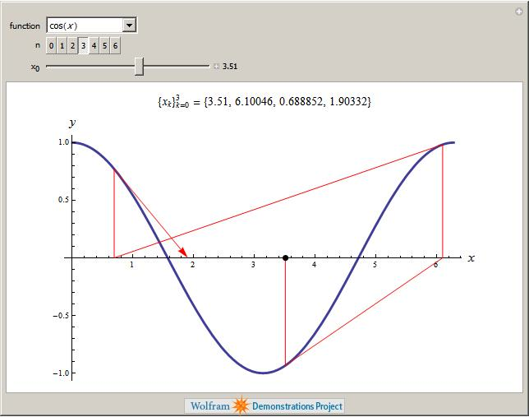
Lock Example:
Blackboard Architecture
Newton Method

Slide 15
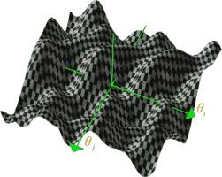

Multiple local minima

Slide 16


Blackboard Architecture
x; f(x);
Processor A
(Newton Method)
Processor B
(Random Search)

Slide 17
Blackboard Architecture
(without lock)
x=7;
f(x) = 14;
x=35;
f(x) = 47;
x=7;
f(x) = 47;
x=7
write
f(x) = 14
f(x) = 47
x = 15
f(x) = 56
f(x) = 47
x = 15
f(x) = 47
x = 7
f(x) = 47
x = 7
f(x) = 14
read x
write x =7
read f(x)
read f(x)
Processor A
(Newton Method)
Processor B
(Random Search)

Slide 18
Blackboard Architecture
(lock)
x=35;
f(x) = 47;
lock=0;
$t0=0
lock=0
$t0 = 1
x = 15
f(x) = 56
lock = 0
sc lock =1
x = 7
f(x) = 14
sc lock=1
ll lock
ll lock
Processor A
(Newton Method)
Processor B
(Random Search)

Slide 19
Transactional Memory

Slide 20
Transactional Synchronization in Haswell:
http://software.intel.com/en-us/blogs/2012/02/07/transactional-synchronization-in-haswell/
Transactional Synchronization explained:
http://software.intel.com/en-us/blogs/2012/02/07/coarse-grained-locks-and-transactional-synchronization-explained/
Support for Transactional Memory in
BlueGeneQ:
http://arstechnica.com/hardware/news/2011/08/ibms-new-transactional-memory-make-or-break-time-for-multithreaded-revolution.ars

Slide 21
Transactions × ll/sc
“Transactional memory is a kind of LL/SC on steroids:
each thread in a transaction can, in effect,
perform an LL on many different memory locations,
and the commit operation performs a kind of SC
that takes effect on those multiple locations
simultaneously, with either every store succeeding or
failing together.”
IBM's new transactional memory: make-or-break time for multithreaded revolution
By Peter Bright
http://arstechnica.com/hardware/news/2011/08/ibms-new-transactional-memory-make-or-break-time-for-multithreaded-revolution.ars

