Slide 1
Compiling, Linking, Loading
J. Nelson Amaral

Slide 2
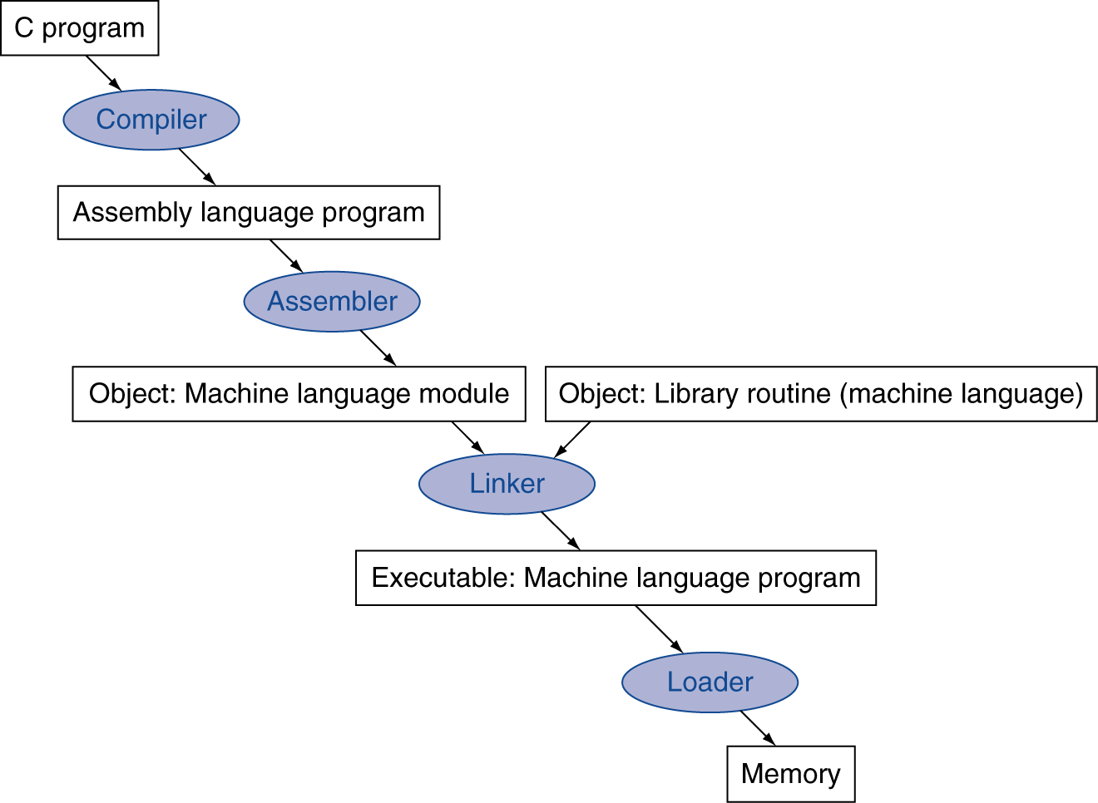
Translation and Startup
Many compilers produce object modules directly
Static linking
Section 2.12

Slide 3
Producing an Object Module
Assembler (or compiler):
translates program into machine instructions
Provides information for building a complete program from the pieces
Header: describes content of object module
Text segment: translated instructions
Static data segment: data allocated for the life of the program
Relocation info: for content that depend on absolute address where the program is loaded
Symbol table: global definitions and external refs
Debug info: for associating with source code
Section 2.12

Slide 4
Linking Object Modules
Produces an executable image
1. Merge segments
2. Resolve labels (determine their addresses)
3. Patch location-dependent and external refs
Could leave location dependencies for fixing by a relocating loader
But with virtual memory, no need to do this
Program can be loaded into absolute location in virtual memory space
Section 2.12

Slide 5
Loading a Program
Load from image file on disk into memory
1. Read header to determine segment sizes
2. Create virtual address space
3. Copy text and initialized data into memory
Or set page table entries so they can be faulted in
4. Set up arguments on stack
5. Initialize registers (including $sp, $fp, $gp)
6. Jump to startup routine
Copies arguments to $a0, … and calls main
When main returns, invoke exit syscall
Section 2.12

Slide 6
Dynamic Linking
Only link/load a library procedure when it is called
Requires procedure code to be rellocatable*
Avoids image bloat caused by statically linking of all (transitively) referenced libraries
Automatically picks up new library versions
*Rellocatable code requires a linker to "fix" the code
to run in a new location.
*Position-Independent code is assembly code that
can run anywhere in memory without change.
Section 2.12

Slide 7
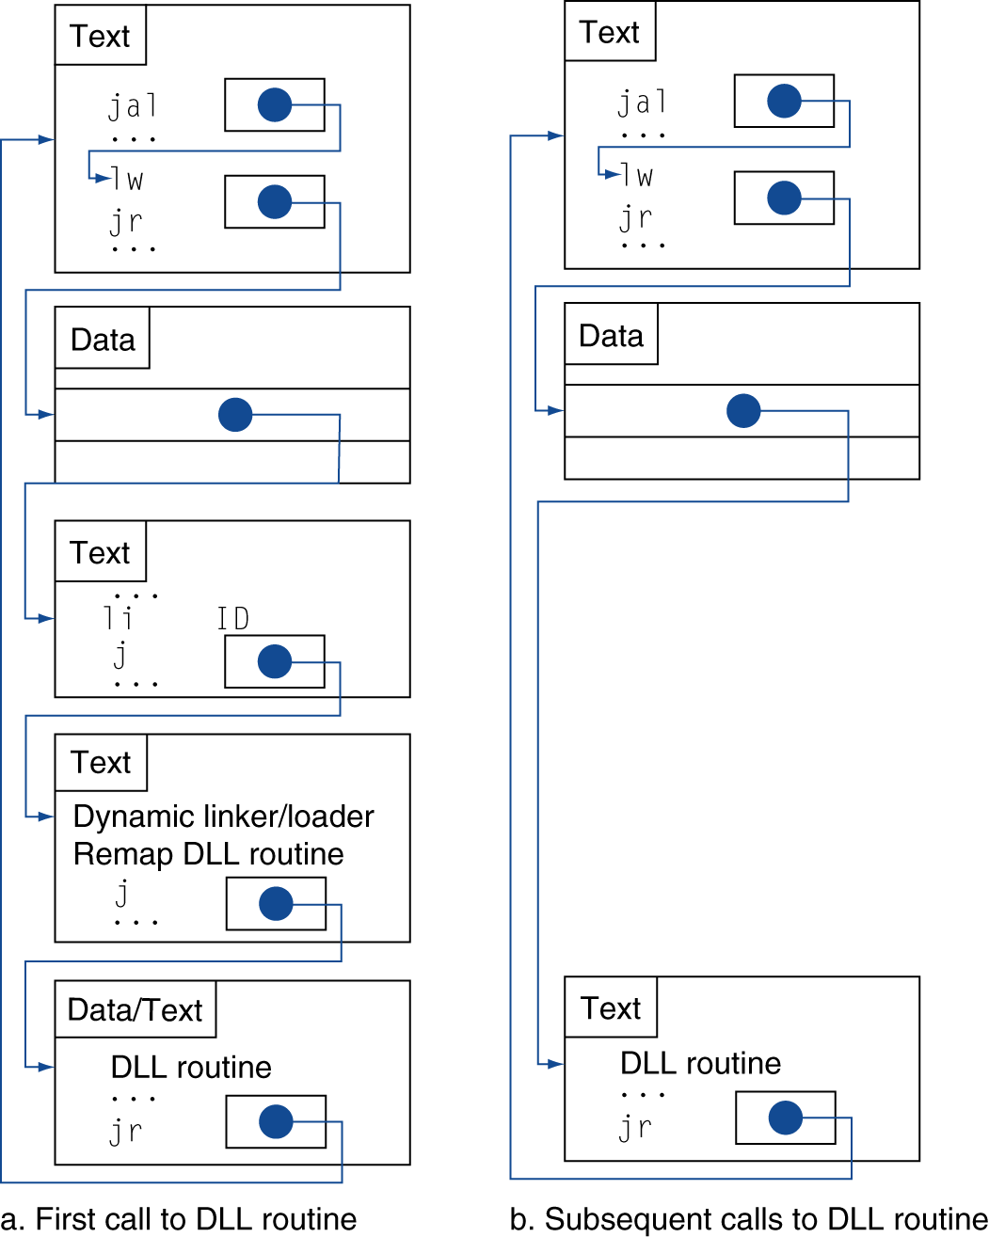
Lazy Linkage
Indirection table
Stub: Loads routine ID, Jump to linker/loader
Linker/loader code
Dynamically mapped code
Section 2.12

Slide 8
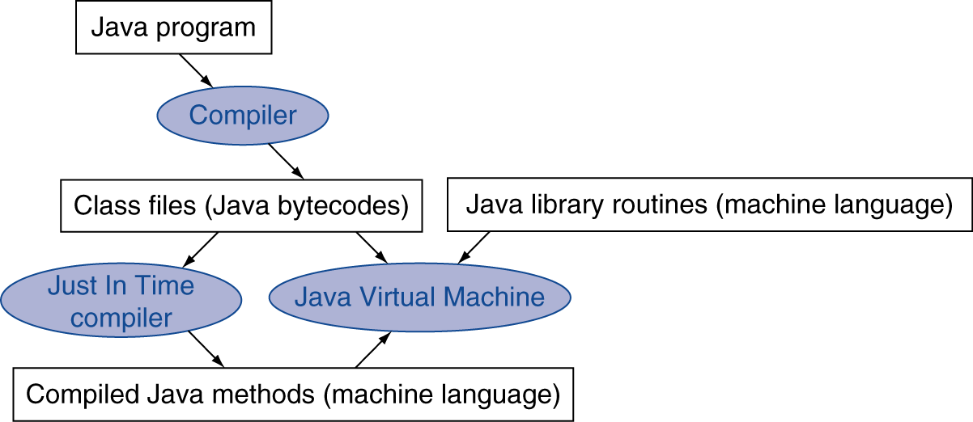
Dynamic JIT Compilers
Simple portable instruction set for the JVM
Compiles bytecodes of “hot” methods into native code for host machine
Interprets bytecodes
Section 2.12

