Slide 1
Topic 9
Arithmetic for Computers
(modified by J. Nelson Amaral)
Notes:
Morgan Kaufmann Publishers
Chapter 3 — Arithmetic for Computers

Slide 2
Arithmetic for Computers
Operations on integers
  Addition and subtraction
  Multiplication and division
  Dealing with overflow
Floating-point real numbers
  Representation and operations
Notes:
Morgan Kaufmann Publishers
Chapter 3 — Arithmetic for Computers

Slide 3
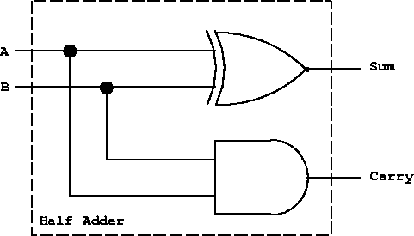
Bit-wise addition
Sum is 1 when A and B
are different.
Carry
0
 | 0
+ | 0
 | 0
0
 | 0
+ | 1
 | 1
Sum
0
 | 1
+ | 0
 | 1
1
 | 1
+ | 1
 | 0
Carry is 1 when A and B
are both 1.
Notes:
Half Adder: takes two inputs and produces two outputs
Morgan Kaufmann Publishers
Chapter 3 — Arithmetic for Computers

Slide 4
Circuit for addition
 | 1
 | 1
+ | 1

Slide 5
Circuit for addition
 | 0
 | 1
+ | 1
1 | 1
 | 1
+ | 1
 | 1

Slide 6
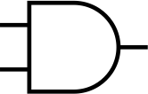

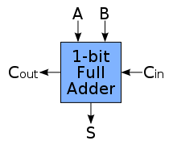
Circuit for addition
0 | 0
 | 0
+ | 0
 | 0
0 | 0
 | 1
+ | 0
 | 1
1 | 0
 | 1
+ | 1
 | 0
1 | 1
 | 1
+ | 1
 | 1
A
B
S
Cin
Cout
Cin | ai | bi | S | Cout
0 | 0 | 0 | 0 | 0
0 | 0 | 1 | 1 | 0
0 | 1 | 0 | 1 | 0
0 | 1 | 1 | 0 | 1
1 | 0 | 0 | 1 | 0
1 | 0 | 1 | 0 | 1
1 | 1 | 0 | 0 | 1
1 | 1 | 1 | 1 | 1

Slide 7
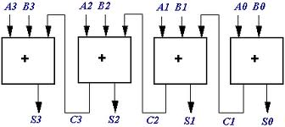
Ripple-Carry Adder
Notes:
Morgan Kaufmann Publishers
Chapter 3 — Arithmetic for Computers

Slide 8
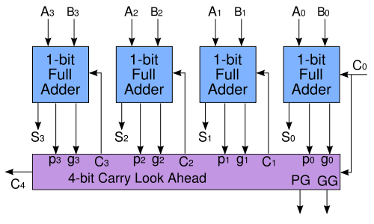
Carry Look Ahead Adder
Notes:
Morgan Kaufmann Publishers
Chapter 3 — Arithmetic for Computers

Slide 9

Integer Addition
Example: 7 + 6
Section 3.2
Notes:
Morgan Kaufmann Publishers
Chapter 3 — Arithmetic for Computers

Slide 10
Integer Addition
Example: 7 + 6
Overflow if result out of range
Section 3.2
Notes:
Morgan Kaufmann Publishers
Chapter 3 — Arithmetic for Computers

Slide 11
Integer Addition
Example: 7 + 6
Overflow if result out of range
A + B |  | A
 |  | Positive | Negative
B | Positive | if (sign == 1) overflow | No overflow
 | Negative | No overflow | If (sign == 0) overflow
Section 3.2
Notes:
Morgan Kaufmann Publishers
Chapter 3 — Arithmetic for Computers
Two positive numbers, and the sum is negative
Two negative numbers, and the sum is positive

Slide 12
Integer Subtraction
Add negation of second operand
Example: 7 – 6 = 7 + (–6)
  +7 0000 0000 … 0000 0111
  –6: 1111 1111 … 1111 1010
  +1: 0000 0000 … 0000 0001
Subtraction overflows if result out of range
A - B |  | A
 |  | Positive | Negative
B | Positive | No overflow | If (sign == 0) overflow
 | Negative | If (sign == 1) overflow | No overflow
Section 3.2
Notes:
Morgan Kaufmann Publishers
Chapter 3 — Arithmetic for Computers
A negative number from a positive number, diff is negative
A positive number from a negative number, diff is positive

Slide 13
Dealing with Overflow
Some languages (e.g., C) ignore overflow
  Use MIPS addu, addui, subu instructions
Other languages (e.g., Ada, Fortran) require raising an exception
  Use MIPS add, addi, sub instructions
  On overflow, invoke exception handler
    Save PC in exception program counter (EPC) register
    Jump to predefined handler address
P-H. pp. 227
Notes:
Morgan Kaufmann Publishers
Chapter 3 — Arithmetic for Computers

Slide 14
Arithmetic for Multimedia
Graphics and media processing operates on vectors of 8-bit and 16-bit data
  Use 64-bit adder, with partitioned carry chain
    Operate on 8×8-bit, 4×16-bit, or 2×32-bit vectors
  SIMD (single-instruction, multiple-data)
Saturating operations
  On overflow, result is largest representable value
    c.f. 2s-complement modulo arithmetic
  E.g., clipping in audio, saturation in video
P-H. p. 227
Notes:
Morgan Kaufmann Publishers
Chapter 3 — Arithmetic for Computers

Slide 15
Multiplication (unsigned)
§3.3 Multiplication
Start with long-multiplication approach
multiplicand
1000
× 1001
1000
0000
0000
1000
1001000
multiplier
product
Length of the product is the sum of operand lengths
Notes:
Morgan Kaufmann Publishers
Chapter 3 — Arithmetic for Computers

Slide 16
Multiplication Hardware
64 bits
multiplicand
1000
× 1001
1000
0000
0000
1000
1001000
Multiplicand
multiplier
32 bits
64-bit ALU
Multiplier
product
Product
Control test
Initially 0
64 bits
ALU ≡ Arithmetic and Logic Unit
P-H. pp. 231-232
Notes:
Morgan Kaufmann Publishers
Chapter 3 — Arithmetic for Computers

Slide 17
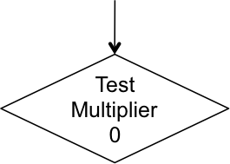
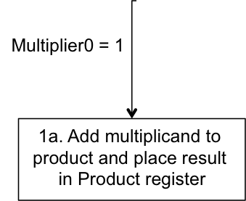
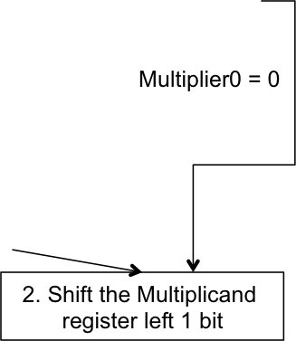

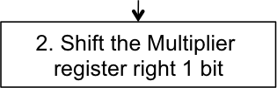
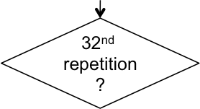

Multiplication Hardware
Start
No: <32 repetitions
Initially 0
P-H. pp. 231-232
Notes:
Morgan Kaufmann Publishers
Chapter 3 — Arithmetic for Computers

Slide 18



Multiplication Hardware
1000 multiplicand
× 1001 multiplier
1001000 product
multiplicand
0
0
0
0
1
0
0
0
0
0
0
0
multiplier
Add = 0
Add = 1
8-bit Adder
0
0
0
0
1
0
0
1
product
1
Control
1

Slide 19



Refined Multiplication Hardware
1000 multiplicand
× 1001 multiplier
1001000 product
multiplicand
1
0
0
0
Add = 1
Add = 0
4-bit Adder
multiplier
0
0
0
0
Control
0
1
1
0
0
1
1
1
1
1
1
product

Slide 20
Fast Multiplication Example
1000 multiplicand
× 1001 multiplier
mplier₃× mcand<<3
mplier₂× mcand<<2
mplier₁× mcand<<1
mplier₀× mcand
01000000
00000000
00000000
00001000
01000000
00001000
01001000

Slide 21
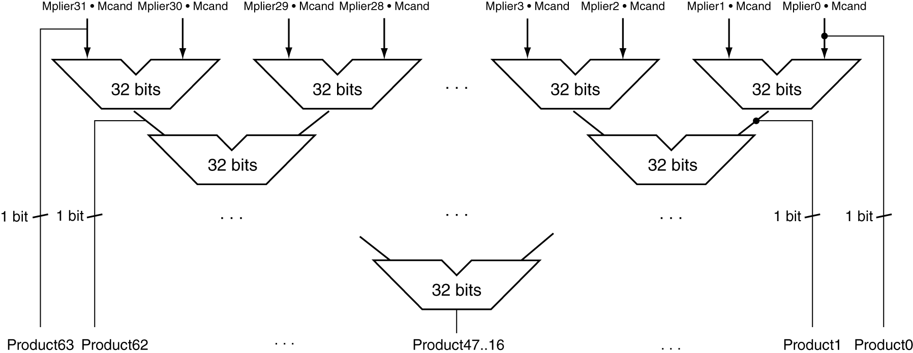
Faster Multiplier
Uses multiple adders
  Cost/performance tradeoff
Can be pipelined
  Several multiplications performed in parallel
P-H. p. 235
Notes:
Morgan Kaufmann Publishers
Chapter 3 — Arithmetic for Computers

Slide 22
Pipelined Multiplication Example
1000 multiplicand
× 1001 multiplier
1010 multiplicand
× 1011 multiplier
1100 multiplicand
× 0011 multiplier
01000000
01010000
00000000
00000000
00000000
00000000
00011000
00000000
00010100
00001100
00001000
00001010
01000000
01010000
00011110
00001000
01001000

Slide 23
MIPS Multiplication
Two 32-bit registers for product
  HI: most-significant 32 bits
  LO: least-significant 32-bits
Instructions
  mult rs, rt / multu rs, rt
    64-bit product in HI/LO
  mfhi rd / mflo rd
    Move from HI/LO to rd
    Can test HI value to see if product overflows 32 bits
  mul rd, rs, rt
    Least-significant 32 bits of product –> rd
P-H. p. 235
Notes:
Morgan Kaufmann Publishers
Chapter 3 — Arithmetic for Computers

Slide 24
Hardware for Division
Same hardware used for multiplication can be used for division. See pages 239-241 in textbook.

Slide 25
MIPS Division
Use HI/LO registers for result
  HI: 32-bit remainder
  LO: 32-bit quotient
Instructions
  div rs, rt / divu rs, rt
  No overflow or divide-by-0 checking
    Software must perform checks if required
  Use mfhi, mflo to access result
P-H. p. 241
Notes:
Morgan Kaufmann Publishers
Chapter 3 — Arithmetic for Computers

