Slide 1
Topic A
Floating Point Representation
(modified by J. Nelson Amaral)

Slide 2
Floating Point
Representation for non-integer numbers
Including very small and very large numbers
Like scientific notation
–2.34 × 10⁵⁶
+0.002 × 10^{–4}
+987.02 × 10⁹
In binary
±1.xxxxxxx₂ × 2^{yyyy}
Types float and double in C
normalized
not normalized
P-H. p. 242

Slide 3
Floating Point Standard
Defined by IEEE Std 754-1985
Developed in response to divergence of representations
Portability issues for scientific code
Now almost universally adopted
Two representations
Single precision (32-bit)
Double precision (64-bit)
P-H. p. 241

Slide 4
Floating Point Representation
Most standard floating point representation use:
1 bit for the sign (positive or negative)
8 bits for the range (exponent field)
23 bits for the precision (fraction field)
Most-Significant Bit (MSB)
Least-Significant Bit (MSB)
MSB
LSB
1
8
23
S
biasedexponent
fraction
P-H. p. 245
From: Patt and Patel, pp. 33

Slide 5
Floating Point Representation (example)
1
8
23
S
biasedexponent
fraction
Thus the exponent is given by:
1 10000001 10101000000000000000000
P-H. p. 245
From: Patt and Patel, pp. 34

Slide 6
Floating Point Representation (example)
1
8
23
S
biasedexponent
fraction
What is the decimal value of the following floating point number?
0011 1101 1000 0000 0000 0000 0000 0000
biasedexponent
biasedexponent = 2⁷ – 2³ + 3 = 128 - 8 + 3 = 123
P-H. p. 245
From: Patt and Patel, pp. 34

Slide 7
Answering Dylan Ashley's Question (Fall 2014)
Why the IEEE standard use the bias format for the exponent
instead of a two-complement representation? Why?

Slide 8
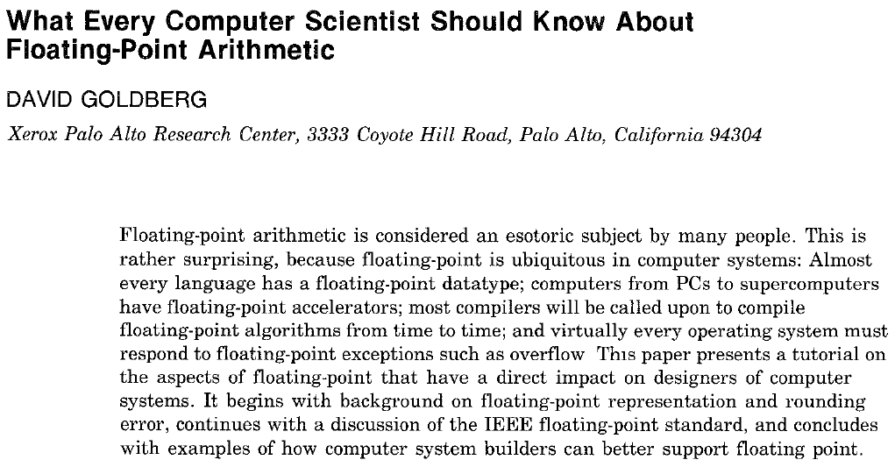
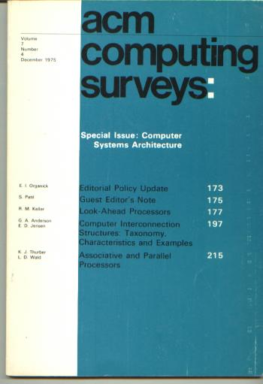

Slide 9

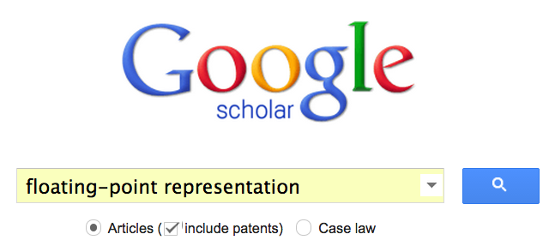
How to find the answer?

Slide 10
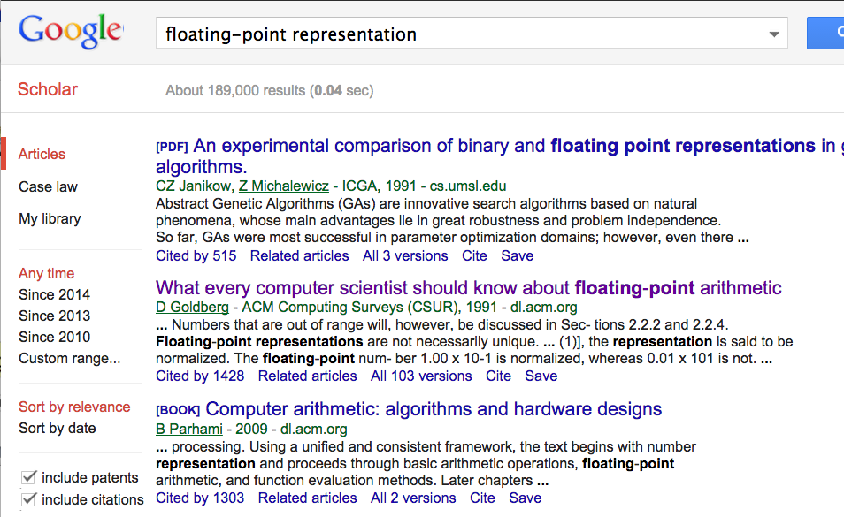

Slide 11
1. Download the .pdf
2. Use search into the .pdf for what you want to find.
Example: "bias"

Slide 12
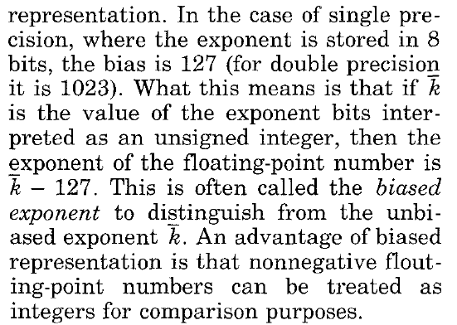

Slide 13
Example
Problem: Compare 2.5 and 0.25. Which is larger?
2.5 = 2¹ + 2⁻¹ = 10.1 × 2⁰ = 1.01 × 2¹
0.25 = 2⁻² = 0.01 × 2⁰ = 1.0 × 2⁻²

Slide 14
Example
Problem: Compare 2.5 and 0.25. Which is larger?
2.5 = 1.01 × 2¹
0.25 = 1.0 × 2⁻²
Representation with exponent in two complement:
2.5 = 0 00000001 01000000000000000000000
-2 = 11111110
0.25 = 0 11111110 00000000000000000000000
Representation with exponent in bias representation:
2.5 = 0 10000000 01000000000000000000000
0.25 = 0 01111101 00000000000000000000000

Slide 15


Example
Problem: Compare 2.5 and 0.25. Which is larger?
2.5 = 1.01 × 2¹
0.25 = 1.0 × 2⁻²
Representation with exponent in two complement:
2.5 = 0 00000001 01000000000000000000000
Using integer comparison:
2.5 < 0.25
0.25 = 0 11111110 00000000000000000000000
Representation with exponent in bias representation:
2.5 = 0 10000000 01000000000000000000000
Using integer comparison:
0.25 < 2.5
0.25 = 0 01111101 00000000000000000000000

