Slide 1
Topic A
Floating Point Representation
(modified by J. Nelson Amaral)

Slide 2
Floating Point
Representation for non-integer numbers
Including very small and very large numbers
Like scientific notation
–2.34 × 10⁵⁶
+0.002 × 10^{–4}
+987.02 × 10⁹
In binary
±1.xxxxxxx₂ × 2^{yyyy}
Types float and double in C
normalized
not normalized
P-H. Section 3.5

Slide 3
Floating Point Standard
Defined by IEEE Std 754-1985
Developed in response to divergence of representations
Portability issues for scientific code
Now almost universally adopted
Two representations
Single precision (32-bit)
Double precision (64-bit)
P-H. Section 3.5

Slide 4
Floating Point Representation
Most standard floating point representation use:
1 bit for the sign (positive or negative)
8 bits for the range (exponent field)
23 bits for the precision (fraction field)
Most-Significant Bit (MSB)
Least-Significant Bit (MSB)
MSB
LSB
1
8
23
S
biasedexponent
fraction
P-H. Section 3.5
From: Patt and Patel, pp. 33

Slide 5
Floating Point Representation (example)
1
8
23
S
biasedexponent
fraction
Thus the exponent is given by:
1 10000001 10101000000000000000000
P-H. Section 3.5
From: Patt and Patel, pp. 34

Slide 6
Floating Point Representation (example)
1
8
23
S
biasedexponent
fraction
What is the decimal value of the following floating point number?
0011 1101 1000 0000 0000 0000 0000 0000
biasedexponent
biasedexponent = 2⁷ – 2³ + 3 = 128 - 8 + 3 = 123
P-H. Section 3.5
From: Patt and Patel, pp. 34

Slide 7
Answering Dylan Ashley's Question (Fall 2014)
Why the IEEE standard uses the bias format for the exponent
instead of a two-complement representation? Why?

Slide 8
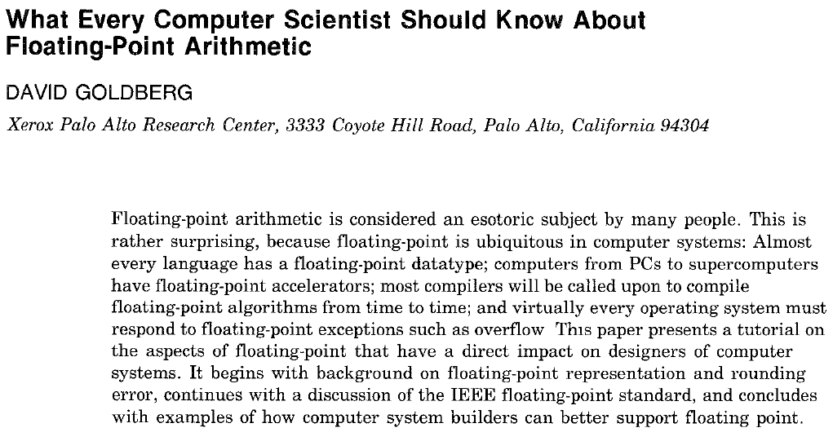
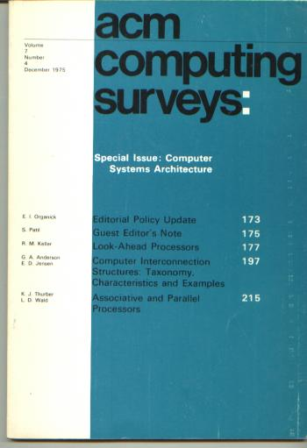

Slide 9

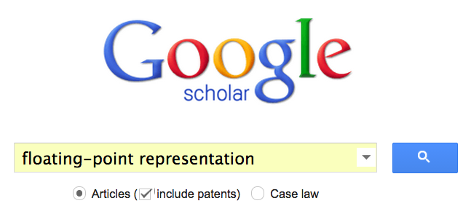
How to find the answer?

Slide 10
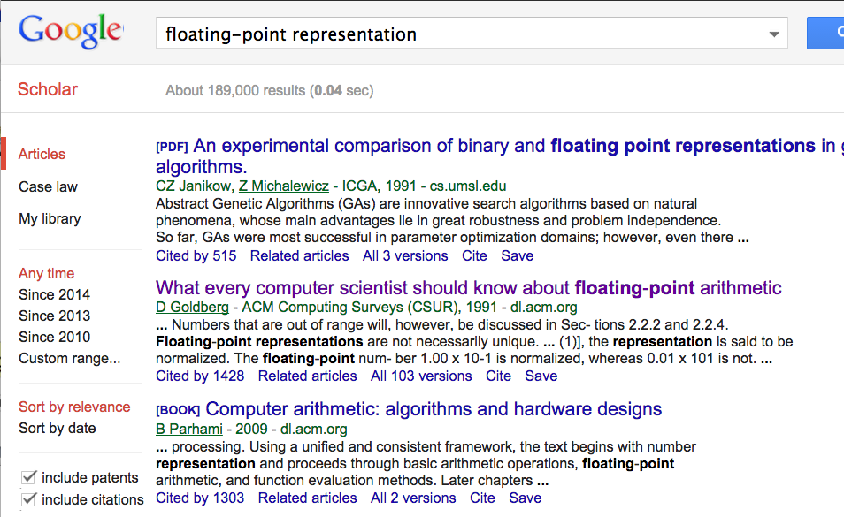

Slide 11
1. Download the .pdf
2. Use search into the .pdf for what you want to find.
Example: "bias"

Slide 12
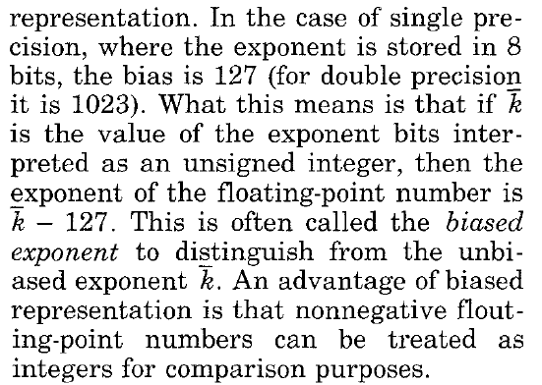

Slide 13
Example
Problem: Compare 2.5 and 0.25. Which is larger?
2.5 = 2¹ + 2⁻¹ = 10.1 × 2⁰ = 1.01 × 2¹
0.25 = 2⁻² = 0.01 × 2⁰ = 1.0 × 2⁻²

Slide 14
Example
Problem: Compare 2.5 and 0.25. Which is larger?
2.5 = 1.01 × 2¹
0.25 = 1.0 × 2⁻²
Representation with exponent in two complement:
2.5 = 0 00000001 01000000000000000000000
-2 = 11111110
0.25 = 0 11111110 00000000000000000000000
Representation with exponent in bias representation:
2.5 = 0 10000000 01000000000000000000000
0.25 = 0 01111101 00000000000000000000000

Slide 15


Example
Problem: Compare 2.5 and 0.25. Which is larger?
2.5 = 1.01 × 2¹
0.25 = 1.0 × 2⁻²
Representation with exponent in two complement:
2.5 = 0 00000001 01000000000000000000000
Using integer comparison:
2.5 < 0.25
0.25 = 0 11111110 00000000000000000000000
Representation with exponent in bias representation:
2.5 = 0 10000000 01000000000000000000000
Using integer comparison:
0.25 < 2.5
0.25 = 0 01111101 00000000000000000000000

Slide 16
Floating Point Representation (example)
1
8
23
S
biasedexponent
fraction
What is the decimal value of the following floating point number?
0100 0001 1001 0100 0000 0000 0000 0000
biasedexponent
biasedexponent =128+2+1=131
P-H. Section 3.5
From: Patt and Patel, pp. 35

Slide 17
Floating Point Representation (example)
1
8
23
S
biasedexponent
fraction
Thus the exponent is given by:
1 10000001 10101000000000000000000
P-H. Section 3.5
From: Patt and Patel, pp. 34

Slide 18
Floating Point
1
8
23
S
biasedexponent
fraction
What is the largest number that can be represented in 32 bits floating
point using the IEEE 754 format above?
01111111011111111111111111111111
biasedexponent
biasedexponent =254
P-H. Section 3.5
From: Patt and Patel, pp. 35

Slide 19
Floating Point
1
8
23
S
biasedexponent
fraction
What is the largest number that can be represented in 32 bits floating
point using the IEEE 754 format above?
01111111011111111111111111111111
biasedexponent
actual exponent =254-127 = 127
P-H. Section 3.5
From: Patt and Patel, pp. 35

Slide 20
Floating Point
1
8
23
S
biasedexponent
fraction
What is the smallest number (closest to zero) that can be represented
in 32 bits floating point using the IEEE 754 format above?
00000000000000000000000000000001
biasedexponent
actual exponent =0-126 = -126
P-H. Section 3.5
From: Patt and Patel, pp. 35

Slide 21
Special Floating Point Representations
In the 8-bit field of the exponent we can represent numbers from 0 to
255. We studied how to read numbers with exponents from 0 to 254.
What is the value represented when the exponent is 255 (i.e. 11111111₂)?
An exponent equal 255 = 11111111₂ in a floating-point representation
indicates a special value.
When the exponent is equal 255 = 11111111₂ and the fraction is 0,
the value represented is ± infinity.
When the exponent is equal 255 = 11111111₂ and the fraction is
non-zero, the value represented is Not a Number (NaN).
P-H. Section 3.5

Slide 22
A Possible Final Exam Question
Write a subroutine called fptoint that receives a 32-bit floating
point number f in IEEE 754 format and returns i, the integer portion
of the number expressed in two-complement.
1
8
23
S
biasedexponent
fraction
Assume that the integer portion of the number is small enough
to be represented in a two-complement 32-bit representation.

Slide 23
t1 ← f >> 23
t2 ← t1 & 0x00ff # t2←bexponent
t3 ← 0x007f ffff
t4 ← f & t3 # t4←fraction
t5 ← 0x0080 0000 # bit 23 is 1
# add the 1 of 1.fraction
t4 ← t4 | t5
t1
S
bexponent
t2
bexponent
t4
1
fraction
1
8
23
S
biasedexponent
fraction
if(t2 <= 126)
return 0
t6 ← t2-127 # exponent -127
t7 ← 23 – t6 # how much to move binary point
if t7 >= 0
i ← t4 >> t7
else
i = t4 << (-t7)
if(f<0)
i = - i
return i
* with thanks to
Stephen Rebstock
and
Douglas Schneider
srlv rd, rt, rs

