Slide 1
Introduction
Artificial Intelligence (AI) refers to the development of computer systems that can perform tasks that typically require human intelligence, such as visual perception, speech recognition, and decision-making.

Slide 2
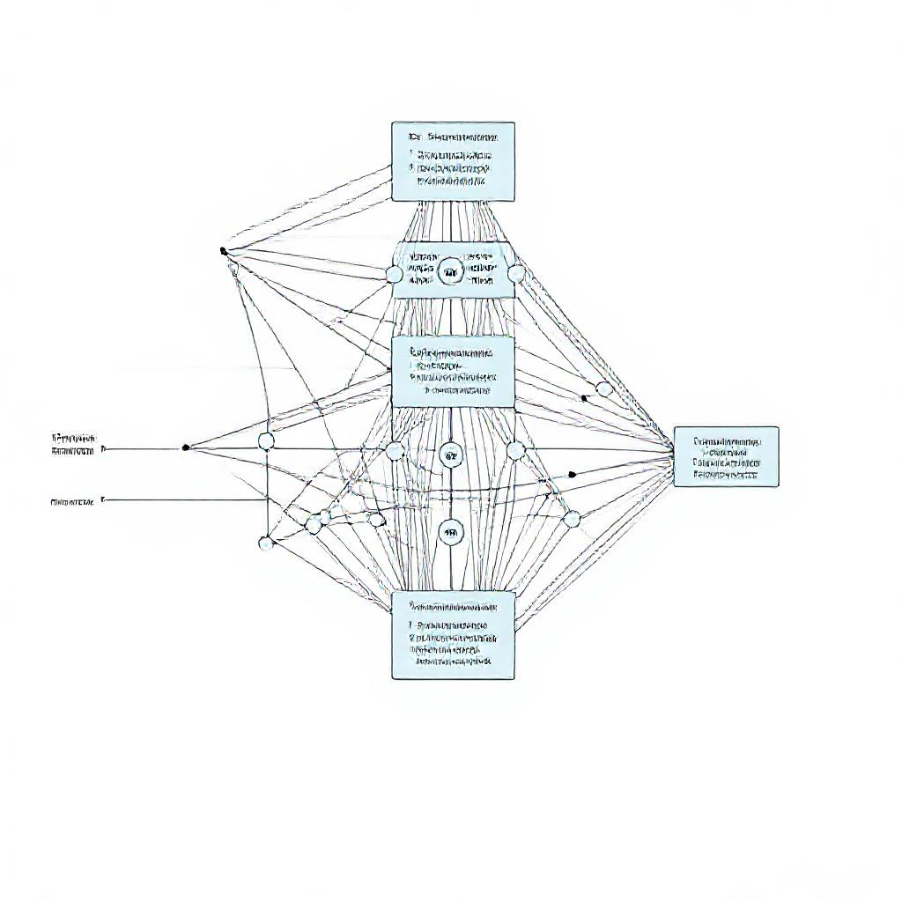
Key Concepts
Machine learning is a crucial aspect of AI, enabling systems to learn from data and improve their performance over time.

Slide 3
Applications of AI
AI is applied in various industries, including healthcare, finance, transportation, and education, to name a few. Examples include virtual assistants, self-driving cars, and personalized medicine.

Slide 4
Conclusion
In conclusion, Artificial Intelligence is a rapidly evolving field with immense potential to transform numerous aspects of our lives. As AI continues to advance, it is essential to address the ethical, social, and economic implications of its development and deployment.

