Slide 1
Introduction
One Piece is a popular manga and anime series created by Eiichiro Oda. The series follows the adventures of Monkey D. Luffy and his crew, the Straw Hat Pirates, as they search for the ultimate treasure known as 'One Piece.' The series is known for its unique characters, engaging storylines, and themes of friendship and perseverance.

Slide 2
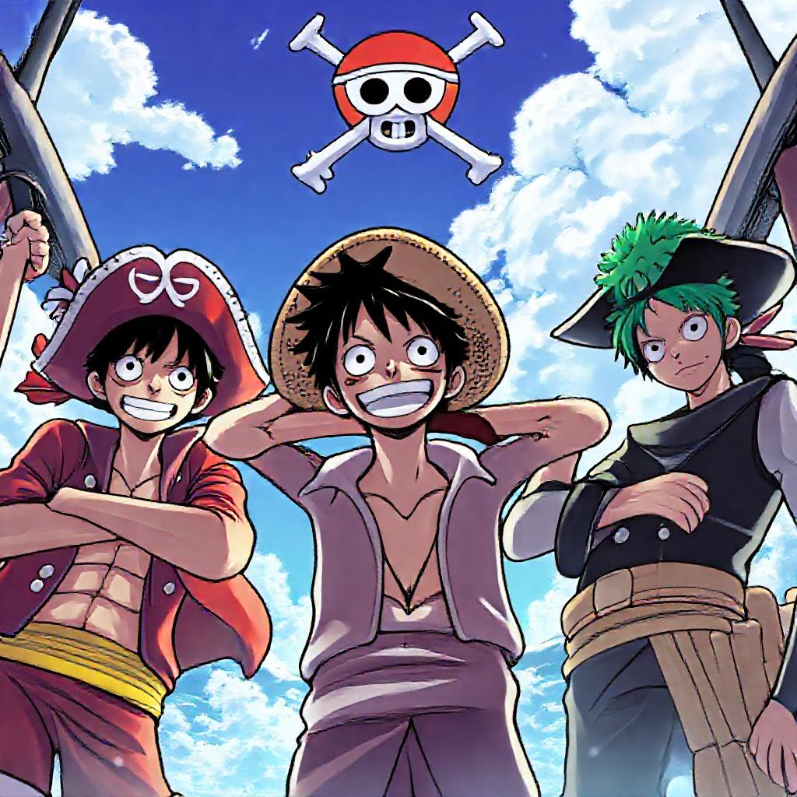
Main Characters
Monkey D. Luffy, Roronoa Zoro, and Sanji are the main characters. They are part of the Straw Hat Pirates crew.

Slide 3
World and Powers
The One Piece world is a vast and diverse place, filled with unique characters and abilities. One of the key concepts in this world is the Devil Fruit, which grants the consumer a special power but also takes away their ability to swim. There are three main types of Devil Fruits: Zoan, Logia, and Paramecia. Each type has its own strengths and weaknesses, and they play a crucial role in the story.
Another important concept in the One Piece world is Haki, a mysterious energy that allows users to sense and manipulate the emotions and auras of others. There are three types of Haki: Kenbunshoku, Busoshoku, and Haoshoku. Haki is used for a variety of purposes, including combat, intimidation, and even healing. It is a powerful tool that can be used to gain the upper hand in battles and to protect oneself and others from harm.

Slide 4
Conclusion
The One Piece series has become a cultural phenomenon due to its rich themes, engaging storylines, and memorable characters. With its massive global fan base, it continues to inspire and influence new generations of fans.
Explore the world of One Piece further to discover its unique charm and appeal.

