Slide 1
smargn
Reversing the n-grams searching process

Slide 2
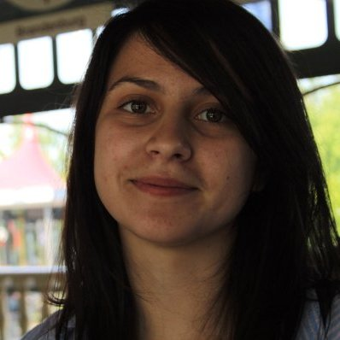
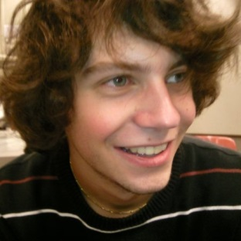
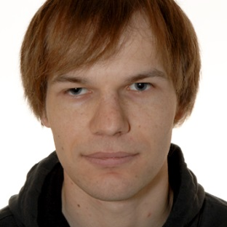
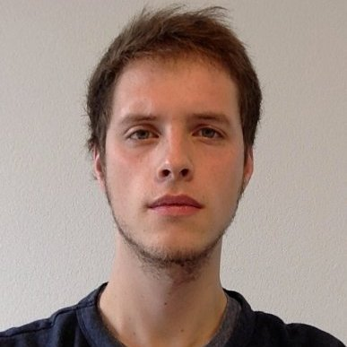
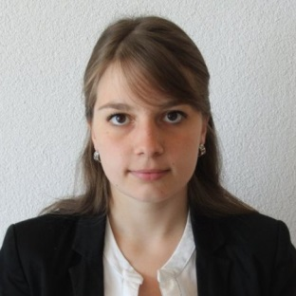
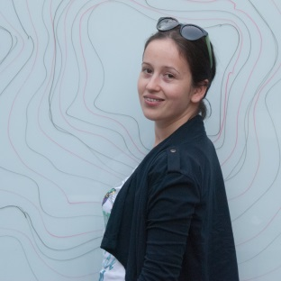
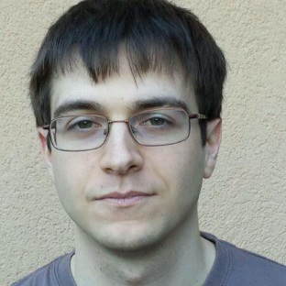


Team
Z. Gucevska | M. Monney | F. Junker | J. Gaspoz | J. Salathé
A. Manasovska | F. Jolidon | V. Rutz | S. Bovet

Slide 3
Plan
What is a temporal profile?
Motivation
Corpus
How smargn works
Example I : “neige”
Example II : “conflits”
Conclusion

Slide 4
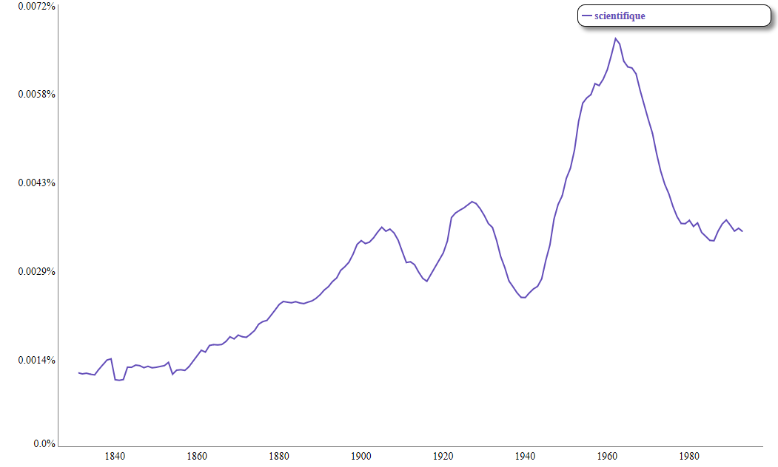
Understand a profile

Slide 5
Motivation
Studies based on n-grams have become popular
Most of them relied on researcher’s intuition
We provide a way to reverse the process
Look for interesting words
Find similar temporal profiles
Understand why

Slide 6
Corpus
Le Temps newspaper
La Gazette de Lausanne
Le Journal de Genève
OCR from 1840 to 1998
→ Cleaning of the data required

Slide 7
How smargn works
Different comparison techniques implemented
Naïve comparison
Peak detection
Dynamic Time Wrapping
…
Check a word’s profile against all the other

Slide 8
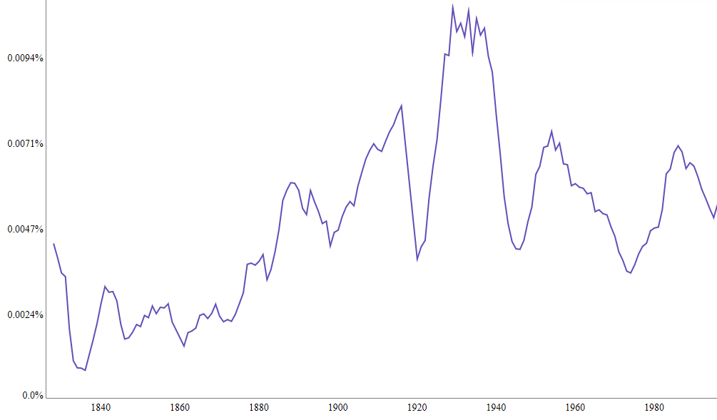
neige

Slide 9
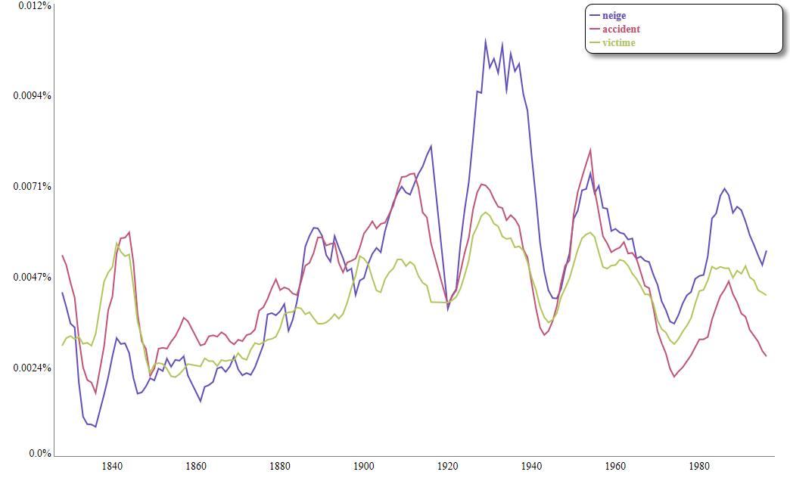
neige, accident & victime

Slide 10
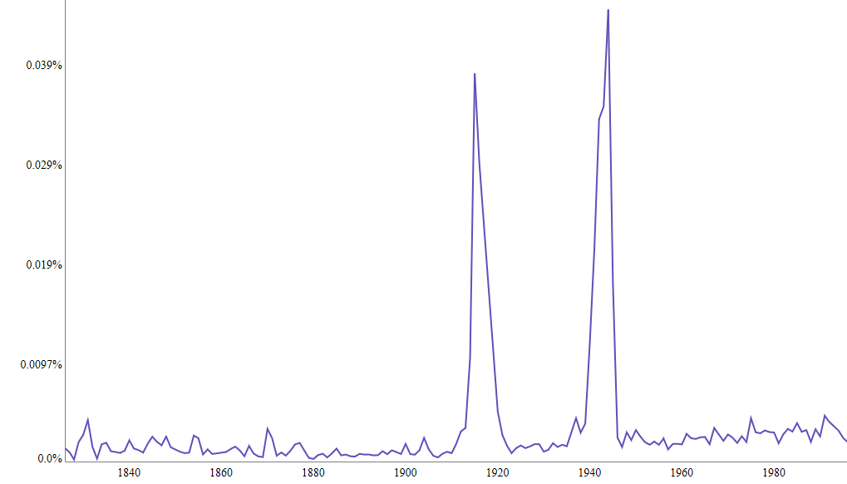
combats

Slide 11
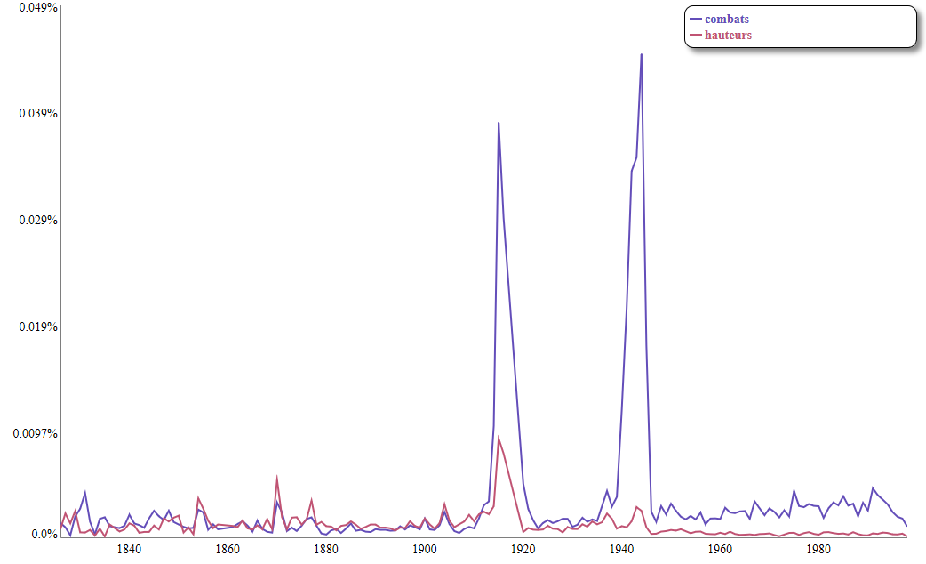
combats & hauteurs

Slide 12
Conclusion
Can help linguistic studies
Gives hints on where to look at
Still needs some global intuition

Slide 13
Thank you!

Slide 14
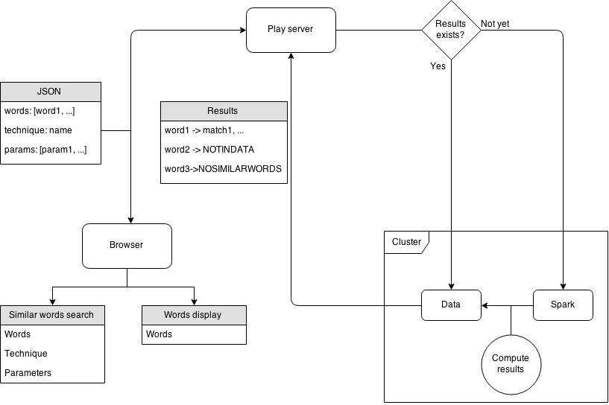
Application flowchart

Slide 15
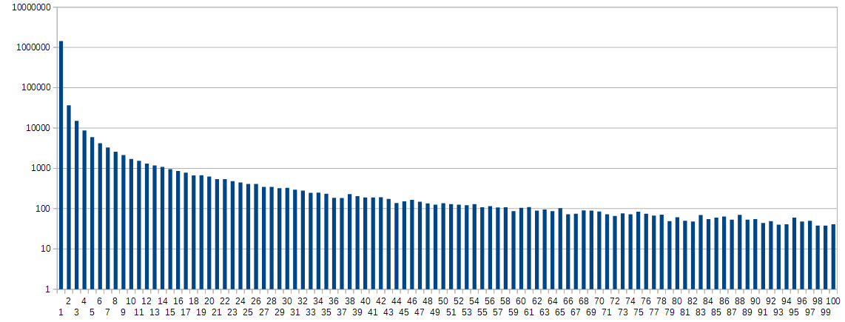
Data histogram

