Slide 1
smargn
Reversing the n-gram search

Slide 2
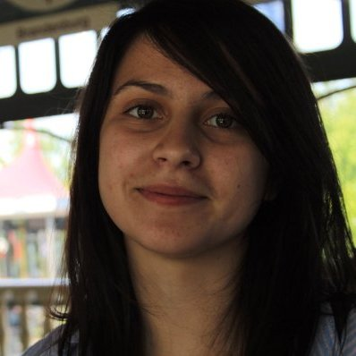
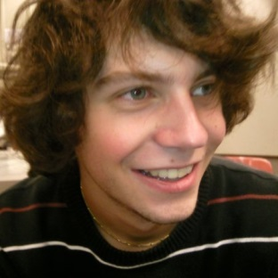
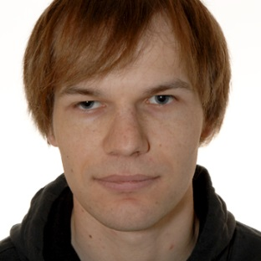
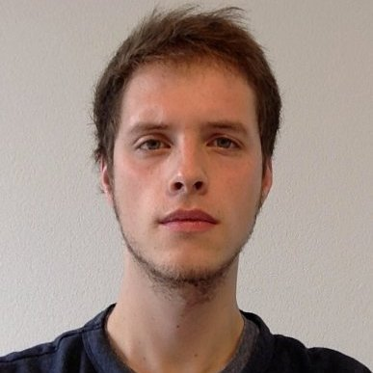
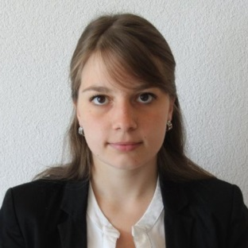
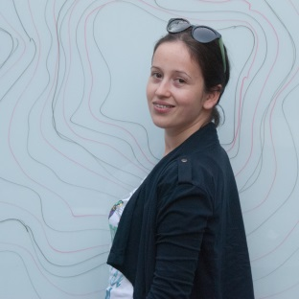


Team
Z. Gucevska | M. Monney | F. Junker | J. Gaspoz | J. Salathé
A. Manasovska | F. Jolidon | V. Rutz | S. Bovet

Slide 3
Motivation
Studies based on n-grams have become popular
Most of them relied on researcher’s intuition
We provide a way to reverse the process
Look for interesting words
Find similar temporal profiles
Understand why

Slide 4
Corpus
Le Temps newspaper
La Gazette de Lausanne
Le Journal de Genève
From 1840 to 1998

Slide 5
Understand the profile
Screenshot du ngrams viewer

Slide 6
Example: “guerre”

