Slide 1
smargn
Reversing the n-grams searching process

Slide 2


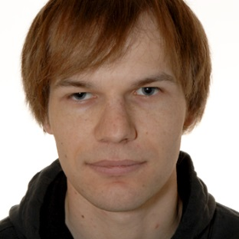



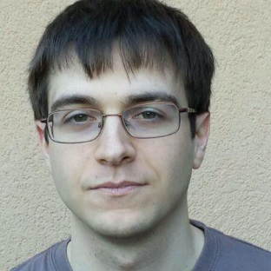


Team
Z. Gucevska | M. Monney | F. Junker | J. Gaspoz | J. Salathé
A. Manasovska | F. Jolidon | V. Rutz | S. Bovet

Slide 3
Corpus
Le Temps newspaper
La Gazette de Lausanne
Le Journal de Genève
159 years of articles ( ≈ 16.7GB)

Slide 4
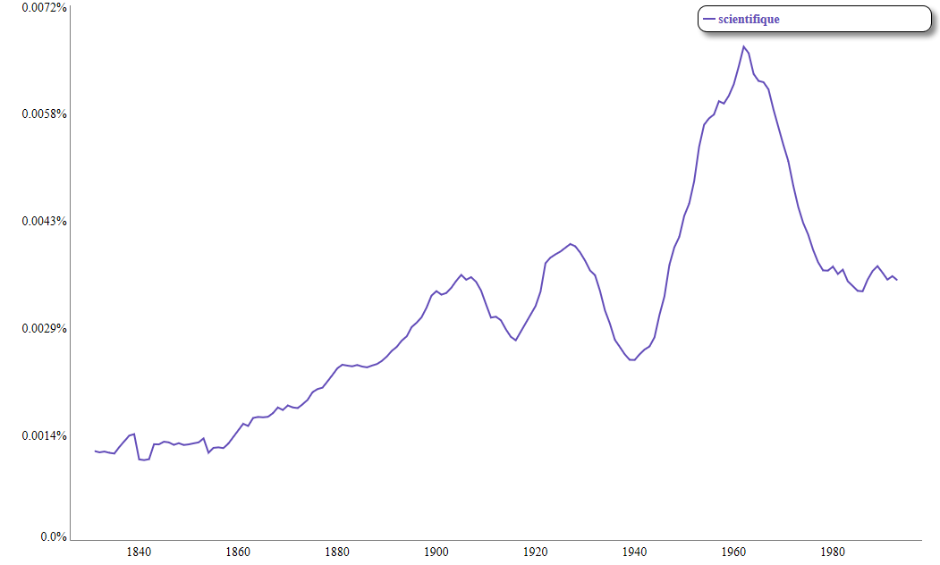
Understand a profile

Slide 5
Motivation
Studies based on n-grams have become popular
Most of them relied on researcher’s intuition
We provide a way to reverse the process
Look for interesting words
Find similar temporal profiles
Understand why

