Slide 1
smargn
Reversing the n-grams searching process

Slide 2


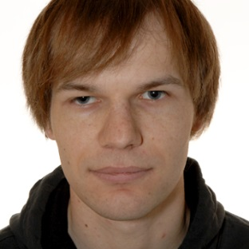



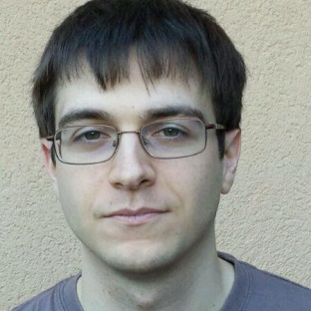


Team
Z. Gucevska | M. Monney | F. Junker | J. Gaspoz | J. Salathé
A. Manasovska | F. Jolidon | V. Rutz | S. Bovet

Slide 3
Corpus
Le Temps newspaper
  La Gazette de Lausanne
  Le Journal de Genève
159 years of articles (~16 GB)
Provided by DHLab in association
with Le Temps and the Bibliothèque nationale suisse

Slide 4
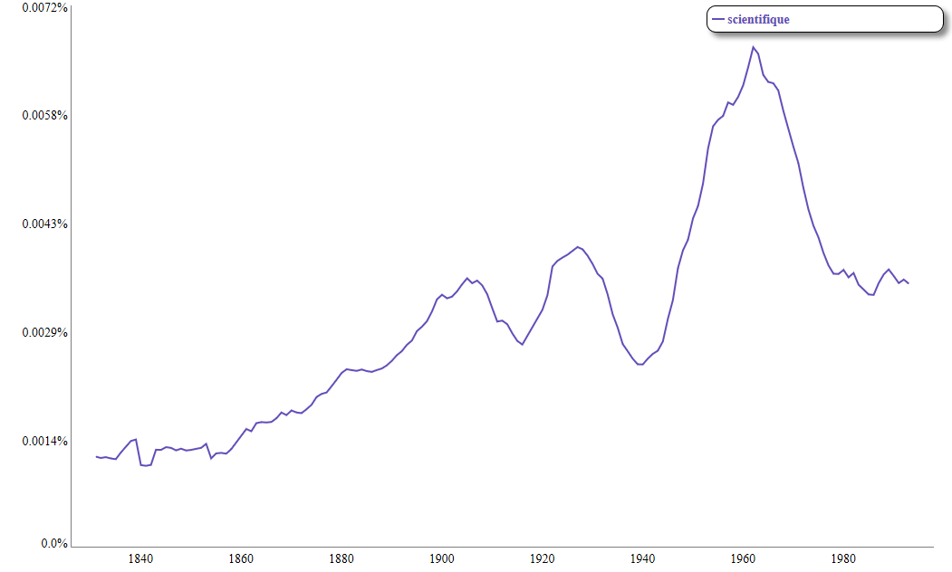
Understand a profile

Slide 5
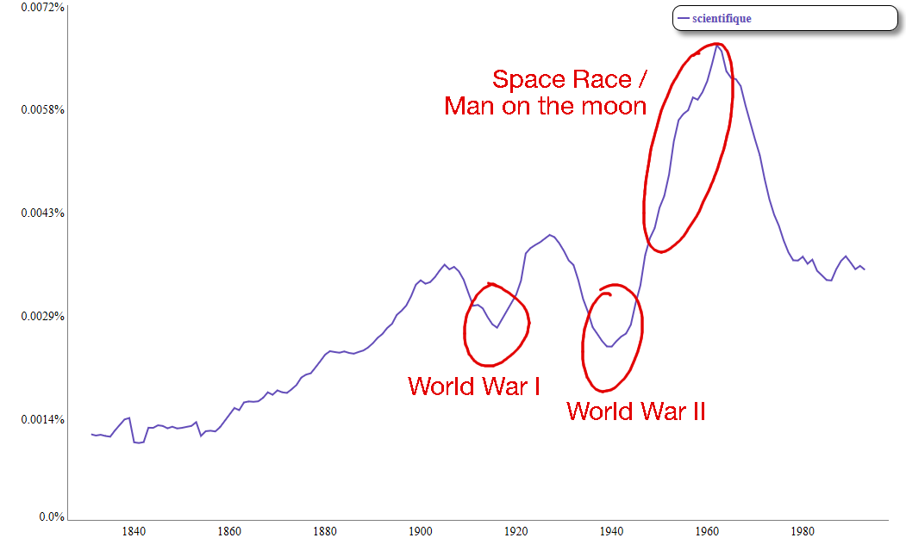
Understand a profile

Slide 6
Motivation
Studies based on n-grams have become popular
Most of them relied on researcher’s intuition
We provide a way to reverse the process
  Look for interesting words
  Find similar temporal profiles
  Understand why

Slide 7
How smargn works
Different comparison techniques implemented
  Naive comparison
  Dynamic Time Warping
  Peak detection
  (many other unsuccessful attempts)

Slide 8
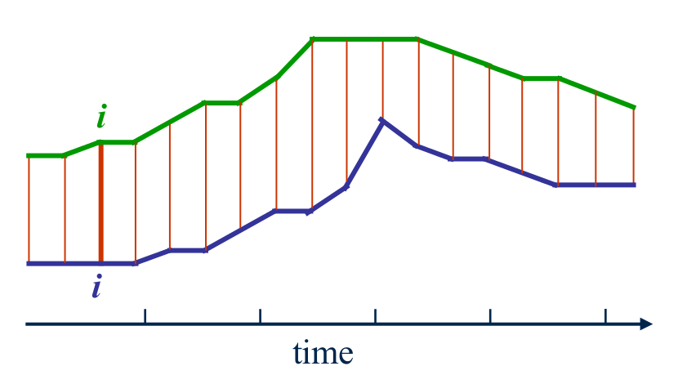
Naive comparison

Slide 9
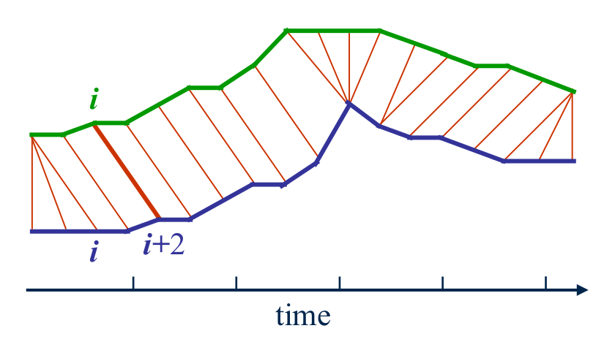
Dynamic Time Warping

Slide 10
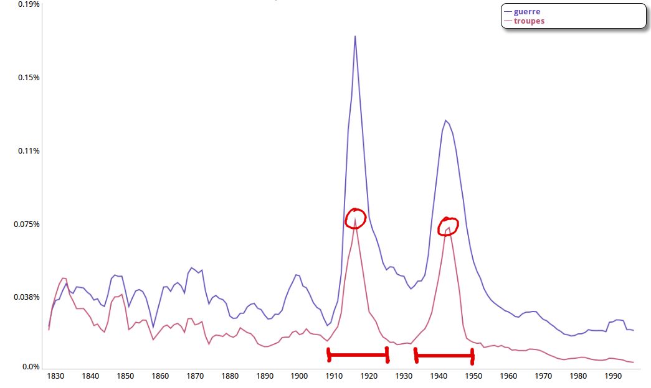
Peak detection

Slide 11
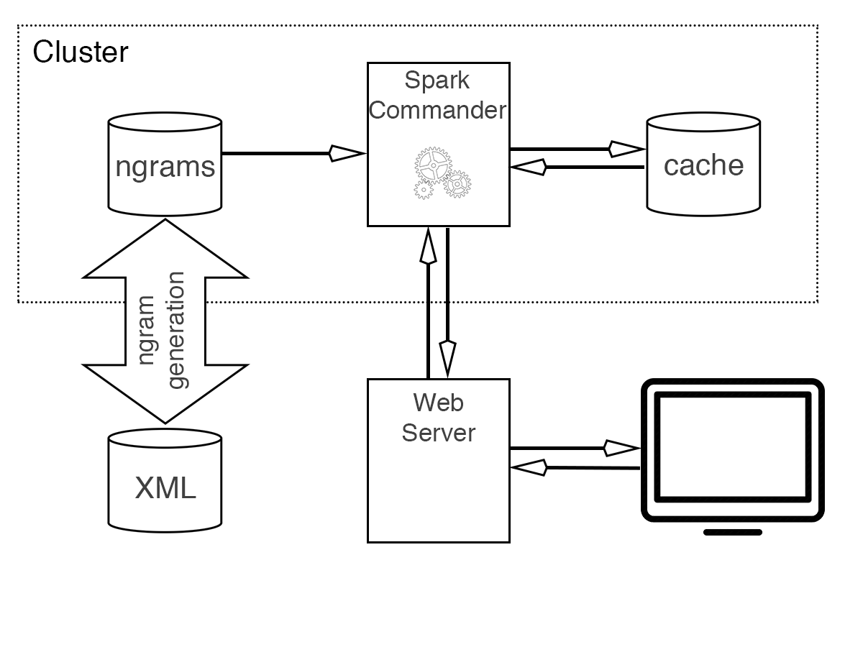
Software architecture

Slide 12
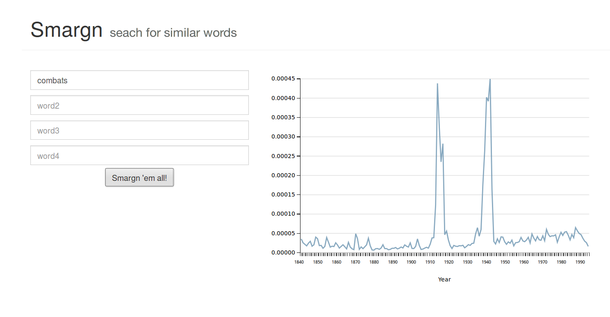
Web interface

Slide 13
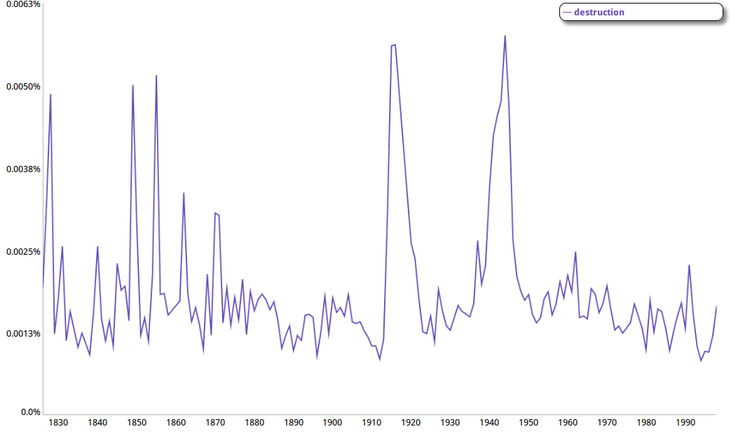
destruction

Slide 14
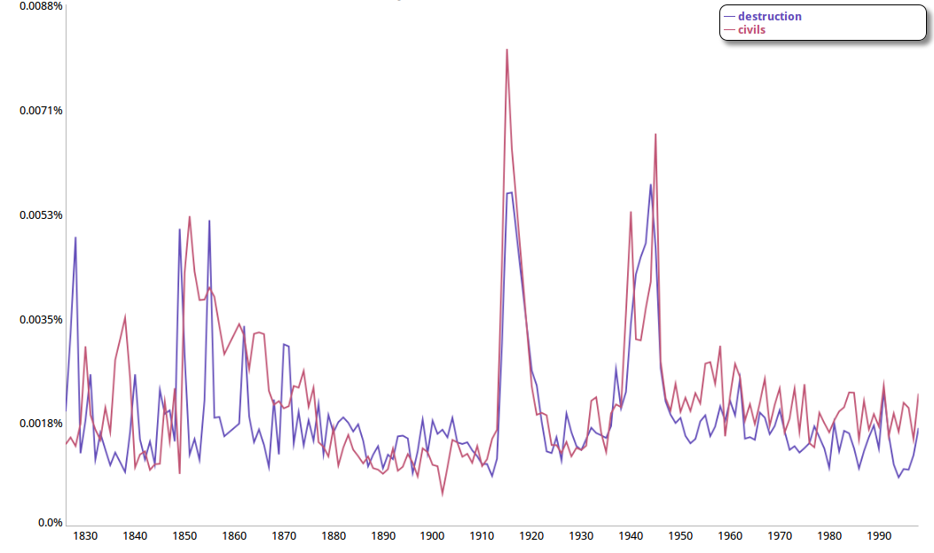
destruction & civils

Slide 15
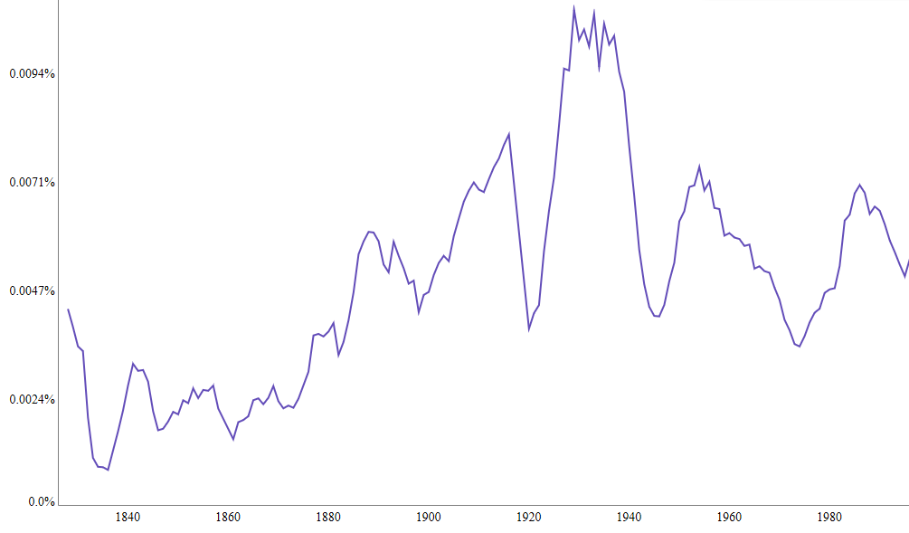
neige

Slide 16
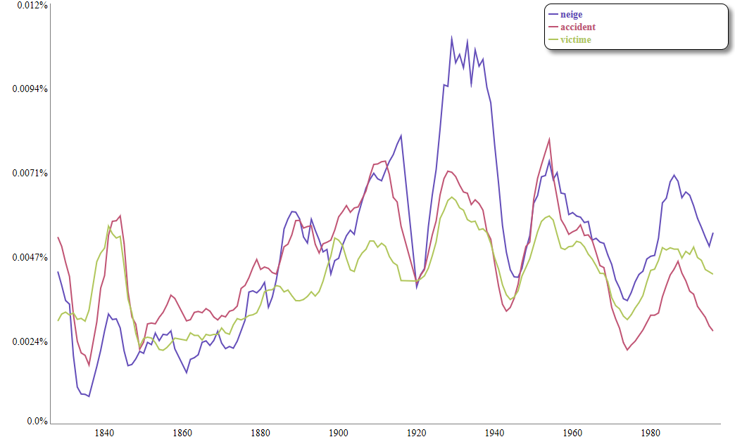
neige, accident & victime

Slide 17
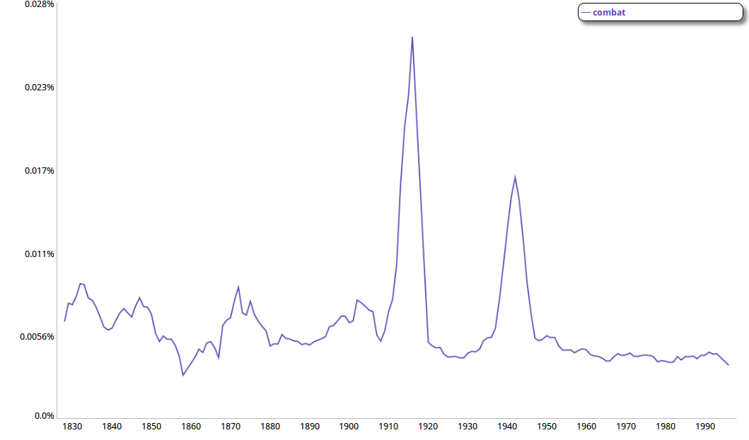
combat

Slide 18
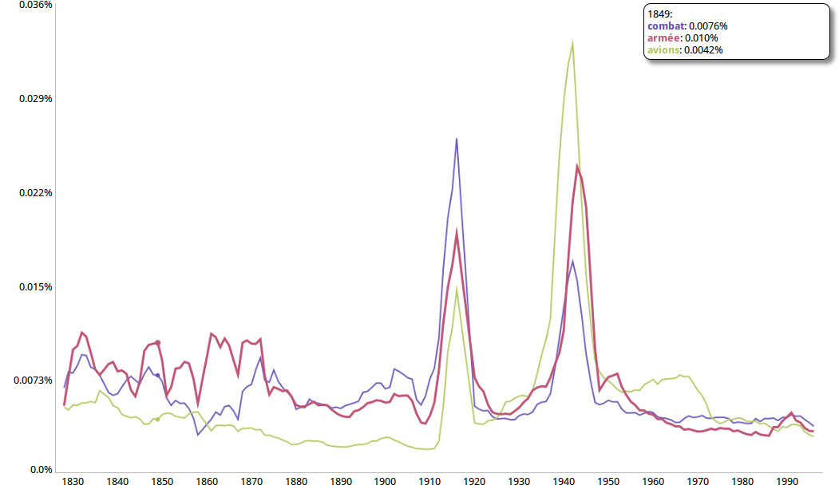
combat, armée, allemande, avions

Slide 19
Conclusion
Can greatly help linguistic and historical studies
Gives hints on where to look at
Makes sure no words are forgotten

Slide 20
Thank you!

Slide 21
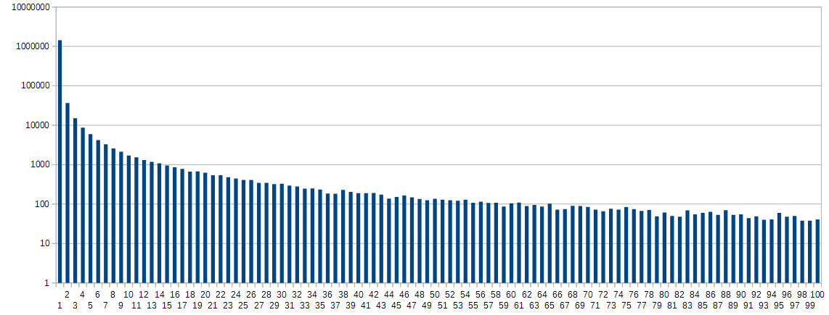
Data histogram

