Slide 2
Topics
Hive
HBASE
Networking
Cloud Fundamentals

Slide 3
Hive
Hive is an abstraction on top of MapReduce
Allows users to query data in the hdfs filesystem without knowing Java or MapReduce
Hive provides a SQL-like interface to data stored in an Apache Hadoop based data warehouse.
Hive was originally developed by Facebook for data warehousing , Now an open-source Apache Project

Slide 4
Database and Data Warehouse
Database- MySQL it will accept the similar format of data (comma separated)
Data Warehouse – ETL(Extract, Transform and Load) it will accept data from multiple sources
Compare the workload of Database with data warehouse, Data ware house is purely designed for higher performance.

Slide 5
How Hive Works?
Hive interpreter runs on the client machine
Turns HiveQL statements into MapReduce jobs
Submit those jobs and Execute across a Hadoop cluster
Parse HiveQL
Make optimization
Plan execution
Generate MapReduce
Submit jobs to Hadoop
Monitor progress

Slide 6


2
HADOOP
CLUSTER
1
Through HIVE
CLI
MAPREDUCE
JAVA
16

Slide 7
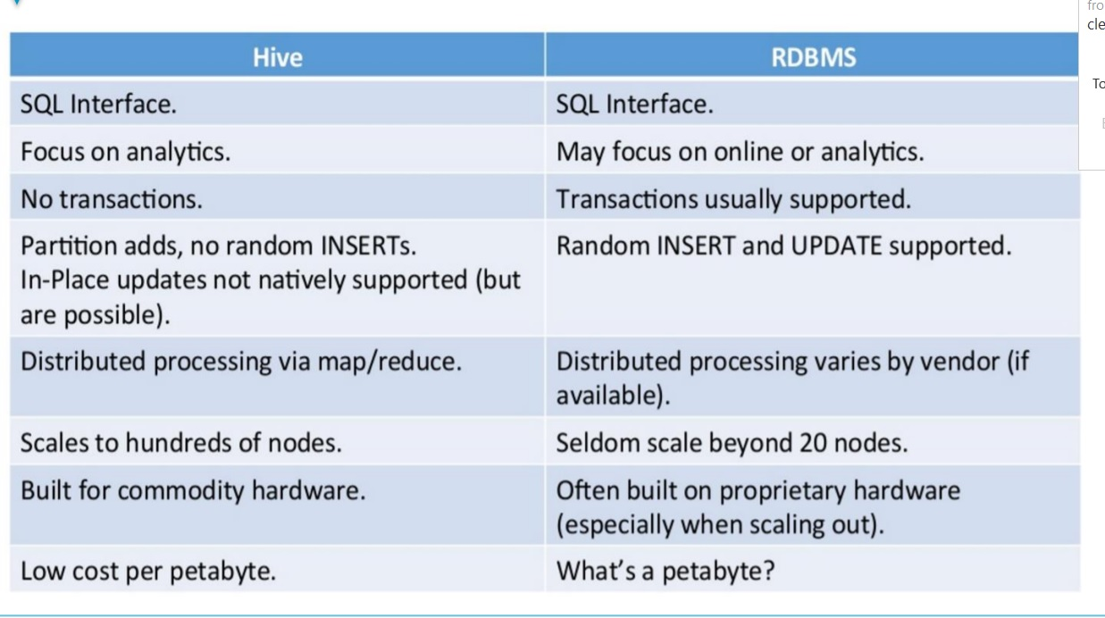

Slide 8
Submitting Hive Queries
Create the file in .hive format and submit it
Hive –f demo.hive
Hive console
Beeline – console to access you local/remote hive CLI( JDBC / ODBC)
Difference internal and external table
While creating hive table metadata and actual data are the 2 places hive will interact
On dropping these internal tables the data stored in them also gets deleted and data is lost forever.

Slide 9
HBASE
Relational and non relational database?

Slide 10
Relational Data base
Name | Roll no | s1 | s2 | s3 | s4 | s5 | s6
abc | 1 | 50 | 50 | 50 | 50 |  | 50
def | 2 |  |  |  |  |  | NULL
ghi | 3
jkl | 4
mno | 5
pqr | 6
stu | 7

Slide 11
RDBMS
Unique format need to maintain till the end
If in the case any modification by means of columns to on particular row means also we need change the structure for all the rows
Null values will also require some space
Relational database will follow ACID Properties(Rules) to maintain some standard

Slide 12
Non Relational Databases
Don’t need to main the unique structure to the entire rows in the tables
For on particular row need around 10 columns means we add only those particular row without altering other rows
Because of not maintaining the unique structure we don’t need any of the null entries
Because of we don’t have null entries we can save some space
CAP Theorem is the standard that will maintain for all the Non Relational Data Base.
Consistency, Availability and Partition tolerance 3 rules, 2 rules as mandatory and 1 rule as customized(tunable) resource.

Slide 13
HBASE
HBase is pure non relational distributed tool
HBase chooses Consistency and Partition Tolerance and compromises on Availability part.
HBase will run on top of Hadoop cluster, Always Hadoop Will ensure that Availability will as top priority.

Slide 14
create ‘<table name>’,’<column family>’
Table is like your database
Column family is like your table
create 'emp', 'personal data', 'professional data’
list

Slide 15
put ’<table name>’,’row1’,’<colfamily:colname>’,’<value>’
put 'emp','1','personal data:name','raju'
put 'emp','1','personal data:city','hyderabad'
put 'emp','1','professional
put 'emp','1','professional data:salary','50000’
Scan ‘emp’

Slide 16
Hadoop Tools
Processing model(Mapreduce)
Import and export(Sqoop)
Relational database supported tool(Hive)
Non relational model supported tool(HBase)
Streaming data handling tool(Apache Flume)
Clustering model tool(Zookeeper)
Memory Resilient Hadoop based tool(Apache Spark)

Slide 17
Amazon Web Services Cloud
Apache Spark(with Scala)
Cluster installation(Readymade Cluster and handle it)
Streaming Tool(AWS Kinesis)
Replacement of HDFS(AWS S3 Cheaper)
Redshift(Aws Data Warehouse Tool)
ETL Tool(AWS GLUE)
Non Relational Database(Dynamo DB)
EC2(Custom Cluster and handle it)

Slide 18
Networking
is the logical medium to interconnect number system together to make communication between each other.
Purpose will be to share any of the computing resources like storage application.
Logical grouping range may vary on LAN, WAN and MAN.

Slide 19
IP Address
Its just and logical and unique name used in networking platform.
Private ip is unique in each and every LAN.
Public IP is an name that is used in WAN.

Slide 20
IP Address
IP Address is designed and maintained by the Organization known as IANA(Internet Assigned Number Authority)
IANA is an Government concern which has been rite now controlled by United States of America.
There are two versions of ip address will be there IPV4 and IPV6.

Slide 21
IPV4
Total address space for ipv4 is 32 bits.
Those 32 bits been divided in to 4 equal parts and they named as octets.(32/4=8)
Each and every octets consist of individual 8 bits
Dotted Decimal Numbers
256*256*256=1,67,77,216 hosts will possible in ipv4
Each and every octets has been divided by means od . Operator
192.168.1.2
Each and every consist of 8 bits
00000000 -> 0 11111111->255
255.255.255.255

Slide 22
IPV6
Address space is 128bit
Divided in to 8 octets
Each and every octets consist of 16 bits(8*16=128bits)
Each and every octets is divided by colon(:) operator
Octets numbers are hexadecimal in format
Colon hexadecimal numbers
2409:4072:51f:2309:1179:9c5d:1dbd:3943
In 2030 we will assign unique number for each and every atom in the world.

Slide 23
IPV4
Subnet Mask
Default Gateway
Subnetting with Example

Slide 24
IPV4 Class
Class A –> 0 - 126
Class B -> 128 - 191
Class C -> 192 – 223
Class D -> 224 - 239
Class E -> 240 – 255
Depends on the first octet we can easily find out which class it belongs to
Class A,B and C are the Classes that has been used by general normal users and Class D is for Multicasting and Class E is used for Experimental and research Purpose

Slide 25
Subnet Mask
Is noting but the information that we are going to give it to network about the starting ip and ending ip range of the network
255.255.255.0 -> 11111111.11111111.11111111.00000000
In Electrical term 0 means off and 1 means on, Networking 1 means network, 0 means host
First 3 octets is meant for network don’t touch it and last octets meant for host
192.168.42.0 -> 192.168.42.255 = 256 host will be possible in same network
If I ping 192.168.42.2 with 192.168.42.253 both are in same network so it will ping

Slide 26
172.16.0.5 subnet mask is 255.255.0.0?
255.255.0.0 -> 11111111.11111111.00000000.00000000
1 means network 0 host
172.16.0.0-172.16.0.255,172.16.1.0-172.16.1.255,172.16.255.0-172.16.255.255 (256*256=65536 host)
172.16.10.5 with 176.16.255.6 – Ping because it belong to same network

Slide 27
10.0.1.2 subnet is 255.0.0.0?
10.0.2.1 10.255.1.3?

Slide 28
Default Subnet Mask
Class A -> 255.0.0.0
Class B -> 255.255.0.0
Class C -> 255.255.255.0

Slide 29
Default Subnet mask
192.168.5.1
Class -> C
Default Subnet Mask -> 255.255.255.0
So the network staring address is
192.168.5.0 – 192.168.5.255(256 – 2 = 254 possible address nodes)
Network Address -> 192.168.5.0
Broadcast Address -> 192.168.5.255
Default Gateway -> nothing but the router address(by default either first host ip nor last host ip 1 or 254) 254-1 253 possible address nodes

Slide 30
Default Subnet mask
172.16.0.1
Class -> B
Default Subnet Mask -> 255.255.0.0
So the network staring address is
172.16.0.0 – 172.16.255.255(256 * 256 = 65536 – 2 = 65534 possible address nodes)
Network Address -> 172.16.0.0
Broadcast Address -> 172.16.255.255
Default Gateway -> nothing but the router address(by default either first host ip nor last host ip 172.16.0.1 or 172.16.255.254) 65534 – 1 = 65533 possible address nodes

Slide 31
Subnetting
According to Default sub netmasks
Class C -> Max Possible Host -> 253 HOSTS
Class B -> Max Possible Host -> 65533 HOSTS
Class A -> Max Possible Host -> 16777213 HOSTS
As a network engineer I got small company network to design no of systems in that company is around 200
To ensure the QOS, we need to restrict ip address wastage

Slide 32
Subnetting
As a network engineer I got small company network to design no of systems in that company is around 20.
Class C (253-20=223 address wastage will be there)
Subnetting is your solution to divide the default network in to multiple pieces to enhance the quality of service
Binary format = binary division

Slide 33
Class C Subnetting
How many octets has been assigned to hosts? -> 1
Write down the values for 2^0 2^7 -> 1 2 4 8 16 32 64 128

Slide 34
20 Systems
128 | 64 | 32 | 16 | 8 | 4 | 2 | 1
1 | 1 | 1 | 0 | 0 | 0 | 0 | 0

Slide 35
20 Systems
Derived number is 224
Default number is 256
256 – 224 = 32
255.255.255.0 -> sub netmask
255.255.255.224 -> derived sub netmask
Network size is 32
192.168.1.0 192.168.1.31 -> 1.0 and 1.31 130

Slide 36
60 System
128 | 64 | 32 | 16 | 8 | 4 | 2 | 1
1 | 1 | 0 | 0 | 0 | 0 | 0 | 0

Slide 37
60 System
Derived sub netmask is 255.255.255.192
Default subnet mask is 255.255.255.0
256 -192 = 64
192.168.100.0 192.168.100.63

Slide 38
CIDR VALUES
Classless Interdomain Routing Values
192.168.1.1 255.255.255.128 - 192.168.1.129 255.255.255.128?
Shortened expression called cidr values

Slide 39
CIDR VALUES
255.0.0.0 -> /8
255.128.0.0 -> /9
255.192.0.0 -> /10
255.224.0.0 -> /11
255.240.0.0 -> /12
255.248.0.0 -> /13
255.252.0.0 -> /14
255.254.0.0 -> /15

Slide 40
CIDR VALUES
255.255.0.0 -> /16
255.255.128.0 -> /17
255.255.192.0 -> /18
255.255.224.0-> /19
255.255.240.0 -> /20
255.255.248.0 -> /21
255.255.252.0 -> /22
255.255.254.0 -> /23

Slide 41
CIDR VALUES
255.255.255.0 -> /24
255.255.255.128 -> /25
255.255.255.192 –> /26
255.255.255.224 -> /27
255.255.255.240 -> /28
255.255.255.248 -> /29
255.255.255.252 -> /30
255.255.255.254 -> /31
255.255.255.255 -> /32

Slide 42
192.168.1.1/24 -192.168.1.128/24
192.168.1.1/30 -192.168.1.253/30

