Slide 1
AWS GLUE

Slide 2
Categories of the data's
Structured data – structured data's are organised in to equal rows and columns
Primary key and foreign key mechanism to make the searching algorithm to work better
Ex: Database, MySQL
Semi structures data - structured data's are organised in to unequal rows and columns
Row wise searching algorithm to process the data
Ex: Excel Sheet
Unstructured data
Consists of large variety of data's and it doesn’t have any data searching mechanism to follow and it will do the searching by means of folder by folder

Slide 3
Categories depends on data origin
Run the query on existing data 1 hour older data?
Import/ pull the data manually to some location and run the query on top the location.
Run the query on live data?
How we are going to store streaming data’s
Without any delays I want to run the query on live data
How we cannot able to go for time based pulling and manual pull it wont work
If some data get originated immediately it need to push in to my data base

Slide 4
Event Driven and Streaming
Depends on live data 1 hour once I updata score
Depends on live data 1 day once I updata score
Depends on live data live score

Slide 5
AWS Glue
AWS GLUE is serverless platform that is for fully managed ETL (Extract, Transform and Load) service.
Simple to deploy because of it belongs to PAAS Model , Cost-Efficient tool if your compare with other tools.
Glue it will categorize the data(txt, csv, json, parquet), Clean it, Enrich it and move it to various data sources.

Slide 6
AWS Glue Usage
To built a data warehouse to organize, Cleanse, validate and format the data
When you run the serverless queries against the data in your data lake tool
When you want to create event driven pipeline
To understand your data assets

Slide 7
Benefits of Glue
Hassle free Deployment
Cost effective
More power

Slide 8
Glue Terminologies
Data Catalogue
Classifier
Connection
Crawler
Data base
jobs

Slide 9
Data Catalogue
Is nothing but the persistent mete data store in AWS Glue
Consist of
Table definition
Job definitions
Other controlled information's
To manage AWS Glue Environment

Slide 10
Classifiers
Data mine schema of the data
AWS Glue provides common file types such as csv, json, avro, parquet and so on
It also provides classifiers for common relational database management system using JDBC/ODBC Connection
Predefined Classifiers if u want means write your own classifiers by specifying the configuration in xml format

Slide 11
Crawler
Crawler is nothing but the program that connects to the data store from various target, progress through prioritize list of classifiers to determine schema for your data and then it creates metadata tables in data catalogue.

Slide 12
Crawler pulling the data from data store, through classifiers we can configure how it will pull and save the metadata's about when it will pull and where it will pull to data catalogue
Data
source
JOB
Data Catalogue
Crawler
transform
Data
target

Slide 13
Glue demo
DM1
DATA WH
Consumer Application
DM2
DM3

Slide 14
Glue Demo
Extract – we need to import the data in to our premises from the consumer end(DataMart, database, Application API)
Transform – Check for Consumer end data format and data type as well as check for the data warehouse data format and data type, if both are equal means we don’t need any Transformation of data to save it in my location, but if data format and data type differs means I need to transformation
Load – I need to load the data into my data ware house tool
For analytical purpose I need to provide API from my data warehouse to consumer end I need to provide

Slide 15
Athena
Is the hive like service that will help you to run the query on top of the data we imported through glue.
Data catalogue – is the meta data service that will help you to link your glue with athenna

Slide 16
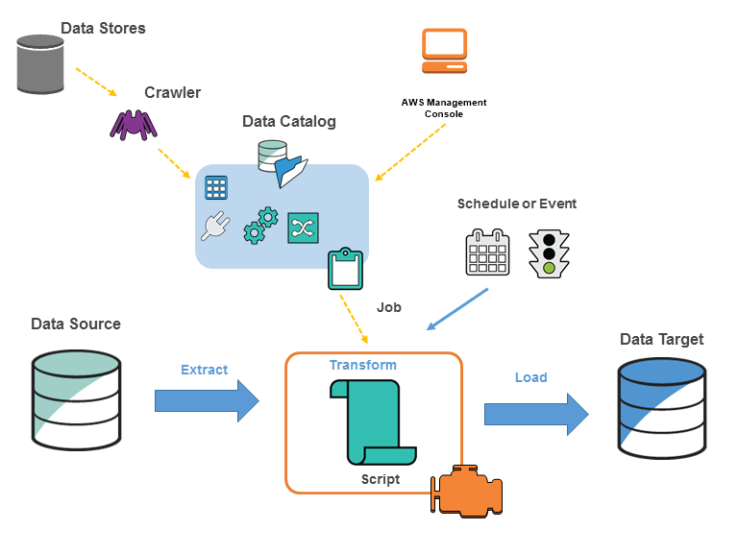

Slide 17
On
Once schema got imported, with the basic structure we can create job and import the data
Creating job with glue script
Create job with custom script – ETL
Query the data what we imported through glue with the help of hive - Athena

