Slide 1
Amazon RedShift
Karthick

Slide 2
Cloud
IAAS - Amazon Web Services
PAAS – Google Cloud
SAAS – Azure Cloud(Microsoft)
DATABASE - ORACLE

Slide 3
REDSHIFT
AWS want to start their own product to compete against the oracle Data Ware House Software – REDSHIFT
In Oracle Logo –RED Colour – shift from oracle – REDSHIFT

Slide 4
Need of RedShift
Comparison of Before Jio and After Jio individual data consume rate?
Digital data growing at comprehensive rate, Enterprises are finding it very difficult to ingest, store and analyse the data quickly at cheaper cost.
Therefore they started to look for some solution to handle those large volume of data with cheaper cost – Cloud
Amazon Web Services – Solution to handle large volume of data with cheaper cost – Amazon RedShift

Slide 5
Bigdata File Formats
Bigdata mainly deal the data's in few important formats
Txt
Csv
Parquet
Json
XML
Avro
ORC

Slide 6
Data Lake
Data Lake is the storage that will store the vast amount of raw data's, so that we use those storage location to import and export in to your data warehouse.
Txt
Csv
Parquet
Json
XML
Avro
ORC

Slide 7
Traditional Data Warehouse
Data Ware house – Tool that will accept the inward data's from multiple sources then it will convert all the data's in to single formatted data and save it tin single location
Ex: Oracle 12c
Cost – License, Hardware’s, Man Power
Because of rapidly increasing data volume in the case scaling up the cluster size is difficult
It wont accept data’s as raw format.

Slide 8
Data Warehouse
Data Warehouse is a subject-oriented, integrated, time-variant and non-volatile collection of data in support of organisations decision making process
Data warehouse is an repository that collect and data form your organisational systems and many other external resources, transform those data's and store in database.

Slide 9
Architecture
Internal
Bottom Tier
Extract
Middle Tier
Analyse
Top Tier
Load
Data Ware House
Data
Mine
OLAP
Server
Report
external
Analytical tool

Slide 10


Example
Data Warehouse
Data Warehouse
Data Warehouse

Slide 11
Disadvantages
Maintenance – cluster(combine 2 or more), Networking, Power Consumption, OS maintenance, Software maintenance, Monitoring, issues manually monitor and increase size
Autoscaling – IF something goes wrong it doesn’t have ability to automatically fix it up with. Ex in case of increased workload extend its size automatically,
Cost – Hardware, Network, OS License, Software License

Slide 12
RedShift
Redshift is Amazon Cloud Data Warehouse tool with massive parallel computing database(it doesn’t have any limitation on scaling up the resources by means of computing and Volume of Data).
Redshift is column oriented database.

Slide 13
Data Base
Emp no | Name | Gross Pay | Total pay
cog101 | abc | 20000 | 25000
cog102 | xyz | 30000 | 35000
cog101 | abc | 20000 | 25000
cog102 | xyz | 30000 | 35000

Slide 14
Data Base
Database will separate the rows in to individual blocks.
It will go head search for block by blocks
Row – Oriented Database
cog101 | abc | 20000 | 25000
cog102 | xyz | 30000 | 35000

Slide 15
Redshift
Emp no | Name | Gross Pay | Total pay
cog101 | abc | 20000 | 25000
cog102 | xyz | 30000 | 35000
cog101
cog102
abc
xyz
20000
30000
25000
35000

Slide 16
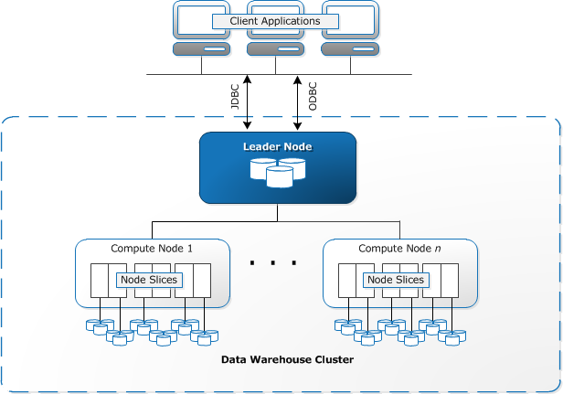
RedShift Architecture

Slide 17
Leader Node
The leader node manages communications with client programs and all communication with compute nodes.
It parses and develops execution plans to carry out database operations, in particular, the series of steps necessary to obtain results for complex queries.
Based on the execution plan, the leader node compiles code, distributes the compiled code to the compute nodes, and assigns a portion of the data to each compute node.
The leader node distributes SQL statements to the compute nodes only when a query references tables that are stored on the compute nodes. All other queries run exclusively on the leader node.
Amazon Redshift is designed to implement certain SQL functions only on the leader node.

Slide 18
Compute Nodes
The leader node compiles code for individual elements of the execution plan and assigns the code to individual compute nodes. The compute nodes execute the compiled code and send intermediate results back to the leader node for final aggregation.
Each compute node has its own dedicated CPU, memory, and attached disk storage, which are determined by the node type.
As your workload grows, you can increase the compute capacity and storage capacity of a cluster by increasing the number of nodes, upgrading the node type, or both.

Slide 19
SQL with some extra features for copy data's from various location, format and handle large amount of data
DS2 – Large workloads with fixed local HDD storage
DC2 – High performance with fixed local SSD storage

Slide 20
IAM ROLE
Instead of giving permissions to users, Group of users, IAM ROLE is nothing but offering the permission from one AWS service to another AWS service
Ex : ec2 to s3 bucket full access

Slide 21
Postgres Commands
\h – \help
\q or \quit
\l or \list
\d or
Create database demo;
\c demo;

Slide 22
Login in to your cloud academy link and try the practical on redshit?

Slide 23
Cloud Academy
10.10.10.0/24(vpc-00803ca13eb2f19f6)(subnet-0569462c63c8134e7)
igw-0761f1dbc045eb106
10.10.10.0/24
RT
10.10.10.0/24
IGW

Slide 24
Cloud Academy
IAM ROLES – Provides the privilege from one AWS service to another AWS service
RedShift – S3
Load the data from Redshift to s3 because of that purpose we need to create the role
Role Name – caredshiftlab
arn:aws:iam::194287215961:role/caredshiftlab

Slide 25
ca-redshift-lab.ccslvigagkpw.us-west-2.redshift.amazonaws.com
S3 to redshift – load
Redshift to s3 - unload

