Slide 1


제 6회 전자구조계산 여름학교
실습 1: 환경 설정 및 Atom 2025.07.11
Dr. J. Park & RyongKyu Lee
School of Electrical Engineering
Korea Advanced Institute of Science & Technology (KAIST)
y.h.kim@kaist.ac.kr

Slide 2
1. 환경 설정
Linux 환경 만들기
Edison 웹 페이지
https://nano2.edison.re.kr/
Jupyter terminal
KISTI 슈퍼컴
계정 및 OTP 를 통한 접속
WSL
https://yhkimlab.github.io/YHKimLabWiki/site/environment/wsl2/
Windows OS에 Ubuntu 설치
개인 플랫폼
Linux 환경
Server 접속
Notes:
HfSeO(amorphous)/HfSe2 interface: when O atoms are inserted at the interface through the hole in the amorphous oxide layer during plasma oxidation, HfSe2 layer under oxide layer are easily oxidized. O atoms are barrierlessly and spontaneously penetrate into the HfSe2 layer and oxidize Hf atom generating a great amount of heat while Se atoms are extracted to outside of Hf-O core.
HfSeO(amorphous)/MoS2 interface: When O atoms are dropped on MoS2 surface, they are bound to top of S atom. While O atoms are largely vibrating due to thermal energy, they are adsorbed on to amorphous oxide layer because O atoms are largely stabilized in the Hf-O network of HfO2 layer.
HfSeO(amorphous)/WSe2 interface: similar to the case of MoS2.
O atoms on the MoS2 (WSe2) surface are bound to top of S (Se) atom and cannot break Mo-S (W-Se) bond to oxidize the substrate.

Slide 3

1-1 환경 설정 - Edison
Edison 웹 페이지: https://nano2.edison.re.kr/
1. 계정 만들기
Notes:
HfSeO(amorphous)/HfSe2 interface: when O atoms are inserted at the interface through the hole in the amorphous oxide layer during plasma oxidation, HfSe2 layer under oxide layer are easily oxidized. O atoms are barrierlessly and spontaneously penetrate into the HfSe2 layer and oxidize Hf atom generating a great amount of heat while Se atoms are extracted to outside of Hf-O core.
HfSeO(amorphous)/MoS2 interface: When O atoms are dropped on MoS2 surface, they are bound to top of S atom. While O atoms are largely vibrating due to thermal energy, they are adsorbed on to amorphous oxide layer because O atoms are largely stabilized in the Hf-O network of HfO2 layer.
HfSeO(amorphous)/WSe2 interface: similar to the case of MoS2.
O atoms on the MoS2 (WSe2) surface are bound to top of S (Se) atom and cannot break Mo-S (W-Se) bond to oxidize the substrate.

Slide 4
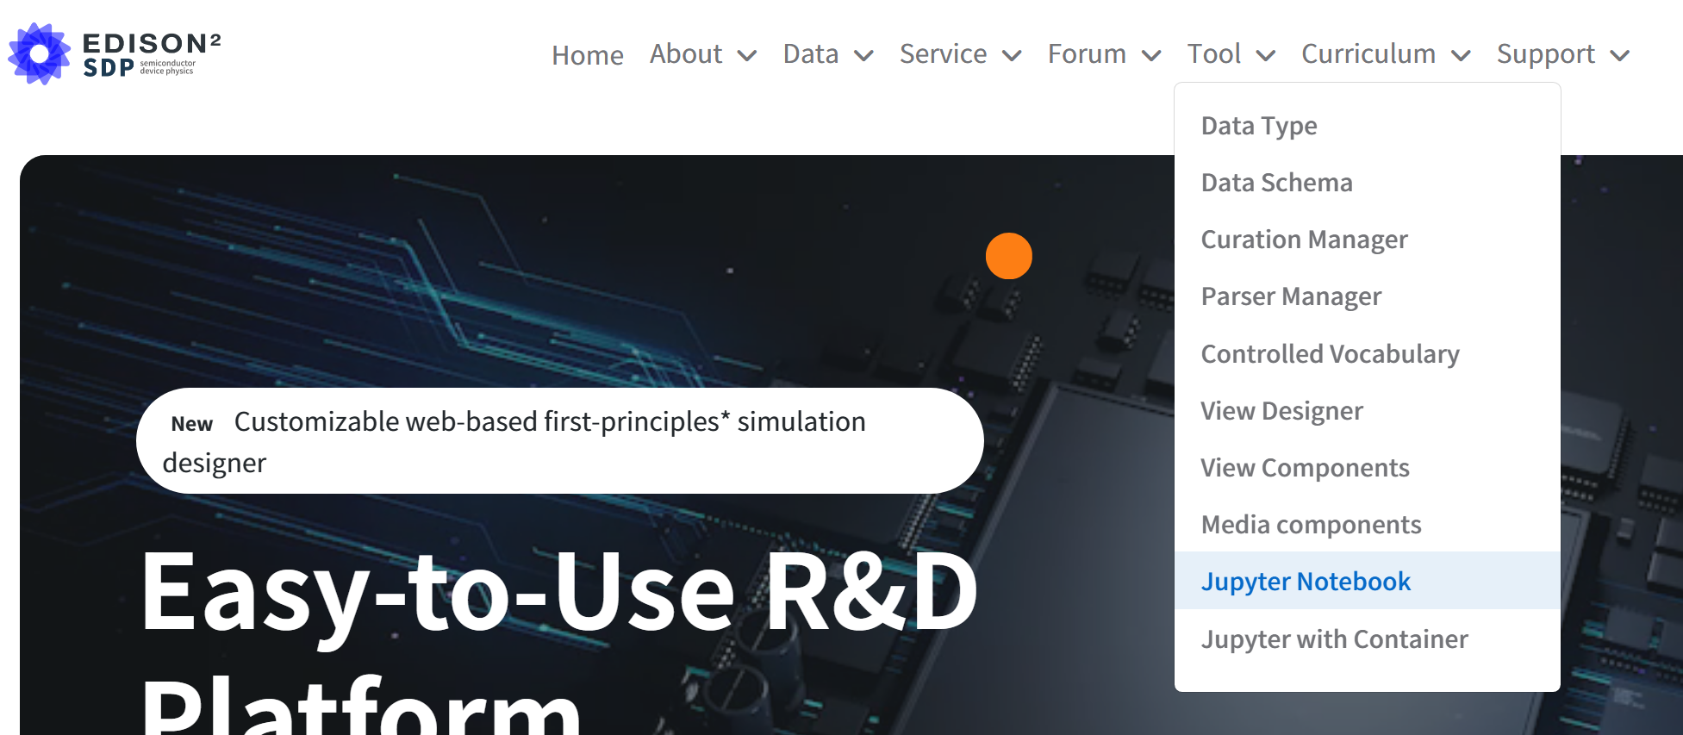
1-1 환경 설정 - Edison/JupyterLab
Edison 웹 페이지: https://nano2.edison.re.kr/
2. JupyterLab 열기
Menu:Tool/Jupyter Notebook
Notes:
HfSeO(amorphous)/HfSe2 interface: when O atoms are inserted at the interface through the hole in the amorphous oxide layer during plasma oxidation, HfSe2 layer under oxide layer are easily oxidized. O atoms are barrierlessly and spontaneously penetrate into the HfSe2 layer and oxidize Hf atom generating a great amount of heat while Se atoms are extracted to outside of Hf-O core.
HfSeO(amorphous)/MoS2 interface: When O atoms are dropped on MoS2 surface, they are bound to top of S atom. While O atoms are largely vibrating due to thermal energy, they are adsorbed on to amorphous oxide layer because O atoms are largely stabilized in the Hf-O network of HfO2 layer.
HfSeO(amorphous)/WSe2 interface: similar to the case of MoS2.
O atoms on the MoS2 (WSe2) surface are bound to top of S (Se) atom and cannot break Mo-S (W-Se) bond to oxidize the substrate.

Slide 5
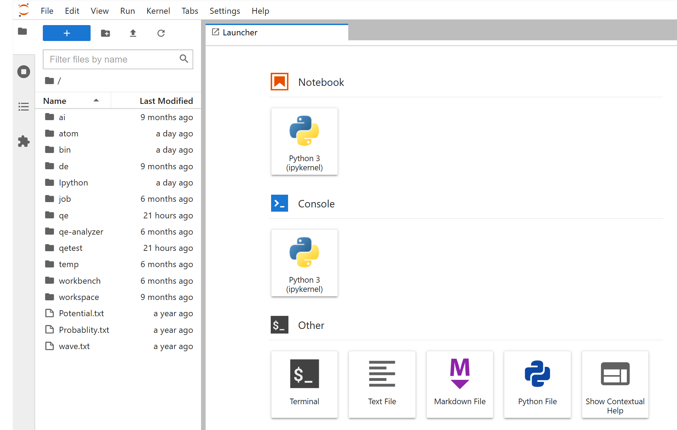
1-1 환경 설정 - Edison/JupyterLab
3. JupyterLab 실습
JupyterLab: Menu, File browser, Workspace
Menu: File/New or [ + ] icon 클릭 → New tab
Workspace: Tab으로 notebook, terminal 등이 열림
File browser: .txt, .ipynb, .csv, .png (그림파일) 등은 바로 열림
Notes:
HfSeO(amorphous)/HfSe2 interface: when O atoms are inserted at the interface through the hole in the amorphous oxide layer during plasma oxidation, HfSe2 layer under oxide layer are easily oxidized. O atoms are barrierlessly and spontaneously penetrate into the HfSe2 layer and oxidize Hf atom generating a great amount of heat while Se atoms are extracted to outside of Hf-O core.
HfSeO(amorphous)/MoS2 interface: When O atoms are dropped on MoS2 surface, they are bound to top of S atom. While O atoms are largely vibrating due to thermal energy, they are adsorbed on to amorphous oxide layer because O atoms are largely stabilized in the Hf-O network of HfO2 layer.
HfSeO(amorphous)/WSe2 interface: similar to the case of MoS2.
O atoms on the MoS2 (WSe2) surface are bound to top of S (Se) atom and cannot break Mo-S (W-Se) bond to oxidize the substrate.

Slide 6
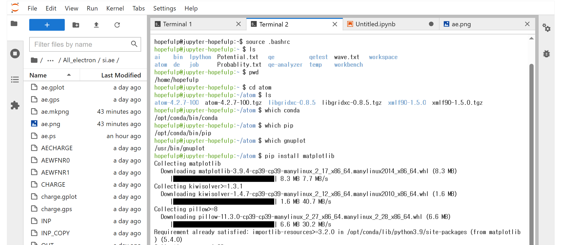
1-2 JupyterLab-Terminal
4. Terminal
Linux 사용
https://yhkimlab.github.io/YHKimLabWiki/site/other/1.1_LinuxCheatSheet/
Notes:
HfSeO(amorphous)/HfSe2 interface: when O atoms are inserted at the interface through the hole in the amorphous oxide layer during plasma oxidation, HfSe2 layer under oxide layer are easily oxidized. O atoms are barrierlessly and spontaneously penetrate into the HfSe2 layer and oxidize Hf atom generating a great amount of heat while Se atoms are extracted to outside of Hf-O core.
HfSeO(amorphous)/MoS2 interface: When O atoms are dropped on MoS2 surface, they are bound to top of S atom. While O atoms are largely vibrating due to thermal energy, they are adsorbed on to amorphous oxide layer because O atoms are largely stabilized in the Hf-O network of HfO2 layer.
HfSeO(amorphous)/WSe2 interface: similar to the case of MoS2.
O atoms on the MoS2 (WSe2) surface are bound to top of S (Se) atom and cannot break Mo-S (W-Se) bond to oxidize the substrate.

Slide 7
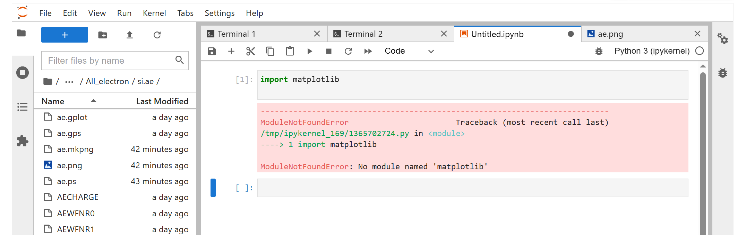
1-2 JupyterLab-ipynb
5. Jupyter notebook
Encode python script
모듈 설치는 터미널에서 pip을 이용
Notes:
HfSeO(amorphous)/HfSe2 interface: when O atoms are inserted at the interface through the hole in the amorphous oxide layer during plasma oxidation, HfSe2 layer under oxide layer are easily oxidized. O atoms are barrierlessly and spontaneously penetrate into the HfSe2 layer and oxidize Hf atom generating a great amount of heat while Se atoms are extracted to outside of Hf-O core.
HfSeO(amorphous)/MoS2 interface: When O atoms are dropped on MoS2 surface, they are bound to top of S atom. While O atoms are largely vibrating due to thermal energy, they are adsorbed on to amorphous oxide layer because O atoms are largely stabilized in the Hf-O network of HfO2 layer.
HfSeO(amorphous)/WSe2 interface: similar to the case of MoS2.
O atoms on the MoS2 (WSe2) surface are bound to top of S (Se) atom and cannot break Mo-S (W-Se) bond to oxidize the substrate.

Slide 8
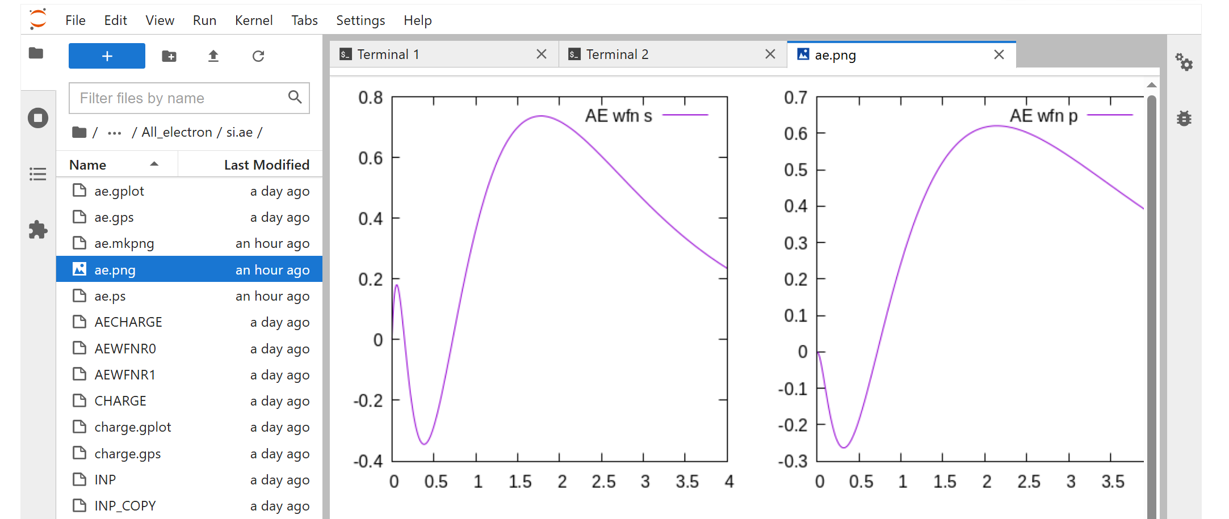
1-2 JupyterLab - png 그림 파일
5. png file
Terminal에서 작업 후 png 파일 생성시 가시화
Notes:
HfSeO(amorphous)/HfSe2 interface: when O atoms are inserted at the interface through the hole in the amorphous oxide layer during plasma oxidation, HfSe2 layer under oxide layer are easily oxidized. O atoms are barrierlessly and spontaneously penetrate into the HfSe2 layer and oxidize Hf atom generating a great amount of heat while Se atoms are extracted to outside of Hf-O core.
HfSeO(amorphous)/MoS2 interface: When O atoms are dropped on MoS2 surface, they are bound to top of S atom. While O atoms are largely vibrating due to thermal energy, they are adsorbed on to amorphous oxide layer because O atoms are largely stabilized in the Hf-O network of HfO2 layer.
HfSeO(amorphous)/WSe2 interface: similar to the case of MoS2.
O atoms on the MoS2 (WSe2) surface are bound to top of S (Se) atom and cannot break Mo-S (W-Se) bond to oxidize the substrate.

Slide 9
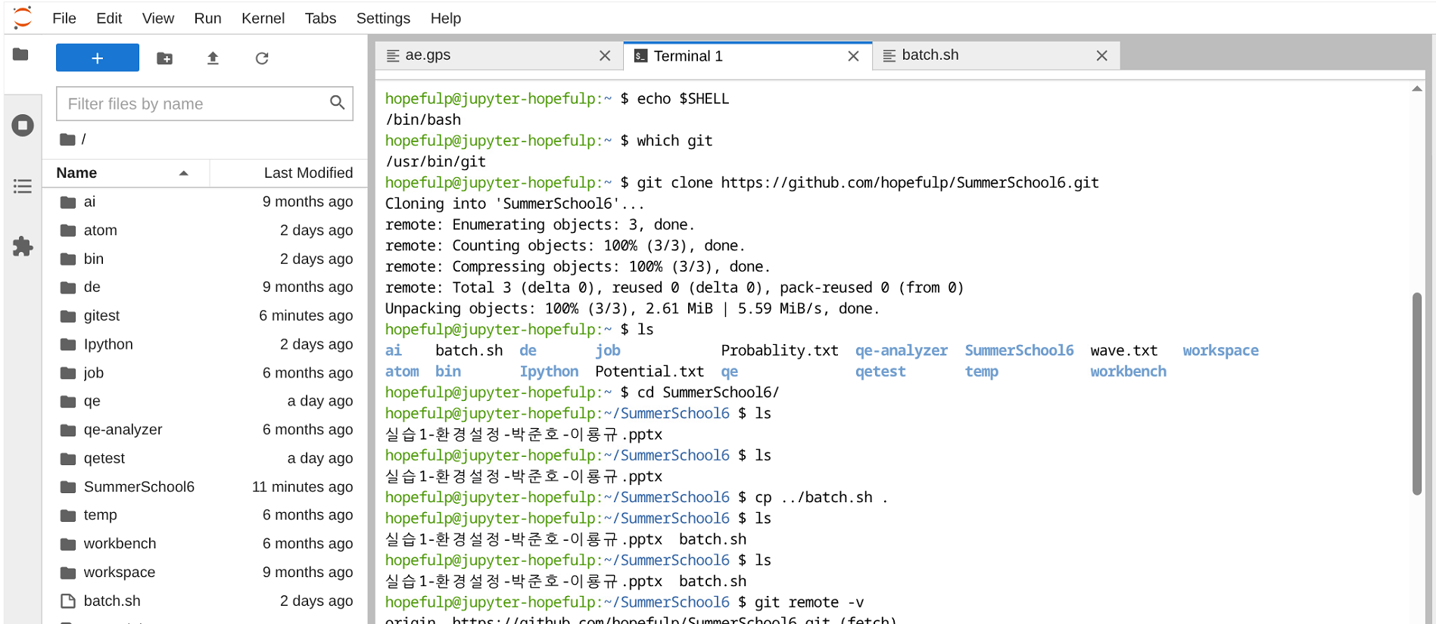
1-2 JupyterLab – Download/Upload
6. Download manual
Git clone https://github.com/hopefulp/SummerSchool6.git
매뉴얼 찾아 오른쪽 마우스로 Download
Source batch.sh
Text 파일 → double click으로 열기 → 수정
7. File upload
Icon 이용 파일 upload
Notes:
HfSeO(amorphous)/HfSe2 interface: when O atoms are inserted at the interface through the hole in the amorphous oxide layer during plasma oxidation, HfSe2 layer under oxide layer are easily oxidized. O atoms are barrierlessly and spontaneously penetrate into the HfSe2 layer and oxidize Hf atom generating a great amount of heat while Se atoms are extracted to outside of Hf-O core.
HfSeO(amorphous)/MoS2 interface: When O atoms are dropped on MoS2 surface, they are bound to top of S atom. While O atoms are largely vibrating due to thermal energy, they are adsorbed on to amorphous oxide layer because O atoms are largely stabilized in the Hf-O network of HfO2 layer.
HfSeO(amorphous)/WSe2 interface: similar to the case of MoS2.
O atoms on the MoS2 (WSe2) surface are bound to top of S (Se) atom and cannot break Mo-S (W-Se) bond to oxidize the substrate.

