Slide 1
Kirchhoff’s Laws and its Applications
Physics Presentation by,
Siddhant Borah
Bisal Nunisa
Bhairab Saikia

Slide 2

Introduction
Kirchhoff’s Laws are two fundamental rules used in electrical circuits:
1. Kirchhoff’s Current Law (First Law or Junction Rule)
2. Kirchhoff’s Voltage Law (Second Law or Loop Theorem)
They help analyze complex circuits containing multiple loops and junctions.

Slide 3
Kirchhoff’s Current Law (KCL)
KCL states that the algebraic sum of currents entering a junction equals the sum of currents leaving it.
Mathematically: ΣI(in) = ΣI(out)
  ΣI - ΣI = 0
This law is based on the principle of conservation of charge.

Slide 4
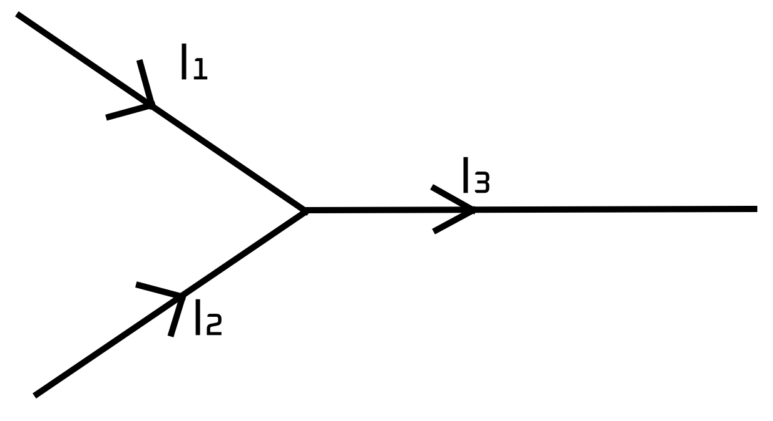
By knowing any one of the incoming current and the output current or both the input current helps us to find the output current.

Slide 5
Kirchhoff’s Voltage Law (KVL)
KVL states that the algebraic sum of all voltages around any closed loop is zero.
Mathematically: ΣV = 0
This law is based on the principle of conservation of energy.

Slide 6
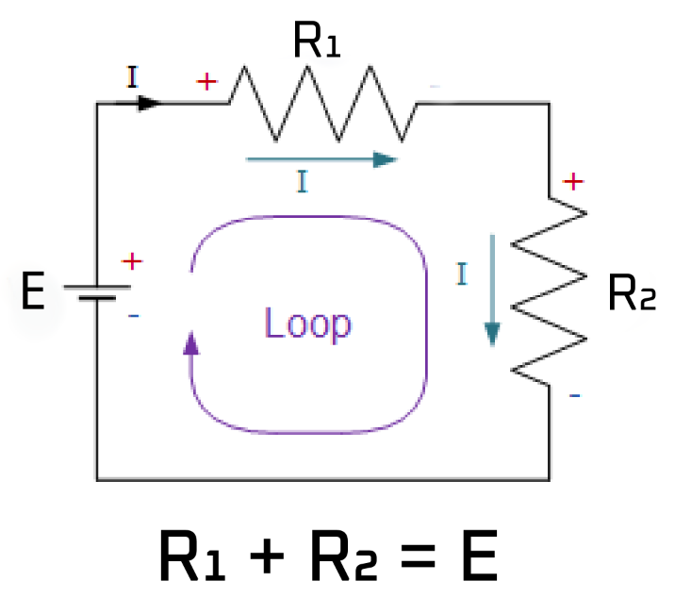
Kirchhoff’s Voltage Law (KVL)
In the direction of current = +ve
Against the direction of current = -ve

Slide 7
Applications of Kirchhoff’s Laws
Used to calculate unknown current, voltage, and resistance in circuits.
Helps analyze complex electrical networks.
Used in designing electronic circuits and power systems.
Basis for the mechanism of Wheatstone Bridge.

Slide 8
Example: Application of KCL and KVL
Consider a simple circuit with two loops and two resistors:
  Apply KCL at a junction to relate currents.
  Apply KVL in each loop to find unknown currents and voltages.
These equations can be solved simultaneously to find circuit parameters.

Slide 9
Wheatstone Bridge
A Wheatstone bridge uses Kirchhoff's laws to determine an unknown resistance.
At balance (no current through galvanometer):
  P / Q = R / S

Slide 10
Use of Kirchhoff’s Laws in Wheatstone Bridge
KCL → Applied at nodes to relate incoming and outgoing currents.
KVL → Applied around loops to derive the balance condition.
Resulting condition for balance:
  P/Q = R/S.

Slide 11
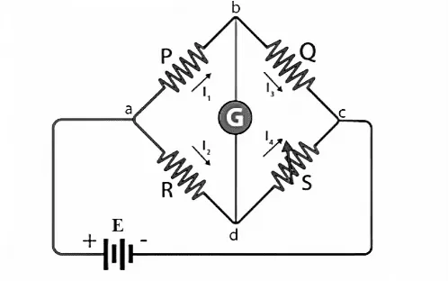
Wheatstone Bridge Diagram

Slide 12
Conclusion
Kirchhoff’s Laws are essential tools in circuit analysis.
They extend Ohm’s law to complex circuits and form the foundation for electrical engineering.

