Slide 1
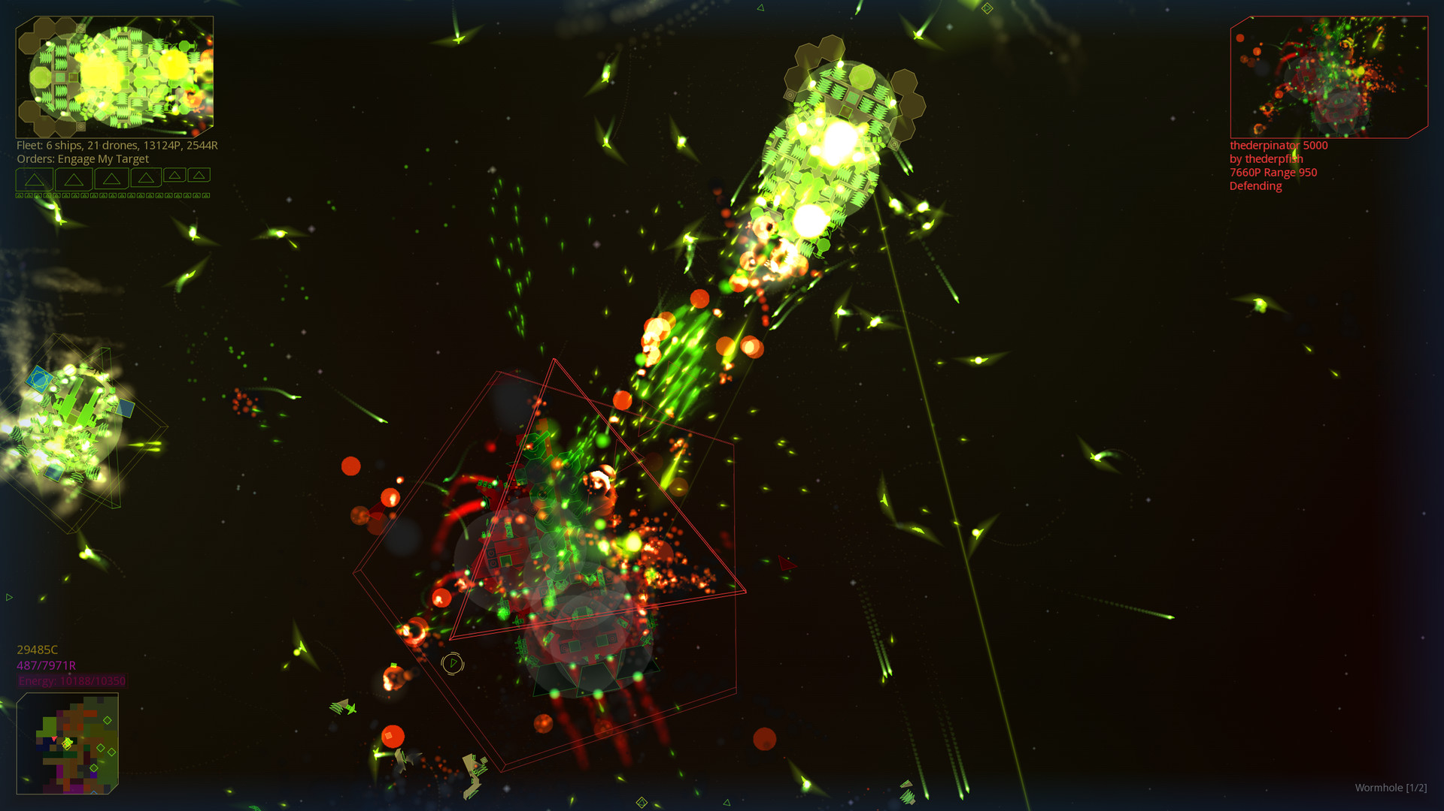
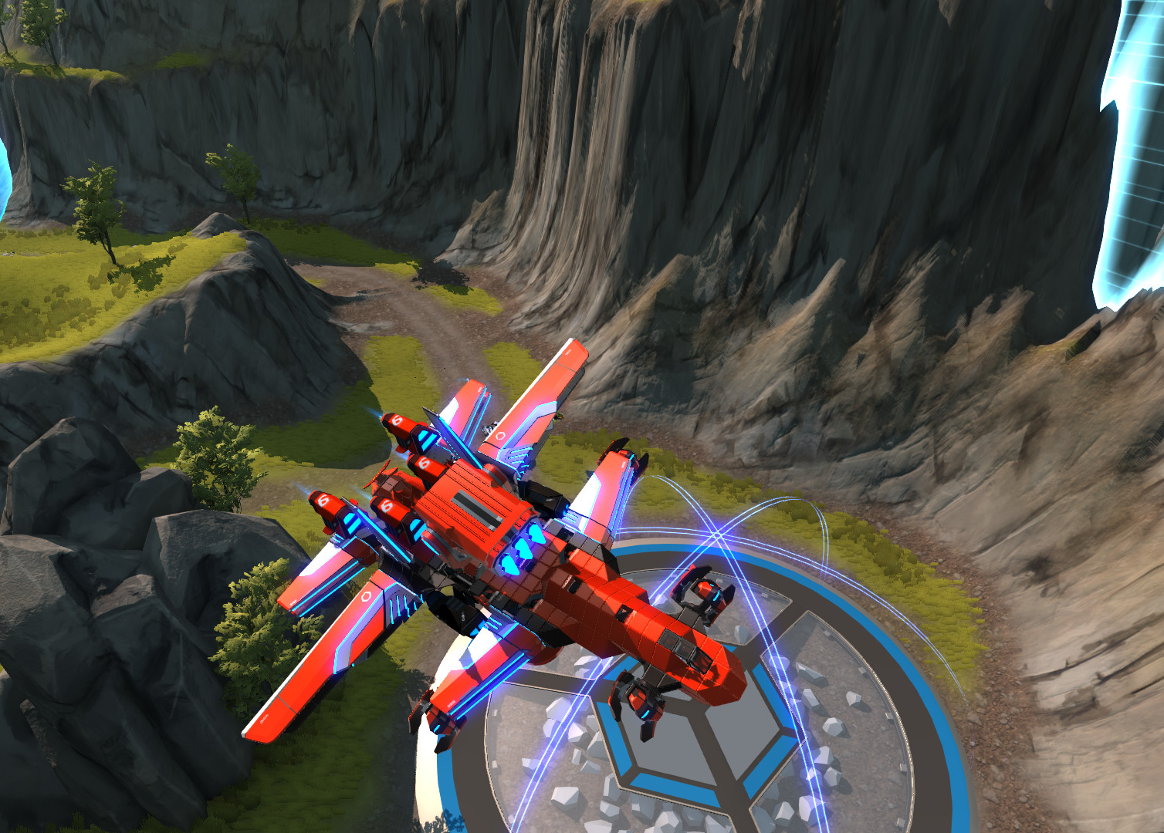
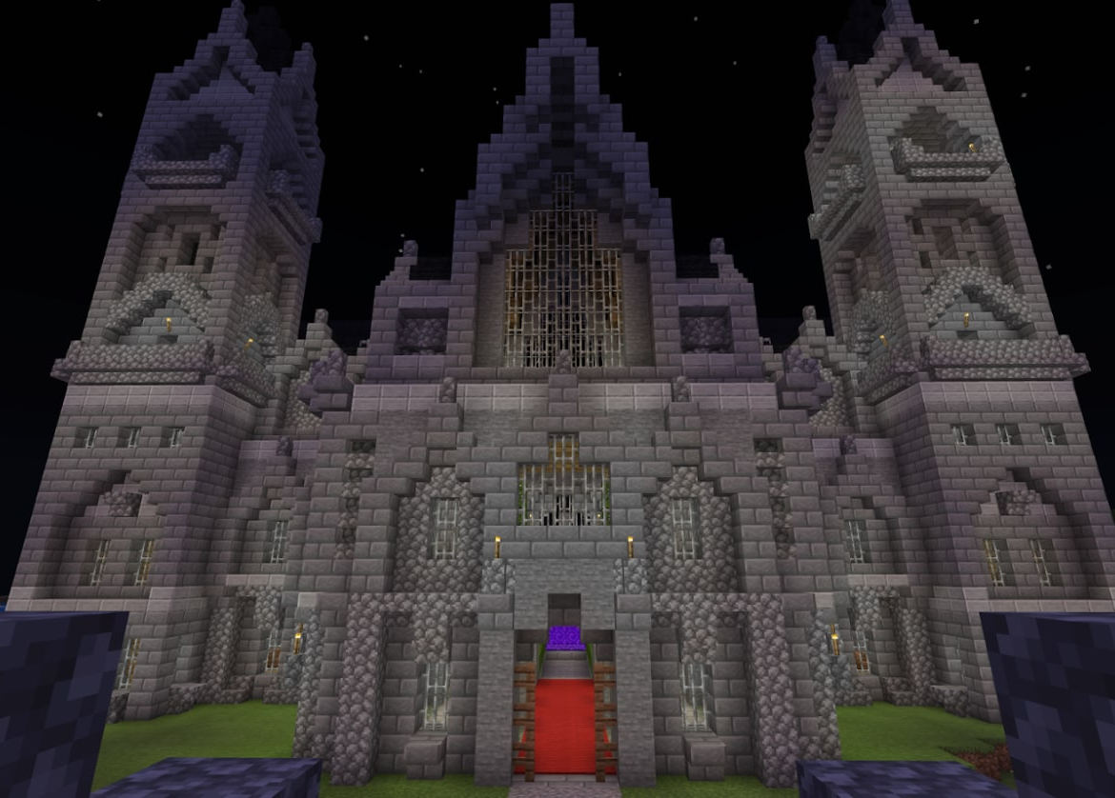
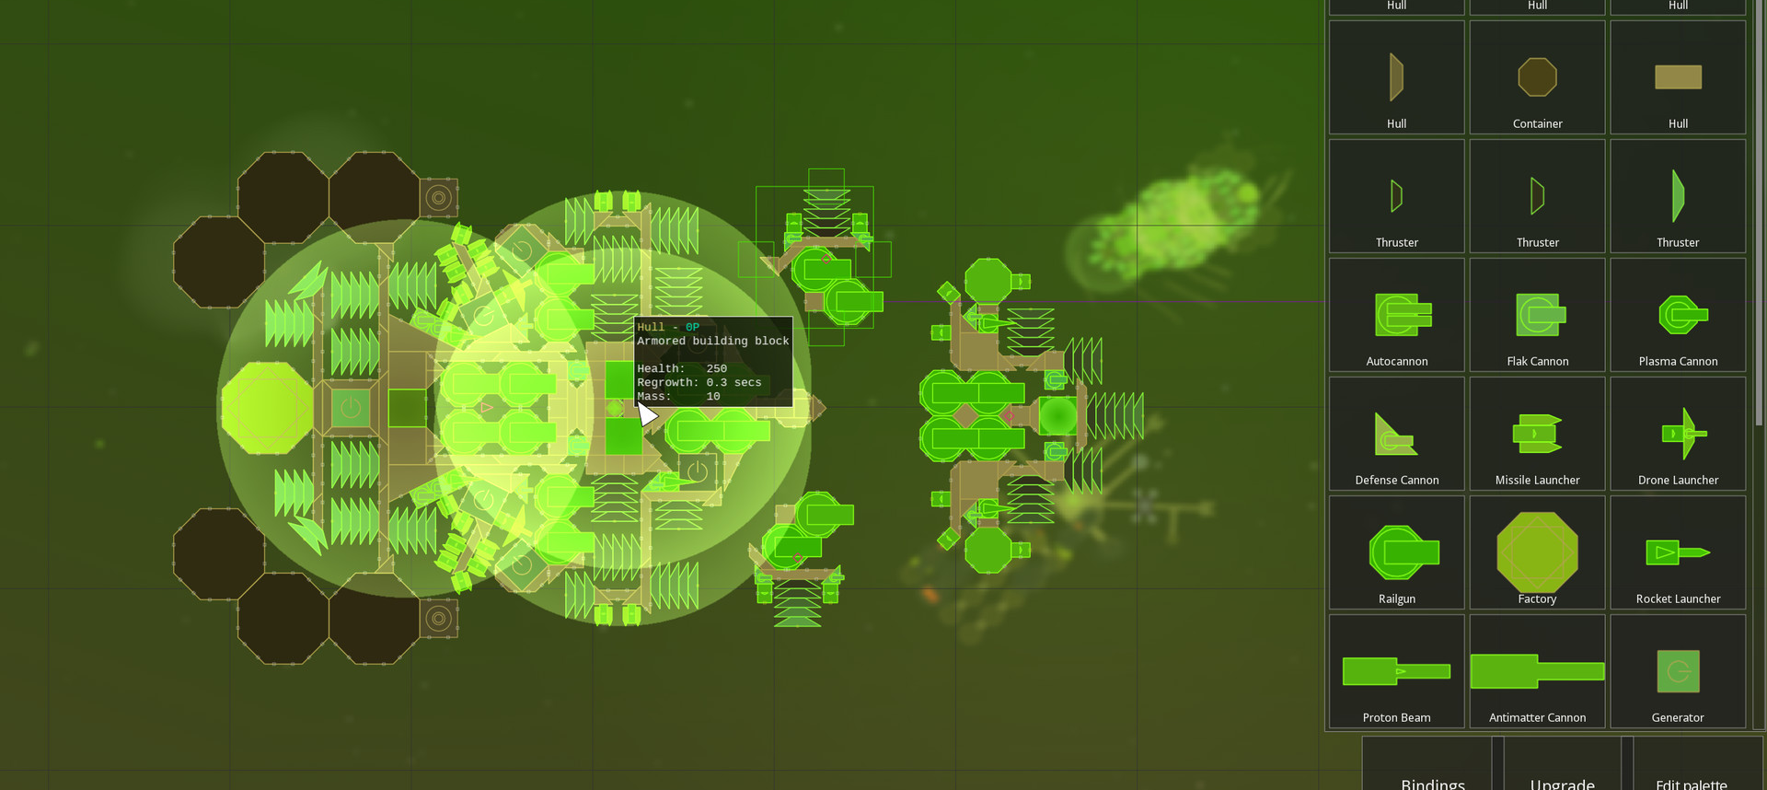
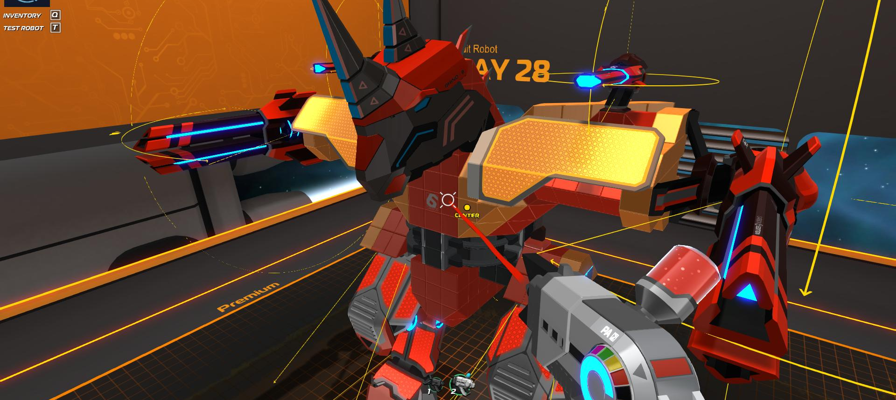
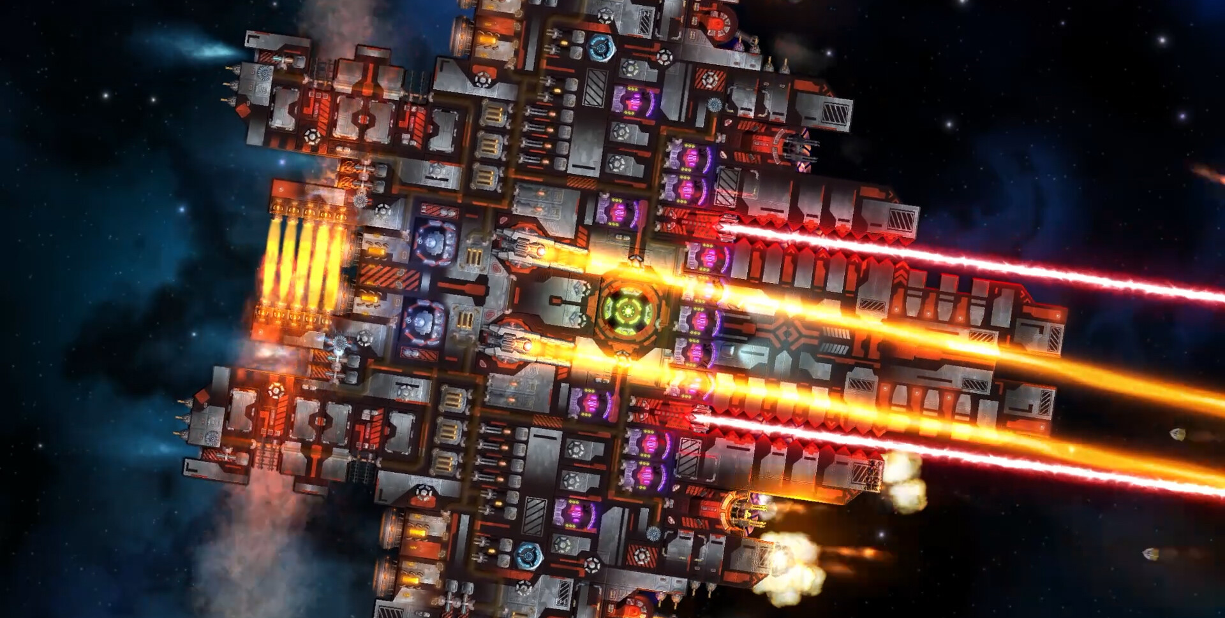
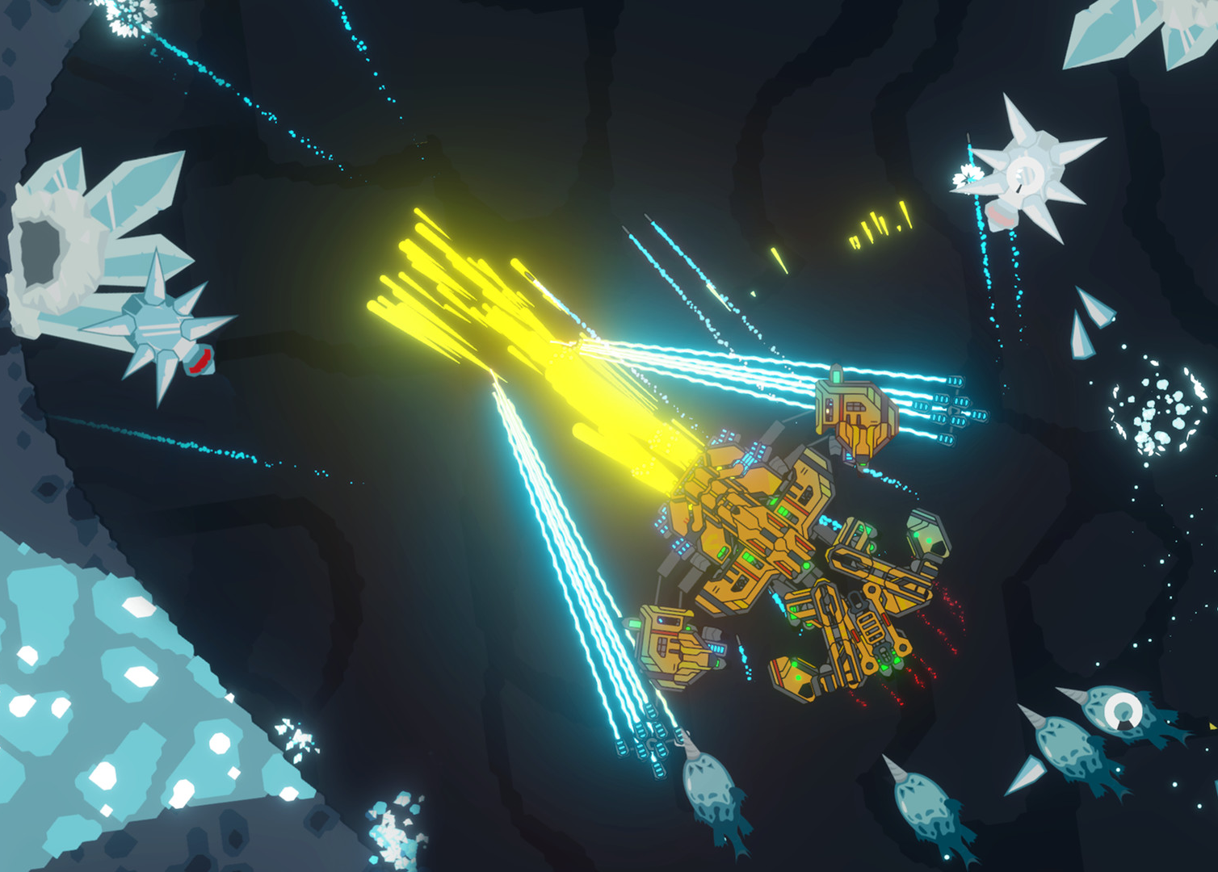
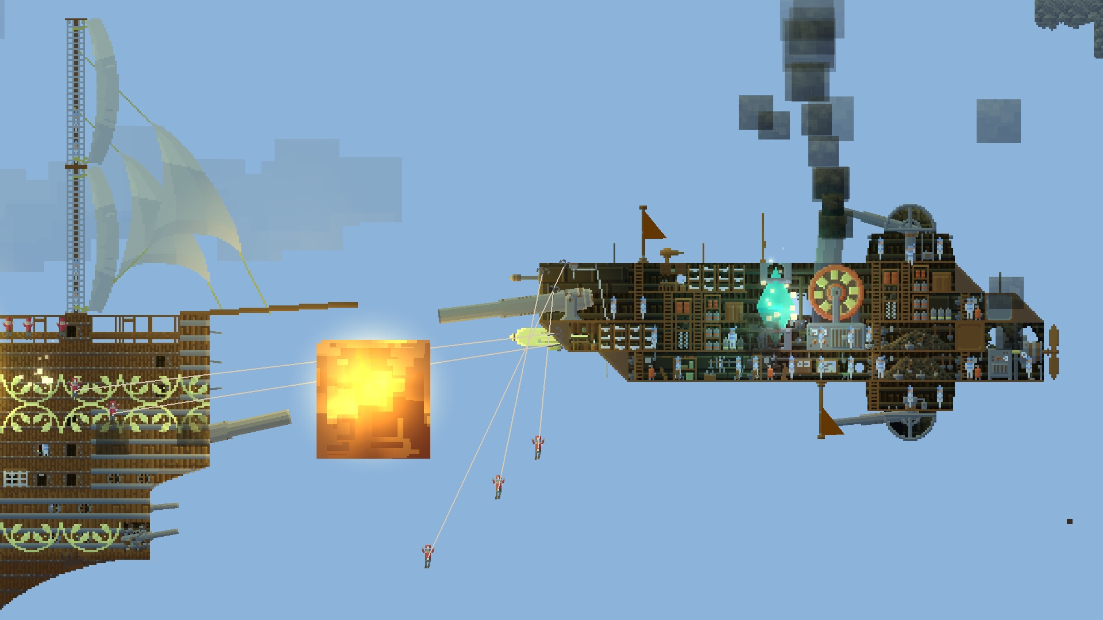
Starframe — Cultural Style: DIY Maker Culture
Cultural style board / modular construction, practical learning and the pleasure of making
01 WHAT I NOTICED
I miss the freedom to build that I experienced in Robocraft and Minecraft, and I want to bring that creative excitement into my own game.
02 CLAIM
DIY culture gives players ownership and understanding through making, testing and improving their own spacecraft.
03 PLAYER ACTIONS
Assemble a ship; configure thrust; compare performance; diagnose failures; revise and save blueprints.
1 Meaning / the player as maker
DIY CONSTRUCTION / GAME REFERENCES
Creative ownership
Resourcefulness
Arrange ordinary parts into a ship that expresses your own idea.
Balance armor, firepower, mass and energy within a fixed budget.
Learning through play
Persistence
Test a design, observe its weakness and change it.
Keep the blueprint after failure and return with a better version.
2 Play & interaction / a workshop loop
BUILD / TEST / DIAGNOSE / REVISE / FIGHT
Assemble a modular spacecraft on a 3D grid. Configure directional propulsion, then try movement and weapons in the range. Compare behavior with the design you intended. Return to the blueprint before facing arcade combat waves.
REASSEMBLY [1]
A ship made from visible parts. Construction choices remain legible during battle.
Freedom to experiment
Choices have consequences
All parts are available from the start. Save unfinished or over-budget ideas. Deployment requires a connected ship within the mission budget.
Blocked exhaust reduces usable thrust. Armor adds mass. Insufficient power reduces output. Each limit gives the player a reason to redesign.
ROBOCRAFT [2]
MINECRAFT [3]
A custom machine becomes a vehicle you can pilot.
Personal expression through blocks. Build: Mr_Mega_Mango.
Reassembly [1]
Robocraft [2]
Borrow: a readable parts palette and the link between ship design and performance.
Borrow: the build bay and the satisfaction of taking your own machine into combat.
UI / UX
The editor feels like a workbench. Speed, energy and component diagnostics explain failures and guide the next revision.
3 Spaces / a workshop in orbit
Structures & wear
Ritual places
Component racks, modular frames and orbital platforms make space feel constructed. Scuffed metal suggests repeated use and repair.
The test range is a place to repeat first launch, measurement and return. Cold planetary light contrasts with warm work lights in the bay.
COSMOTEER [4]
Readable interiors and functional modules connect the look of a ship with its operation.
4 Sound / feedback for experiments
An equipment hum supports concentration. Placement clicks confirm decisions. Changing engine response makes tests readable. A power warning prompts diagnosis; a clean launch after revision marks progress.
5 Look / visible construction
NIMBATUS [5]
AIRSHIPS [6]
Shape & material
Color & light
A machine built to solve a practical challenge.
Conquer the Skies: pixel modules make construction readable.
Modular blocks, exposed joints and clear silhouettes reveal how things fit. Worn panels and work lights suggest practical use.
Graphite and off-white keep parts readable. Cyan identifies tools, amber signals attention and red marks a fault.
WORKSHOP TABOO / GAME RULE
6 Sources / DIY Maker Culture
Never adjust machinery while it is running. Manual structural editing is unavailable during combat. The player must finish or exit the run and return to construction. Until then, the design must face its weaknesses. Automatic recovery remains a separate system.
DIY Maker Culture comes from hands-on workshops and makerspaces, represented by Maker Faire and student machine shops, with Robocraft, Reassembly and Minecraft as game references for player-built creations.
Culture: Maker Faire, Mission [7]. Workshop rule: CMU, Makerspace Safety Program [8].
Image credits: developer screenshots via official Steam listings [1, 2, 4, 5, 6]. Minecraft image: Mr_Mega_Mango / Minecraft.net [3]. Reference images inform the design direction.
Notes:
[1] Reassembly / Anisoptera Games: https://store.steampowered.com/app/329130/Reassembly/
[2] Robocraft / Freejam: https://store.steampowered.com/app/301520/Robocraft/
[3] Minecraft / Safe Haven on a Dark Night / Mr_Mega_Mango: https://www.minecraft.net/en-us/article/safe-haven-on-a-dark-night
[4] Cosmoteer / Walternate Realities: https://store.steampowered.com/app/799600/
[5] Nimbatus / Stray Fawn Studio: https://store.steampowered.com/app/383840/
[6] Airships: Conquer the Skies / David Stark: https://store.steampowered.com/app/342560/
[7] Maker Faire, Mission: https://makerfaire.com/community/mission/
[8] Carnegie Mellon University, Student Makerspace Safety Program: https://www.cmu.edu/ehs/Workplace-Construction/documents/ehs-student-makerspace-safety-program.pdf
Opening lines translate the user’s stated motivation and approved direction. Proposed spatial/audio choices are design intentions.

