Slide 1
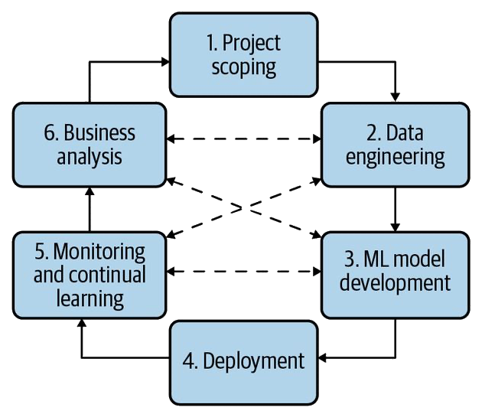
Setting up the project for success
Pre-deployment phase
Ch 1, 2, 11
Infrastructure and tooling
Ch 3, 4
Ch 10
Ch 8, 9
Ch 5, 6
Deployment and post-deployment
Ch7

