Slide 1
Geospatial Analysis of Political Polarization in the UK using Geopandas and PySAL
Chinna Subbaraya Siddharth (Sid) Ramavajjala (ramavajjala@wisc.edu), Ramakrishna Raju Gangaraju (grk.gangaraju@wisc.edu)
MSc GIS and Cartography, University of Wisconsin – Madison

Slide 2
Motivation and Background
Why measure political polarization?
What is our motivation?
How did we include geospatial concepts to an existing research?

Slide 3
Datasets
UK Data Service – British Household Panel Survey (BHPS) data 1991 – 2009.
What is format of the data ? What is a “Wave” and What is “Statement”?
How did we convert the information and extracted a calculated dataset?

Slide 4
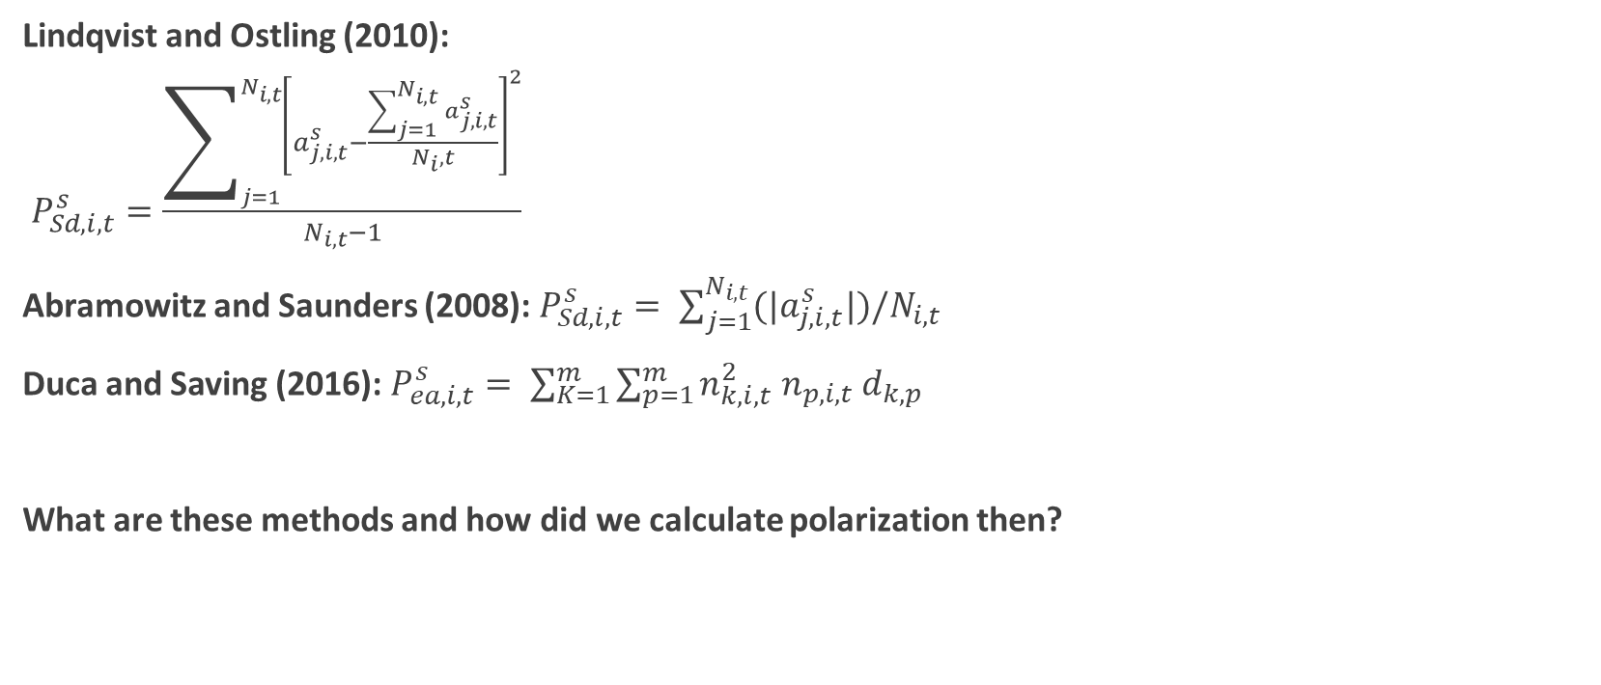
Methods
Lindqvist and Ostling (2010):
$P_{Sd,ⅈ,t}^{s}=\frac{\sum_{j=1}^{N_{i,t}}{{\left[a_{j,i,t}^{s}−\frac{\sum_{j=1}^{N_{i,t}}{a_{j,i,t}^{s}}}{N_{i},t}\right]}^{2}}}{N_{i,t}−1}$
Abramowitz and Saunders (2008): $P_{Sd,ⅈ,t}^{s}= \sum_{j=1}^{N_{i,t}}{(|a_{j,i,t}^{s}|)/N_{i,t}}$
Duca and Saving (2016): $P_{ea,i,t}^{s}= \sum_{K=1}^{m}{\sum_{p=1}^{m}{n_{k,i,t}^{2} n_{p,i,t} d_{k,p}}}$
What are these methods and how did we calculate polarization then?

Slide 5
Results

Slide 6
Results (Contd)

Slide 7
Discussions
What did we find?
Future work?
Questions?

