Slide 1
Political Polarization
Siddharth RCS (sid)
Ramakrishna G (raju)

Slide 2
Data Acquisition
Reference : Political Polarization UK - Daryna Grechyna
Three different polarization measures, computed following different strands of the literature, are highly correlated and characterized by similar statistical properties, which implies they can be used interchangeably in the quantitative analysis.
1. Lindqvist and Ostling (2010)
2. Abramowitz and Saunders (2008)
3. Duca and Saving (2016)

Slide 3
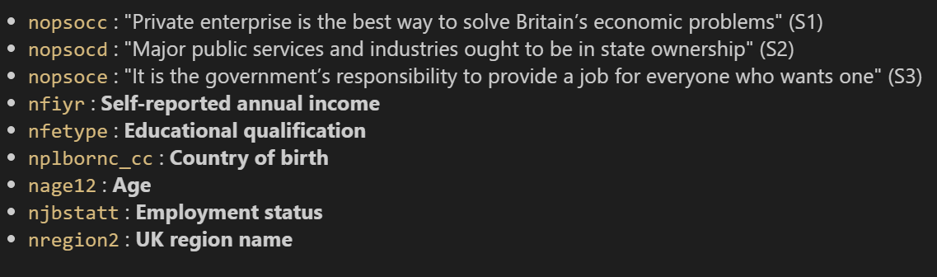
Data Processing / Analysis

Slide 4
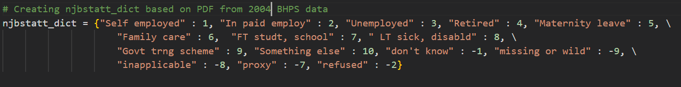
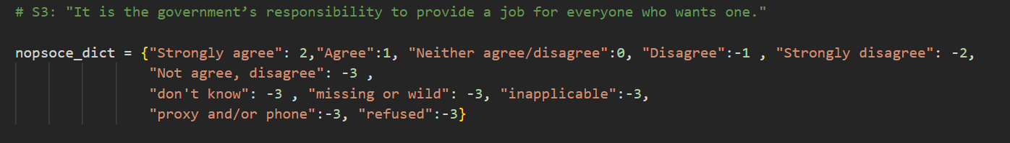
Survey results we processed from the reference paper

Slide 5
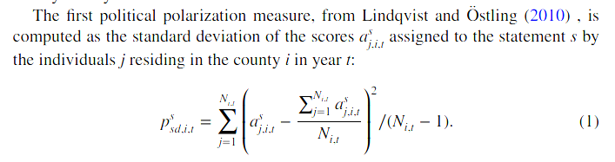
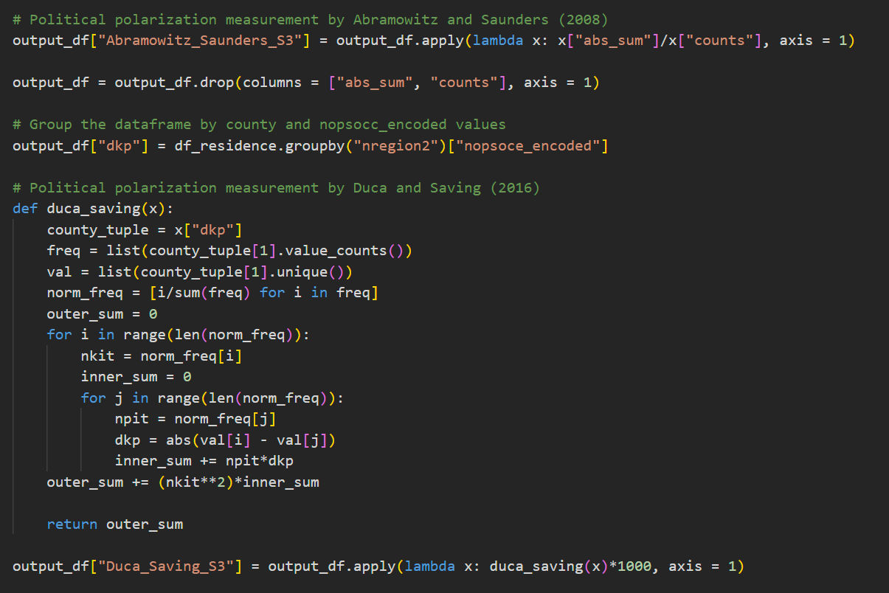
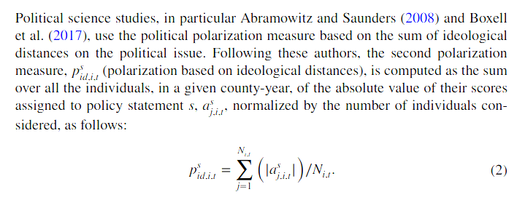
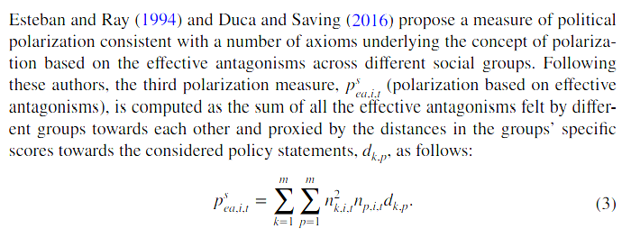
Applied Formulae

Slide 6
Attribute Values in UK Regions (1995)
Data Curation Results
region_name | job_variability | frac_employed | median_income | gini_index | education_variability
East Midlands | 399 | 0.446808511 | 6427.445313 | 0.485967897 | 399
East of England | 411.5 | 0.470873786 | 7721.132813 | 0.497099252 | 411.5
London | 445.5 | 0.487668161 | 8279.160645 | 0.520353421 | 445.5
North East | 211.5 | 0.464622642 | 6390.706543 | 0.455351775 | 211.5
North West | 559.5 | 0.46875 | 6927.100586 | 0.496123116 | 559.5
Scotland | 420 | 0.475624257 | 6681.736328 | 0.497526678 | 420
South East | 668 | 0.504113687 | 7912.114746 | 0.494031596 | 668
South West | 422 | 0.455621302 | 6339.334961 | 0.494527316 | 422
Wales | 246 | 0.39959432 | 6077.859863 | 0.458941589 | 246
West Midlands | 402 | 0.475776398 | 6500 | 0.484509679 | 402
Yorkshire & Humber | 429 | 0.462165308 | 6588.619141 | 0.471141046 | 429

Slide 7
(2000)
region_name | job_variability | frac_employed | median_income | gini_index | education_variability
East Midlands | 462 | 0.511351351 | 8678.311 | 0.449645691 | 462
East of England | 459 | 0.503808487 | 9591.966 | 0.493657648 | 459
London | 463 | 0.514563107 | 10688.222 | 0.505179495 | 463
North East | 251.5 | 0.466269841 | 8281.648 | 0.456206696 | 251.5
North West | 633.5 | 0.495268139 | 9418.572 | 0.455935763 | 633.5
Scotland | 1745 | 0.486107133 | 8709.897 | 0.453888422 | 1745
South East | 734.5 | 0.521768707 | 10013.899 | 0.463004738 | 734.5
South West | 483 | 0.490175801 | 8671.81 | 0.472033178 | 483
Wales | 1500 | 0.410863046 | 8300 | 0.468484577 | 1500
West Midlands | 478 | 0.500522466 | 8520.921 | 0.446613377 | 478
Yorkshire & Humber | 491.5 | 0.462398374 | 8283.303 | 0.458670115 | 491.5

Slide 8
(2004)
region_name | job_variability | frac_employed | median_income | gini_index | education_variability
Channel Islands | 1 | 0 | 10603.949 | 0.312804127 | 1
East Midlands | 368.5 | 0.51897019 | 10909.073 | 0.459948929 | 368.5
East of England | 439.5 | 0.469318182 | 10939.176 | 0.511208644 | 439.5
London | 376.5 | 0.4933687 | 12899.309 | 0.513331008 | 376.5
North East | 198 | 0.483627204 | 10847.169 | 0.460722559 | 198
North West | 552.5 | 0.508137432 | 10917.676 | 0.468178835 | 552.5
Northern Ireland | 1295 | 0.426862215 | 10157.714 | 0.456657084 | 1295
Scotland | 1418 | 0.487134297 | 10570.116 | 0.472727212 | 1418
South East | 622 | 0.525301205 | 12449.538 | 0.481282071 | 622
South West | 419 | 0.504171633 | 10708.486 | 0.495058747 | 419
Wales | 1377.5 | 0.418359942 | 9717.174 | 0.462822021 | 1377.5
West Midlands | 375 | 0.475366178 | 9775.497 | 0.496307062 | 375
Yorkshire & Humber | 416 | 0.489795918 | 10375.661 | 0.470570474 | 416

Slide 9
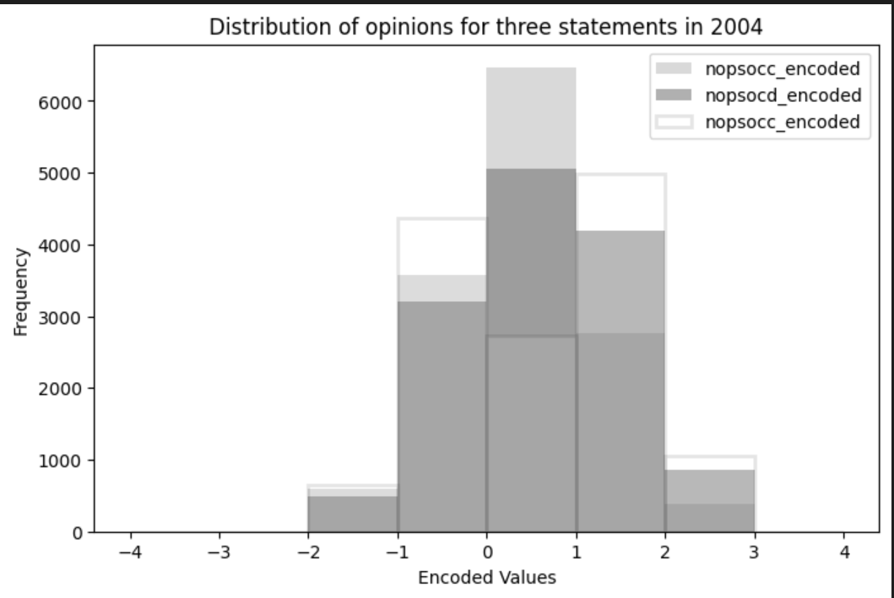
Result Finding
Statement 1 : nopsocc_ encoded
“Private enterprise is the best way to solve Britain’s economic problems.”
Statement 2 : nopsocd_encoded
“Major public services and industries ought to be in state ownership.”
Statement 3: nopsocc_encoded
“It is the government’s responsibility to provide a job for everyone who wants one.”

Slide 10
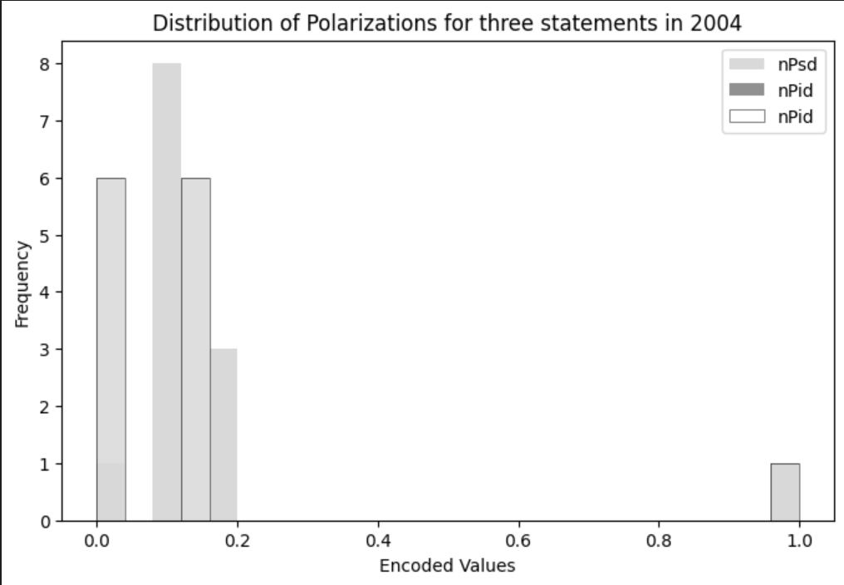

Slide 11
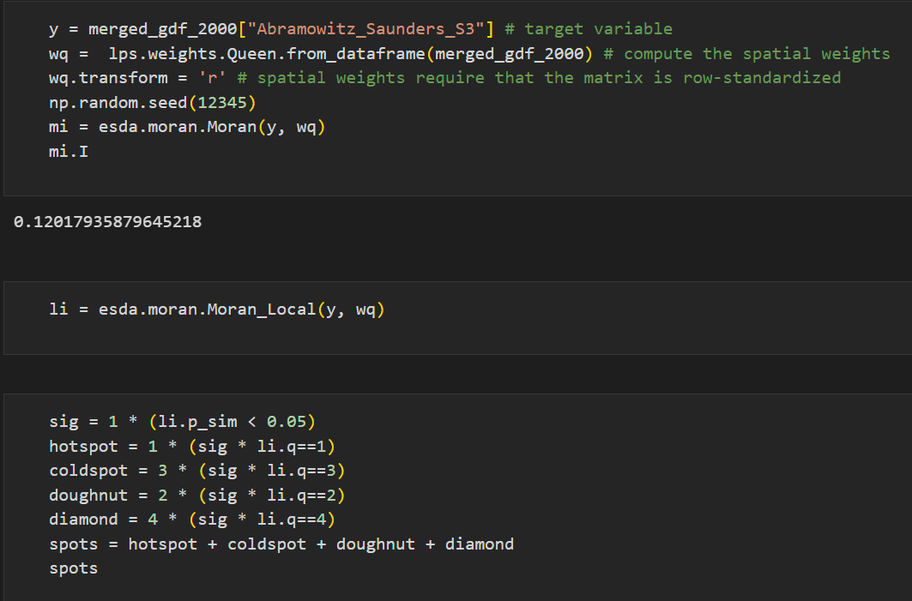
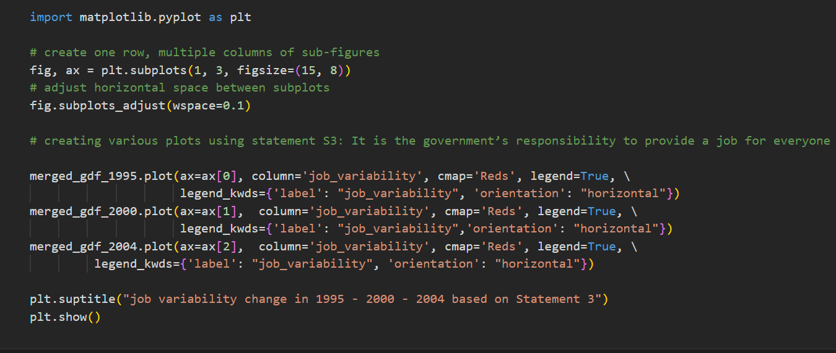
Moran's I

Slide 12
