Slide 1
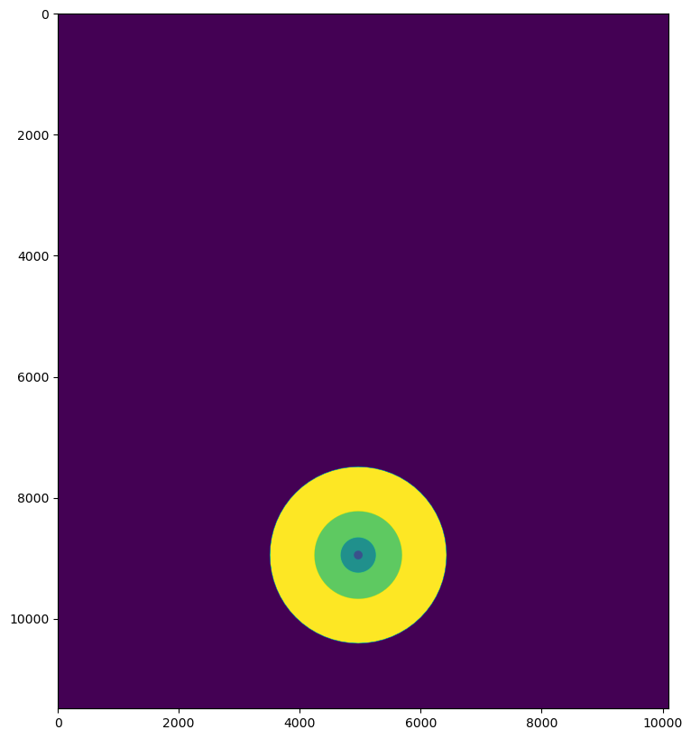
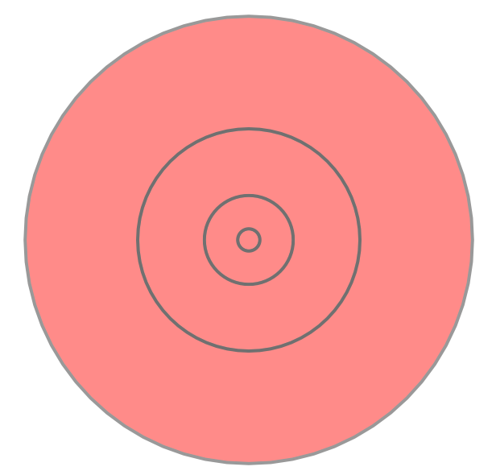
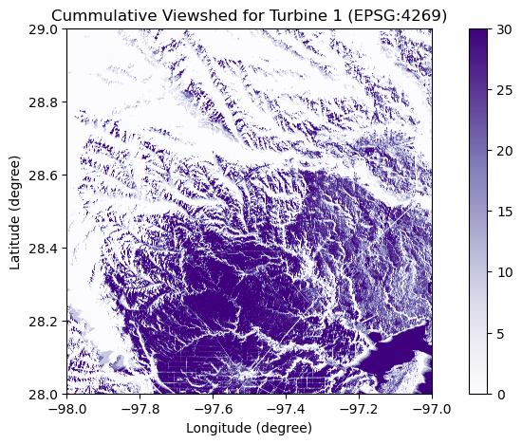
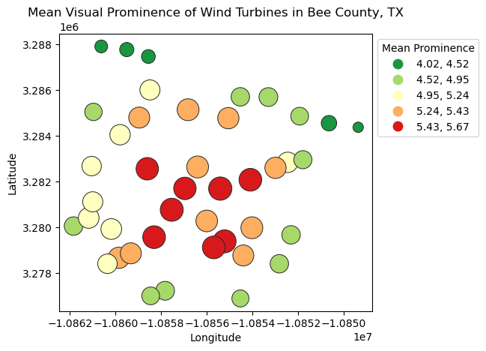
GIS Workflow of Visual Impact Assessment (VIA)
0 – No Visibility
255 – Complete Visibility
Rasterio
GDAL
Blade End [255:10]
Hub [255:20]
Rotor Sweep [255:30]
Store maximum in each pixel and calculate for each wind turbine
Geopandas
Create for each location separately
Blade End
Wind Turbine Locations
Compute Relative Viewsheds
Hub
Reclassify Relative Viewsheds
Merge Relative Viewsheds
Rasterio
Digital Elevation Model
Rotor Sweep
(Palmer 2022)
Shapely
Create for each location separately
Rioxarray
Visual Exposure Raster
Rasterio
Raster Sum (Visual Exposure, Distance Zone)
Compute Multi Ring Buffer
Rasterize Multi Ring Buffer
Distance Zone Raster
Merge Rasters
Immediate: 0 – 0.8 KM
Foreground: 0.8 – 3.2 KM
Near-Midground: 3.2 – 8 KM
Far-Midground: 8 – 16.1 KM
Background: 16.1 – 32.2 KM
Immediate: 1
Foreground: 2
Near-Midground: 3
Far-Midground: 4
Background: 5
Rasterio
(Palmer 2022)
(Palmer 2022)
Rasterio
Reclassify as per Table 3
Reclassify as per Table 4
Geopandas, Rasterio
Rasterio
Final Step
Raster Value Extraction
Mean Visual Prominence Raster
Visual Prominence Raster
Meaningful Visibility Raster
Rioxarray
Rioxarray
Cumulative Visual Prominence
Cumulative Meaningful Visibility
Geopandas
Turbine Visual Prominence Bubble Plot
Rasterio
Raster Division

