Slide 1
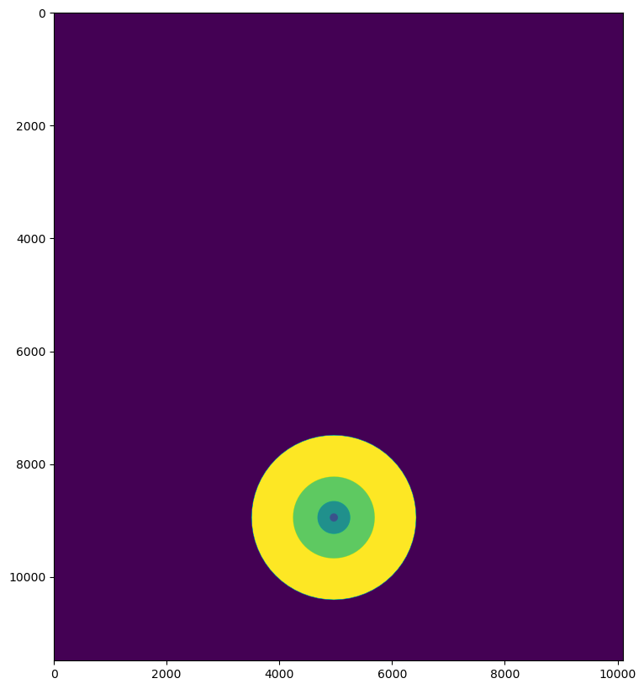
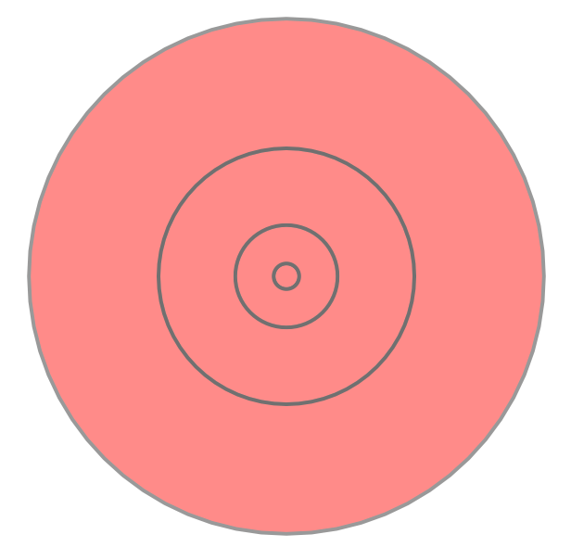
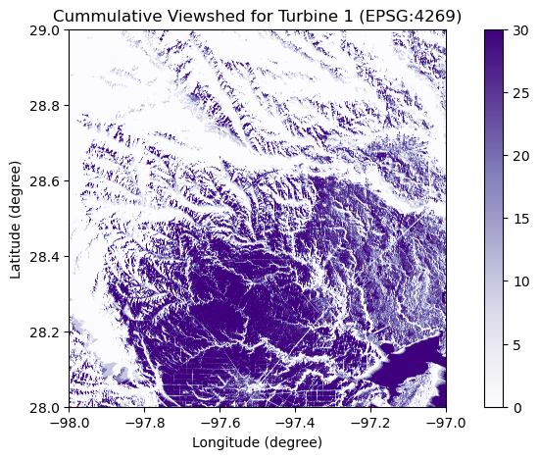
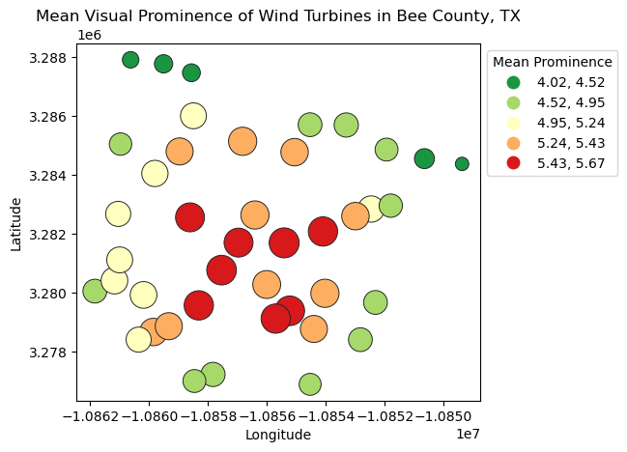
GIS Workflow of Visual Impact Assessment (VIA)
0 – No Visibility
255 – Complete Visibility
Blade End [255:10]
Hub [255:20]
Rotor Sweep [255:30]
Store maximum in each pixel and calculate for each wind turbine
Create for each location separately
Blade End
Wind Turbine Locations
Compute Relative Viewsheds
Hub
Reclassify Relative Viewsheds
Merge Relative Viewsheds
Digital Elevation Model
Rotor Sweep
(Palmer 2022)
Create for each location separately
Visual Exposure Raster
Raster Sum (Visual Exposure, Distance Zone)
Compute Multi Ring Buffer
Rasterize Multi Ring Buffer
Distance Zone Raster
Merge Rasters
Immediate: 0 – 0.8 KM
Foreground: 0.8 – 3.2 KM
Near-Midground: 3.2 – 8 KM
Far-Midground: 8 – 16.1 KM
Background: 16.1 – 32.2 KM
Immediate: 1
Foreground: 2
Near-Midground: 3
Far-Midground: 4
Background: 5
(Palmer 2022)
(Palmer 2022)
Reclassify as per Table 3
Reclassify as per Table 4
Final Step
Raster Value Extraction
Mean Visual Prominence Raster
Visual Prominence Raster
Meaningful Visibility Raster
Cumulative Visual Prominence
Cumulative Meaningful Visibility
Turbine Visual Prominence Bubble Plot
Raster Division

