Slide 1
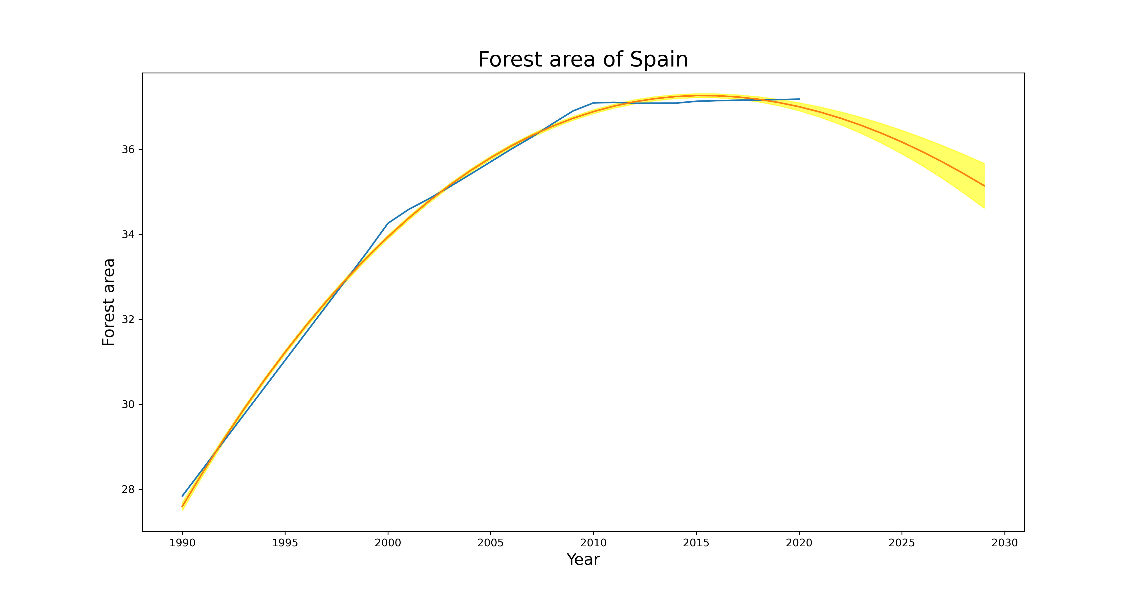
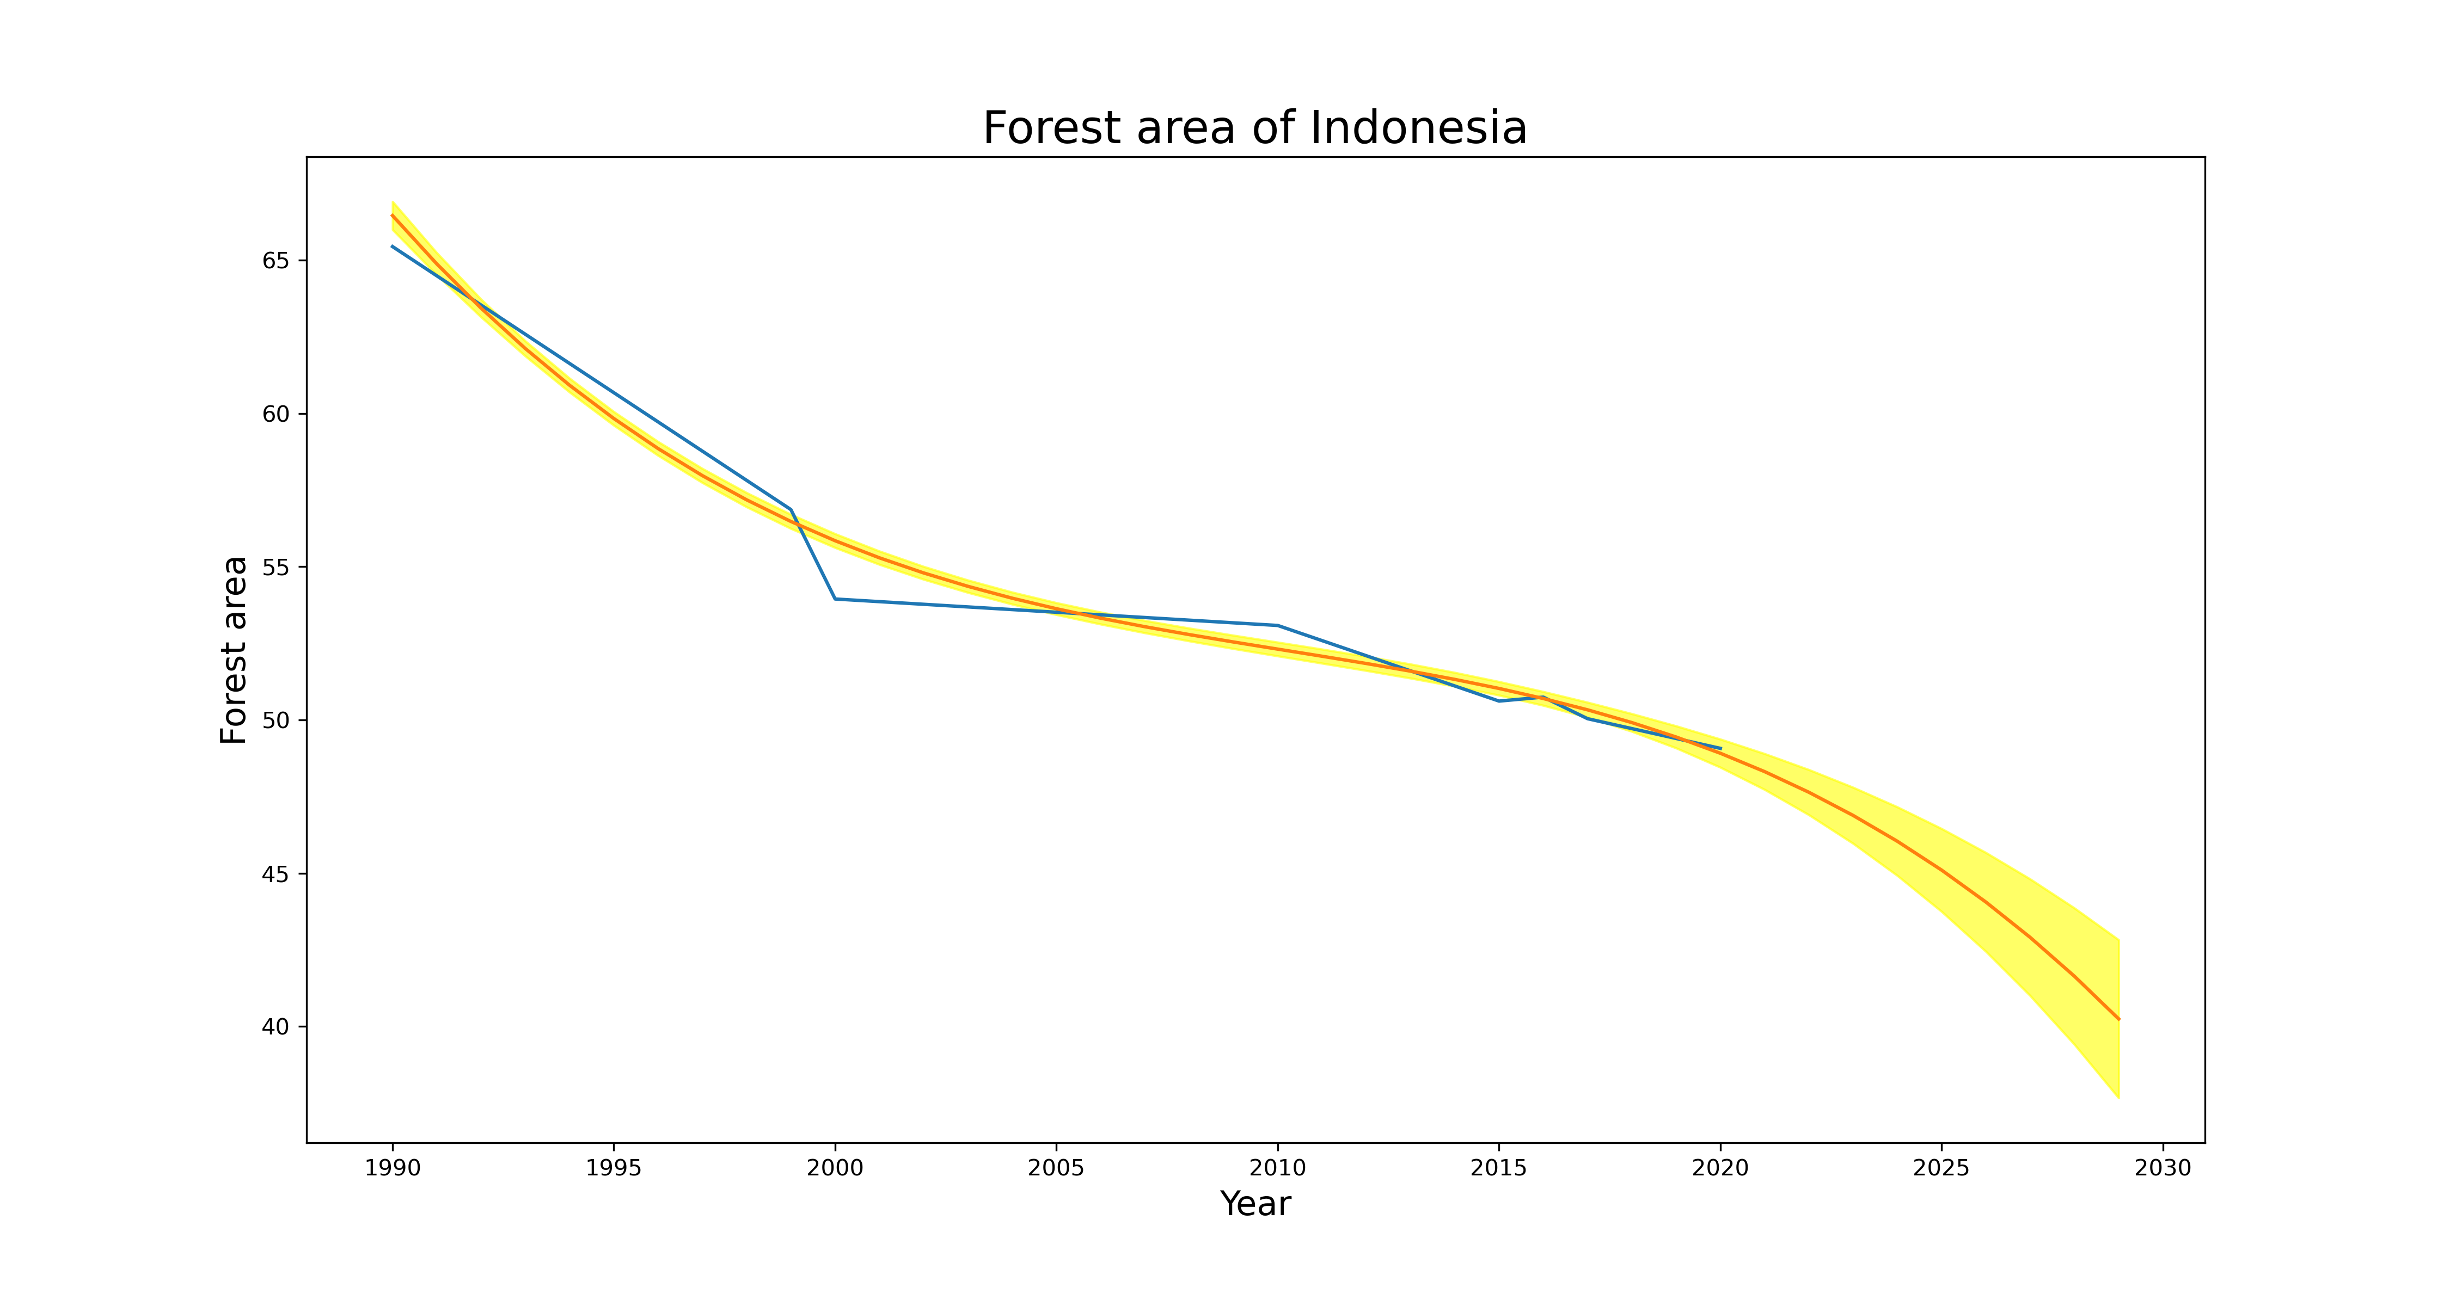
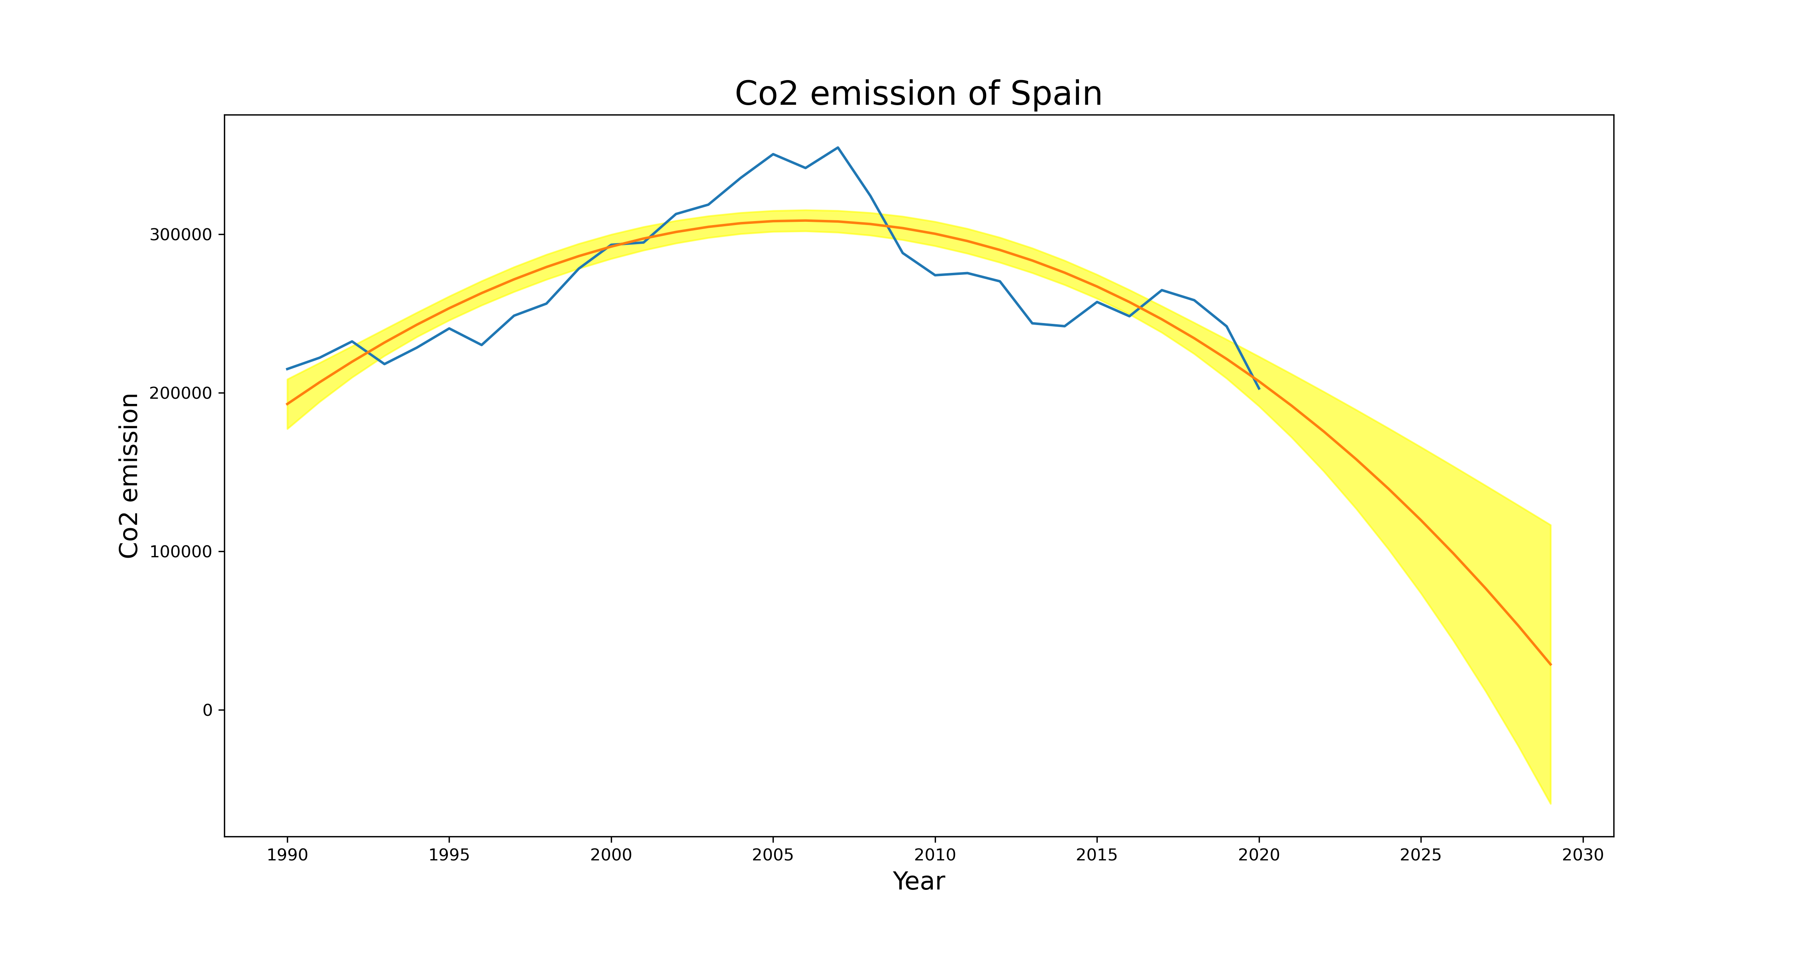
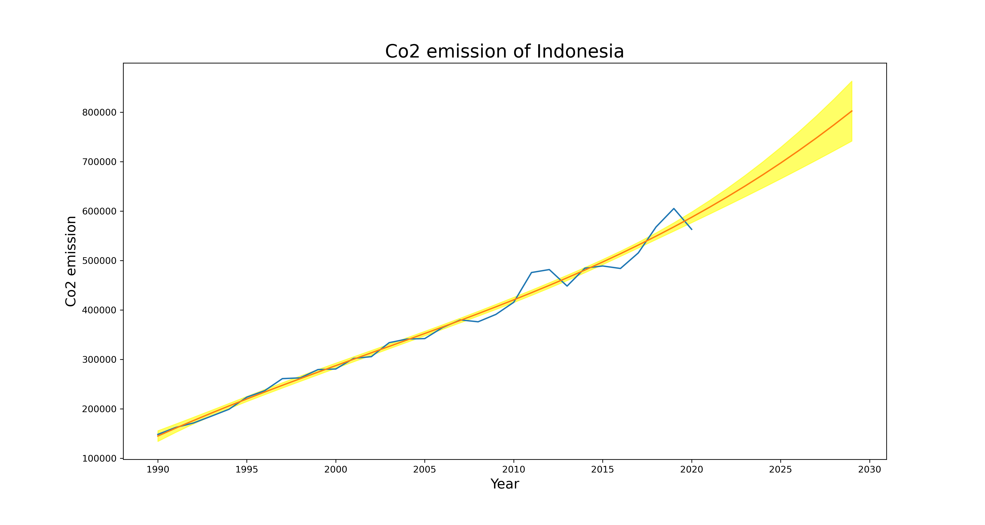
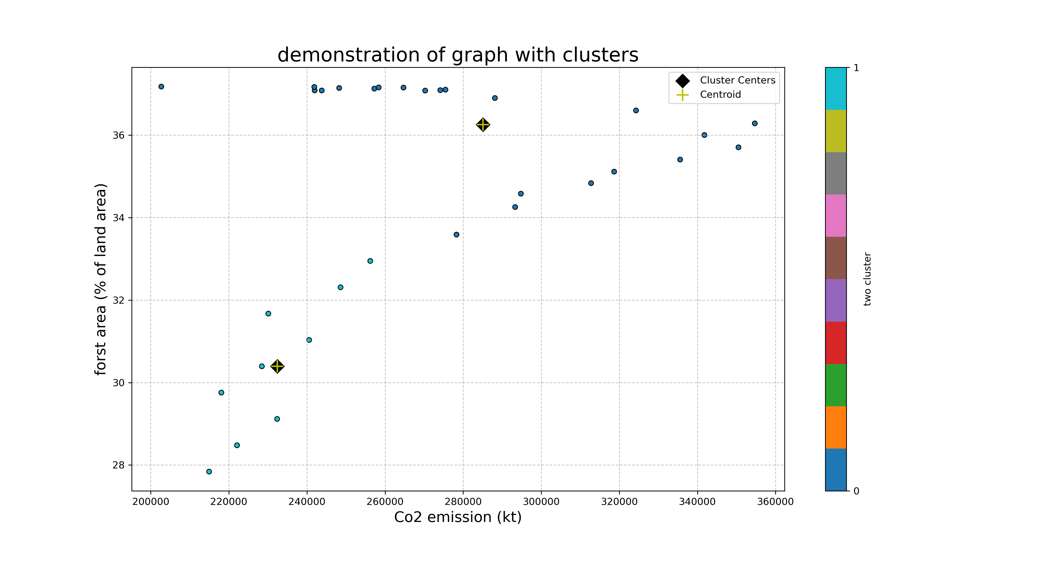
Forestation and deforestation
ABSTRACT
There is a strong link between CO2 levels and forestation/deforestation. While deforestation adds to rising CO2 levels, aggravating the greenhouse effect and climate change, forestation functions as a carbon sink, assisting in the offset of CO2 emissions. Therefore, one of the most important ways to mitigate climate change and preserve ecological balance is to increase and preserve wooded regions through forestation activities.
INTRODUCTION:
Using indicators is the most crucial step in explaining real-world issues pertaining to the environment and forests. There are two indicators that provide clear information regarding forestation and deforestation as well as the effects of this activity on the environment: forest area and CO2 emissions. In order to provide an explanation, I have compared the forest area and CO2 emissions year over year. Data is separated via clustering, and predictions are also made in the end.
ANALYSIS OF CLUSTERED DATA AND PREDICTION:
Here, data that was collected between 1990 and 2020 is examined. It is evident that Spain's CO2 emissions are declining year over year and that the country's forest area is growing every five years, both of which have a direct impact on CO2 emissions. This indicates that Spanish citizens care about protecting trees and that they plant and grow trees on a yearly basis. However, Indonesia faces a completely different situation. Due to deforestation and little public knowledge of tree conservation, Indonesia released a significant amount of CO2 throughout the course of the year. Predictions on the amount of forest area and CO2 emissions during the following ten years have also been made.
CONCLUSION:
In summary, we have come to the conclusion that the amount of forest area determines the extent to which deforestation and forestation occur. Through data-driven projection, the nation's forest area, forest conservation efforts, and agricultural development may all be calculated.
Name : Sidhdharth Dayabhai Zinzala
Student id : 22097763
Repolink: https://github.com/Sids9726/clustering_and_fitting_AS_3

