Slide 1


Slide 2
A look at the project

Slide 4
Topics
Python Frameworks
What is Django
Django Architecture
How Django Works
Install Django
Creating Project & App in Django
Django Project Structure
Django App Structure
Create the sentiment analyser app
Demo1: Create Sentiment Analysis Model
Demo2: Link the model with Django App
Run the Django App
Host the app on Heroku
Demo3: Create Streamlit App using the created Django API

Slide 5
Objectives
After completing this module, you should be able to:
Understand What is Django
Understand Django’s structure
Create Django Projects and Apps
Deploy your machine/deep learning models using Django
Host your apps on Heroku

Slide 6
Python Frameworks

Slide 7
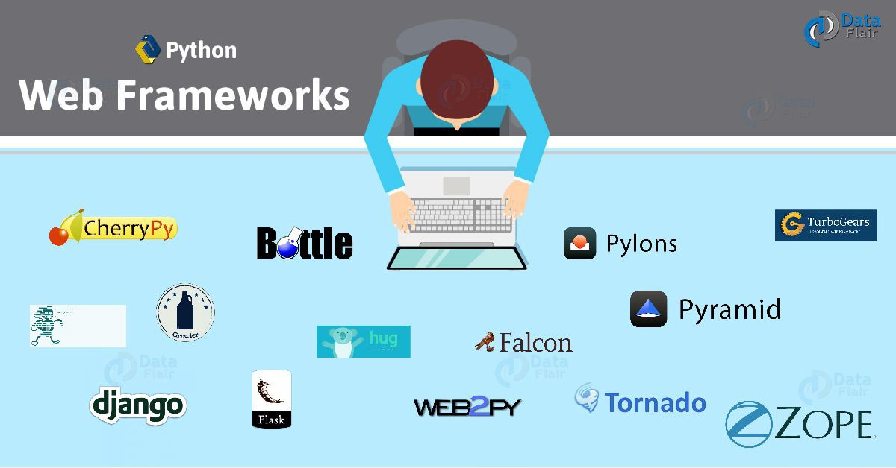
Python Frameworks
Django
CherryPy
Pylons
Flask
Bottle
Tipfy
Pyramid
Cubic Web
GAE framework

Slide 8
What is Django?

Slide 9
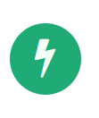
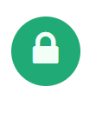
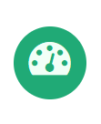
What is Django?
Django is a high-level Python Web framework that encourages rapid development and clean, pragmatic design. Built by experienced developers, it takes care of much of the hassle of Web development,
so you can focus on writing your app without needing to reinvent the wheel. It’s free and open source.
Ridiculously fast.
Django was designed to help developers take applications from
concept to completion as quickly as possible.
Reassuringly secure.
Django takes security seriously and helps developers avoid many
common security mistakes.
Exceedingly scalable.
Some of the busiest sites on the Web leverage Django’s ability to
quickly and flexibly scale.
Source: https://www.djangoproject.com/

Slide 10
Django Architecture
Django follows a MVC-MVT architecture
MVC stands for Model View Controller, where we have 3 segments:
Model: Backend / where data is stored and maintained
View: Presentation / whatever the user sees
Controller: Business logic that controls data and presentation
MVT stands for Model View Template, where we have predefined template for user interface

Slide 11
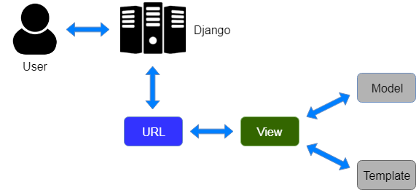
How Django Works

Slide 12
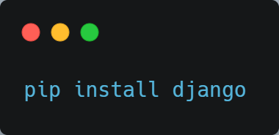
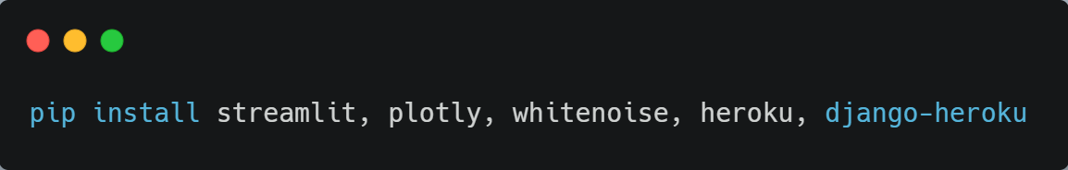
Install Django
To install Django:
Other libraries (required for this module):

Slide 13
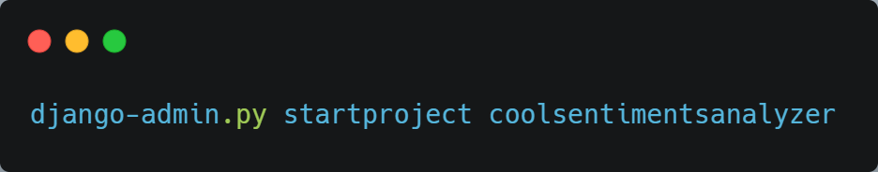
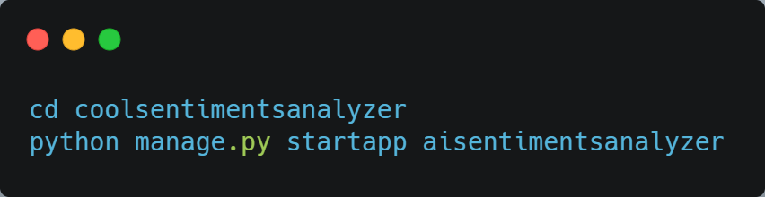
Creating Project & App in Django
To create a Django project:
To create an app inside a Django project:

Slide 14
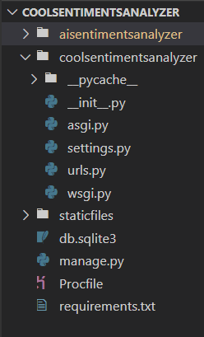
Django Project Structure
A Python package on your PYTHONPATH
Contains or references one or more apps
Holds project-wide settings in settings.py
Holds a URL configuration in urls.py

Slide 15
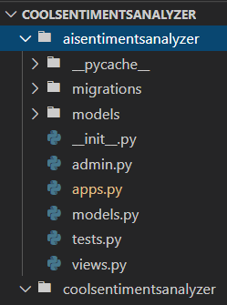
Django App Structure
A Python package on your PYTHONPATH
May contain data models in model.py
May contain views in views.py

Slide 16
Create Sentiment Analyzer App

Slide 17
Demo1: Create Sentiment Analysis Model

Slide 18
Demo2: Link the model with Django App

Slide 19
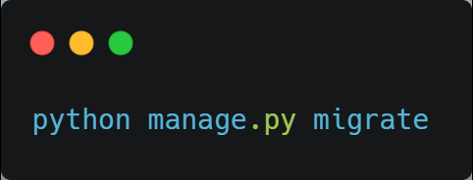
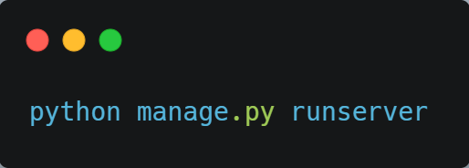
Run the Django App
We have successfully linked the sentiment analyzer model with our Django app. Now we need to migrate the database using:
And to run the app, use:

Slide 20
Time to launch the app
We have successfully deployed our machine learning model using Django. But the app is still accessible by the local machine only, to make it go live, you can host this on any one of the hosting platforms available like:
Heroku
GitHub
etc.
So, let’s see how we can host our app for free on Heroku

Slide 21
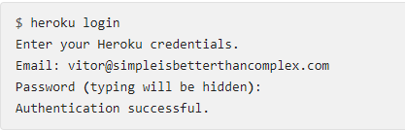
Host Django App on Heroku
Actually, first thing – sign up to Heroku. Then install the Heroku CLI. It is a command line tool to manage your Heroku apps.
After installing the Heroku Toolbelt, open a terminal and login to your account:

Slide 22
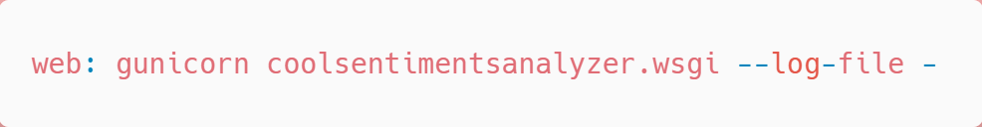
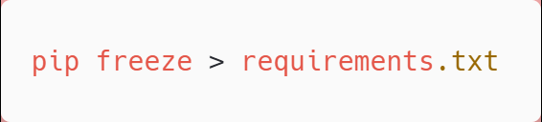
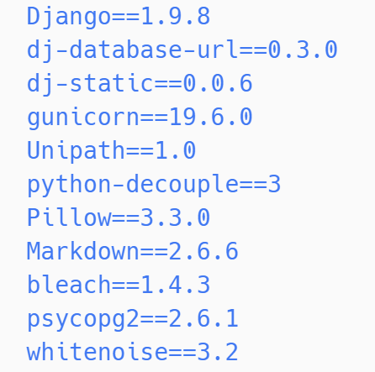
Host Django App on Heroku
Create a file named Procfile in the project root with the following content:
If you are using a virtualenv and pip you can simply run:
Otherwise, list the dependencies like the example below. This is how a requirements.txt looks like:

Slide 23
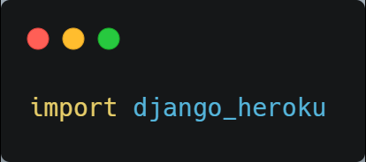
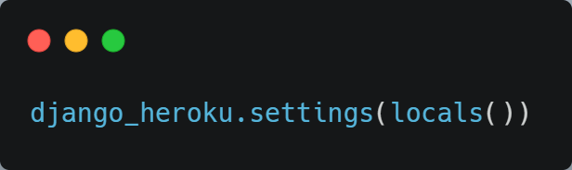
Host Django App on Heroku
Add
at the start of settings.py file, and
at the end of settings.py file

Slide 24
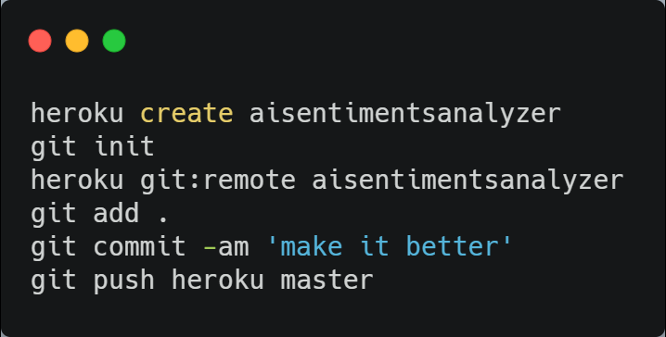
Host Django App on Heroku
After that put the following commands:
After the push is successful, you can see your app at: https://aisentimentsanalyzer.herokuapp.com

Slide 25
Demo3: Create Streamlit App using the created Django API

Slide 26
Questions???
Comment below

Slide 27
Thank You!!!

